Slide 1
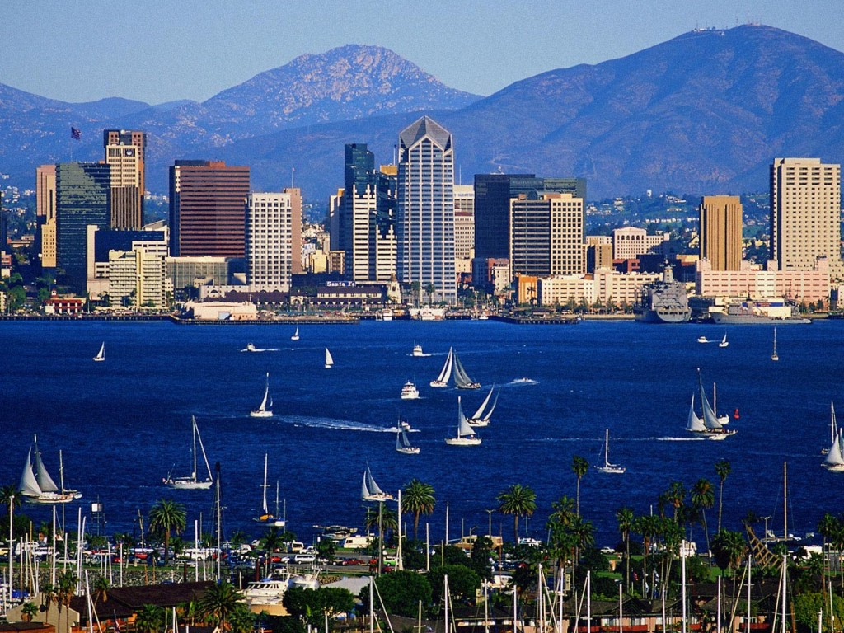
The Effect of ENSO on Precipitation in San Diego, California
Andrew Horan

Slide 2
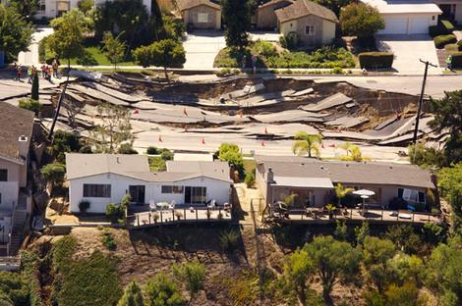
Why?
Does El Nino directly correspond to increased rainfall in San Diego?
Increased rainfall tends to cause more landslides
Desert by the sea
Plan better for a “rainy” year

Slide 3
Data
El Nino-Southern Oscillation Index (SOI)
Negative numbers typically correspond to El Nino year
Data from 1866-2008, prior to 1935 used with caution
Rain Data-monthly average (in.) from San Diego-Lindbergh Field International Airport (SAN)

Slide 5
Attempting to Correlate
R=-0.1061
Pvalue=0.0940
Low correlation
Not significant
Too much data

Slide 6
4-month running mean
R=-0.1603
Pvalue=0.1072
Data still insignificant
Too much noise
12-month mean then cross spectral analysis

Slide 7
12-month running mean
R=-0.3614
Pvalue=0-permissible

Slide 8
Periodicities
El Nino occurs roughly every 3-7 years
No significant cycle in increased rainfall

Slide 9
cPSD
Significant peak at 2 years, lesser so at 4,6,7
Still no concreteness in trend

Slide 10
Coherence
Incoherent in frequency, random signals

Slide 11
Conclusion
El Nino occurs roughly every 3-6 years
Some years in San Diego are wetter than others, with or without El Nino
Not many years with extreme precipitation
Should take data at more regional scale
There are other reasons for spike in precipitation (winter Pacific storms coming in from Alaska)

