Slide 1
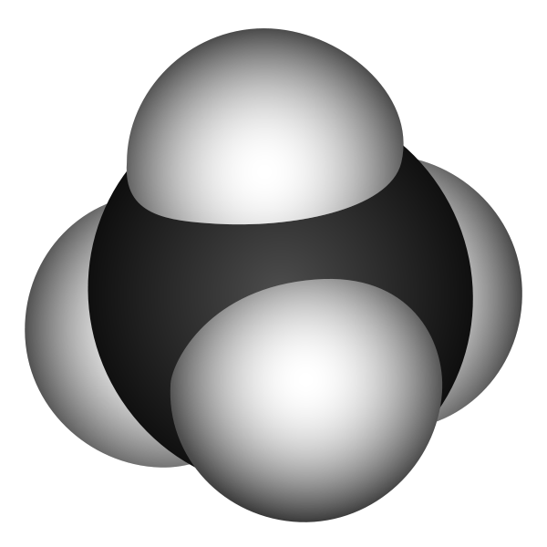
Increasing Levels of Atmospheric Methane
Jordan Simpkins
EAS 4803
Spring 2009

Slide 2
A little background
Methane levels have been increasing since 1700.
Levels have increase from ~800 to ~1700 ppb.
Main cause in increase are anthropogenic sources: fossil fuel emissions, waste, animals, rice agriculture, biomass burning.
Anthropogenic sources account for about 55% of all methane released into the atmosphere.

Slide 3
(Ppbv)

Slide 9
Effect on Climate
Lifetime: CH4- 9 years, CO2 -100.
Increase in radiative forcing
Global Warming potential:
CH4 - ~22, CO2 – 1

Slide 10
The End

