Slide 1
Correlations Between Wind Direction and Precipitation
Michelle Hsia
Apr. 21, 2009
EAS4803

Slide 2
Objective
To analyze data concerning wind direction and precipitation taken from a weather station.
To use different forms of regression to determine correlation between wind direction and precipitation.

Slide 3
Data Source
Information comes from the National Climate Data Center (NCDC), and is collected by a Automated Service Observing System located at the Atlanta Hartsfield International Airport

Slide 4
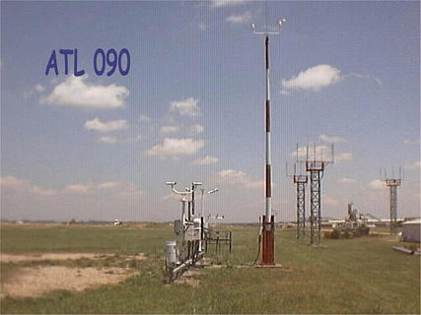
Data Source Cont.
A year’s worth of data with a daily sampling rate is used for this study.
Variables taken into account are wind direction (in tens of degrees) and total precipitation (in inches).

Slide 5
Data

Slide 6
Data
Wind Direction & Cumulative Precipitation

Slide 7
Regression

Slide 8
Conclusions
It is shown by regression that there is a correlation between wind direction and total precipitation.
Cumulative precipitation increases with greater occurrence of a wind direction.
Pearson Correlation Coefficient is 0.0053

