Slide 1
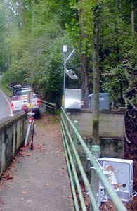
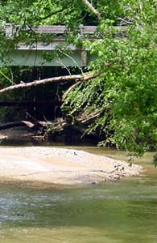
Temporal Dynamics in Water Quality Measurements Along Nancy Creek, Atlanta, GA Environmental Data Analysis Georgia Institute of Technology: Earth and Atmospheric Sciences April 23,2009 Joe Estep
West Wesley Site
Rickenbacker Drive Site

Slide 2
Location: Nancy Creek
02336360:
Rickenbacker Drive
02336410:
West Wesley
Data (60 days):
Dissolved Oxygen
pH
Conductivity
Turbidity
(96 samples/day)
Note:
Channel Intersects Interstate 75

Slide 3
Methods
 | F table | F calc | =Var? | H calc | =Mean?
DO | 1.04 | 1.02 | yes | 1 | no
pH | 1.04 | 1.20 | no | 1 | no
Cond | 1.04 | 1.29 | no | 1 | no
Turb | 1.04 | 9.07 | no | 1 | no
Chi square test
F test
Student’s t-test
Crossspectral analysis
Coherence
Phase shift
 | RD | WW | Chi table | Chi data | Normal?
DO | x |  | 11.07 | 508 | no
 |  | x | 11.07 | 1.4e3 | no
pH | x |  | 11.07 | 1.2e3 | no
 |  | x | 11.07 | 4.5e3 | no
Cond | x |  | 11.07 | 3.2e3 | no
 |  | x | 11.07 | 1.9e3 | no
Turb | x |  | 11.07 | 3.6e20 | no
 |  | x | 11.07 | 4e18 | no

Slide 4
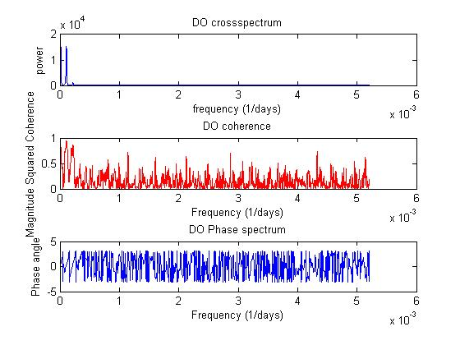
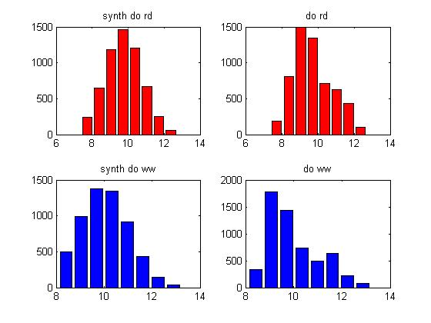
Dissolved Oxygen

Slide 5
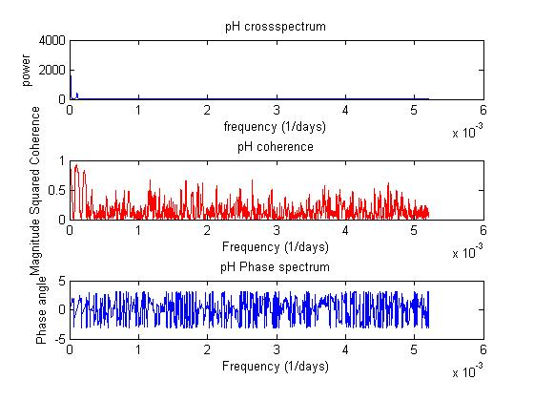
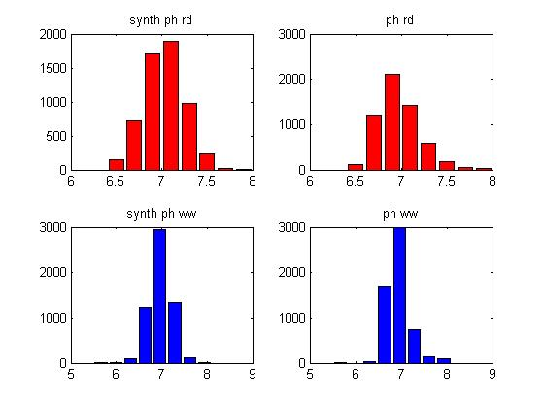
pH

Slide 6
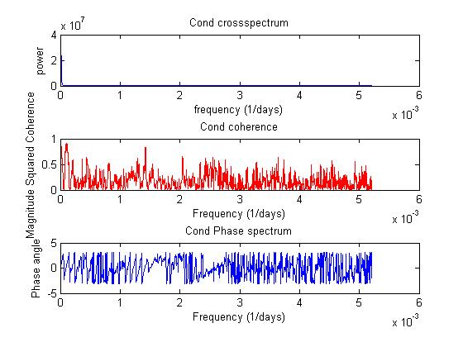
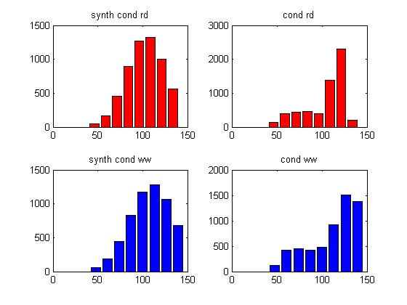
Conductivity

Slide 7
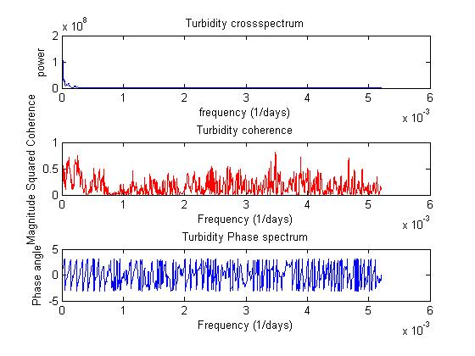
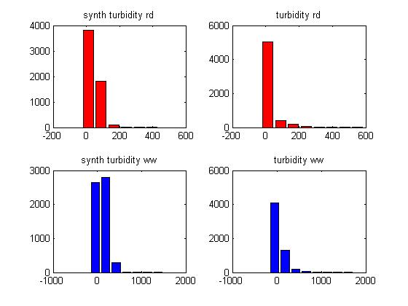
Turbidity

Slide 8
Lags
 | Time Lag (Hours)
Dissolved Oxygen | 1.04
pH | 9.82
Conductivity | 0.33
Turbidity | 0.99

Slide 9
Conclusions
Precipitation heavily influences water quality measurements
Data Sets aren’t statistically normal or equivalent
Lag Times are inconsistent between parameters

Slide 10
Thanks for your attention! Questions/Comments?

