Slide 1
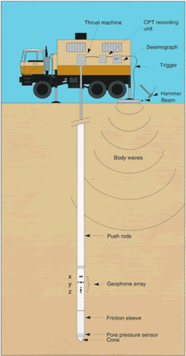
Spatial Variability of CPT Data
and Soil Parameters at NGES, Texas A&M
Fawad S. Niazi
Geosystems Engineering Division
Civil & Environmental Engineering
Georgia Institute of Technology
April 27, 2010
www.clu-in.org
Niazi et al. 2010

Slide 2
Scope of Study
  Spatial variability of CPT readings for horizontal & vertical variability in soil profiles (all soundings, each 10 cm depth):
    Mean, min, max
    Moment statistics (variance, skewness, kurtosis)
    Residuals of principal comp. analysis of CPT readings (space and depth)
    Test of normality (χ² test)
  Comparison of measured and evaluated soil unit weight, γ_{t}
  LS regression, correlation coefficient
  LS, principal component and reduced major axis regression
  Higher order regression and residuals analysis

Slide 3
Cone Penetration Test – a Hybrid Method
  Site characterization:
    Conventional boring/sampling methods
    Lab investigations on disturbed samples
  Cone penetration test:
  Fast, economical, and continuous data
  up to 4 separate readings in one sounding
  Soil parameter interpretation
V_{s}
f_{s}
u₂
q_{c}
q_{c}, f_{s}, u₂, V_{s}
I_{c}, γ_{t}, OCR, σ_{p}', K_{o}, s_{u}, φ', D_{R}, G_{max}

Slide 4
Typical Cone Penetration Sounding
V_{S}
f_{s}
u₂
q_{t}

Slide 5
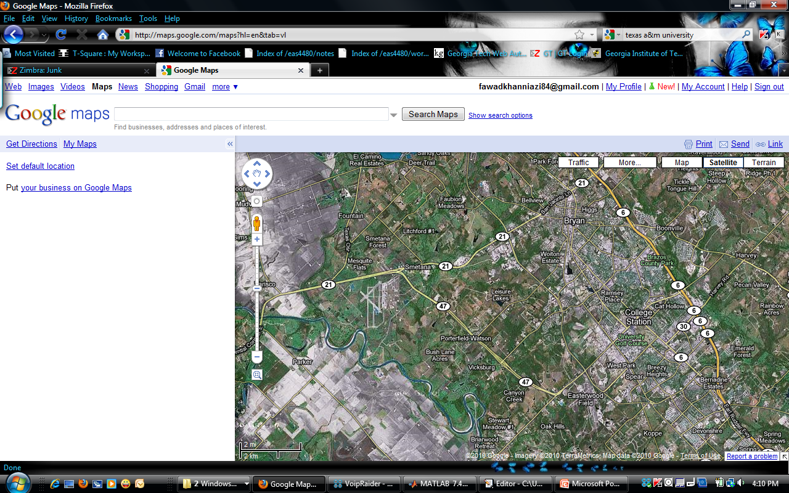
National Geotechnical Experimentation Site
Riverside Campus, Texas A&M University
Geotechnical
Experimentation Site
College Station
Texas A&M University

Slide 6
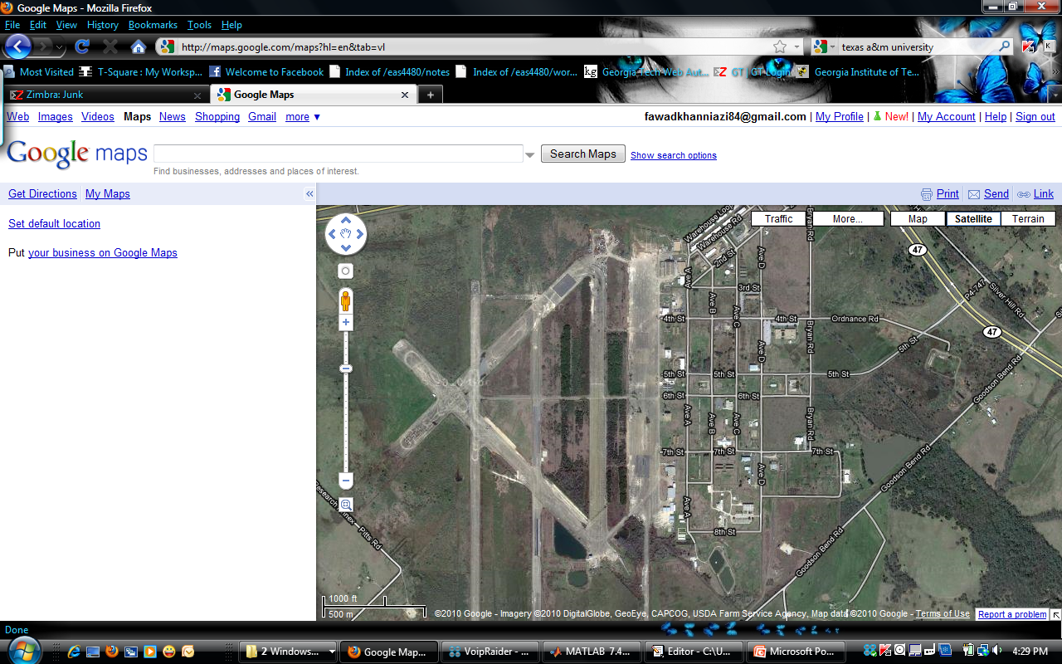
Location of Clay and Sand Sites on
Riverside Campus, Texas A&M University
Sand Site
Clay Site

Slide 7
Field Investigations at NGES
Clay Site, Texas A&M University
N
3
13
6
14
5
4
18
15
1
16
8
22
30
17
7
28
2
19
31
29
15
9
21
32
33
10
23
24
16
20
25
11
26
12
Legend
27
CPT
CPTu
MCPT
15 m
SCPT
BH
Clay Control
CPT: 10 cm² Cone Penetration Test
CPTu: Piezocone Penetration Test
MCPT: 2 cm² Mini Cone Penetration Test
SCPT: 15 cm² Seismic Piezocone Penetration Test
BH: Borehole
Testing Program
1977 to 1995
Nine CPT
1995 to 1996
Three CPTu
1997
Twelve MCPT
Six CPT
Three SCPT

Slide 8
Horizontal Variability of Tip Resistance Profiles
Critical χ2 Value = 11.08

Slide 9
Spatial Variability Trend of Tip Resistance Profiles
for 33 CPT Soundings
Critical χ2 Value = 11.08

Slide 10
Horizontal Variability of Sleeve Friction Profiles
Critical χ2 Value = 11.08

Slide 11
Spatial Variability Trend of Sleeve Friction Profiles
for 33 CPT Soundings
Critical χ2 Value = 11.08

Slide 12
Residuals of Principal Comp. Analysis of q_{t} at 0.16 m
Critical χ2 Value = 11.08

Slide 13
Residuals of Principal Comp. Analysis of q_{t} at 10.56 m
Critical χ2 Value = 11.08

Slide 14
Residuals of Principal Comp. Analysis of
Tip Resistance at CPT4
Critical χ2 Value = 11.08

Slide 15
Residuals of Principal Comp. Analysis of
Tip Resistance at MCPT13
Critical χ2 Value = 11.08

Slide 16
Results of Horizontal Variability Study
0 – 1.1 m
4.9 – 8.7 m
10.5 – 13.6 m

Slide 17
Results of Vertical Variability Study
N
3
13
6
14
5
4
18
15
1
16
8
A
22
30
17
7
28
2
19
31
29
15
9
21
32
33
10
23
A’
24
16
20
25
11
26
12
Legend
27
CPT
CPTu
MCPT
15 m
SCPT
BH
Clay Control
CPT: 10 cm² Cone Penetration Test
CPTu: Piezocone Penetration Test
MCPT: 2 cm² Mini Cone Penetration Test
SCPT: 15 cm² Seismic Piezocone Penetration Test
BH: Borehole
Testing Program
1977 to 1995
Nine CPT
1995 to 1996
Three CPTu
1997
Twelve MCPT
Six CPT
Three SCPT

Slide 18
Correlations: CPT Readings and Soil Unit Weight, γ_{t}
Mayne et al. 2010
  γ_{t} = Total unit weight (kN/m³)
  γ_{w} = Unit weight of water (kN/m³)
  q_{t} = Cone tip resistance (kPa)
  f_{s} = Sleeve friction (kPa)
  z = Depth (m)
  σ_{vo}’ = Effective vertical overburden stress (kPa)
  σ_{atm} = Atmospheric pressure (kPa)

Slide 19
Measured and Evaluated Soil Unit Weight Profiles

Slide 20
Least Square Regression, Correlation Coefficient,
95% Confidence Bounds
r = -0.2999
r = -0.2508

Slide 21
Results of Vertical Variability Study
N
3
13
6
14
5
4
18
15
1
16
8
22
30
17
7
28
2
19
31
29
15
9
21
32
33
10
23
24
16
20
25
11
26
12
Legend
27
CPT
CPTu
MCPT
15 m
SCPT
BH
Clay Control
CPT: 10 cm² Cone Penetration Test
CPTu: Piezocone Penetration Test
MCPT: 2 cm² Mini Cone Penetration Test
SCPT: 15 cm² Seismic Piezocone Penetration Test
BH: Borehole
Testing Program
1977 to 1995
Nine CPT
1995 to 1996
Three CPTu
1997
Twelve MCPT
Six CPT
Three SCPT

Slide 22
Least Square Regression, Correlation Coefficient,
95% Confidence Bounds
p = 0.0001
p = 0.0002

Slide 23
Least Squares, Principal Component
And Reduced Major Axis Regression Analyses

Slide 24
Higher Order Regression Analysis

Slide 25
Conclusions
  Horizontal and vertical variability of CPT readings for better site characterization
  CPT-based relationship for evaluating soil unit weight
Mayne et al. 2010

Slide 26
Spatial Variability of CPT Data
and Soil Parameters at NGES, Texas A&M
Fawad S. Niazi
Geosystems Engineering Division
Civil & Environmental Engineering
Georgia Institute of Technology
April 27, 2010
www.clu-in.org
Niazi et al. 2010

Slide 27
Stratigraphy at the NGES TAMU Clay Site
0
2
γ_{t} = 19.6 kN/m³
Very Stiff Clay
s_{u} = 110 kPa
4
6
Sand
8
Depth (m)
γ_{t} = 19.5 kN/m³
10
Very Stiff Clay
s_{u} = 140 kPa
12
14
γ_{t} = 18.9 kN/m³
Hard Clay
(Shale)
16
s_{u} = 160 kPa
18
After Briaud 2000

Slide 28
Autocorrelation of Residual
Higher Order Regression

