Slide 1
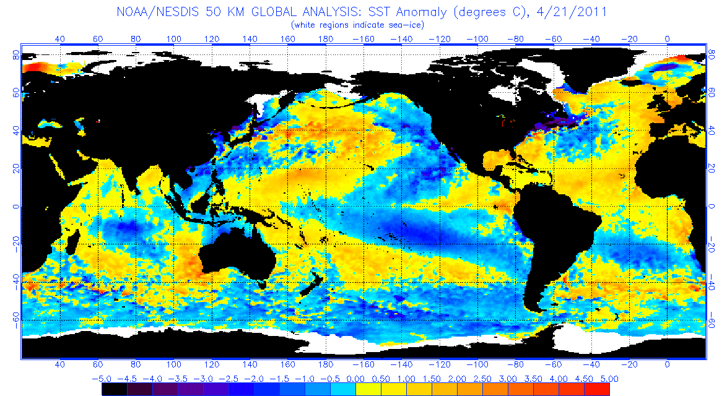
Solar Cycle Variations Influencing Oceanic Niño Index Anomalies Across The Equatorial Pacific Ocean Christopher Johnson SP11
Image: (Top) http//elnino.noaa.gov (Bottom) Hathaway/NASA, 2011

Slide 2
Objective
Compare periods of increased solar luminosity to climate variations
Increasing solar output should increase surface temperatures on Earth, notably, sea surface temperature

Slide 3
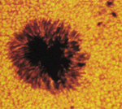
Solar Cycle
Image: nasa.gov
Differential rotation in plasma
Magnetosphere discontinuities
Sunspots occur on photosphere
Observed 11 year cycle
Luminosity increases during sunspot maximum

Slide 4
Oceanic Niño Index
3 month SST average
5ºN-5ºS, 120º-170ºW
Predicted 3-7 year cycle
(+) El Niño
(-) La Niña

Slide 5
Trend & Correlation
Positive slope, low correlation, high random error.
Not indicating a linear trend

Slide 6
Chi Square 290
Chi Critical 36
Not Normally Distributed

Slide 7
Power Spectral Density - Periodogram
Periodicity in Sunspot 10.17 years
Periodicity in ONI 5.08 years

Slide 8
Cross Power Spectral Density

Slide 9
Conclusion
Low Correlation Coefficient
Sunspot trend 10.18 years (between 1950-2010)
ONI periodicity 5.08 years (between 1950-2010)
Lag Time between periodicity is 1.45 years
At this time no direct correlation was determined between the solar sunspot cycle and Oceanic Niño Index in the southern Pacific

