Slide 1
Comparison of Maximum Likelihood Estimate and Least-Squares Regression to Compute b-values for Three Different Tectonic Regimes
Christine Gammans

Slide 2
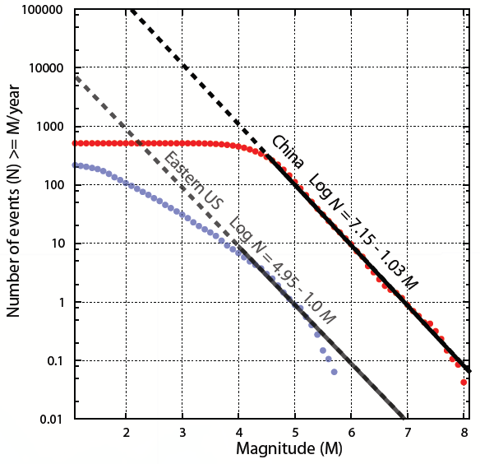
What is the b-value and why do we care?
Earthquake occurrence per magnitude follows a power law introduced by Ishimoto and Iida (1939) and Gutenberg and Richter (1944).
b-values are inversely proportionate to the differential stress on a system (Schorlemmer et al. 2005)
The global b-value is ~ 1 (Stein and Wysession, 2003)
Gutenberg-Richter Relationship:
log₁₀N= a - bM
(Gammans and Newman, 2011)

Slide 3
Tectonic Regimes
Eastern United States
  Intraplate, few seismically active regions, notably New Madrid and Eastern Tennessee
  Question as to the existence of any significant strain field
China
  Seismically active, intraplate region
  India’s collision with Asia produces significant strain and, therefore, earthquake activity
Chile
  Subduction zone
  Has produced two of the ten largest earthquakes on record (USGS).

Slide 4
Eastern United States
Maximum Likelihood Estimate
Least-Squares Regression
b-value=0.9634
b-value=1.2477

Slide 5
Do they compare at 10,000 Bootstraps?
Maximum Likelihood Estimate
Mean b-value=0.9654
Standard Deviation=0.0405
Least-Squares Regression
Mean b-value=1.2105
Standard Deviation=0.0923
Chi-Squared Test
p-value=1.0233x10⁴
χ²=555.0214
Correlation Coefficient
r=0.0003
p=0.9740

Slide 6
China
Maximum Likelihood Estimate
Least-Squares Regression
b-value=0.9577
b-value=1.0658

Slide 7
Do they Compare at 10,000 Bootstraps?
Maximum Likelihood Estimate
Mean b-value=0.9577
Standard Deviation=0.0103
Least-Squares Regression
Mean b-value=1.0715
Standard Deviation=0.0620
Chi-Squared Test
p-value=1.0233x10⁴
χ²=150.3044
Correlation Coefficient
r=0.0039
p=0.6987

Slide 8
Chile
Maximum Likelihood Estimate
Least-Squares Regression
b-value=0.8081
b-value=0.9769

Slide 9
Do they Compare at 10,000 Bootstraps?
Maximum Likelihood Estimate
Mean b-value=0.8082
Standard Deviation=0.0067
Least-Squares Regression
Mean b-value=0.9923
Standard Deviation=0.0810
Chi-Squared Test
p-value=1.0233x10⁴
χ²=385.4640
Correlation Coefficient
r=-0.0016
p=0.8724

Slide 10
Conclusions
The maximum likelihood estimate consistently gave the most consistent distribution across tectonic regimes and had the lowest error associated with the distribution
However, the least-squares method produced the more expected values for the Eastern United States (China and Chile are debatable)
The most appropriate method appears to vary by regime from this preliminary analysis, and, in the future, the results of each method should be analyzed before the method is finalized.

Slide 11
References
Gammans, C. N. and A. V. Newman (2011), Is the Relationship Between Modern Seismicity and Strain Fields Well Behaved in the Plate Interior?, Seismological Research Letters, 82, 327.
Gutenberg, B., and C. F. Richter (1944), Frequency of earthquakes in
California, Bull. Seismol. Soc. Am., 34, 185–188.
Ishimoto, M., and K. Iida (1939), Observations of earthquakes registered with the microseismograph constructed recently, Bull. Earthquake Res. Inst. Univ. Tokyo, 17, 443– 478.
Schorlemmer, D., S. Wiemer, and M. Wyss (2005), Variation in earthquake size distribution across different stress regimes, Nature, 437, 539– 542,
doi:10.1038/nature04094.
Stein, S., and M. Wysession (2003), An Introduction to Seismology, Earthquakes, and Earth Structure, Blackwell, Oxford, U. K.
United States Geological Survey (2010), Historic World Earthquakes, Retrieved April 27, 2011 from http://earthquake.usgs.gov/earthquakes/world/historical_mag.php

