Slide 1
Does the Arctic Oscillation Influence Severe Weather in Atlanta?
Daniel Ross
EAS 4480
April 28, 2011

Slide 2
Outline
What is the Arctic Oscillation?
What is “severe” weather?
Methods
The Analysis
Results
Conclusion

Slide 3
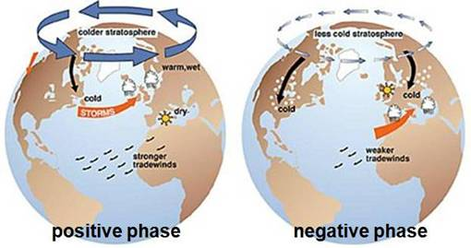
What is the Arctic Oscillation?
http://www.appinsys.com/GlobalWarming/AO_NAO.htm

Slide 4
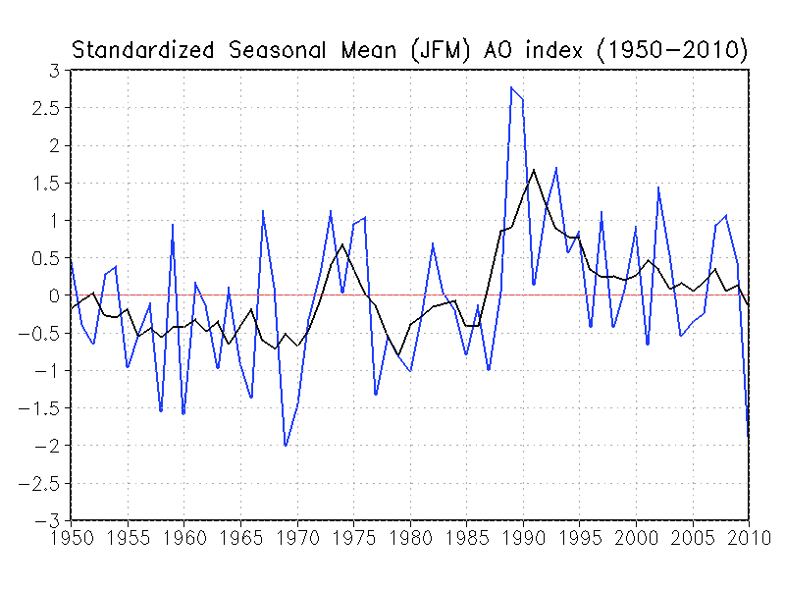
The Arctic Oscillation Index
http://www.cpc.ncep.noaa.gov/

Slide 5
Severe Weather
A “Severe Weather Event” for this study will be those events that had more than two confirmed Severe Thunderstorms
  This is determined by using the NWS’s “Six Trees Method”

Slide 6
Data
Start: 2870 total warnings
Period: From March 2005 to March 2011
Not evenly spaced
Combined all events for a month into one number
Arctic Oscillation Index was collected on a monthly basis for the same time period.

Slide 7
Methods
Storm Reports (Last 6 years)
60 events chosen
AOI Measurements (Last 50 years)
Hypotheses:
  Null: The AO- doesn’t affect severe weather
  Alternative: The AO- increases the number of severe weather events

Slide 8
T-test
A Student’s T-test was performed first.
It returned a p-value of practically 0 for NOT overturning the null hypothesis.

Slide 9
Linear Regression
Corr Coef= -.0405

Slide 10
Autocovariance

Slide 11
Periodogram

Slide 13
Results
There is no conclusive evidence that the Arctic Oscillation Index is correlated with the amount of severe weather throughout the year.
In future studies, the correlation between the number of cold weather events and the Arctic Oscillation should be studied.

Slide 14
Works Cited
http://nsidc.org/arcticmet/glossary/arctic_oscillation.html
http://www.usatoday.com/weather/climate/2006-04-19-global-climate-patterns_x.htm
http://rs.resalliance.org/2010/01/10/visualizing-the-arctic-oscillation/
http://www.cpc.ncep.noaa.gov/products/precip/CWlink/daily_ao_index/ao.shtml
http://jisao.washington.edu/ao/

