Slide 1
Correlation Between Wind Direction and Observed BrO concentrations
Jeffery A. Shook
26 Apr 11

Slide 2
Objectives and Hypothesis
Hypothesis:
Wind direction and BrO concentrations (pptv) are correlated.
Objectives:
Using regression fitting, bootstrap method, and correlation coefficient test the hypothesis above.

Slide 3
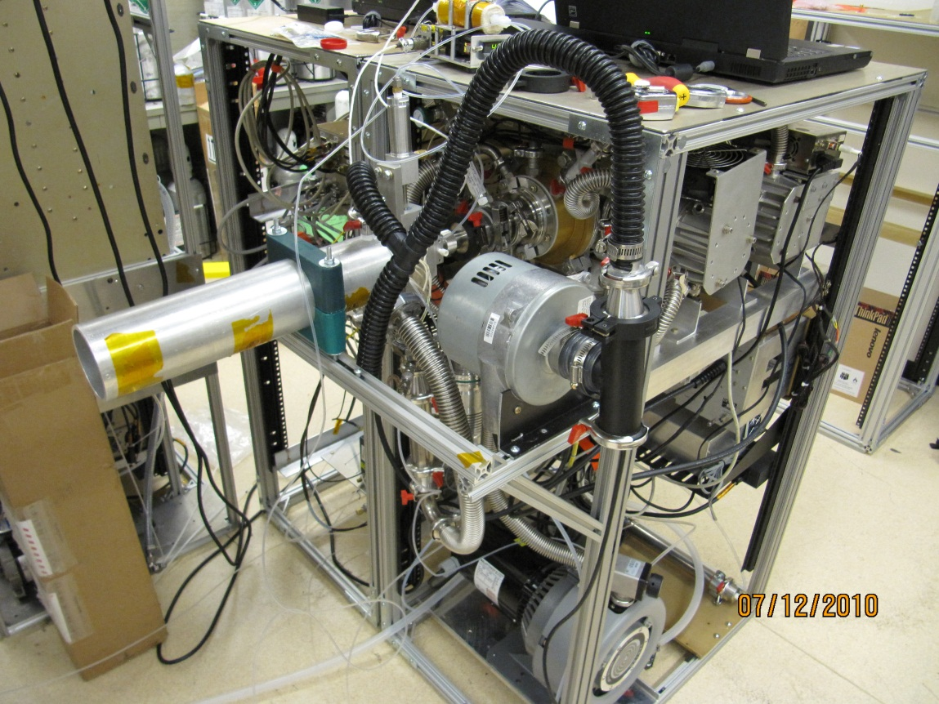
Data Acquisition
Data used was collected during the 2010 Greenland field mission using a Chemical Ionization Mass Spectrometer
Data collected from 26 May 10 to 20 Jun 10.
Location: Summit Station Greenland (72°35'46.4"N 38°25'19.1"W)

Slide 4
Original Data

Slide 5
Bootstrap Histogram

Slide 6
Regression Fitting

Slide 7
Conclusions
BrO concentrations have small correlation due to low correlation coefficient value (0.1539)
Bootstrap method confirmed correlation coefficient
Average wind direction: 192 deg. (S)
Best correlation regression—Least Squares method.

