Slide 1
Correlations between Atlantic SST and drought conditions
Kristin McCallum
EAS 4480
April 26, 2010

Slide 2
Introduction
Droughts effect every country world wide
There has been several studies done on the connections of sea surface temperature anomalies and drought conditions world wide
Attempted to correlate the two with the goal of being able to predict a drought in Georgia from a trend in the Sea surface temperature anomalies.

Slide 3
Data
From NOAA and National Climatic Data Center
  Atlantic Multidecadal Ocean temperature anomalies are for monthly SST from 5.5N to 23.5N and 15W to 57.5W.
  Precipitation anomalies are from AWAPS Climate program at NWS, Peachtree City, and are for that station.
  Standardized Precipitation Index- based on the probability of recording a given amount of precipitation.

Slide 4
Methods
CPSD
Mscohere
Phase
Periodogram
T-test
F-test
Correlation coeffecent
Notes:
Tried all these but didn’t give me sig results

Slide 5
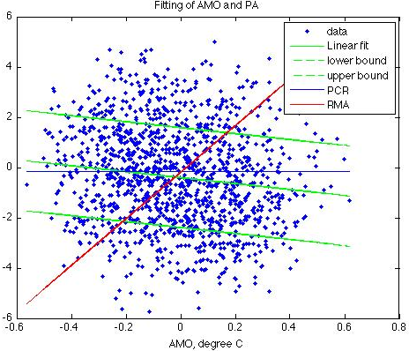
Linear Fitting attempt
Notes:
Did a Linear fit ( with 95% error bounds) Principal component regression and reduced major axis.
Linear fit has a negative slope, indicating that as sea surface temp anom becomes more positive, the PA becomes more negative ( drought).

Slide 6
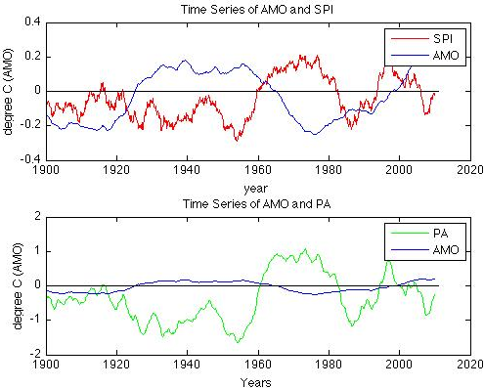
Time Series
Notes:
Time series.
Notice that when SST is positive SPI is neg and visa versa.

Slide 7
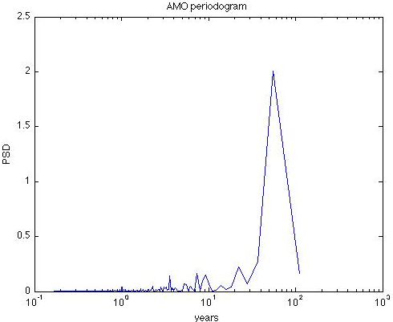
Periodograms
7 and 9
3.5
15
Notes:
Noticeable cycles: 3.5 (ENSO), 7, 9 and 22 yrs

Slide 8
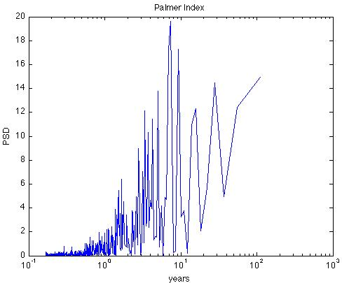
Periodograms
9
7
27
Notes:
Noticeable cycles7 yrs, 9 yrs and 27 (hist return freq of long drought, found in other research.

Slide 9
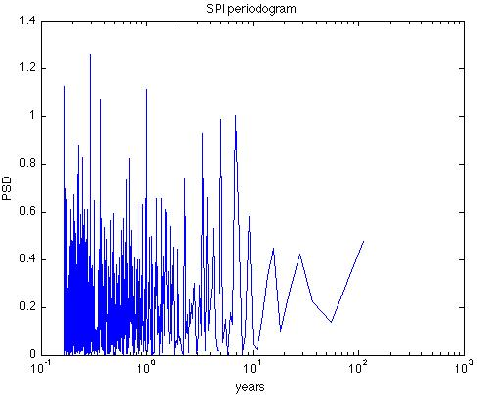
Periodograms
1
15
5
3
27
Notes:
Major cycles: 1, 3, 5, 15, 27.

Slide 10
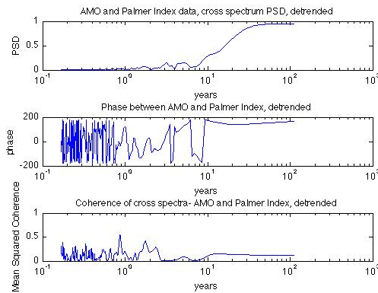
Cross Spectrum PSD (1)
Notes:
Biggest power spikes: 3.75 and 5 , but phase is really out in both places and has a rather low MScoh

Slide 11
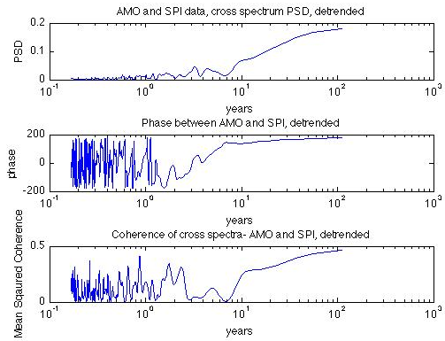
Cross Spectrum PSD (2)
Notes:
1, 3 yrs, phase is out, but not exactly 180 deg. Mscoh is small, does not line up with power spikes.

Slide 12
Conclusions
Time periods with a power spike at 3.75 years, with in the normal return period of ENSO, annual and 15-20 years, the cycle of AMO.
Researcher have found that there is a 25 yr cycle of drought in Georgia, but not dependent on only SSTs
  Too many variables influencing drought to make a direct link between Sea Surface temperatures and either the Precipitation anomaly or the SPI.
Other Research has found that 52% of the droughts can be explained by PMO and AMO phase, but was found via PCA, beyond the scope of the class.

Slide 13
Sources
McCabe, Gregory J., Palecki, Michael, ‘Pacific and Atlantic Ocean influences on multidecadal drought frequency in the United States’,PNAS, Jan 2004.
Trauth, Martin H., “Matlab Recipes for Earth Sciences”, Springer, 2010.
NCDC
NOAA.org

