Slide 1
INTER-LABROTARY COMPARISON OF REFERNCE MATERIAL FOR SELENIUM ISOTOPE DATA
BABAK SHAFEI| DATA ANALYSIS PROJECT| APRIL 28TH, 2011
Notes:
Good morning and welcome. Today I propose an experimental plan to develop the selenium isotope system as a paleoproxy to further our understanding of the oxygenation of Earth’s atmosphere.

Slide 2
BACKGROUND & OBJECTIVES
Se is essential to life +toxic character: Importance of trace determination of Se species in environmental and biological samples
Large number of Se isotopes (six) : Excellent tracers of geological and biological processes
Multi Collector-Inductively Coupled Plasma-Mass Spectrometry (MC-ICP-MS) as a
new method for the study of non-traditional stable isotope systems such as selenium (Se)
Necessity of inter-laboratory comparison of Se isotope data
Objectives
Apply statistical methods to compare inter-laboratory Se isotope data
Develop a modular code capable of handling extended datasets for future applications
1
Notes:
Redox chemistry at the Earth’s surface has changed significantly throughout it’s over 4 billion year history. These changes have been vital to the evolution of the Earth, atmosphere as well as life on Earth. However, as you can see there are still some areas that are not well understood.

Slide 3
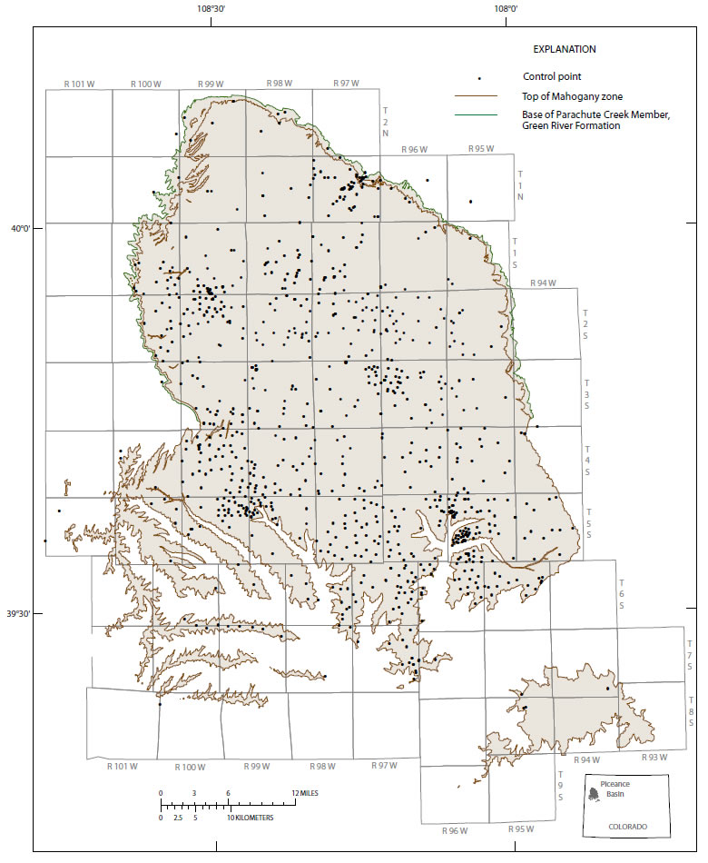
APPROACH
Standard isotope notation:
Reference material: USGS, SGR-1
Green River Formation,Western Colorado
2
Notes:
Redox chemistry at the Earth’s surface has changed significantly throughout it’s over 4 billion year history. These changes have been vital to the evolution of the Earth, atmosphere as well as life on Earth. However, as you can see there are still some areas that are not well understood.

Slide 4
APPROACH
Standard isotope notation:
Reference material: USGS, SGR-1
Data sets: 3 different labs (data_GT, data_ILL, data_BR) for + published data (data_PUB)
Univariate statistics:
Empirical distribution
Pearson’s Chi-squared test
F-test
T-test
Bivariate statistics:
Least square regression
2
Notes:
Redox chemistry at the Earth’s surface has changed significantly throughout it’s over 4 billion year history. These changes have been vital to the evolution of the Earth, atmosphere as well as life on Earth. However, as you can see there are still some areas that are not well understood.

Slide 5
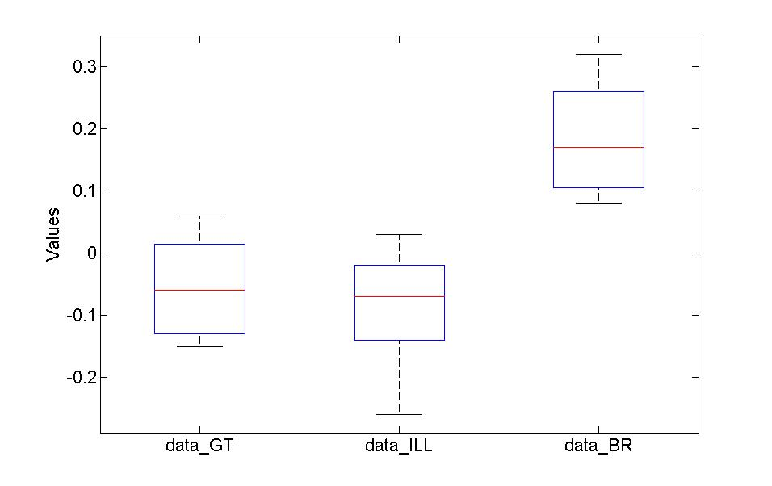
RESULTS:EMPIRICAL DISTRIBUTION
Boxplot
Measures of distribution and dispersion
 | MEAN | MIN | MAX | MEDIAN | VAR | STD | KURTOSIS | SKEWNESS
data_GT | -0.0550 | -.1500 | 0.0600 | -0.0600 | .0059 | 0.0767 | 1.7187 | 0.1326
data_ILL | -0.0857 | -0.2600 | 0.0300 | -0.0700 | .0071 | 0.0840 | 2.5750 | -0.6978
data_BR | 0.1838 | 0.0800 | 0.3200 | 0.1700 | 0.0080 | 0.0896 | 1.6030 | 0.2511
data_PUB | 0.35* | - | - | - | - | - | - | -
* Rouxel et al. 2002
3
Notes:
Redox chemistry at the Earth’s surface has changed significantly throughout it’s over 4 billion year history. These changes have been vital to the evolution of the Earth, atmosphere as well as life on Earth. However, as you can see there are still some areas that are not well understood.

Slide 6
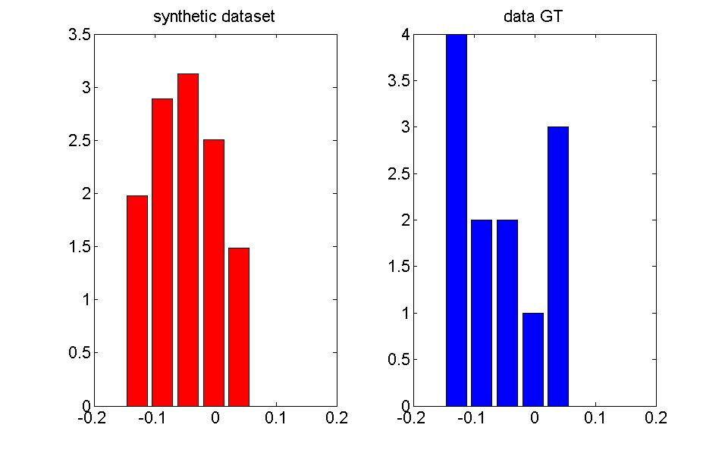
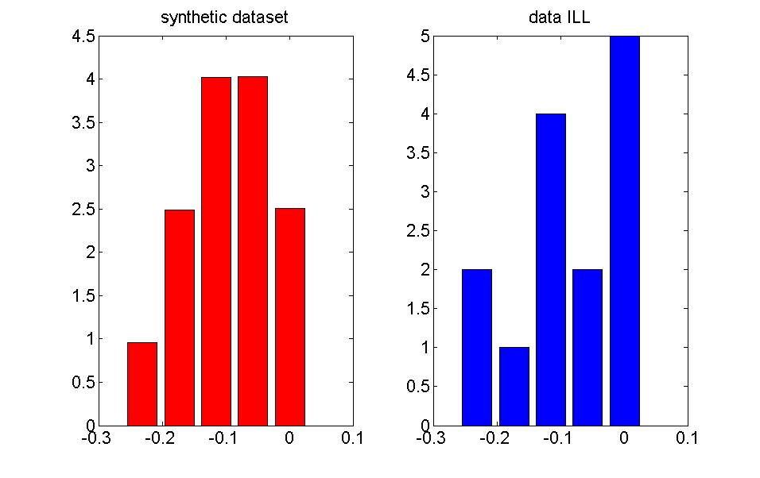
RESULTS:CHI-SQUARED TEST
Confidence level=0.95
 | data_GT | DATA_ILL | DATA_BR
Chi_mesured | 5.7561 | 5.4717 | 5.8154
Chi_table | 7.8147 | 7.8147 | 7.8148
Conclusion: all the datasets are normally distributed
4
Notes:
So why selenium? Selenium has been an element of interest as a proxy since the early 1960s due to its chemical similarities to sulfur. You can see here that sulfur and selenium are group six non-metals. One big difference between sulfur and selenium is that selenium far less abundant that sulfur with sulfur being 4 to 8 orders of magnitude greater than selenium depending on the material

Slide 7
RESULTS:F-test and T-test
 | data_GT/data_ILL | data_GT/data_BR | data_ILL/data_BR
F_real | 1.1998 | 1.3647 | 1
F_table | 2.6347 | 3.6030 | 2.5769
Conclusion: the variances of all the pairs of the datasets are equal at the confidence level of 95%
 | data_GT/data_ILL | data_GT/data_BR | data_ILL/data_BR
h | 0 | 1 | 0
significance | 0.3432 | 5.1955e-6 | 1
ci | [-0.0348,0.0963] | [-0.3173,-0.1602] | [-0.0653,0.0653]
Conclusion: the mean values of data_GT and data_BR datasets are not equal at the confidence level of 95%
5
Notes:
So why selenium? Selenium has been an element of interest as a proxy since the early 1960s due to its chemical similarities to sulfur. You can see here that sulfur and selenium are group six non-metals. One big difference between sulfur and selenium is that selenium far less abundant that sulfur with sulfur being 4 to 8 orders of magnitude greater than selenium depending on the material

Slide 8
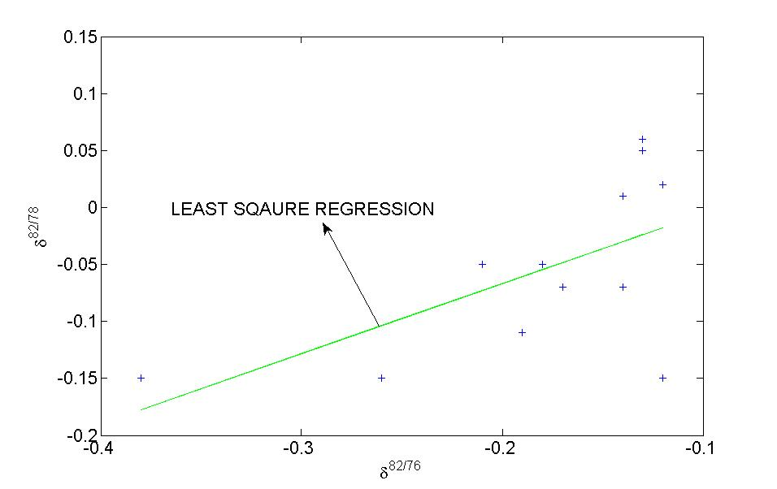
RESULTS:LEAST SQUARE REGRESSION
max_slope=2.5002
meas_slope=0.6145
min_slope=-1.2711
pub_slope=0.6667 *
For 1-α confidence level, the slope error of the least square fit is:
* Rouxel et al. 2002
6
Notes:
So why selenium? Selenium has been an element of interest as a proxy since the early 1960s due to its chemical similarities to sulfur. You can see here that sulfur and selenium are group six non-metals. One big difference between sulfur and selenium is that selenium far less abundant that sulfur with sulfur being 4 to 8 orders of magnitude greater than selenium depending on the material

Slide 9
SUMMARY
All the datasets are normally distributed
Variances of the all the pairs of the datasets are equal at the confidence level of 95%
Mean values of data_GT and data_BR datasets are not equal at the confidence level of 95%
The calculated slope of Least square regression of with respect to of data_GT is in agreement with the published data suggesting that Se isotopic composition can be measured by MC-ICP-MS at the low concentration levels without interference
7

Slide 10
REFERNCES
1) Rouxel et al. Natural variations of Se isotopic composition determined by hydride generation multiple collector inductively coupled plasma mass spectrometry. Geochimica et Cosmochimica Acta, Vol. 66, No. 18, pp. 3191–3199, 2002.
2) Reference and intercomparison materials for stable isotopes of light elements. Proceedings of a consultants meeting held in Vienna, IAEA, VIENNA, 1995.
3) Martin H. Trauth. MATLAB® Recipes for Earth Sciences
4) Data analysis course notes
8

Slide 11
ACKNOWLEDGEMENTS
Dr. Yuhang Wang
Charles Smeltzer
Kristen Mitchell
QUESTIONS?

