Slide 1
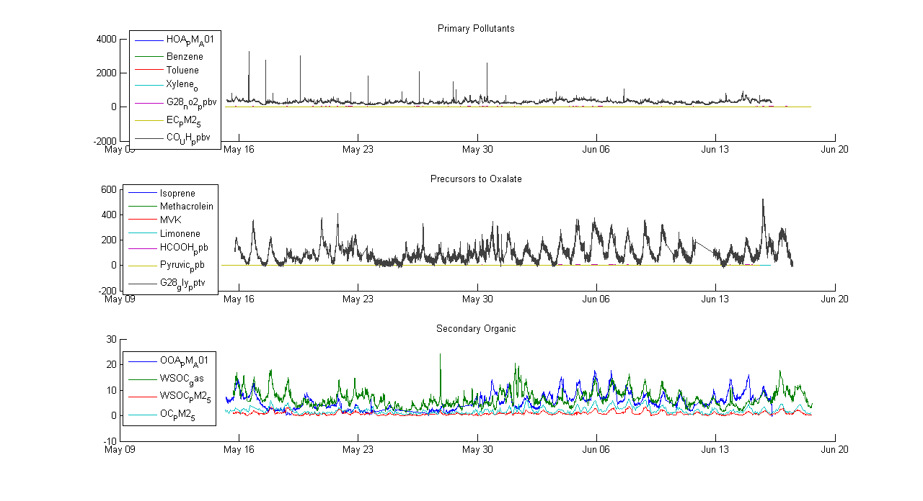
Analysis of changing compound concentrations in air above
Pasadena, Summer 2010
Kayla N Hosking EAS 4480 April 26, 2011

Slide 2
Scientific Problem
There appears to be a significant shift in the mean value of the background concentrations of various species at a certain point during a study.
  Is the difference of the means from before and after this point significant? For which species is it significant?
  Are there similarities between the species that have a significant change / similarities between the species that do not have a significant change?
  From these groupings, is it possible to determine why the means shifted? Or why it happened when it did?
Because the change occurs at the same time across multiple species as seen from data collected by different groups of researchers in the study, it is assumed not to be purely error, and should have an explanation.

Slide 3
The Data: CalNex 2010 Study
Observation platform:
  fixed in situ instruments at a ground site located on CalTech’s campus in Pasadena, CA
Sampling:
  0-D through time (time series measurements at a single site)
  Sampling frequencies: vary depending on what is being measured
  Sampling period: mid May – mid June 2010
  Uncertainties: vary depending on what is being measured

Slide 4
Data Analysis Methods
Univariate methods
  Plotting the time series
  Plotting the histograms
  Statistical tests
    Student’s t-test of means
Exploratory data analysis
  Hypothesis:
    There is a change in species background concentrations because there was a change in meteorological conditions. If this is true, there will be a statistically significant change in concentrations of various groups of compounds and in the met data.
  Assumptions and support:
    The data sets are normal distributions: see histograms

Slide 5
Results: Student’s t-test
At the 99.9% confidence level (α = 0.001, p = α – 1 = 0.999)
Precursors for Oxalate
Primary Pollutants
 | h | p | ci, lb | ci, ub
Isoprene | 1 | 0 | -0.35818 | -0.16781
Methacrolein | 1 | 0 | -0.06197 | -0.03117
MVK | 1 | 0 | -0.17875 | -0.09344
Limonene | 1 | 2.08E-14 | 0.008204 | 0.020355
HCOOH_ppb | 1 | 0 | -1.10184 | -1.01542
Pyruvic_ppb | 1 | 0 | -0.01565 | -0.01248
G28_gly_pptv | 1 | 0 | -45.3043 | -39.0839
 | h | p | ci, lb | ci, ub
HOA_PM_A01 | 1 | 0 | -0.3625 | -0.20928
Benzene | 1 | 1.11E-16 | -0.07766 | -0.03393
Toluene | 1 | 8.47E-10 | -0.16301 | -0.04968
Xylene_o | 1 | 2.48E-04 | -0.02293 | -0.00124
G28_no2_ppbv | 1 | 0 | -2.19594 | -1.54619
EC_PM2_5 | 1 | 2.99E-10 | -0.22514 | -0.07177
CO_UH_ppbv | 1 | 0 | -40.1076 | -33.6857
Secondary Organics
 | h | p | ci, lb | ci, ub
OOA_PM_A01 | 1 | 0 | -2.89909 | -2.18116
WSOC_gas | 0 | 0.001227 | -0.72547 | 0.006448
WSOC_PM2_5 | 1 | 1.17E-09 | -0.23293 | -0.06963
OC_PM2_5 | 1 | 1.02E-07 | -0.83973 | -0.20078

Slide 6
Results: Summary
Primary pollutants
  Volatile
    Carbon monoxide, CO
    Nitrogen dioxide, NO₂
  Particulate
    Elemental carbon, EC
    Hydrocarbon-like organic aerosols, HOA
Secondary organics
  Organic Carbon, OC
  Oxygenated organic aerosols, OOA
  Water soluble organic carbon in the particulate phase, WSOCp
Oxalate precursors
  Glyoxal, CHOCHO
  Organic acids
    Pyruvic acid
    Formic acid, HCOOH
  Biogenic volatile organic compounds (VOCs)
    Isoprene
    Methacrolein (MCAR)
    MVK
    Limonene
Statistically significant changes at the 99.9% confidence level in the means of species from many different groups

Slide 7
Results: Student’s t-test
At the 99.9% confidence level (α = 0.001, p = α – 1 = 0.999)
 | h | p | Confidence interval, lower bound | Confidence interval, upper bound
Temp_G31_C | 1 | 0 | -2.79372 | -1.95096
RelHum_G31_pct | 0 | 0.003352 | -3.06554 | 0.176039
DewPt_G31_C | 1 | 0 | -2.86045 | -2.33986
WindSpeed_G31_m_s | 0 | 0.53875 | -0.08909 | 0.061054
WindDir_G31_deg | 0 | 0.759961 | -5.5409 | 6.674424
Pressure_G31_mb | 1 | 0 | 0.56393 | 0.946005
SolarRad_G31_W_m2 | 0 | 0.663442 | -30.4869 | 39.77297
h1 | 1 | 4.31E-11 | 54.68938 | 162.7789

Slide 8
Results: Summary
Not significant at 99.9% confidence level
  Relative Humility (%)
  Wind Speed (m/s)
  Wind Direction (°)
  Solar Radiation (W/m²)
Significant at the 99.9% confidence level
  Temperature (°C), with confidence interval [-2.7937, -1.9510]
  Dew Point (°C), with confidence interval [-2.8605, -2.3400]
  Pressure (mb), with confidence interval [0.5639, 0.9460]
  Boundary Layer Height (m), with confidence interval [54.6894, 162.7789]

Slide 9
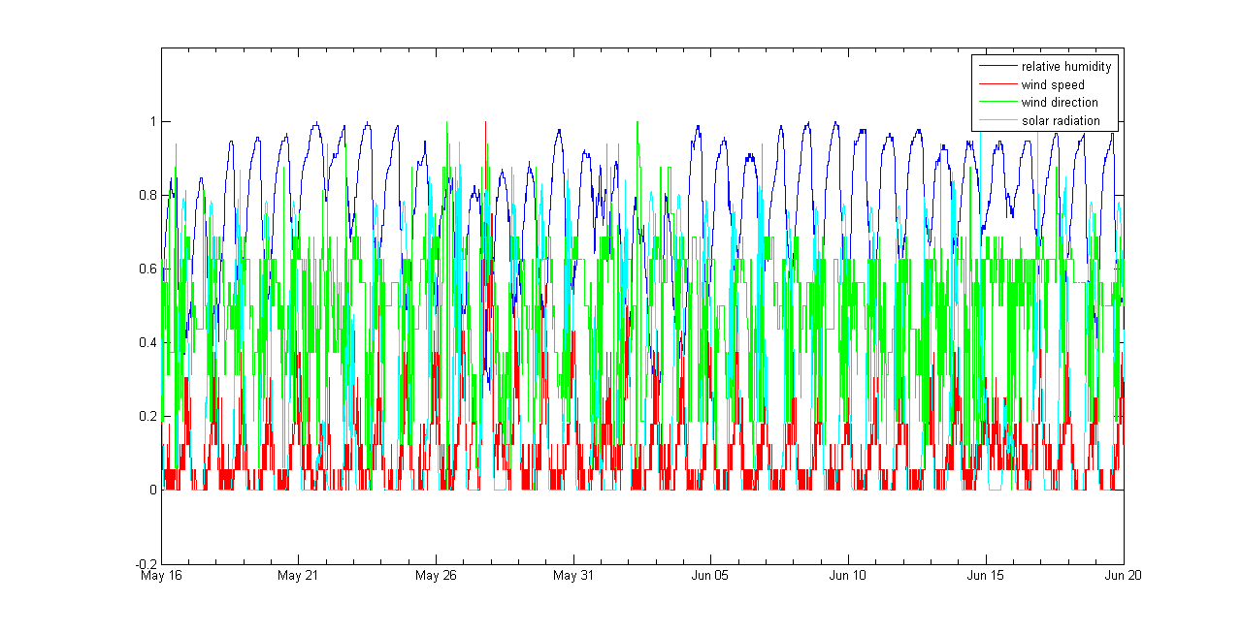
Results: Time Series
Relative units normalized to maximums

Slide 10
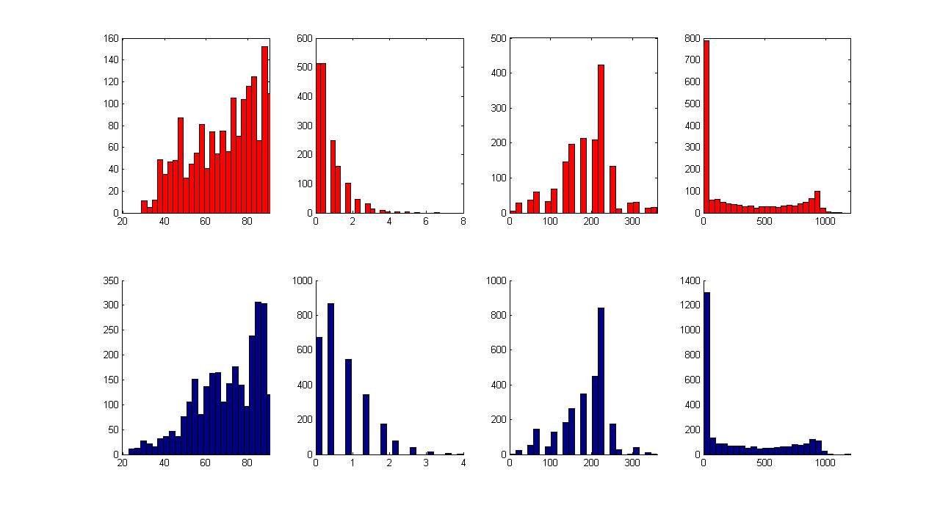
Results: Histograms
frequency
Relative Humidity (%) Wind Speed (m/s) Wind Direction (°) Solar Radiation (W/m²)

Slide 11
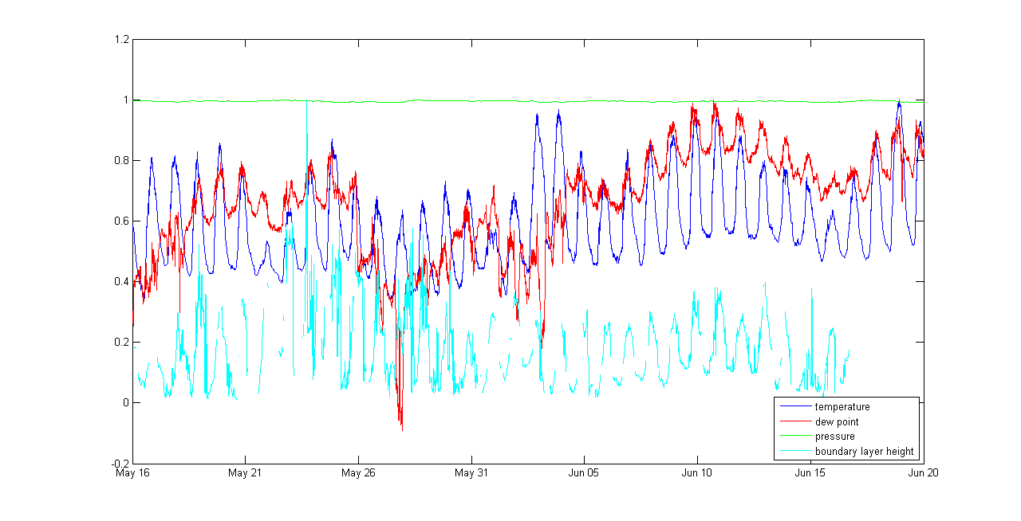
Results: Time Series
Relative units normalized to maximums

Slide 12
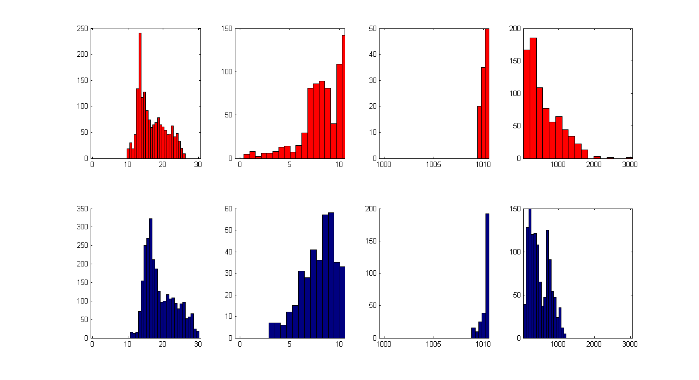
Results: Histograms
frequency
Temperature (°C) Dew Point (°C) Pressure (mb) Boundary Layer Height (m)

