Slide 1
Heat Mortality in the Southeast
Lindsey Morgan
EAS 4480
April 28, 2011

Slide 2
Deaths 1995 - 2010

Slide 3
Data
NCDC Storm Data
http://www4.ncdc.noaa.gov/cgi-win/wwcgi.dll?wwEvent~Storms
Chose Temperature Extremes for Event Type
NCDC Surface Data
http://lwf.ncdc.noaa.gov/oa/ncdc.html
Chose hourly surface data from closest station

Slide 4
Heat Deaths in Georgia
Date | Location (County) | Time (EST) | Time (UTC) | # of Deaths | Age | Sex
6/9/95 | Fulton | 11:00 | 16 | 2 | 2
6/9/95 | Greene | 18:00 | 23 | 1 | 64 | M
8/1/99 | Coweta | 6:00 | 11 | 1 | 14 | M
8/1/99 | Hart | 12:00 | 17 | 1
8/8/99 | Sumter | 6:00 | 11 | 1 | 75 | F
7/31/06 | Rockdale | 15:00 | 20 | 1 | 15 | M
8/11/07 | Burke | 14:00 | 19 | 1 | 69 | F
7/23/10 | Bleckley | 12:00 | 17 | 2 | 90, 83 | M, F
7/26/10 | Twiggs | 11:00 | 16 | 1 | 47 | F

Slide 5
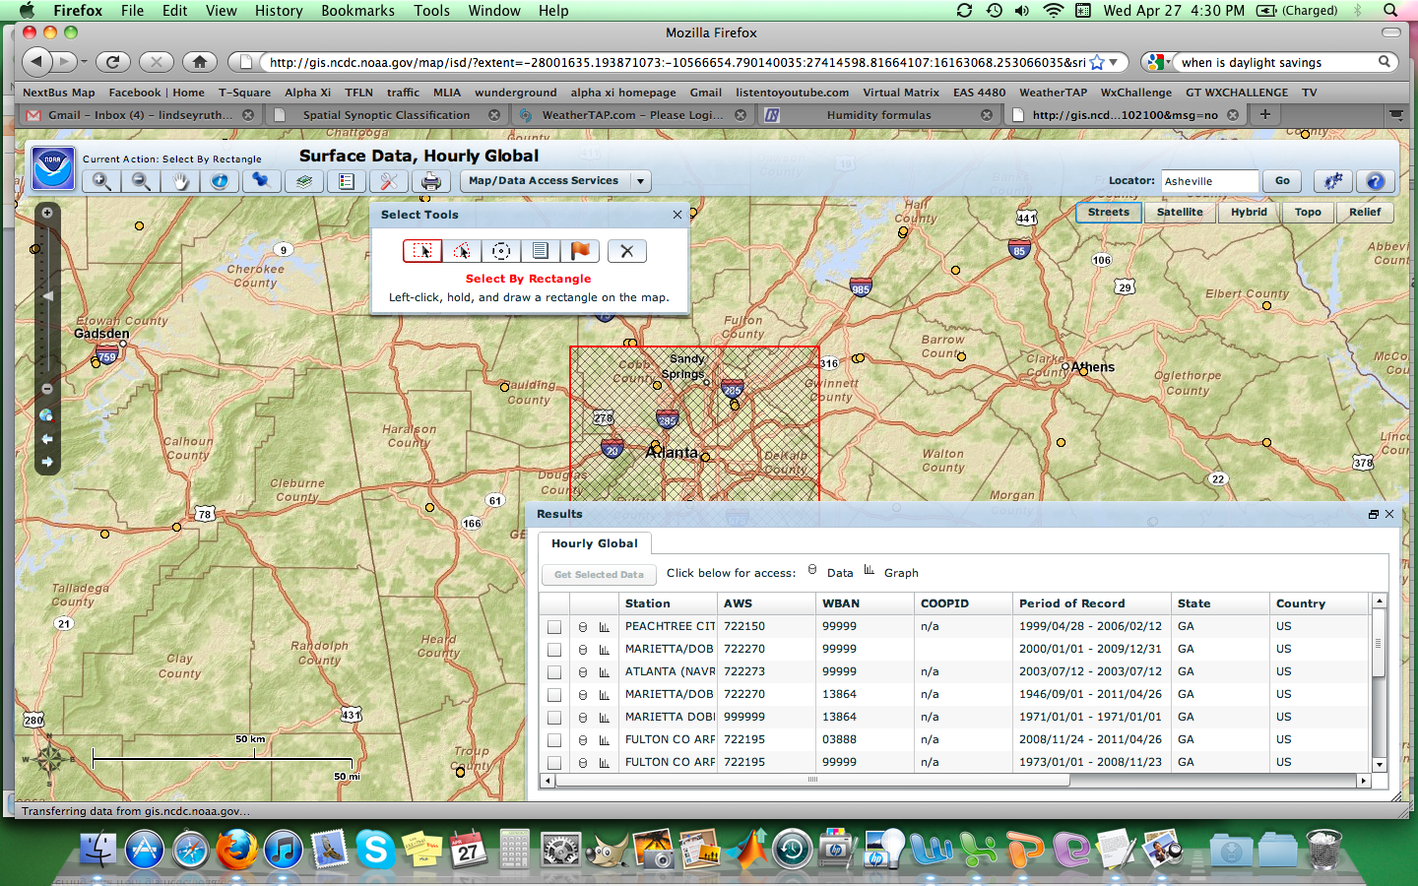
NCDC Hourly Data

Slide 6
GA vs. Neighboring States
 | Max Temp | Min Temp | Relative Humidity | Heat Index
T-test | h=0 p=0.1956 | h=0 p=0.9479 | h=0 p=0.2062 | h=0 p=0.0770
F-test | h=0 p=0.2067 | h=0 p=0.0974 | h=0 p=0.1705 | h=0 p=0.1906

Slide 7
Max Temp

Slide 8
Min Temp

Slide 9
Relative Humidity

Slide 10
Heat Index

Slide 11
Summary (GA & Southeast)
 | Max Temp. | Min Temp. | Relative Humidity | Heat Index
Mean | 94.606 | 73.742 | 91.319 | 102.365
Standard Deviation | 4.839 | 3.702 | 7.739 | 7.001
Current NWS criteria for Excessive Heat Warning/Advisory:
Heat Index of 105 for Heat Advisory
Heat Index of 110 for Excessive Heat Warning

Slide 12
Max Temp
Y = 0.0088X + 0.2601
R = 0.1467

Slide 13
Min Temp
Y = 0.0141X + 0.0522
R = 0.18

Slide 14
Relative Humidity
Y = -0.0068X + 1.709
R = -0.1808

Slide 15
Heat Index
Y = 0.0044X + 0.6374
R = 0.1071

Slide 16
Conclusions
Current NWS criteria may be too high
Need larger data set to get better correlations
More years
Combine NCDC data with ME or CDC data
May also get better correlations with mortality rates
Use populations

