Slide 1
Post-processing of Continuous Shear Wave Signals
April 28, 2011
EAS 4480
Taeseo Ku
Civil & Environmental Engineering
Notes:
My topic is “Post-processing of continuous shear wave signals”. I am from Civil engineering department. I tried to apply what I learned in this class to my research area.

Slide 2
Introduction
1. Shear wave velocity (V_{s})
Second fastest wave & Directional and polarized
Most fundamental wave to geotechnical engineering
Depends on site-specific geostatic stress state
2. Applied data
‘ConeTec, Inc.’ produced continuous shear wave measurements with depth to 45m at Richmond, BC (Seismic CPT)
Shear waves are collected at every 10cm vertical interval
(Very short frequent interval !)
Sampling time = 0.05 msec → f_{s} = 20 kHz
Notes:
Vs is second fastest wave and has directional and polarized properties.
I obtained the data from Contech which is a geotechnical company. They collected shear waves at every 10cm vertical interval up to 45 meter depth. Very short frequent interval.

Slide 3
Downhole Testing
Oscilloscope
Pump
Horizontal Plank
with normal load
x
Δt
z₁
Hammer
z₂
packer
Horizontal
Velocity
Transducers
(Geophone
Receivers)
Test
Depth
Interval
Shear Wave Velocity:
V_{s} = ΔR/Δt
R₁² = z₁² + x²
R₂² = z₂² + x²
Cased
Borehole
Δx
Notes:
I will briefly show how to generate and calculate shear wave. First, make borehole. Then set up receivers. Then, packing. Generate shear waves and record signals. Finally, Vs is calculated the equation : depth interval divided by time interval.

Slide 4
Notes:
I plot all raw signals. Y-axis is depth measured waves. You can see the shear waves in the center. Then, attenuated. A lot of noise are captured together with shear waves.

Slide 5
Post processing for continuous V_{s} signals
Signals are normalized by max. signal
Signal process : de-trend and filter the raw signals (low/high cutoff frequency pass)
A total of 418 data analyzed – bad signals are deleted
Butterworth filter - [b,a] = butter(n, W_{n}, 'type')
Input
▪ n: order of filter → n = 4
▪ W_{n}: Cutoff frequency - use Nyquist frequency f_{N} to normalize the input (f_{N} = ½*f_{S} = 10 kHz)
▪ W_{n}=[w₁, w₂]/f_{N}, band filter → [18Hz, 300Hz]/f_{N}
Notes:
To reduce noise effect, I detrend and filtered the raw signals. I use bandpass filter. I applied this cutoff frequency values based on visual examination.

Slide 6
Notes:
This is filtered signals. But, there is still boundary effect near surface.

Slide 7
Auto-covariance
• Auto-covariance for signal at 45.3 meter depth
x = [x₁, x₂, …, x_{n}] where x_{i} is
equally spaced in time
Notes:
I can not show all signals now. This is auto-covariance for one signal at 45.3 meter depth.

Slide 8
Power spectral density
• Power Spectral Density Estimate (signal at 45.3 meter depth)
FFT
fy = fft(y,nfft)
f = 1/2*fs*linspace(0,1,n/2)
Periodogram
[Pxx,f]
= periodogram(x,window,nfft,fs)
LSSA : Lomb method
[xp,xf]
=lombscargle2(data,hifac,ofac)
Observed Peak Frequency = 37.5 Hz
Notes:
Power spectral density for same signals. I used FFT, Periodogram, and least-squares spectral analysis. Estimates shows same result. Observed peak frequency is 37.5 Hz.

Slide 9
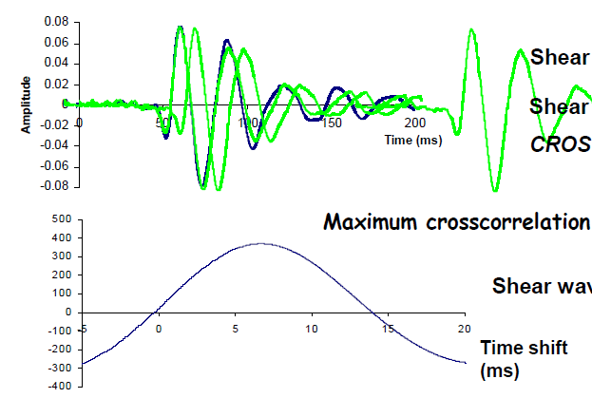
Post-processing for V_{s} – Time domain
• Example : cross-correlation method in time domain
Time shift
0.0003 sec
Time shift
45.2 & 45.3 meters
Maximum covariance gives the time shift between two signals !
Notes:
Vs calculation method in time domain. I apply cross-correlation method between two continuous signals. If two signals have same shape, we have the largest cross-correlation value when two signals are overlapped. This is covariance plot for two signals at 45.2 and 45.3 meter depth.

Slide 10
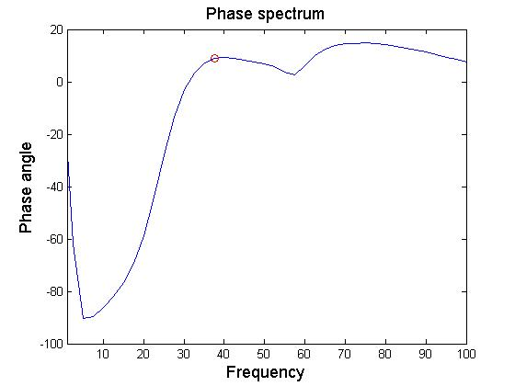
Post-processing for V_{s} – Frequency domain
Signals at 45.2 & 45.3 m depth
Cross spectral analysis
[Pxy,F]=cpsd(x,y,window,noverlap,nfft,fs)
Signals at 45.2 & 45.3 meter depth
Observed peak frequency = 37.5 Hz
Phase = angle(Pxy)/(2*pi)*360;
interp1(F, phase, 37.5)
Lag: 8.924
f = 37.5 Hz; T= 0.0267 sec
∆t = 8.924/360* 0.0267
= 0.000661 sec
Notes:
Vs calculation in frequency domain using cross-spectral analysis. From phase spectrum, time shift is calculated.

Slide 11
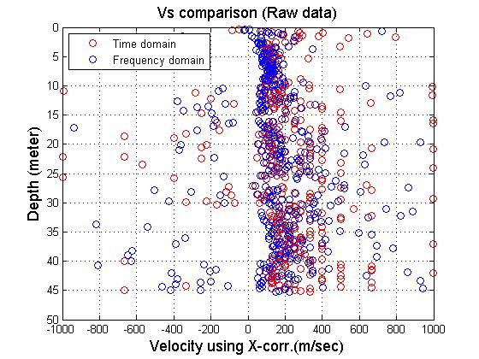
Estimated V_{s} profile
• Sensitive
Time lags are very small
• Running-mean Filter for ∆t
Filter function: filtfilt
y = filtfilt (b, a, x)
describes filtering of vector x by
y(n) = b(1)*x(n) + b(2)*x(n-1) + ... + b(nb+1)*x(n-nb)
-a(2)*y(n-1) -... -a(na+1)*y(n-na)
Generate a n^{th} order running mean filter coefficient vector
→ b=1/(n+1)*ones(1,n+1);
Notes:
I compared results. But, very sensitive because time shifts are very small. So, I tried to apply running mean filter for time interval.

Slide 12
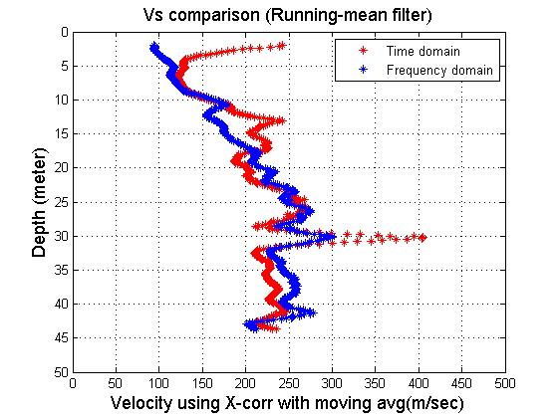
V_{s} estimation using Running-mean filter
10th order running mean filter
15th order running mean filter
Notes:
I had reasonable values after running mean filter.

Slide 13
Relationship between V_{s} and depth of overburden
Empirical estimate from Lew & Campbell (1985, ASCE)
Relationships are derived for various Quaternary age soils
Over 270 V_{s} surveys including refraction, downhole , and crosshole
Regression analysis
- V_{s} =K(d+c)^{n}
d : depth
K,c, and n : constants dependent on geotechnical classification
Average V_{s}
Lew and Campbell,1985
Notes:
Previous study from Lew and Campbell shows, Vs is increasing with depth as a power function. But, this is site-specific and depends on stress state of ground. They surveyed over 270 Vs including various types by regression analysis.

Slide 14
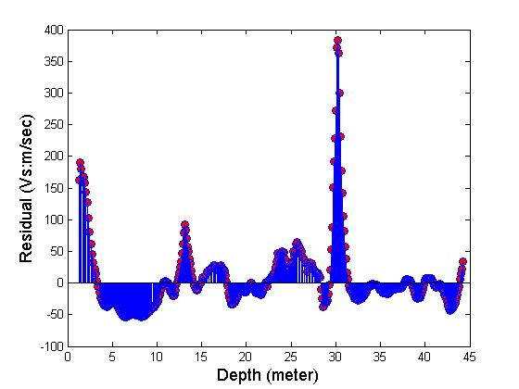
Regression analysis (Time domain : n = 10)
10th order running mean filter
Least-squares regression
V_{s} = 120.86*(Depth)^{0.1882} (m/sec)
Reduced major axis
V_{s} = 74.51*(Depth)^{0.3539} (m/sec)
Principal component
V_{s} = 114.74*(Depth)^{0.2060} (m/sec)
Y = a∙X^{c} (Y = V_{s}, X = depth)
Transform to linear form
log(y) = c∙log(x) + log(a)
Correlation coefficient: r = 0.5317
Coefficient of determination : R² = r² = 0.283
Notes:
I tried to find a trend line. First, I transform the data to linear form. 10th order running mean filter in time domian.

Slide 15
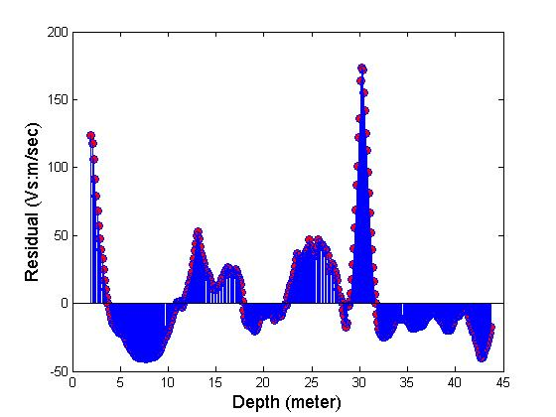
Regression analysis (Time domain : n = 15)
15th order running mean filter
Least-squares regression
V_{s} = 101.56*(Depth)^{0.2419} (m/sec)
Reduced major axis
V_{s} = 77.37*(Depth)^{0.3344} (m/sec)
Principal component
V_{s} = 97.82*(Depth)^{0.2547} (m/sec)
Y = a∙X^{c} (Y = V_{s}, X = depth)
Transform to linear form
log(y) = c∙log(x) + log(a)
Correlation coefficient: r = 0.7232
Coefficient of determination : R² = r² = 0.523
Notes:
15th order running mean filter in time domian.

Slide 16
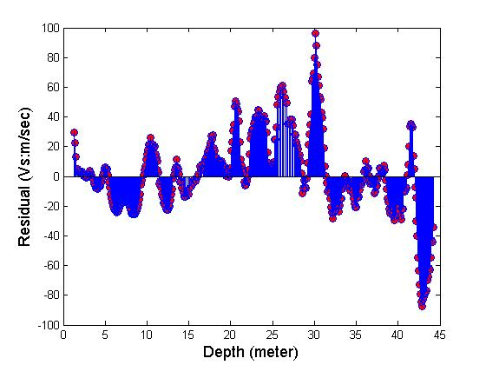
Regression analysis (Frequency domain : n = 10)
10th order running mean filter
Least-squares regression
V_{s} = 64.75*(Depth)^{0.3834} (m/sec)
Reduced major axis
V_{s} = 58.94*(Depth)^{0.4156} (m/sec)
Principal component
V_{s} = 63.12*(Depth)^{0.3922} (m/sec)
Y = a∙X^{c} (Y = V_{s}, X = depth)
Transform to linear form
log(y) = c∙log(x) + log(a)
Correlation coefficient: r = 0.9225
Coefficient of determination : R² = r² = 0.851
Notes:
10th order running mean filter in frequency domian.

Slide 17
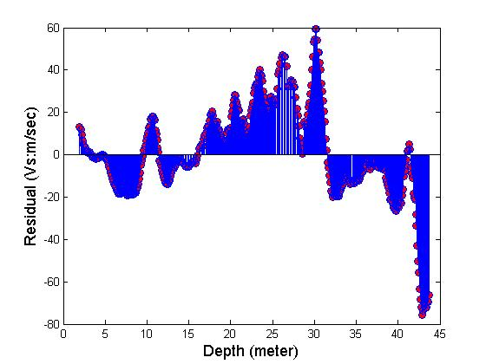
Regression analysis (Frequency domain : n = 15)
15th order running mean filter
Least-squares regression
V_{s} = 61.96*(Depth)^{0.3982} (m/sec)
Reduced major axis
V_{s} = 57.71*(Depth)^{0.4224} (m/sec)
Principal component
V_{s} = 60.71*(Depth)^{0.4051} (m/sec)
Y = a∙X^{c} (Y = V_{s}, X = depth)
Transform to linear form
log(y) = c∙log(x) + log(a)
Correlation coefficient: r = 0.9427
Coefficient of determination : R² = r² = 0.889
Notes:
15th order running mean filter in fq domian.

Slide 18
Summary
Post processing for continuous V_{s} signals
▪ Detrend data & band pass filtering
▪ Auto-covariance, PSD estimate
V_{s} evaluated by ‘cross-correlation’ & ‘cross-spectral analysis’
▪ Time domain : find max. covariance between signals
▪ Frequency domain : cross spectral analysis – phase lags
▪ Sensitive results : apply n^{th} order running-mean filter
Regression analysis
▪ Transform to linear form (V_{s} vs depth)
▪ LS regression, RMA regression , PC regression

