Slide 1
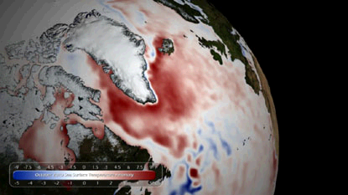
Exploring the Relationship Between North Atlantic and Global Temperature Anomalies Using Bivariate and Time Series Analysis
EAS 4480
Ryan Schilling

Slide 2
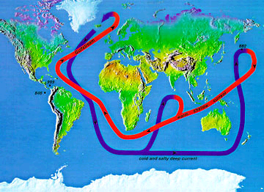

The Problem
North Atlantic waters play a crucial role in Ocean Circulation.
Cold, Salty water in the North Atlantic sinks driving formation of deep waters.
Determining the impact of climate change in these waters is important for determining future climate

Slide 3
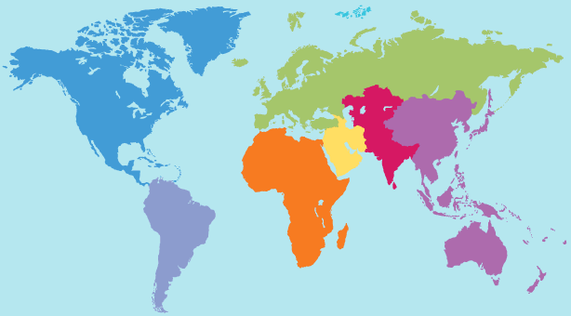


The Data
North Tropical Atlantic SST Index
  Anomaly index using running mean, and long term averages.
Global Mean Land/Ocean Index
  Anomaly index using similar techniques to NTA
North Atlantic Oscillation Index
  Index calculated from mean sea level pressure in three locations in the North Atlantic

Slide 4
Concerns With Data
North Atlantic Temperature Anomalies Contribute to Global Anomalies
  Trends may simply be an artifact of how indices are calculated
Historical Values Not Permanent
  By using a running mean to calculate anomaly, all data is affected by future measurements
Reasons to Continue Using Data
Area for NTA much smaller than Global Data
  Analysis aimed at finding much stronger correlations.
Long Time Scale of Data With Hundreds of Values
  Values only changing slightly with time

Slide 5
Techniques
Least Squares Regression
Removed Major Axis
Correlation Coefficient
Bootstrap of LS correlation
PSD analysis

Slide 6
Linear Least Squares Regression
Bootstrap Histogram
NTA
Global Temp Anomaly
Correlation Coefficient
LS Slope: .71
RMA Slope: 1.46

Slide 7
Temp Anomaly
Date
North Atlantic
Global

Slide 8
Atlantic SST PSD
Global Temp PSD

Slide 9
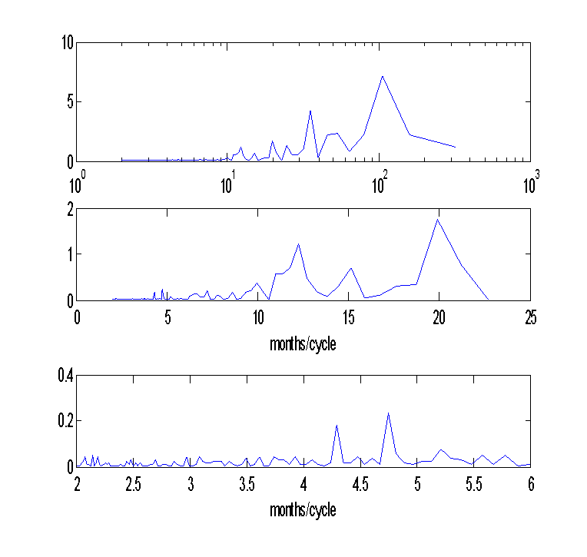
Atlantic SST PSD
NAO Index PSD

Slide 10
Cross Correlation Atlantic and Global Anomalies

Slide 11
Conclusions
Bivariate analysis showed weak correlation between Atlantic and Global SST anomalies
Data for temperatures anomalies already smoothed. Making conclusive time series analysis difficult.

