Slide 1
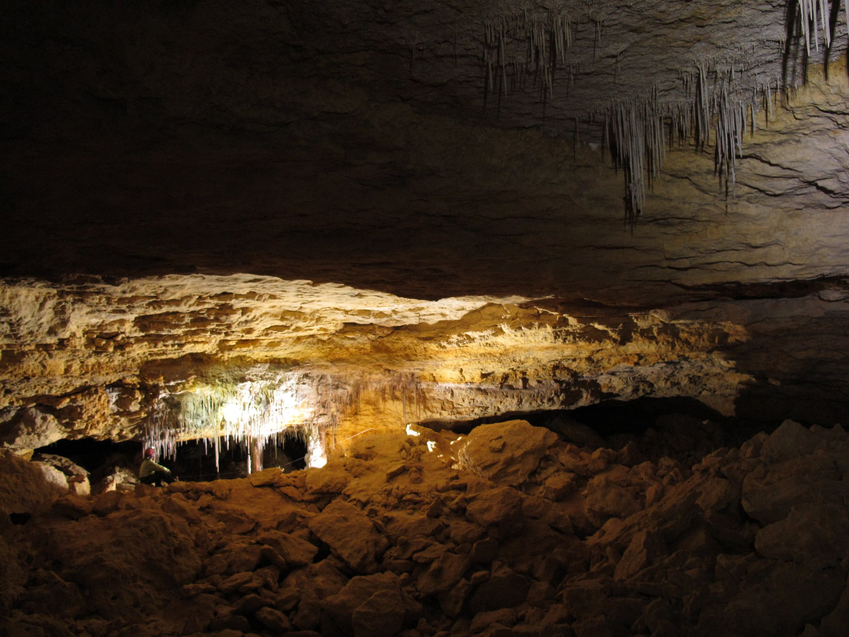
Resolving Age Model Errors in U-series Dating of Stalagmites from Borneo
Stacy Carolin
Georgia Institute of Tech.
April 28, 2011

Slide 2
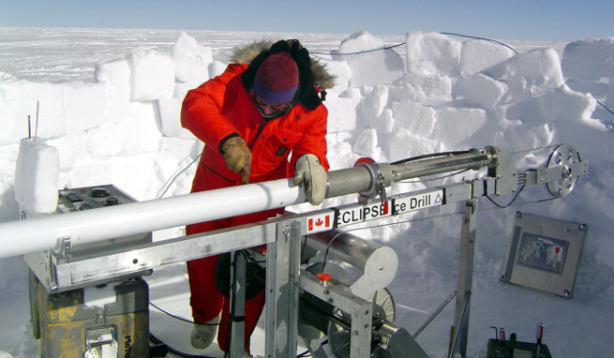
Evidence for Abrupt Climate Change
Mapping Spectral Variability in Global Climate Project
(composite record of ocean marine sediments – proxy for ice volume)
North Greenland
Ice Core Project
(ice core record - proxy for temp.)
Imbrie et al., 1984
North Greenland Ice Core
Project Members, 2004

Slide 3
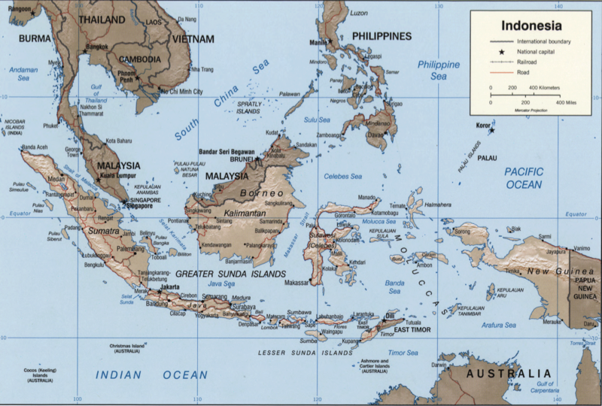
Collecting Samples
Notes:
Note dirt, flat banding, no banding

Slide 4
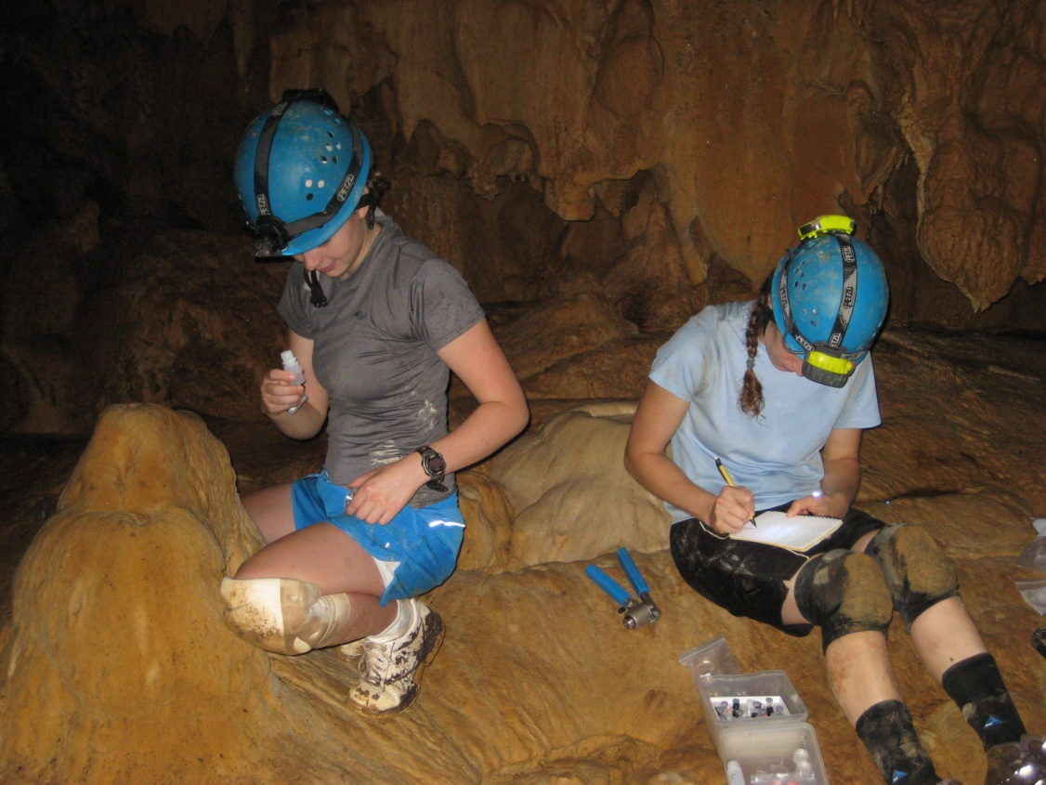
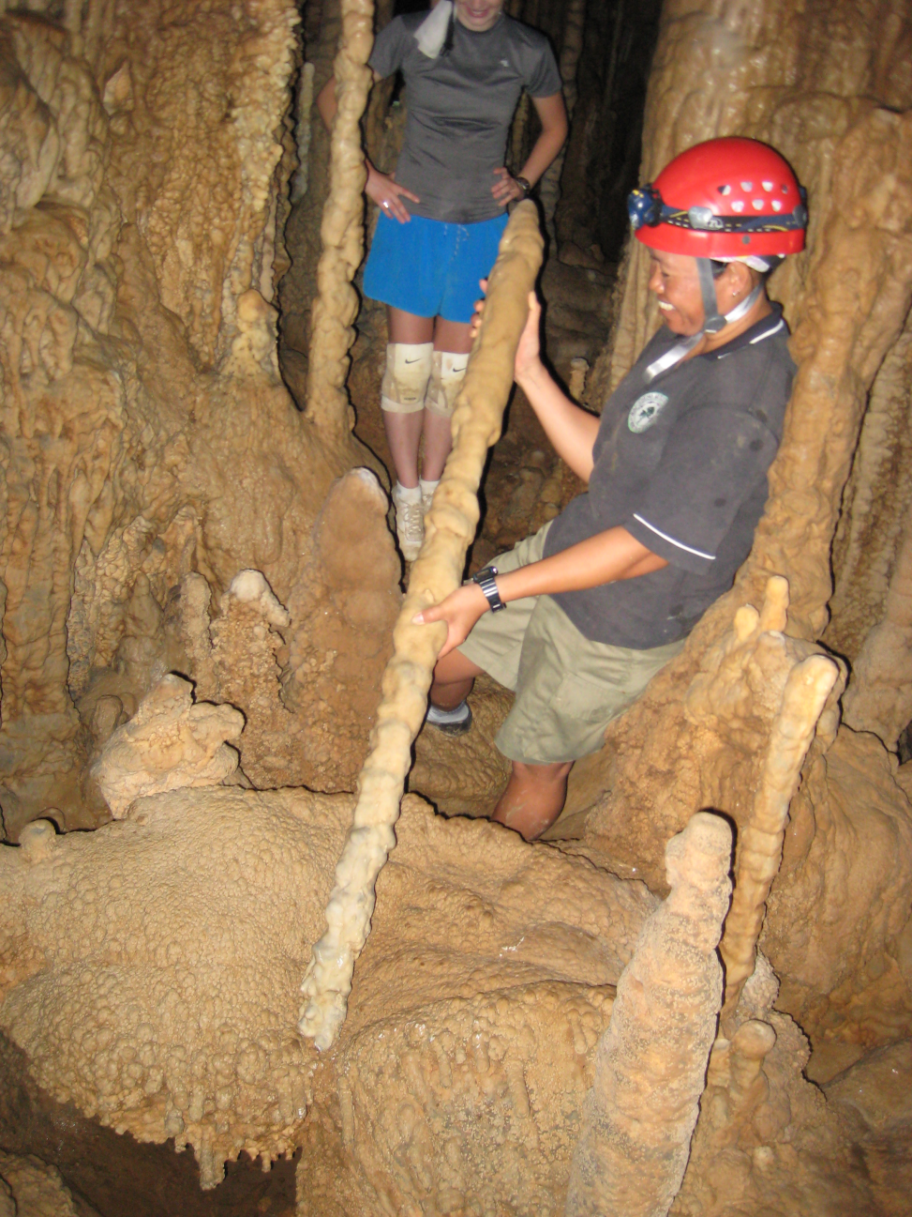
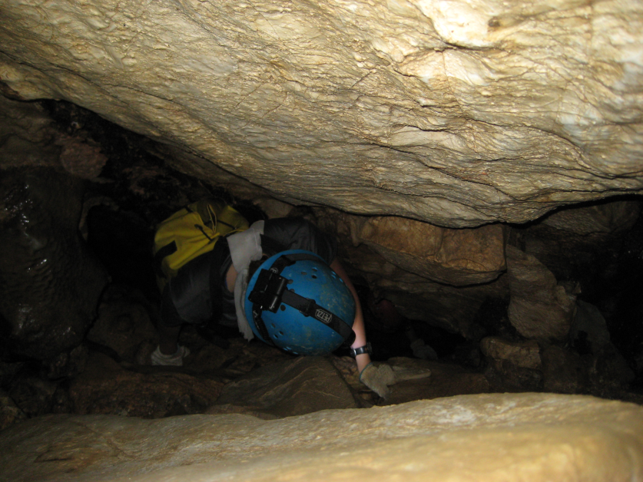
Collecting Samples
Notes:
Note dirt, flat banding, no banding

Slide 5
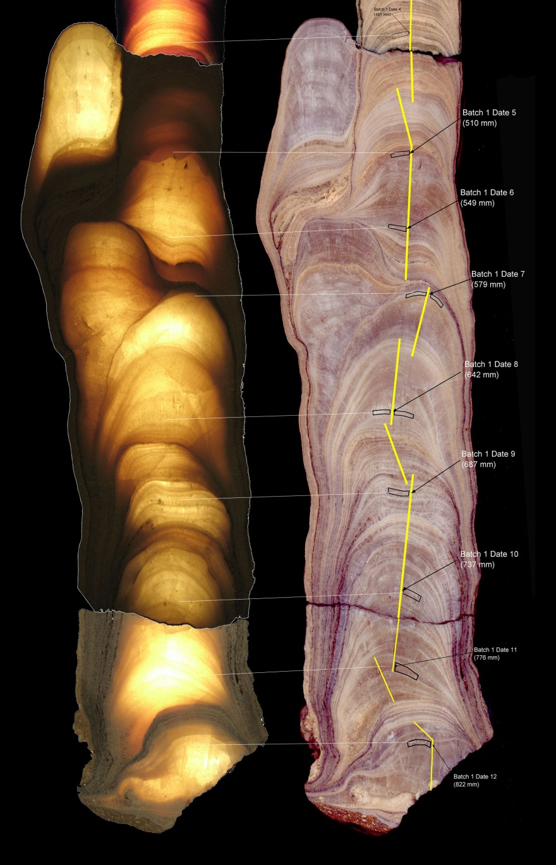
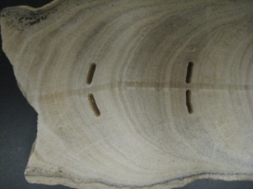
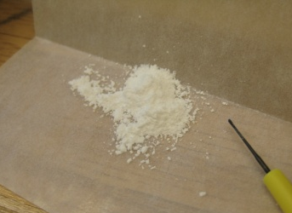
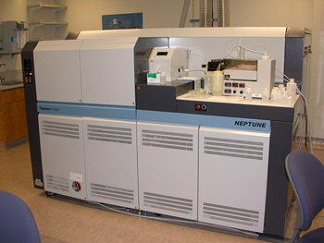
Determining Age of Sample
250 mg powder samples:
Finnigan Neptune MC-ICP-MS
Uranium batch: ²³⁴U, ²³⁵U, ²³⁶U, ²³⁸U
Thorium batch: ²²⁹Th, ²³⁰Th, ²³²Th
Notes:
Note dirt, flat banding, no banding

Slide 6
U-Series Disequilibrium Dating
²³⁸U
^{4,468,000,000 yrs}
²³⁴U
^{245,300 yrs}
²³⁴Pa
^{1.2 mins}
²³⁴Th
^{24 days}
²³⁰Th
^{75,690 yrs}
²⁰⁶Pb
Notes:
Note dirt, flat banding, no banding

Slide 7
How to Determine Age Error?
Monte Carlo Simulation Steps to Calculate Error:
Calculate “Age” for each set of isotopes
Simulate 1000 data points for each isotope measured (normally distributed) based on the analytical error
Dist = randn(1000,1) .* Err;
Dist = Dist + Measd;
Calculate 1000 “Simulated Ages” for each simulation set of isotopes
Check that “Simulated Ages” are normally distributed
Calculate age errors
Age error = “Age” ± 2* St. Dev(“Simulated Ages”)
Notes:
Note dirt, flat banding, no banding

Slide 8
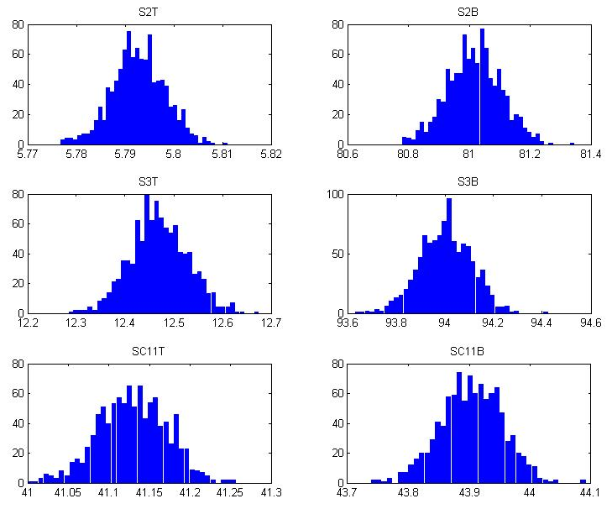
How to Determine Age Error?
Age (in kyr BP) of 6 Stalagmite Samples of Interest
Notes:
Note dirt, flat banding, no banding

Slide 9
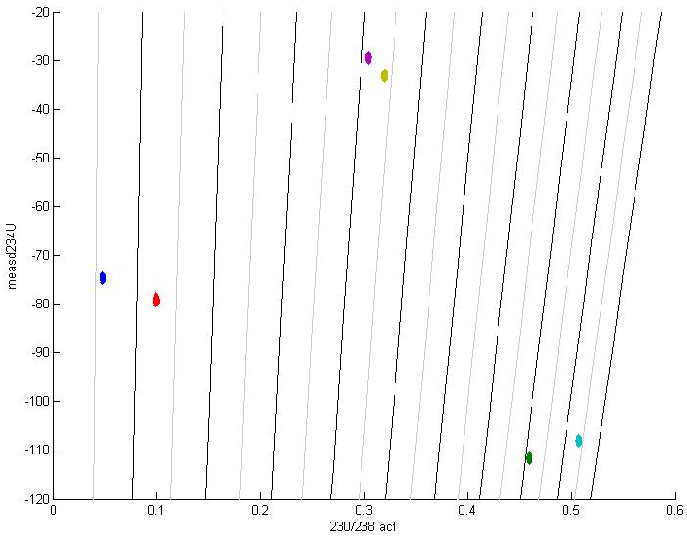
How to Determine Age Error?
10 ky
20 ky
30 ky
40 ky
50 ky
60 ky
70 ky
80 ky
90 ky
100 ky

Slide 10
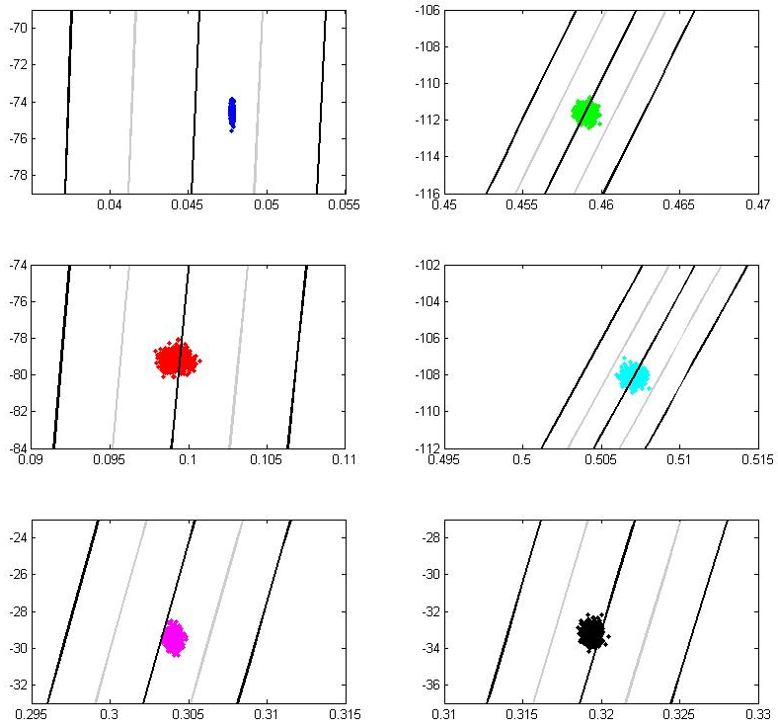
How to Determine Age Error?
5,500 yrBP
81,000 yrBP
X-axis:
²³⁰U/²³⁸U Activity
Y-axis:
δ²³⁴U measured
12,500 yrBP
94,000 yrBP
41,000 yrBP
44,000 yrBP

Slide 11
What Next?
Correct for the amount of initial non-radiogenic daughter isotope in the sample (²³⁰Th)
Requires the initial ratio of ²³⁰Th/²³²Th of the stalagmite to be known
Analyze 3 or more samples of the same age with variable ²³²Th content
Calculate a least-squares regression of the data on a pair of isotope ratio diagrams that completely define the ²³⁸U- ²³⁴U-²³⁰Th- ²³²Th system
Use a procedure that weighs analytical errors and error correlations of the individual data points (Ludwig and Titterington, 1994)

