Slide 1
Submarine Transit From Groton to the Deep Blue Sea
Joshua Wingfield
26 April 2011
EAS-4480

Slide 2
Groton, CT
Base is located in New London, CT on Thames River
“Home of the Submarine Force” & “Submarine Capital of the World”
14 in service submarines

Slide 3
Buoys
Eastern Long Island
Nantucket
Location: 41.263N 72.067W
University of Connecticut
Water Depth: 23m
Barometer: Sea Level
Temperature: 3.5m above
Sea Temperature: 1m below
Location: 40.502N 69.247W
54NM SE
National Data Buoy Center
Water Depth: 65.8m
Barometer: Sea Level
Temperature: 4m above
Sea Temperature: .6m below

Slide 4
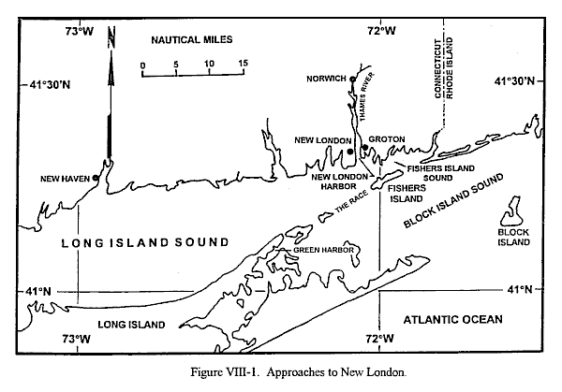

Slide 5
Raw Data

Slide 6
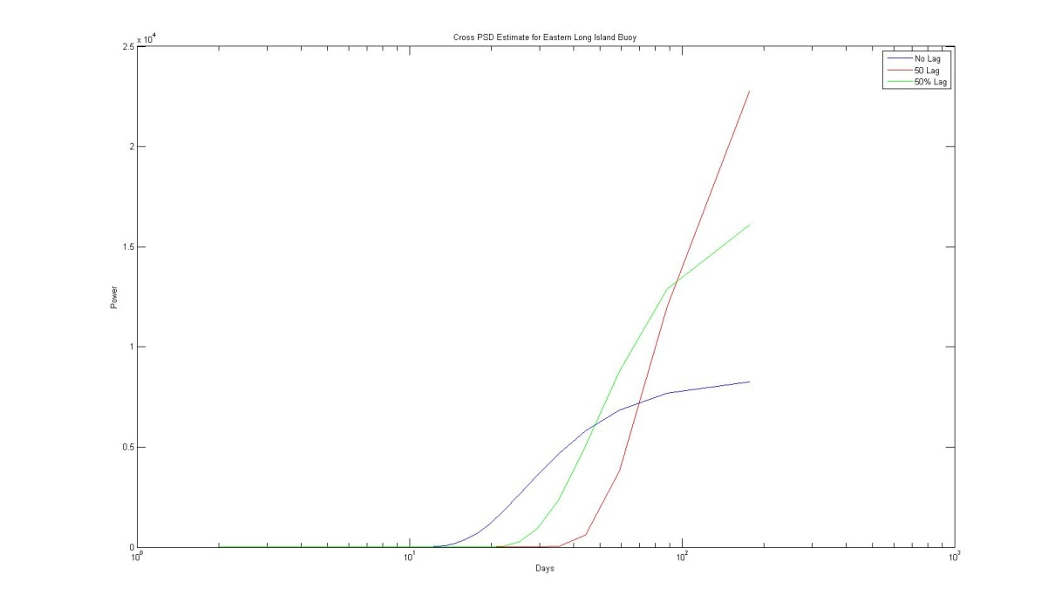
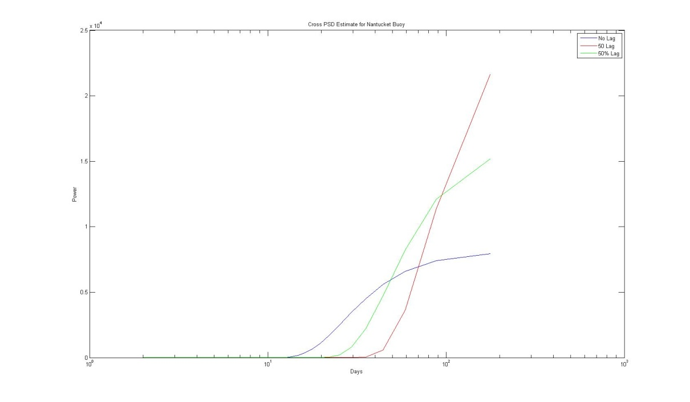
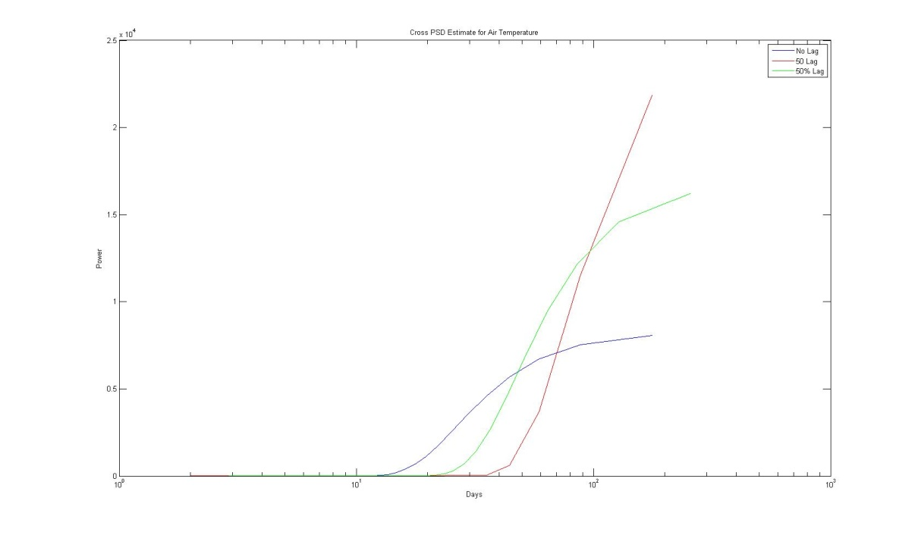
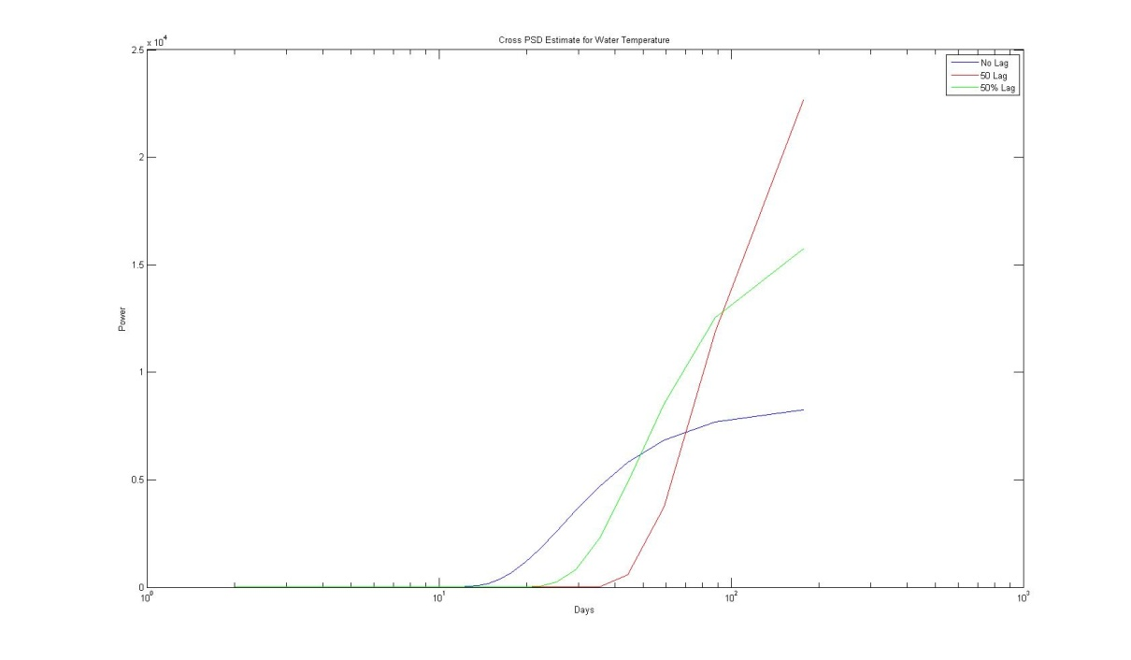
RAW PSD’s

Slide 7
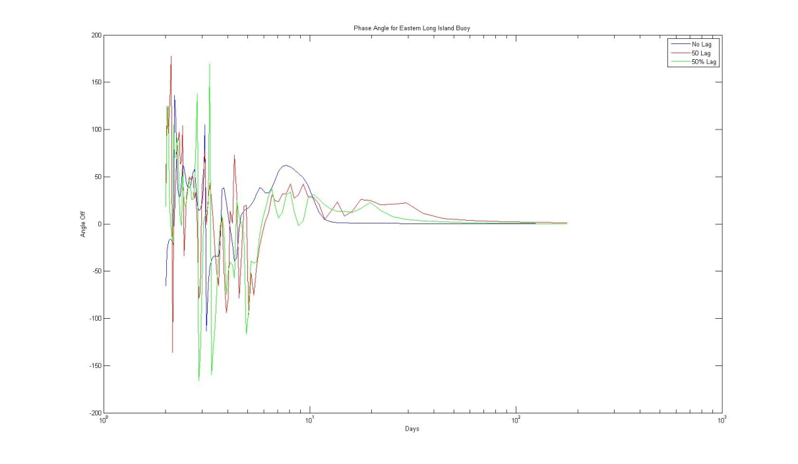
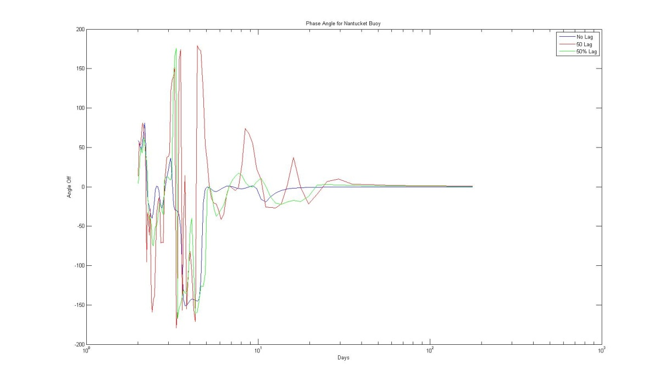
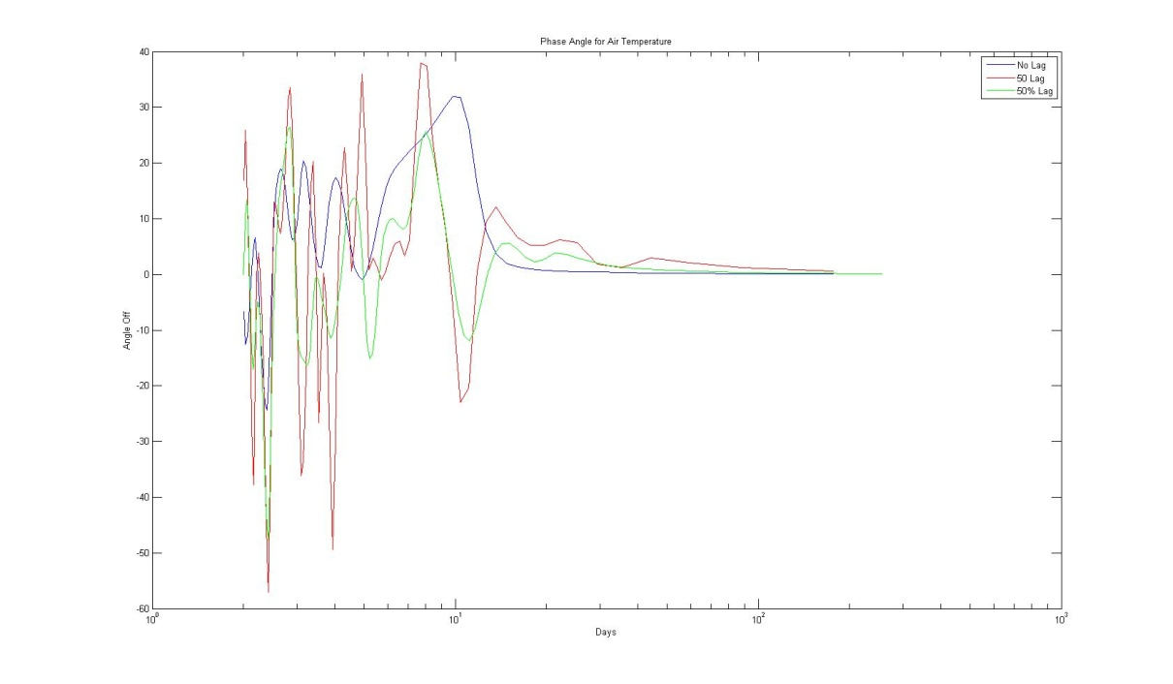
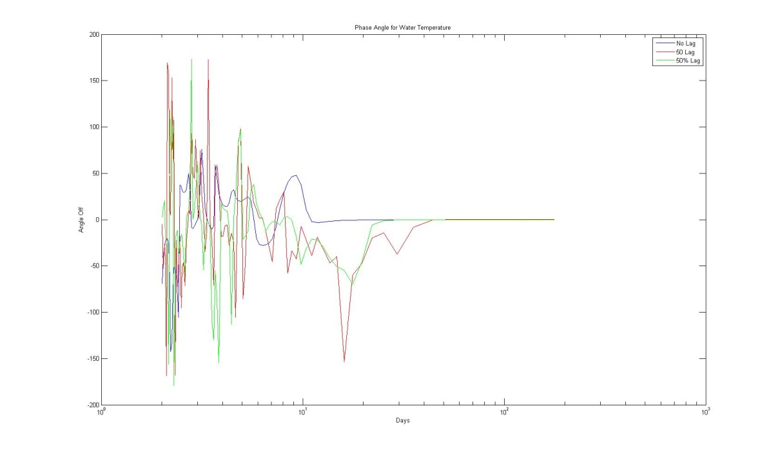
Raw Phase Angles

Slide 8
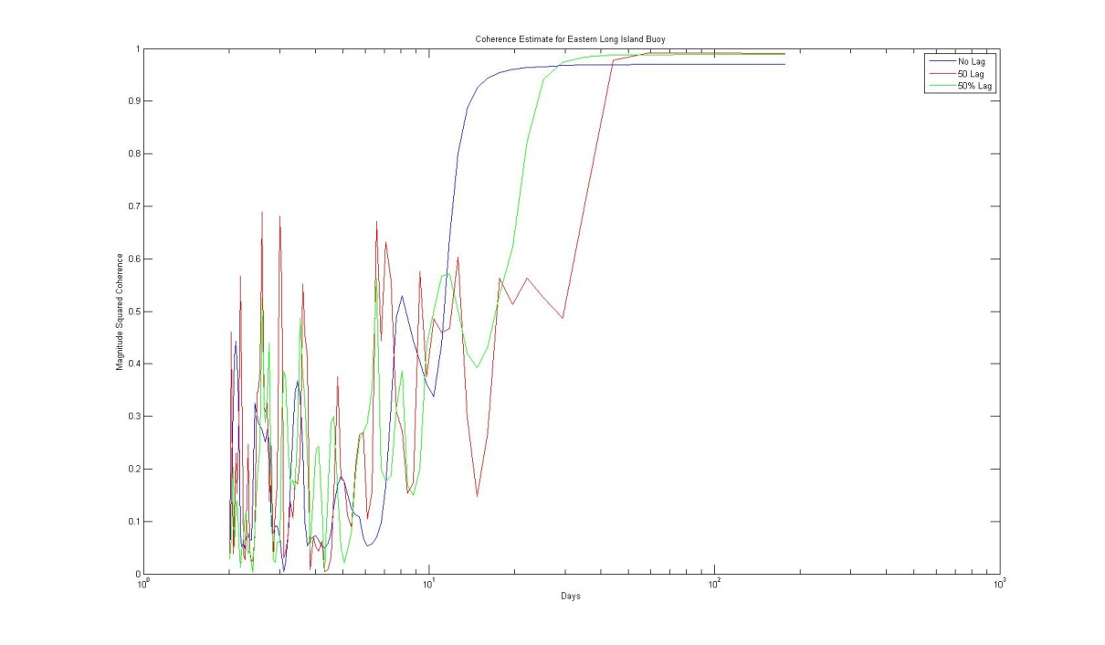
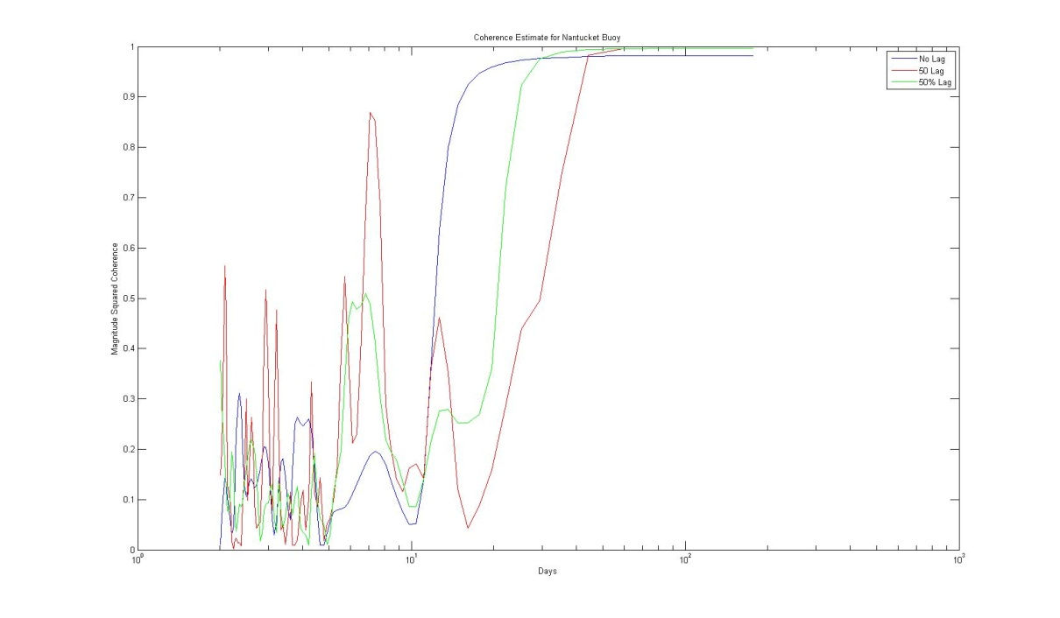
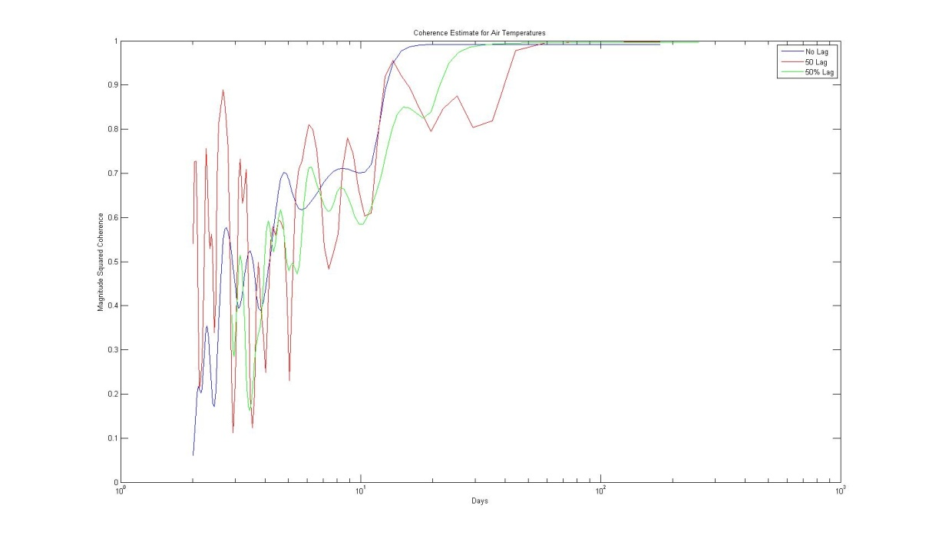
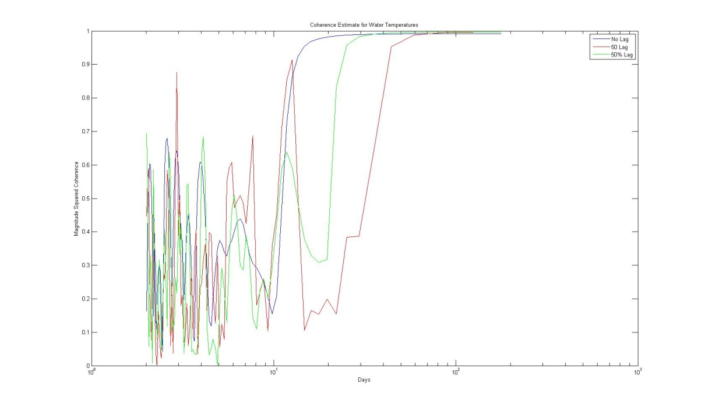
Raw Coherence

Slide 9
Detrended Data

Slide 10
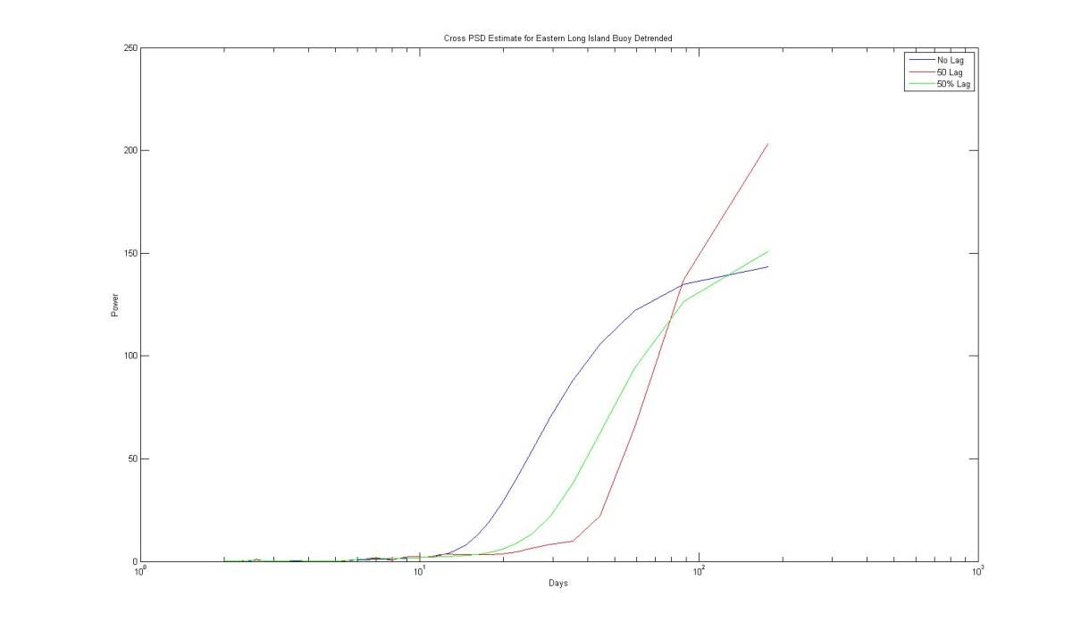
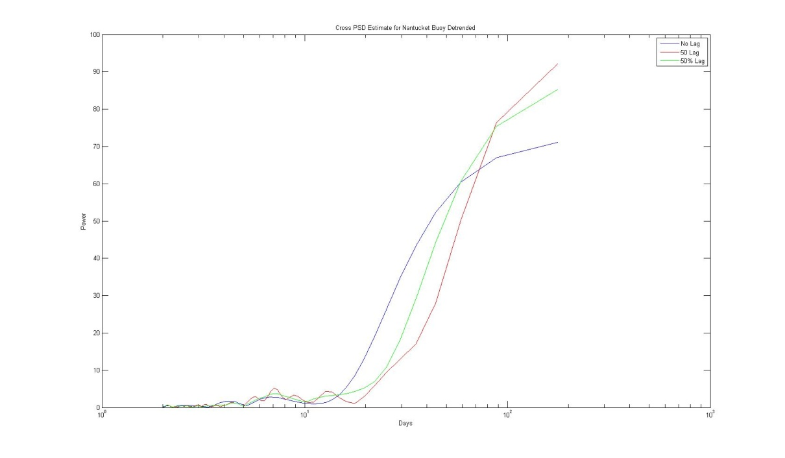
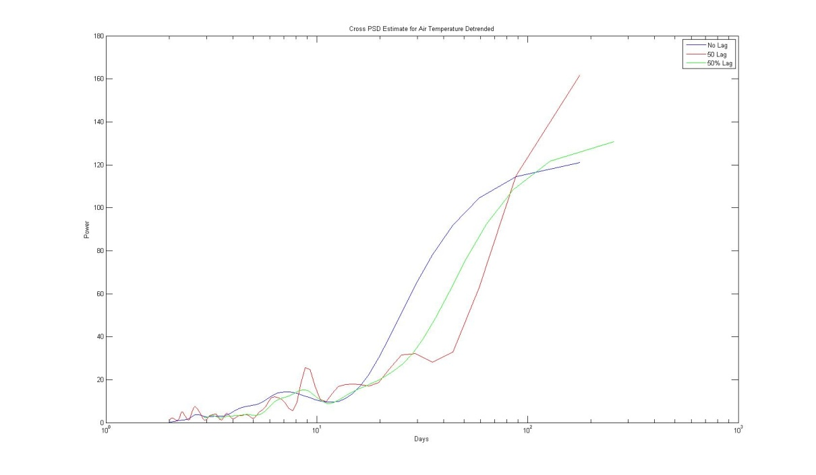
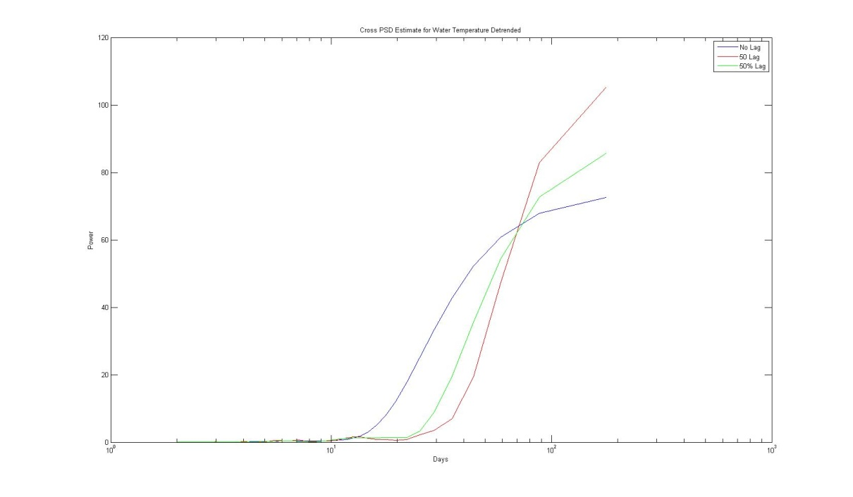
Detrended PSD’s

Slide 11
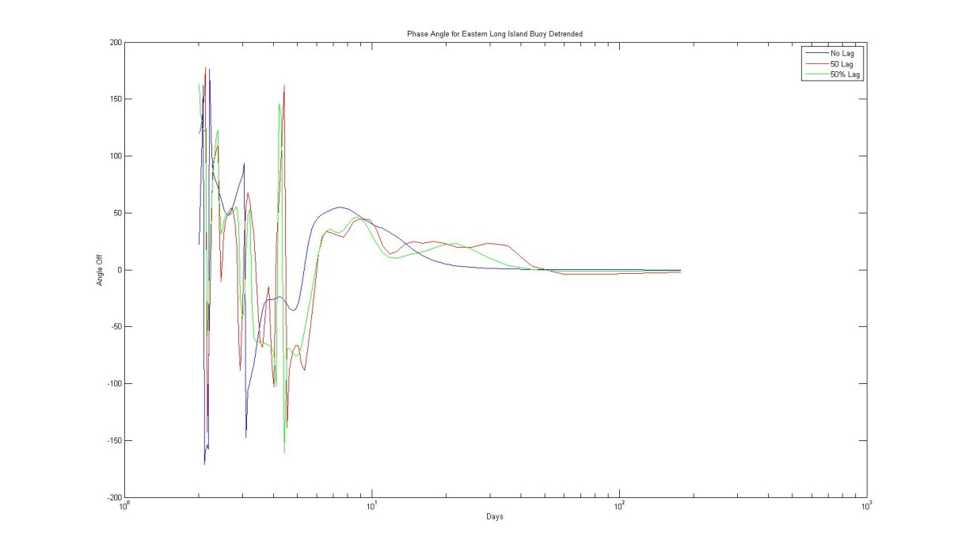
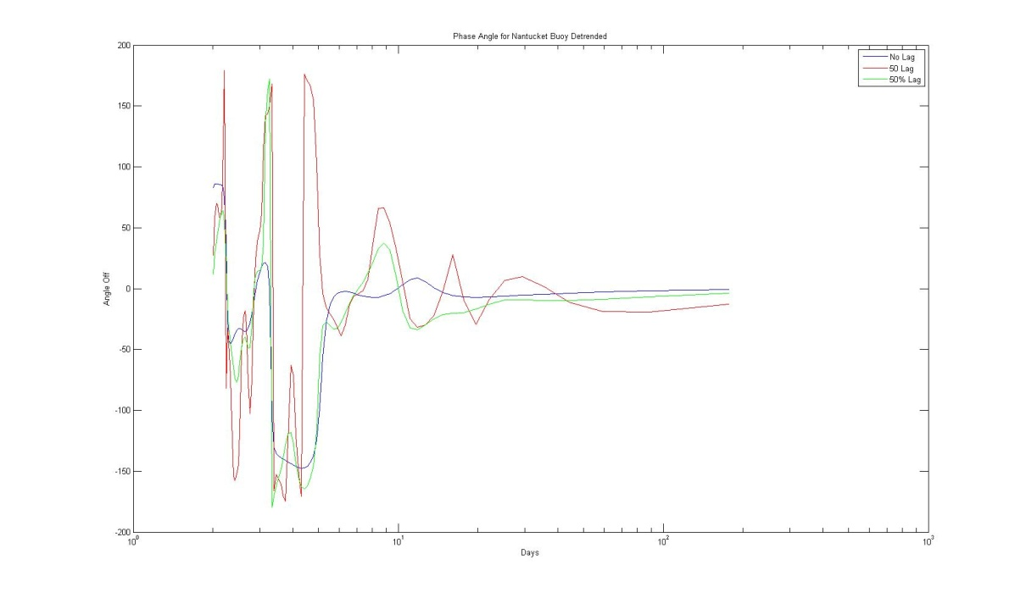
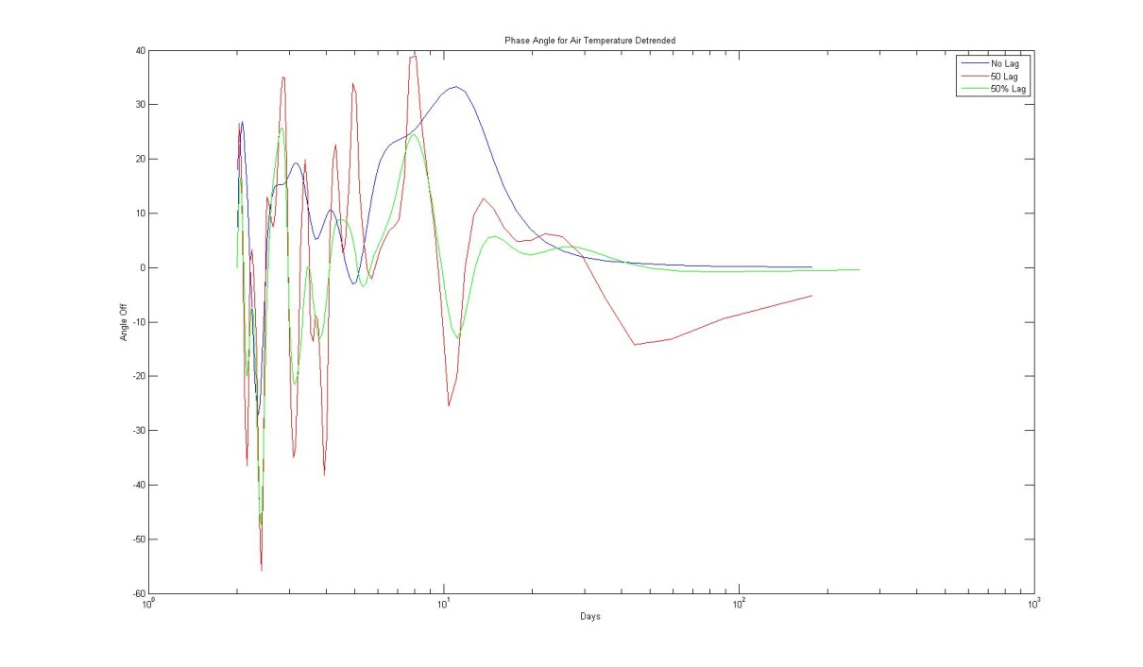
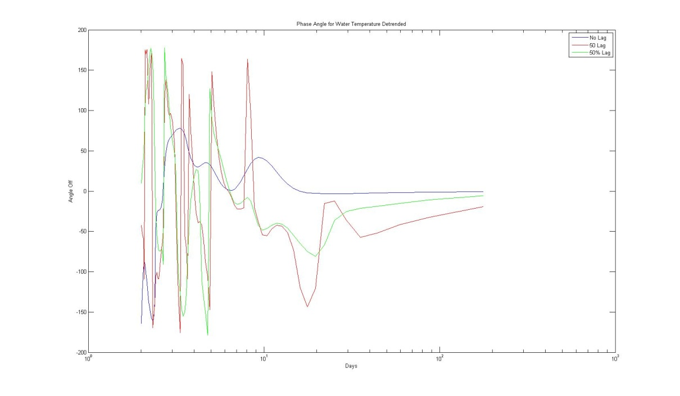
Detrended Phase Angles

Slide 12
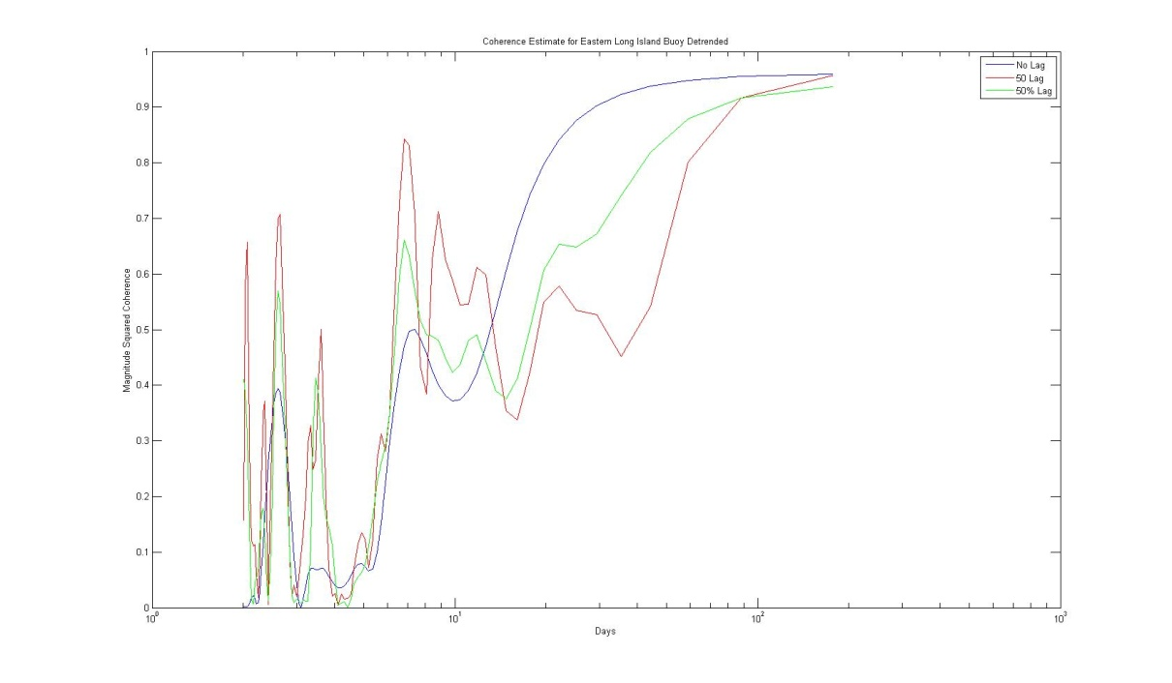
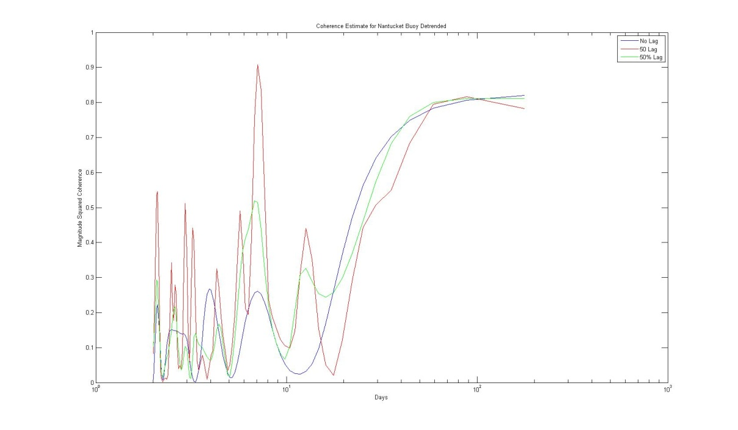
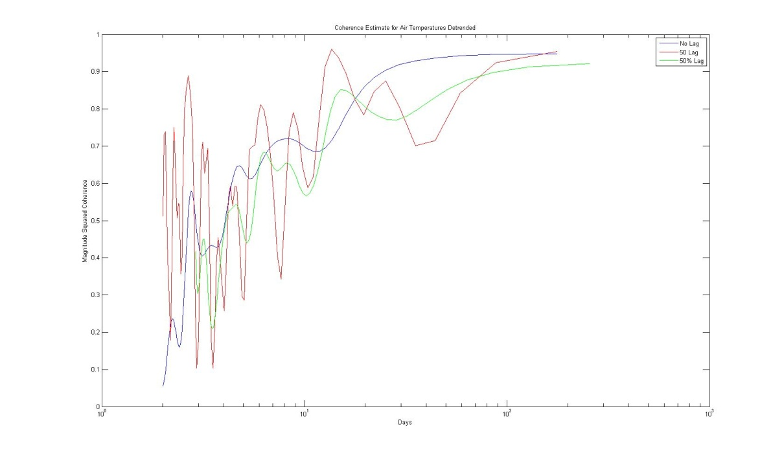
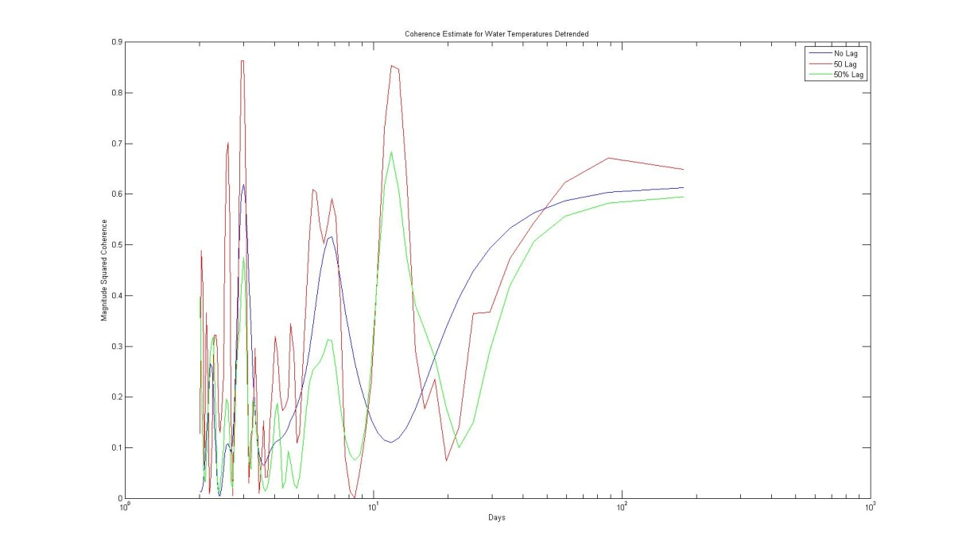
Detrended Coherence

Slide 13
Conclusions
Both Data sets show it beneficial to transit the area in the Summer.
There is cycle shown using the raw data.
There is a 7 to 10 day cycle with low power.

