Slide 1
Particle Aggregation
Afshan Shaikh
EAS 4480
Spring 2012
April 26, 2012

Slide 2
Importance
Ash plumes of explosive volcanism can reach upper atmosphere
Ash plume travel distance dependent on ash aggregation
Also case for volcanic vents
Pyroclastic density currents
Better understanding of eruptive flows
Help predict after math of volcanic eruptions

Slide 3
http://www.boston.com/bigpicture/2011/06/volcano_erupts_in_chile.html
Notes:
600 miles south
10 miles high
puyehue

Slide 4
http://www.boston.com/bigpicture/2011/06/volcano_erupts_in_chile.html

Slide 5
Methods
First experiment (referred to as ‘old data’ later’)
Laser sheet
Data processed by matlab
Ash and Ballontini
Second experiment
Evacuate to simulate lower pressures
Hand processed (yay)
Old experiment set up, Image obtained from Jen Telling

Slide 6
Formulas and Assumptions
CKE ( Collisional Kinetic Energy)
Calculated differently for both experiments
Energy of the collision
Assumed densities of the ash was 2650 kg/m³
Perfect sphere for volume calculation
Diameter
Reduced Diameter vs. Assumed Diameter
Aggregation Efficiency calculation

Slide 7
Analysis
Used Regression analysis (RH and CKE)
For linear regression, error structures calculated and plotted (RH)
Correlation Coefficient (RH and CKE)
Boot Strap for Correlation Coefficients (RH and CKE)
Comparison of actual vs. bootstrap mean

Slide 8
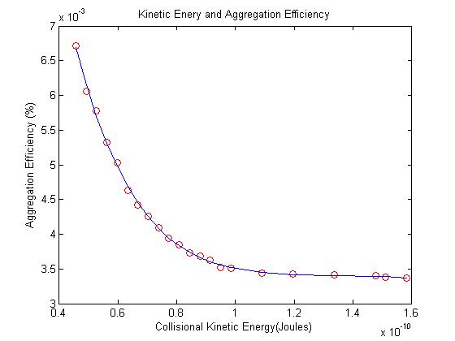
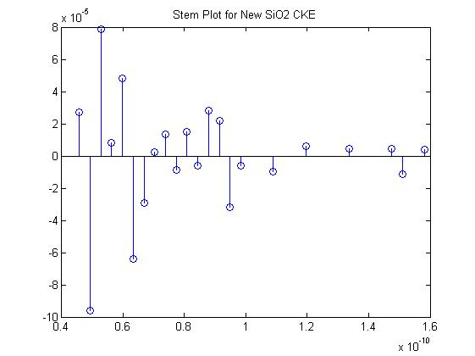

Slide 9
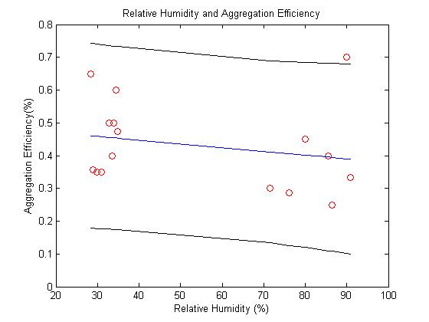
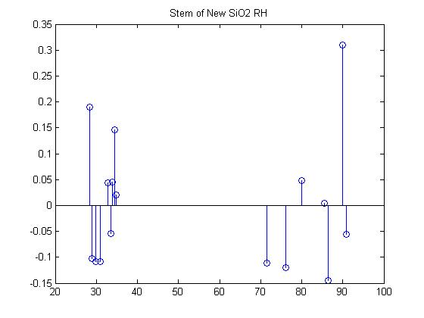

Slide 11
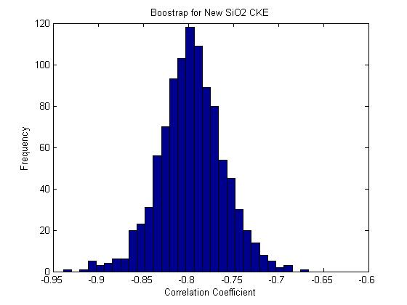
Boot Strap Correlation Coefficients (CKE)
CorrCoef
R = -0.7858
P = .0
BootStrap
R = 0.7972
CorrCoef
R = -0.5659
P = .005
BootStrap
R = 0.609

Slide 12
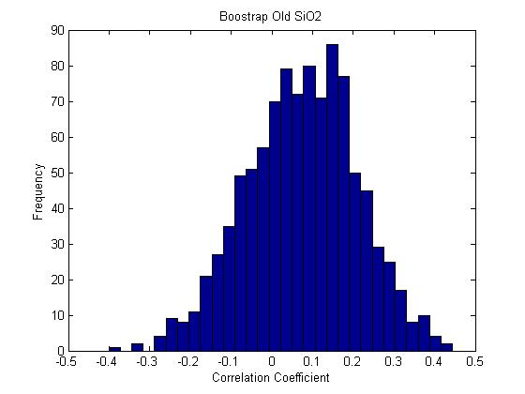
Boot Strap Correlation Coefficient (RH)
CorrCoef
R = -.2704
P = ..4499
BootStrap
R = -0.2798
CorrCoef
R = -.2290
P = .0.3936
BootStrap
R = -0.2461
CorrCoef
R = 0.0837
P = .5892
BootStrap
R = 0.0807

Slide 13
Conclusion
No significant correlation between RH and Aggregation Efficiency
Definite nonlinear regression Aggregation Efficiency and CKE

