Slide 1
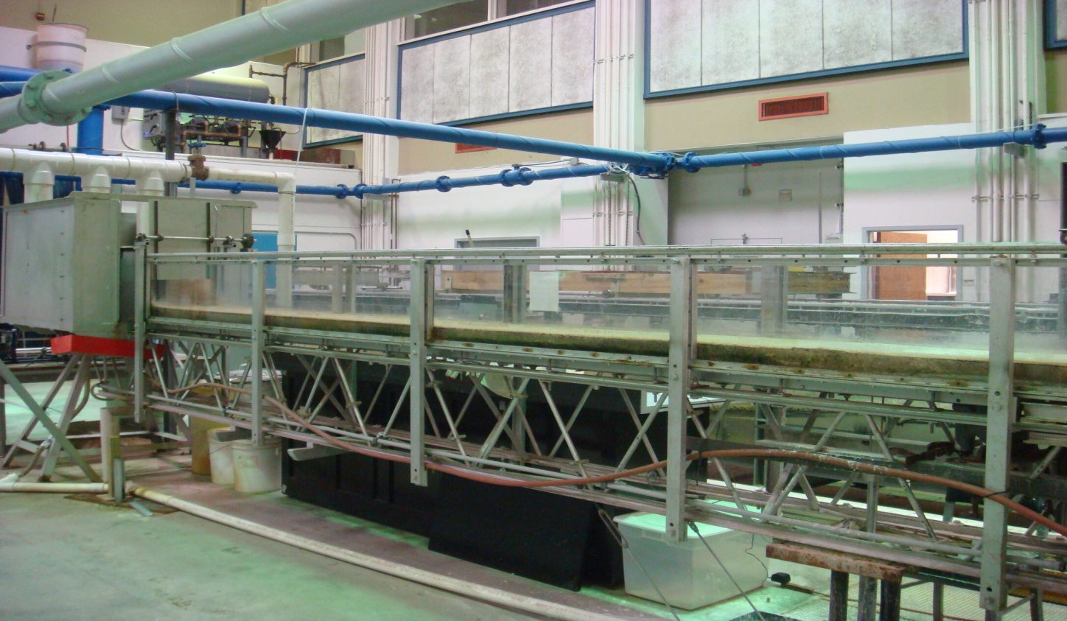
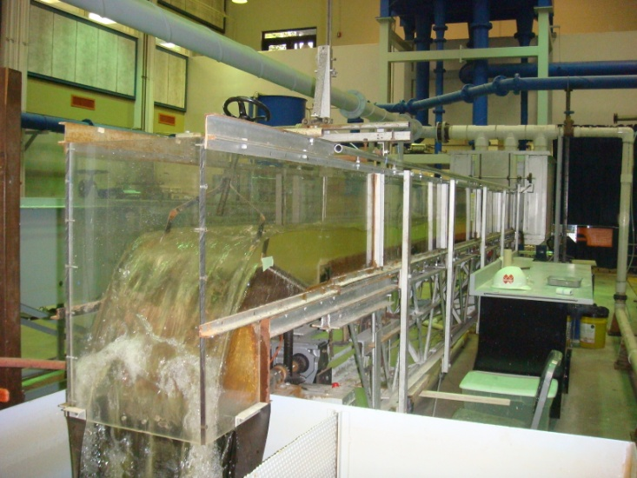
EAS4480 Environ. Data Analysis Project Effects of Physical Properties on Critical Shear Stress of Fine Sediments
Becky (Yung-Chieh) Wang
April 24th 2012

Slide 2
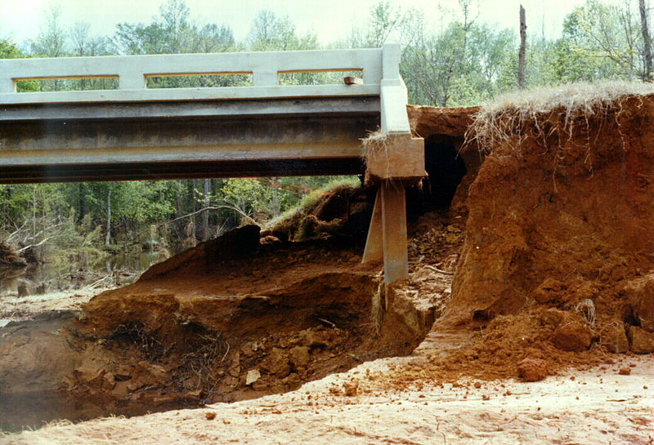
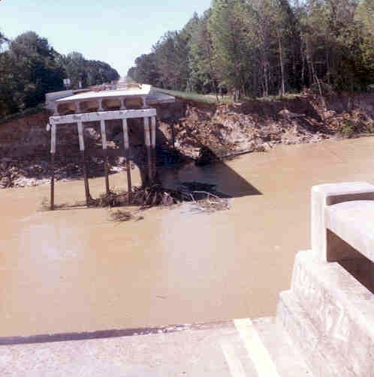
Introduction
Sediment degradation, aggradation, transport → River morphology and evolution.
Scours around bridge foundations → Undermining → Construction failure.
Bridge failure in Mississippi, caused by the April 1974 flood on the Homochitto River.
Abutment scour
Source: USGS (Colson, 1979)
Source: USGS (1974)
Notes:
Contraction and local scour

Slide 3
Introduction
Stability of river beds
Hydrodynamic forces
Resistive forces
Gravity,
interparticle interactions
Oppose Erosion
Flow, turbulence, vortices
Cause Erosion
Estimate/ Predict the erodibility of fine (cohesive) sediments?
Critical shear stress: min. bed (applied) shear stress (friction) required to initiate erosion.
Notes:
By investigating the critical shear stress & yield stress
Thus, yield stress can be considered as an indication of critical shear stress needed to initiate the sediment erosion.
In fine sediments, interparticle forces dominate the erodibility ← strongly related to particle association (structure)

Slide 4
Objectives & Approach
Determine the physical properties of clay-silt mixtures
Geotechnical tests (bulk density: water content; d50: hydrometer; Shields parameter; d*)
Determine critical shear stress
Hydraulic flume experiments
Identify and quantify the relationships between critical shear stress (or Shields parameter) and physical properties of fine sediments.
Least-squares linear regression (single- or multi-variables)
Submodel selection: bi-direction stepwise (AIC criterion)
Residual analysis (Chi2 test: Normal distribution)
Model reproducibility: Leave-one-out cross-validation (LOOCV)

Slide 5
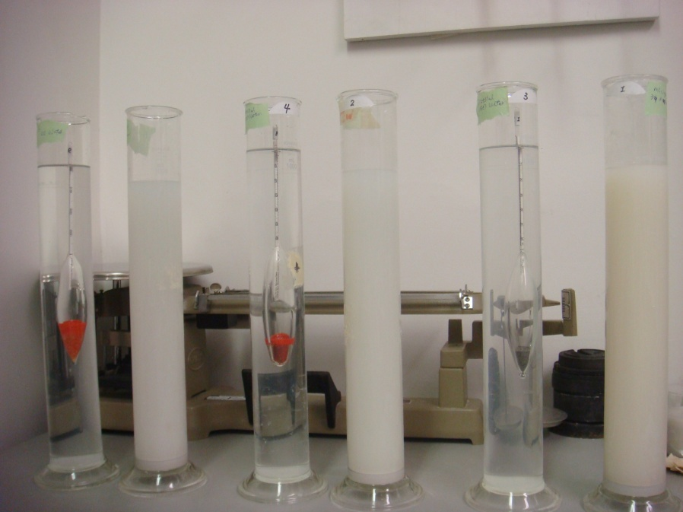
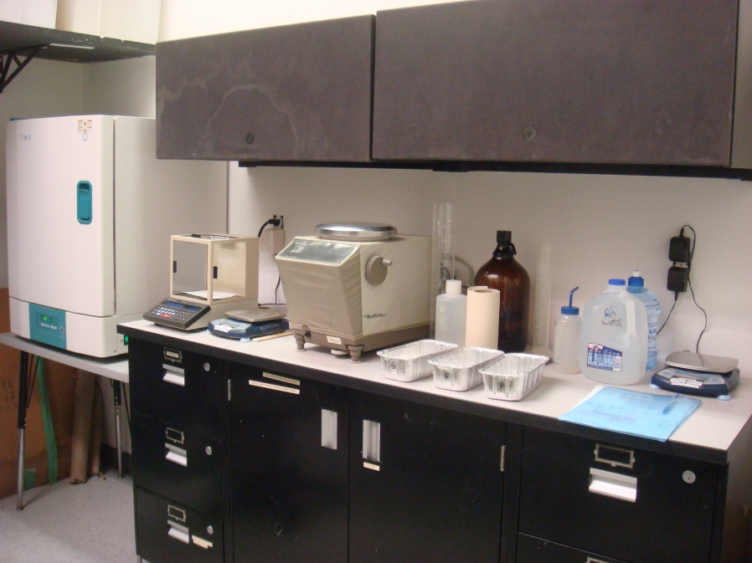
Data Collection-Material & Geotechnical test
Georgia kaolin (Hydrite Flat D; Dry Branch Kaolin Company)
Industrial ground silica (SIL-COSIL 106; US Silica Company)
Geotechnical tests:

Slide 6
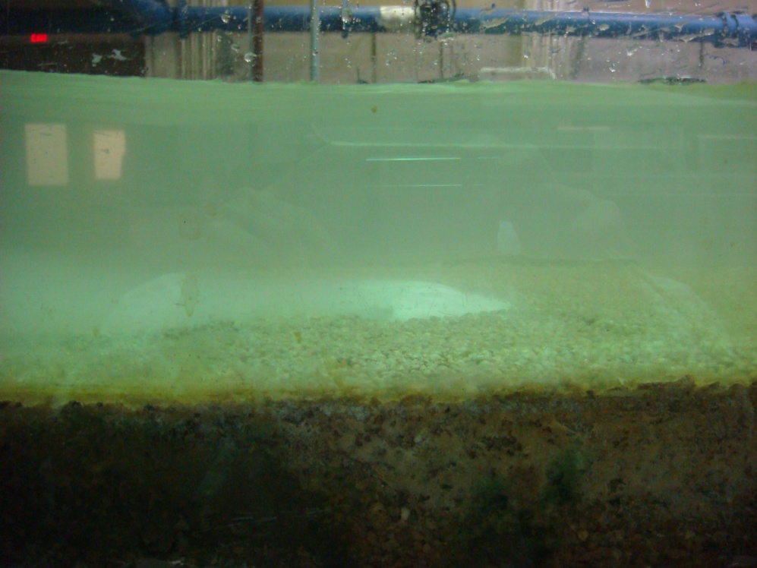
Data Collection-Hydraulic Flume
d₅₀=3.3mm fixed gravel bed → fully-rough turbulent flow conditions

Slide 7
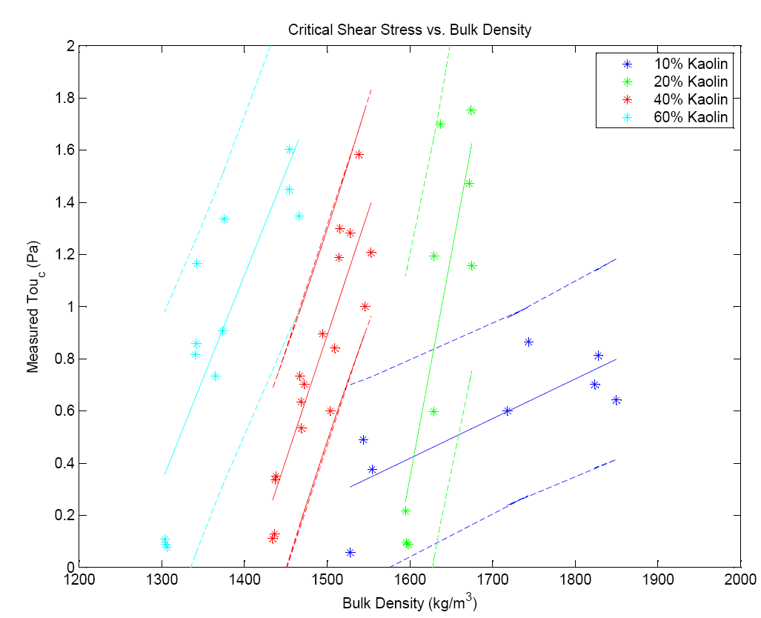
LS Linear Regression
 | Slope | Intercept | R^2
10% Kaolin | 0.0015 | -2.0188 | 0.6403
20% Kaolin | 0.0172 | -27.1234 | 0.7227
40% Kaolin | 0.0096 | -13.4532 | 0.8033
60% Kaolin | 0.0079 | -9.9605 | 0.7469

Slide 8
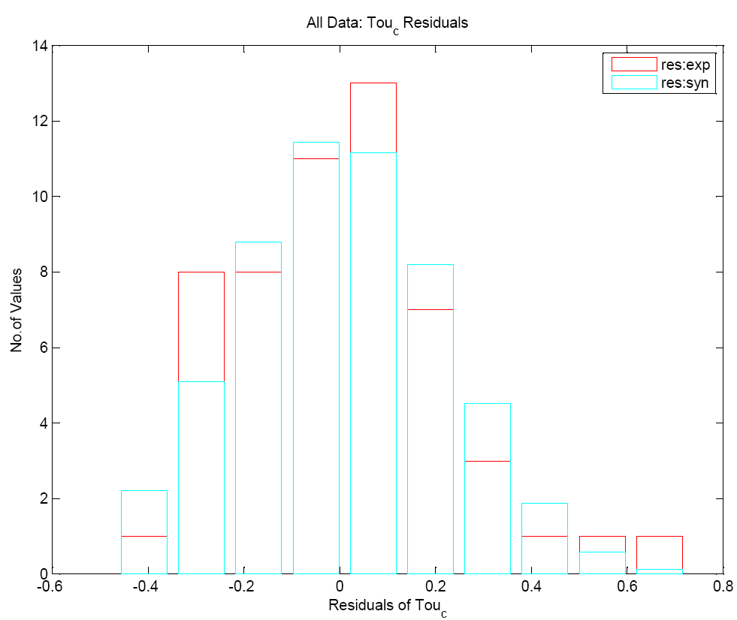
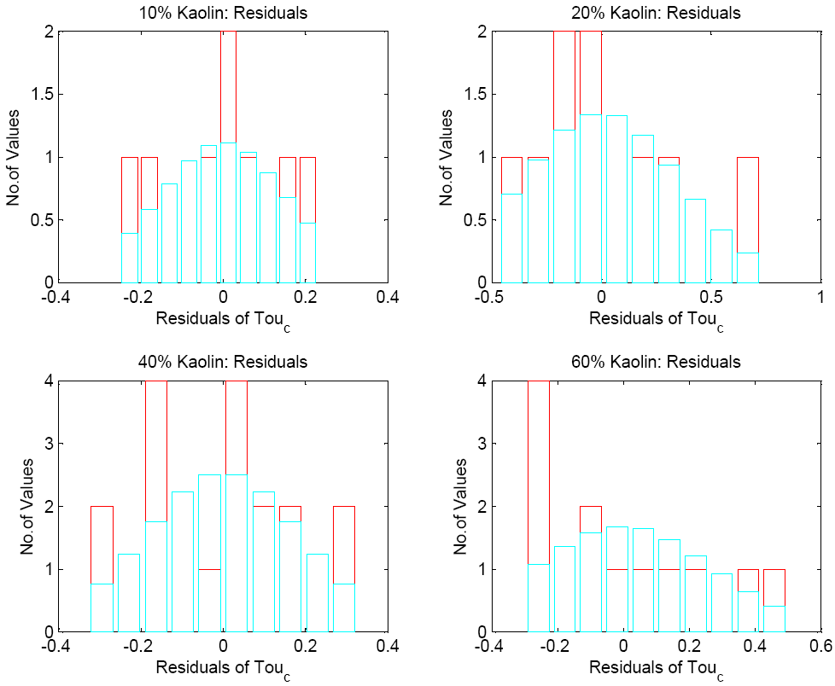
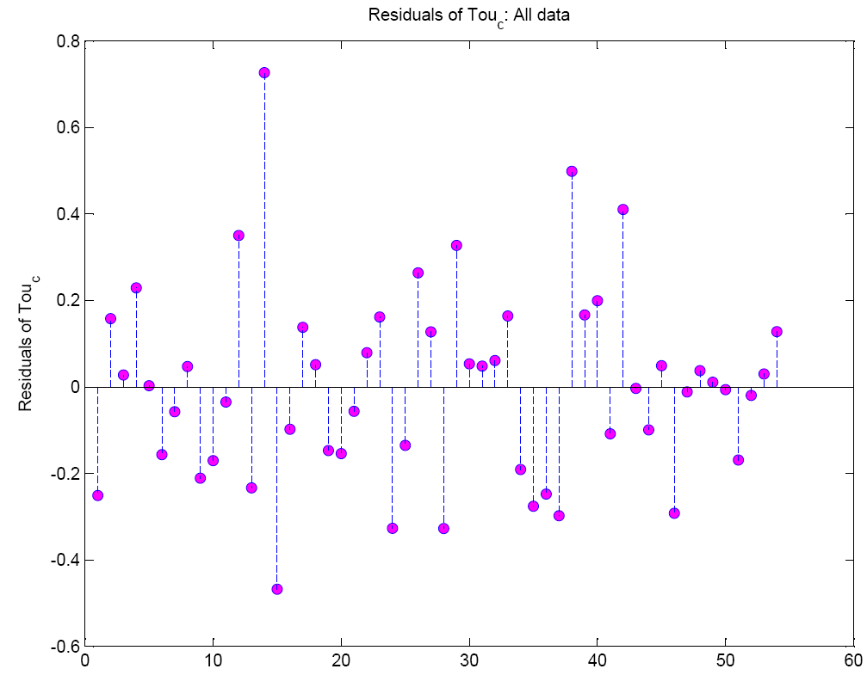
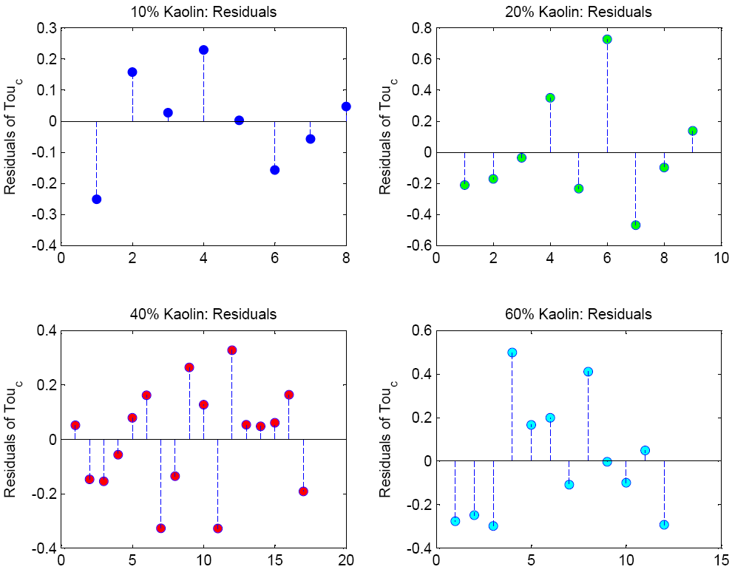
Residual Analysis
Chi2 tests: All data~ Normal distribution

Slide 9
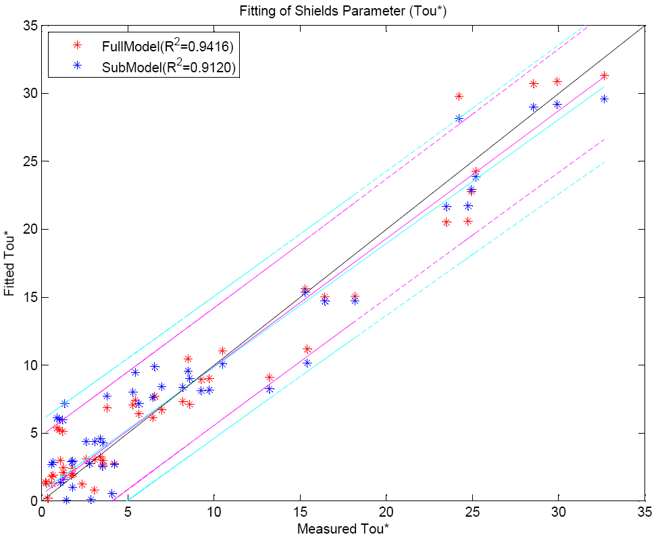
Multivariable Linear Regression
 | x variables
Full Model | 8 (redundant information)
Sub Model | 3 (Bulk density, SG, D50)
Submodel selection: Bi-direction stepwise-add or drop variables to get lowest AIC value)
& Physical meaning judgment

Slide 10
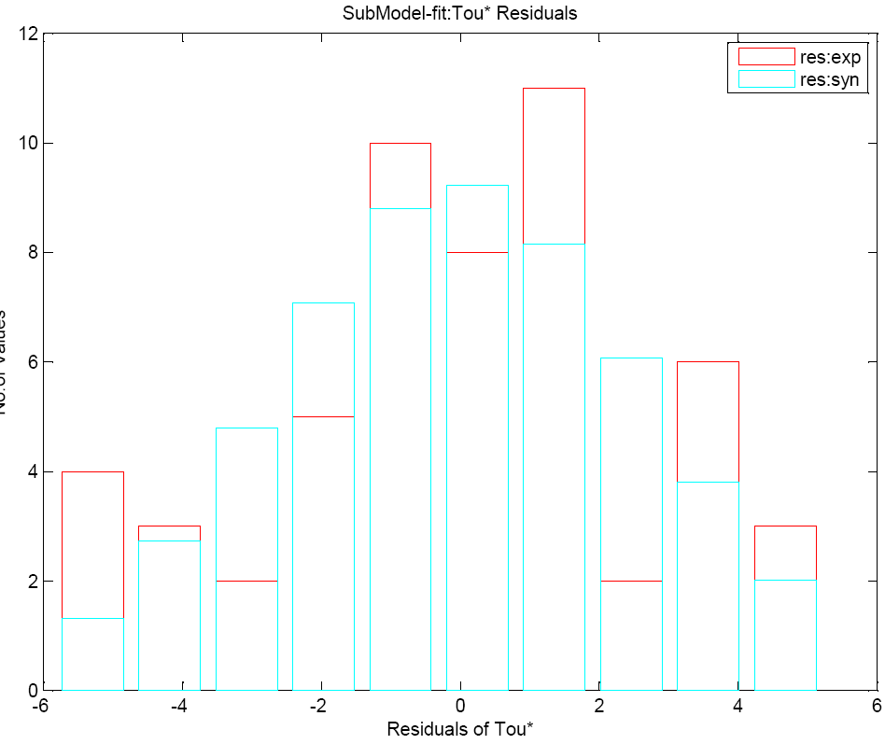
Residual Analysis
Chi2 test: residuals~ Normal distribution

Slide 11
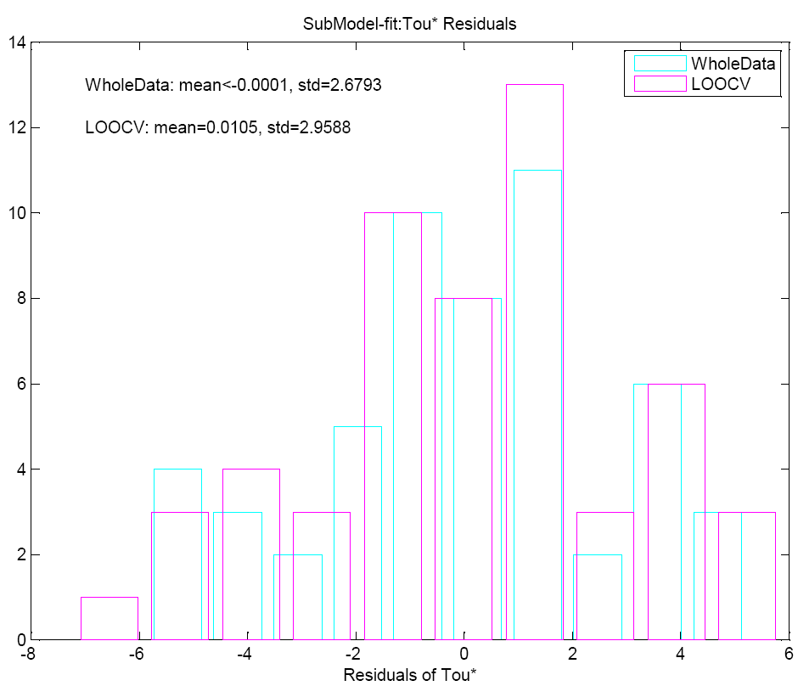
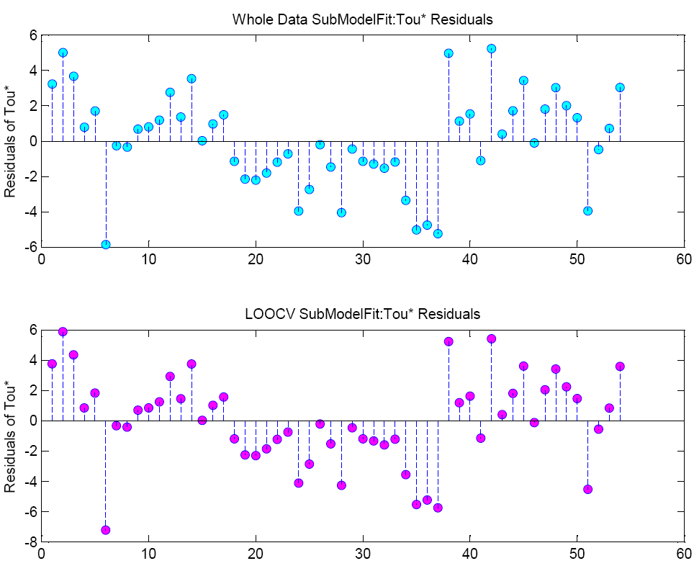
Leave-One-Out Cross Validation

Slide 12
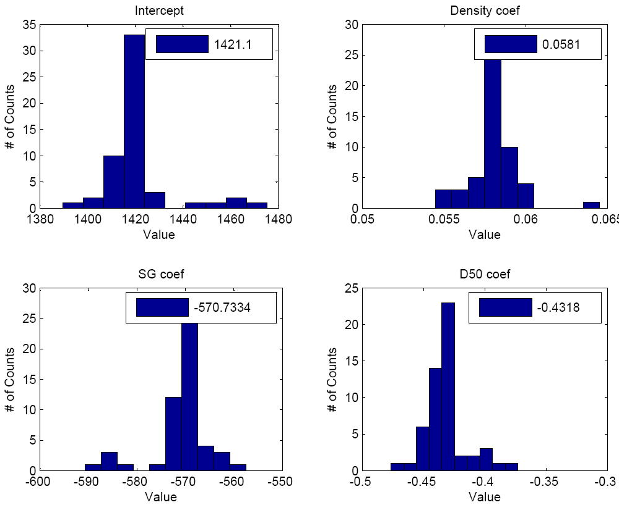
Jackknife: Regression Coefficients

Slide 13
Conclusion
With the information of kaolin (clay) content, the critical shear stress of fine sediments can be estimated by the bulk density.
For engineering application, Shields parameter (dimensionless form of τ_{c}) can be obtained from sediment properties (bulk density, d50, SG) without the erosion flume tests.
Cross validation (LOOCV & Jackknife) of the multivariable least-squares linear regression model shows the reproducibility the model and the absence of outliers which distort the regression coefficients.
13

Slide 14
Reference
Hobson, P. M. (2008). "Rheologic and flume erosion characteristics of Georgia sediments from bridge foundations." Master Thesis, Georgia Institute of Technology.
Ravisangar, V., Sturm, T. W., and Amirtharajah, A. (2005). "Influence of sediment structure on erosional strength and density of kaolinite sediment beds." J. Hydraul. Eng., 131(5), 356-365.
Sturm, T. W. (2001). Open Channel Hydraulics. Textbook series in water resources and environmental engineering, 2 Ed., McGRaw Hill, New York.
Thank you
Questions?
14

