Slide 1
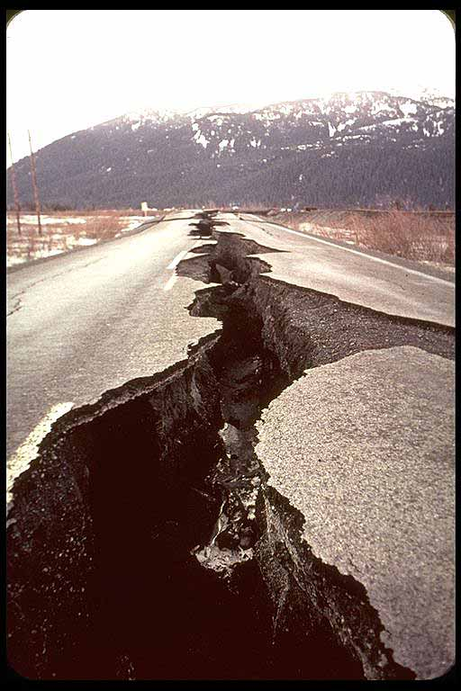
Earthquakes: Increasing Over Time?
By: Dan Arrington
EAS 4480
Spring 2012
Image obtained from: http://www.survival-goods.com/What_is_an_Earthquake_s/269.htm

Slide 2
Background Information
Richter Scale
Measures magnitude
Energy released
follows log scale:
log Es = 4.8 + 1.5Ms
Es is the energy
released in joules.
Ms is the magnitude of the
earthquake.
Magnitude | Description | Earthquake effects | Frequency of occurrence
Less than 2.0 | Micro | Micro earthquakes, not felt.^{[14]} | Continual
2.0–2.9 | Minor | Generally not felt, but recorded. | 1,300,000 per year (est.)
3.0–3.9 |  | Often felt, but rarely causes damage. | 130,000 per year (est.)
4.0–4.9 | Light | Noticeable shaking of indoor items, rattling noises. Significant damage unlikely. | 13,000 per year (est.)
5.0–5.9 | Moderate | Can cause major damage to poorly constructed buildings over small regions. At most slight damage to well-designed buildings. | 1,319 per year
6.0–6.9 | Strong | Can be destructive in areas up to about 160 kilometres (99 mi) across in populated areas. | 134 per year
7.0–7.9 | Major | Can cause serious damage over larger areas. | 15 per year
8.0–8.9 | Great | Can cause serious damage in areas several hundred kilometres across. | 1 per year
9.0–9.9 |  | Devastating in areas several thousand kilometres across. | 1 per 10 years (est.)
10.0+ | Massive | Never recorded, widespread devastation across very large areas; see below for equivalent seismic energy yield. | Extremely rare (Unknown/May not be possible)
Source: http://en.wikipedia.org/wiki/Richter_magnitude_scale

Slide 3
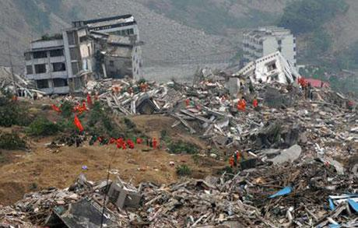
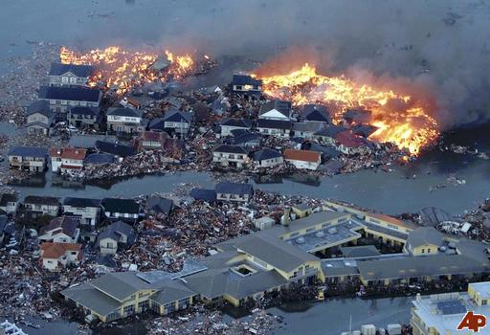
Why is it important?
Earthquakes can be deadly and cause widespread damage.
Haiti – Magnitude 7.0; 200,000+ Deaths
Japan – Magnitude 8.9; 10,000+ Deaths
Source: http://disastersstrike.blogspot.com/2011/03/haiti-compared-to-japan.html
Es = 1.995 x 10¹⁵ J
Es = 1.413 x 10¹⁸ J

Slide 4
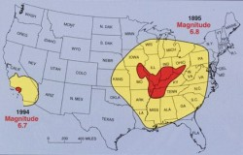
It’s About Location
The San Andreas Fault Zone is well known
The New Madrid Fault Zone is much larger
It would be a good idea to make some assessments. A few things to consider are:
Awareness of geographic location
Enforcement of building codes
Implementing warning systems
Source: http://endoftheamericandream.com/archives/is-the-new-madrid-fault-earthquake-zone-coming-to-life

Slide 5
Data
I looked at long term and short term data. I wanted to see if the numbers of earthquakes per year are increasing over time.
The long term data spans a century, from 1900-1999. I compared the first half to the second half of the century.
The short term data compares 20 year increments, 1970-1989 and 1990-2009.

Slide 6
Long Term Procedure
For the 100 years of data, I looked at major (7 to 7.9) to great (8+) earthquakes only. This is because before the 1930’s the catalog is only complete down to magnitude 7.
I plotted the data to look at trends. Then I did a least squares regression, reduced major axis regression, and principal component regression. I also calculated the correlation coefficient using the corrcoef() function and bootstrap method.
I also tested for normality of the residuals using the chi-squared test. If normal, I could apply the F-test to see if the data has equal variances. If equal, I could apply the Student’s t-test to see if the means of the data are equal.

Slide 7
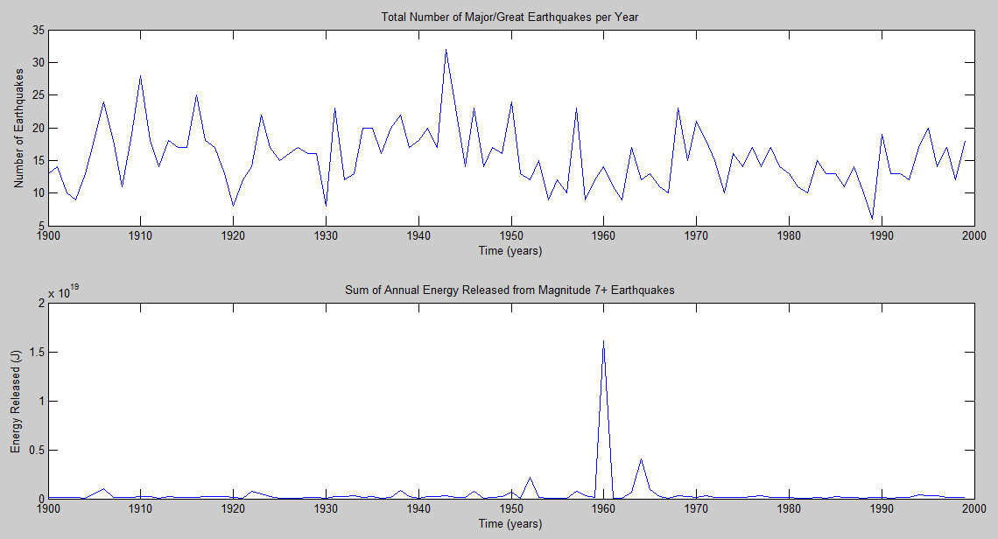
Long Term Results
1943: 32 Magnitude 7+ Earthquakes 1960: 14 Magnitude 7+ Earthquakes

Slide 8
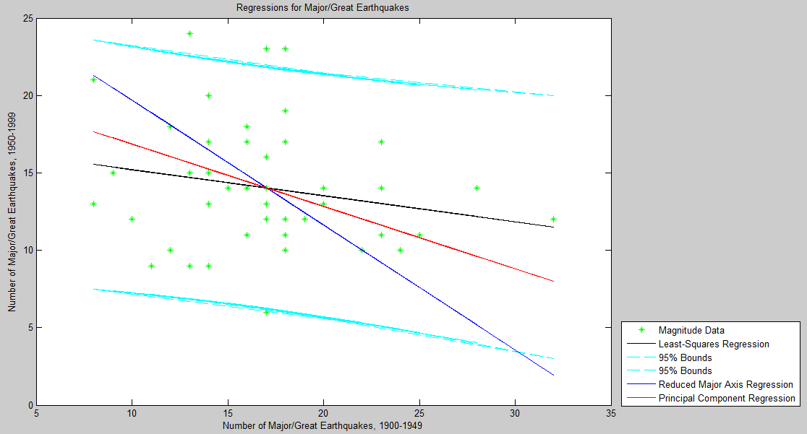
Long Term Results (cont.)
pLSQ = -0.1682
pRMAR = -0.8066
pPCR = -0.4031
Total Earthquakes, 1900-1949: 852
Total Earthquakes, 1950-1999: 701

Slide 9
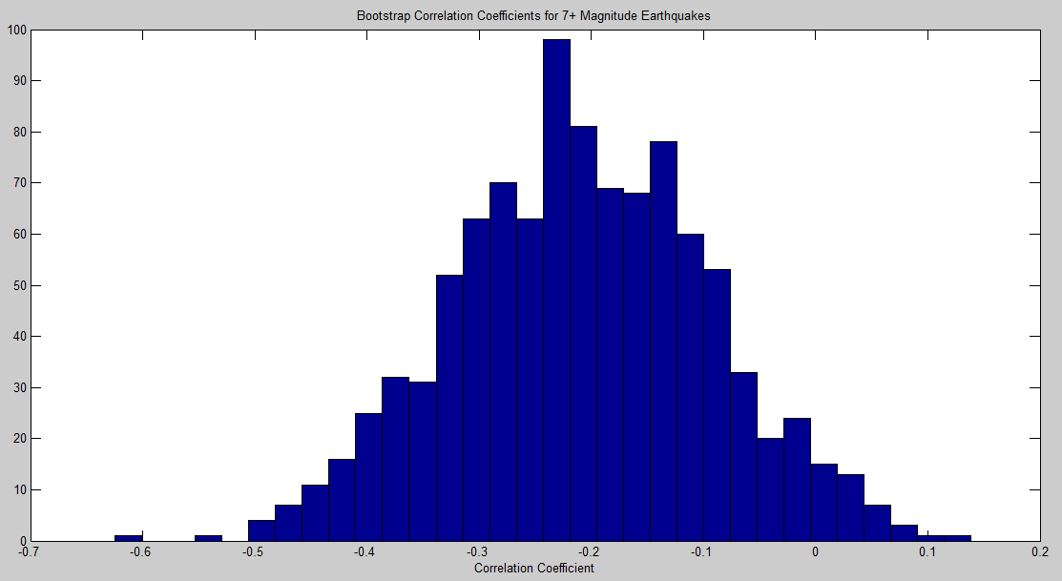
Long Term Results (cont.)
Mean r = -0.2090
Using corrcoef()
r = -0.2085
p = 0.1462
95% Confidence
rlow = -0.4601
rhigh = 0.0742
Result
Insignificant
Small Correlation

Slide 10
Long Term Results (cont.)
Chi-squared value: 14.9340
Critical Chi-squared value: 14.0671
Data doesn’t follow a normal distribution.
F-test can’t be applied
Student’s t-test can’t be applied

Slide 11
Short Term Procedure
I looked at major to great earthquakes and plotted the data. I did all of the same regressions here as I did for long term.
I calculated the correlation coefficient using the corrcoef() function and bootstrap method.
Finally, applied the Chi-Squared test to check for normality and see if other tests could be applied.

Slide 12
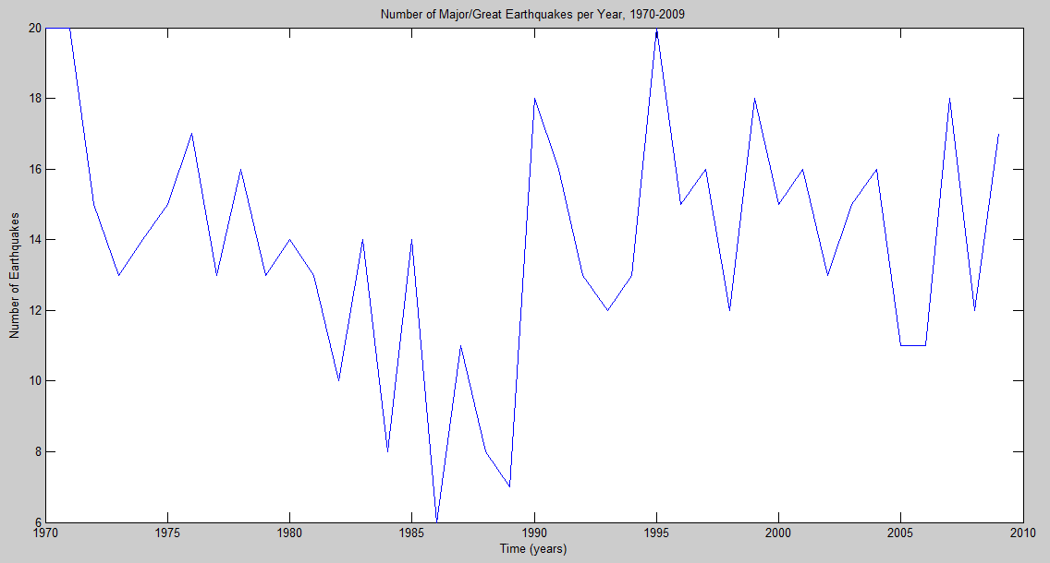
Short Term Results

Slide 13
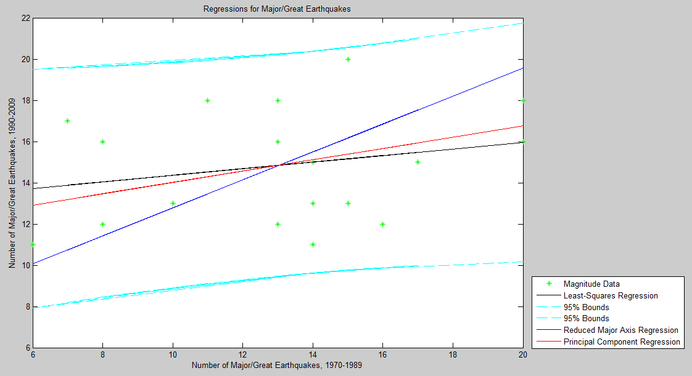
Short Term Results (cont.)
pLSQ = 0.1596
pRMAR = 0.6793
pPCR = 0.2740
Total Earthquakes, 1970-1989: 261
Total Earthquakes, 1990-2009: 297

Slide 14
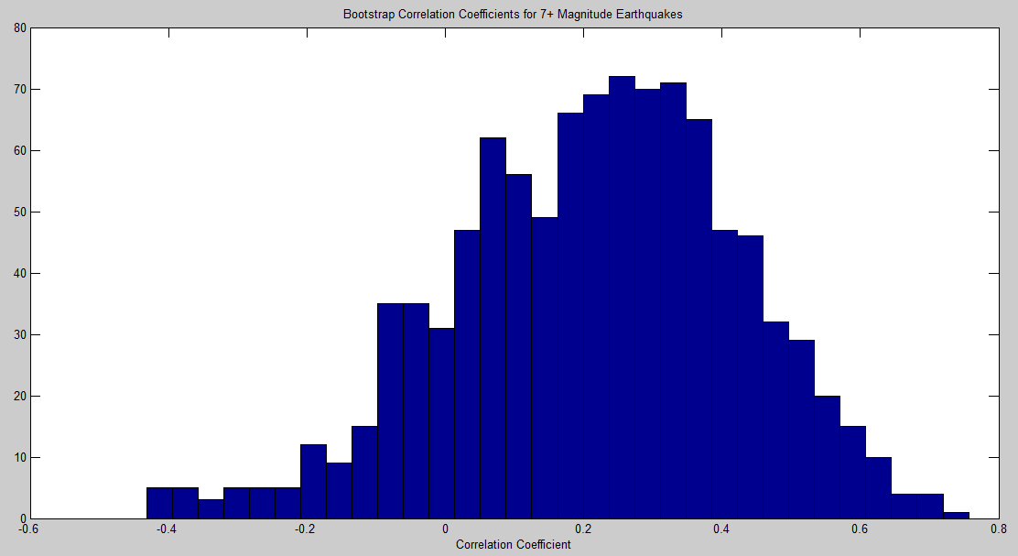
Short Term Results (cont.)
Mean r = 0.2150
Using corrcoef()
r = 0.2349
p = 0.3188
95% Confidence
rlow = -0.2317
rhigh = 0.6136
Result
Insignificant
Small Correlation

Slide 15
Short Term Results (cont.)
Chi-Squared value: 8.1197
Critical Chi-Squared value: 14.0671
F value: 2.1674
Critical F value: 2.1683
h 0
% Significance for t: 0.0926
95% Confidence Interval: [-3.9117 0.3117]

Slide 16
Conclusions
Based on the long term results, there is not an increasing trend in the number of major and great earthquakes per year.
Based on the short term results, however, there seems to be an increasing trend.
Neither long term or short term results have a large correlation.
I feel that the number of major and great earthquakes occurring each year follow a pattern, and trends can be found based on what time periods you compare.

Slide 17
Questions?

Slide 18
Sources
Data Sources:
http://earthquake.usgs.gov/research/data/centennial.php
http://www.johnstonsarchive.net/other/quake1.html
Other Sources:
http://en.wikipedia.org/wiki/Richter_magnitude_scale
http://earthquake.usgs.gov/learn/faq/?faqID=33
http://www.survival-goods.com/What_is_an_Earthquake_s/269.htm
http://disastersstrike.blogspot.com/2011/03/haiti-compared-to-japan.html
http://endoftheamericandream.com/archives/is-the-new-madrid-fault-earthquake-zone-coming-to-life

