Slide 1
Impacts on Atlanta weather during winter by Central Pacific and Eastern Pacific El Nino
Rebecca Kollmeyer
EAS 4480
April 24th, 2012

Slide 2
Overview
Background of Central Pacific and Eastern Pacific El Nino
Analyze Atlanta data
Apply statistical tests to compare results
Conclusions about impacts
Overview · Background · Data · Results · Conclusion · Future

Slide 3
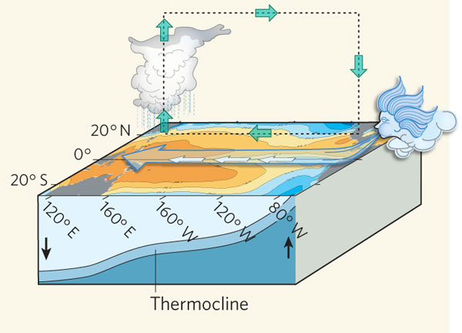
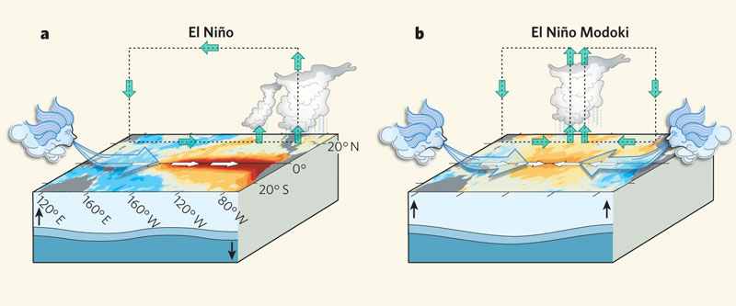
Variations of El Nino Events
EP El Nino:
Easterly winds weaken
Warmer SST
CP El Nino:
Warm SST surrounded by cold
Change in Circulation
Normal
EP
CP
Ashok, 2009 Nature
Overview · Background · Data · Results · Conclusion · Future

Slide 4
Theoretical Impacts
Eastern Pacific:
North/South impact
More rain in south
Less rain in north
Change in temp pattern
Central Pacific:
East/West impact:
More rain in East
Less rain in West
Change in temp pattern
“How much more” rain
still not fully understood
Overview · Background · Data · Results · Conclusion · Future

Slide 5
Goals
Identify years considered EP events
Identify years considered CP events
Collect temperature/precipitation data for ATL
Compare rainfall amounts during events vs. average
Compare temperature during events vs. average
Statistically analyze results and draw conclusions
Overview · Background · Data · Results · Conclusion · Future

Slide 6
Data
Data from NCDC:
El Nino 3.4 monthly index
Atlanta monthly rainfall
Atlanta monthly mean temperature
Data from literature for event dates
CP: 6 average DJF from 1950-2011
EP: 6 average DJF from 1950-2011
Overview · Background · Data · Results · Conclusion · Future

Slide 7
Methods
Chi-squared to test normal distribution
Students T-test to see if mean values are different
Linear regression to test relationship between events
Pearson Correlation to test correlation between particular event index and rainfall/temp

Slide 8
El Nino, Temperature, Rainfall
Overview · Background · Data · Results · Conclusion · Future

Slide 9
Results
Rainfall amounts not normally distributed
Temperature values normally distributed
El Nino index poorly correlated to rainfall, temp
P-values values
Between CP El Nino and rainfall: 0.9746
Between EP El Nino and rainfall: 0.8607
Between CP El Nino and temperature: 0.5922
Between EP El Nino and temperature: 0.2408
Overview · Background · Data · Results · Conclusion · Future

Slide 10
Conclusions
So far…
Limitations:
With monthly averages, no obvious connection between El Nino events and rainfall/temp
Hard to test magnitude of difference with limited data set
Lack of normal distribution
Small data set
Weak connection
Overview · Background · Data · Results · Conclusion · Future

Slide 11
Future Work
Use weekly or daily values of both El Nino and weather data to create a larger data set
Test difference of each kind of El Nino vs. total El Nino
More advanced statistics to find magnitude of difference (even if it is small)
Overview · Background · Data · Results · Conclusion · Future

Slide 12
References
Ashok, Karumuri. "The El Nino with a Difference." Nature 461 (2009): 481-84. Print.
Black, Rob X. ENSO Extratropical Impacts, Class Presentation, EAS 4470
National Climate Data Center, http://www1.ncdc.noaa.gov/
Weng, Hengyi. "Anomalous Winter Climate Conditions in the Pacific Rim during Recent El Nin˜o Modoki and El Nin˜o Events." Climate Dynamics 674th ser. 32.663 (2009). Print.

