Slide 1
Model Output Statistics (MOS) Temperature Forecast Verification JJA 2011
Benjamin Campbell
April 24 ,2012
EAS 4480

Slide 2
Goal and Motivation
Our goal - to provide accurate temperature forecast for 105 stations by removing systematic biases associated with temperature forecast data from the European Centre for Medium Range Forecast (ECMWF) Ensemble Prediction System (EPS)

Slide 3
Model Data
ECMWF Monthly Hindcast Temperature Data
Reforecast
ECMWF EPS Temperature Data
Both have horizontal resolution of 0.25 deg x 0.25 deg

Slide 4
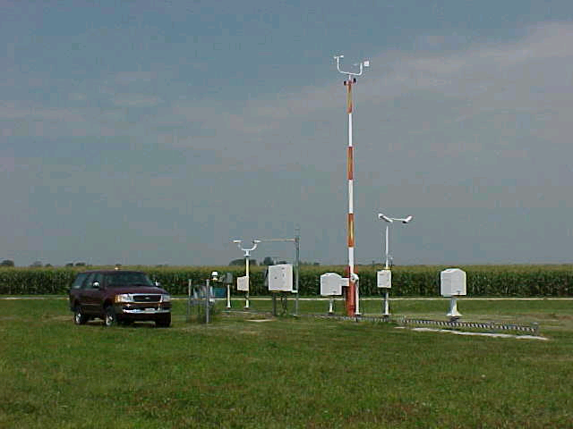
Observed Data
Temperature Data Observations from the NOAA Automated Surface Observing System (ASOS) network.
http://www.crh.noaa.gov

Slide 5
Interpolation of Model Data
Longitude (0.25 º)
Latitude (0.25 º)

Slide 6
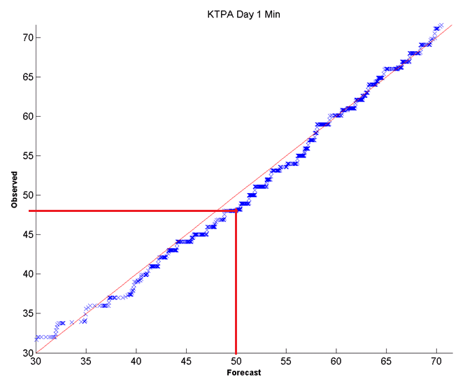
Q to Q Correction
To correct for the systematic model biases, the quantile to quantile technique was applied using historical forecast (18 years) and observations
Quantile-to-Quantile Map
Hindcast Data and Observations
ECMWF Fcst = 50 deg F
Fcst quant = 50 deg F
Observed quant = 48 deg F
New Fcst = 48 deg F

Slide 8
MOS Forecast Verification Methods
Box Plots (individual sites only)
Forecast Skill:
$1 − \frac{{MSE}_{new}}{{MSE}_{old}}$
Root mean square error
Anomaly Correlation Coefficient
Matlab: corrcoef(fcst-climo,obs-climo)
Uncertainty: Standard deviation of bootstrap
Correlation Coefficient
Matlab: corrcoef(fcst,obs)
Uncertainty: Standard deviation of bootstrap

Slide 9
KTPA Results: Box Plots

Slide 10
KTPA Results: RMSE

Slide 11
KTPA Results: ACC and CC

Slide 12
KTPA Results Skill

Slide 13
S.E. Regional Results

Slide 14
National Results: 105 Cities

Slide 15
National Results: Skill

Slide 16
Conclusions
KTPA
Box Plots show that New MOS may capture Observations distribution better
RMSE shows vast improvement from Old MOS → New MOS
Skill Plots show vast improvement from Old MOS → New MOS
Anomaly Corr. Coef. And Corr Coef. Show improvement at for T min forecast but worse for T max
For all sites and regional
Anomaly Corr. Coef. And Corr Coef. Results are similar
RMSE shows vast improvement from Old MOS → New MOS
National Skill Plot points to overall improvement
Implementation of New MOS
Run both
For each site and lead time, Final Forecast = MOS with lowest 21day running RMSE

