Slide 1
The Correlation between Atlantic Hurricane Frequency and ENSO
Jessica Johnson
EAS 4480
Spring 2012

Slide 2
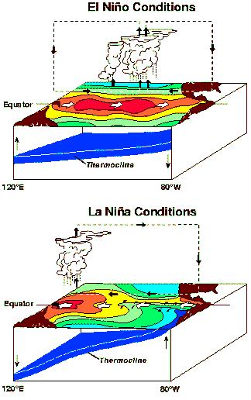
Introduction: ENSO
Cycle that occurs in the Pacific Ocean approximately every five years
Causes extreme weather to occur (increase drought, flooding) in many region of the world
ENSO cycles change the SST and pressure in the Pacific Ocean
El Nino: warmer SST and high pressure
La Nina: colder SST and low pressure

Slide 3
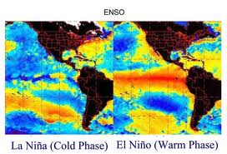
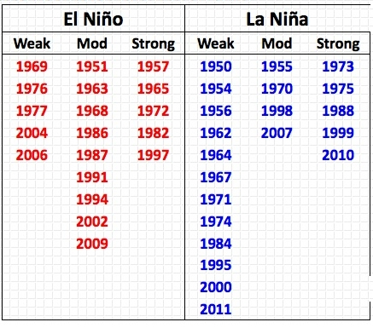
Introduction: ENSO

Slide 4
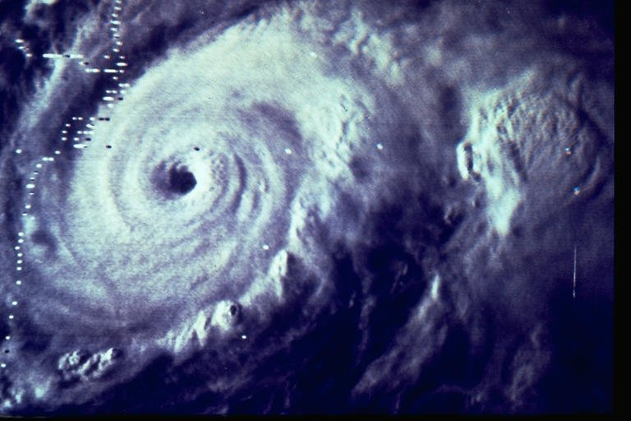
Introduction: Hurricanes
Tropical storm characterized by low pressure center, with a defined eye, and thunderstorms and high winds in the outer rain bands
Hurricane season: June 1- November 30
There are four conditions necessary to the formation of a hurricane:
Low pressure
Moist air
Warm SST
Wind

Slide 5
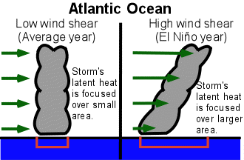
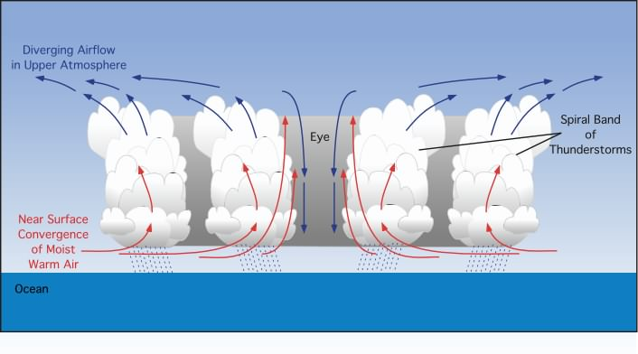
Introduction: Hurricanes

Slide 6
Analysis Techniques and Data
Used HURDAT and the MEI (multivariate ENSO index); 60 year time span from 1950-2010
Correlation Coefficient
Periodogram
Cross Spectrum Analysis
Autocorrelation
Least Squares Regression
Principal Component Regression
Major Reduced Axis Regression
Coherence

Slide 7
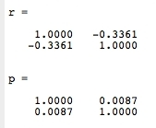
Correlation Coefficient
R value: -0.3361
P value: 0.0087
Correlation is significant because P < 0.05
There is a medium correlation between ENSO data and Hurdat data because 0.3<abs(r)<0.5

Slide 8
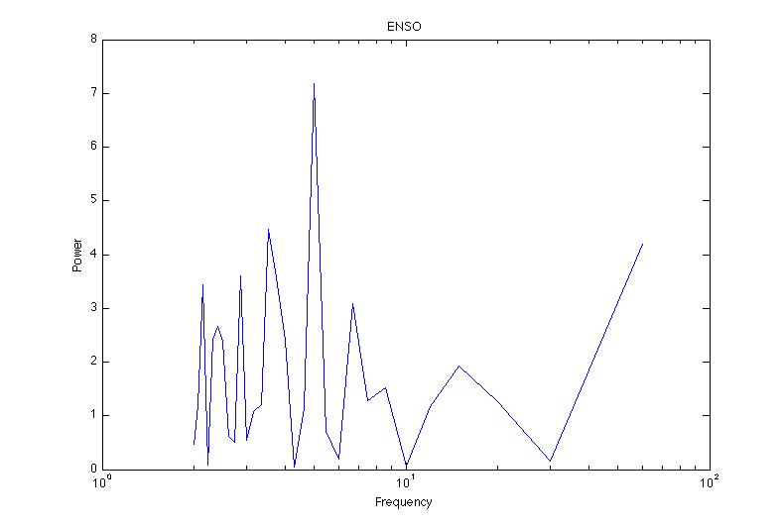
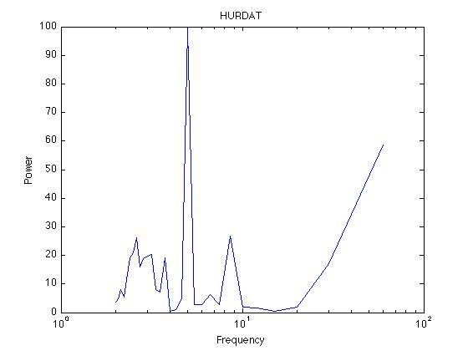
Periodogram
ENSO data showed a frequency of 5 years, which was to be expected, with smaller peaks approximately every other year
HURDAT showed a strong frequency of 5 years

Slide 9
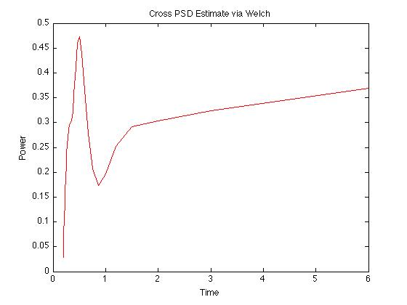
Cross Spectrum Analysis
Strong peak around 5 years, then decrease around 10 years, and then stabilizes around 15 years
1 time span is equivalent to 10 years

Slide 10
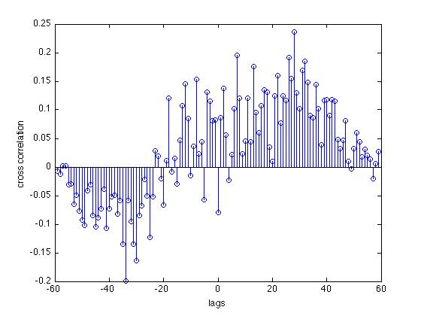
Autocorrelation
Negative correlation until approximately -20 lags, then function becomes mostly positive.

Slide 11
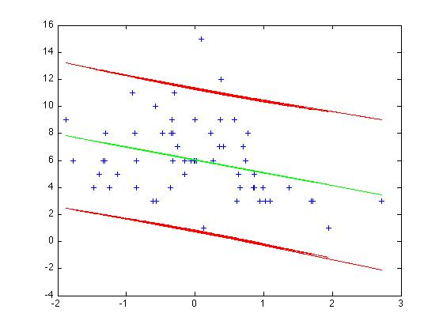
Least Squares Regression
Most points between 2 standard deviations with a few outliers, signifying a correlation within 2 standard deviations
slope is negative meaning there is a negative correlation

Slide 12
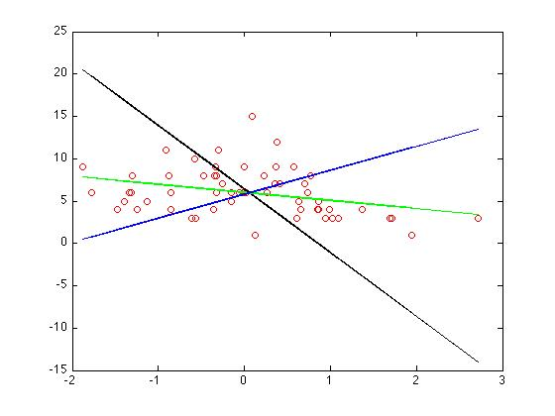
Principal Component Regression, LS Regression, and Major Axis Regression
Most points follow LS regression (green) and major axis regression (blue), showing correlation
No correlation for principal component regression (black)

Slide 13
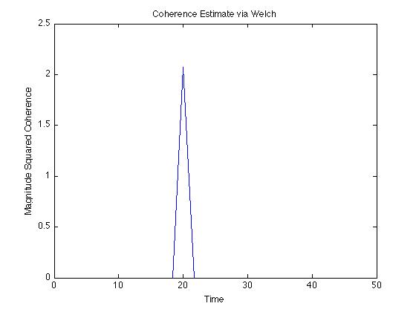
Coherence
Strong coherence peak at 20 years

Slide 14
Conclusions
Correlation between ENSO and Atlantic hurricane frequency is mediocre (r = -0.3361) and negative, meaning La Nina cycles produce a greater number of hurricanes while El Nino cycles produce less hurricanes
All data correlates within 2 standard deviations with a negative LS regression slop, confirming correlation coefficients and autocorrelation results
Frequency of 5 years for both ENSO and hurricane frequency, meaning both occur regularly approximately every 5 years.
ENSO had small frequency peaks roughly every other year indicating ENSO cycle

Slide 15
Sources
http://www.aoml.noaa.gov/hrd/hurdat/Data_Storm.html
http://www.esrl.noaa.gov/psd/data/correlation/mei.data
Trauth, Martin H., “Matlab Recipes for Earth Sciences”, Springer, 2010.

