Slide 1
STATISTICAL PROPERTIES OF FLOW AROUND A CYLINDER
by Sibel Kara
EAS 4480 Environmental Data Analysis
Project Presentation

Slide 2
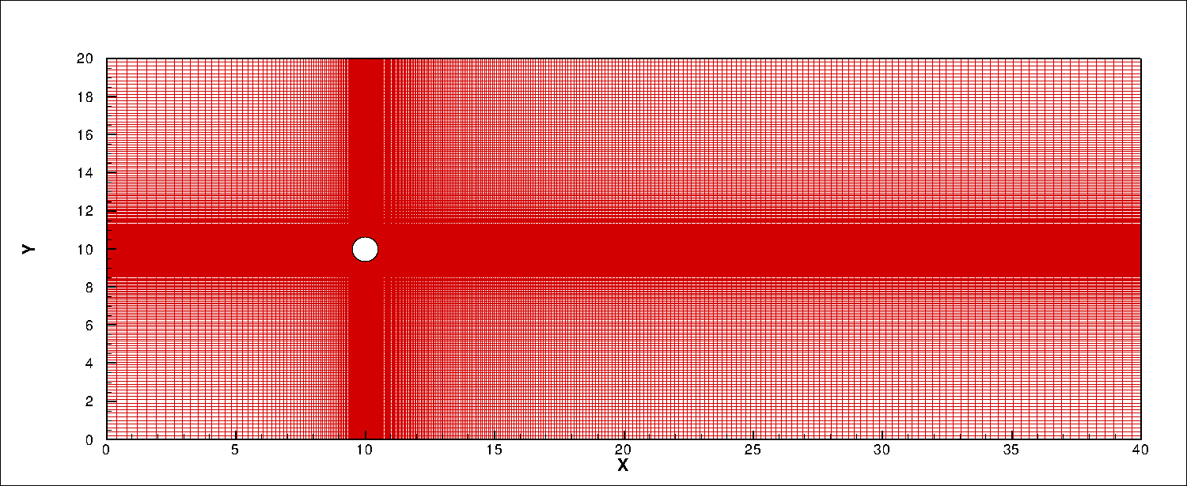
Methodology
Numerical Methodology (Fluid solver)
(Momentum Eq’n)
Navier-Stokes Equations
(Conservation of Mass)
NORTH (Freestream)
INFLOW
OUTFLOW
Y_{G}
SOUTH (Freestream)
X_{G}
Z_{G}

Slide 3
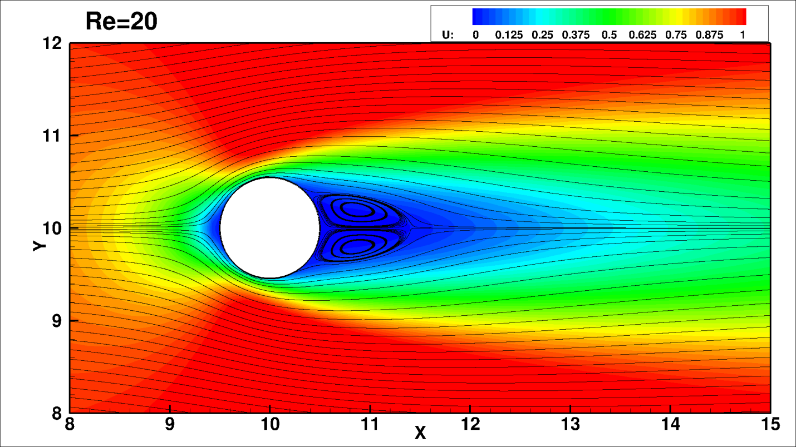
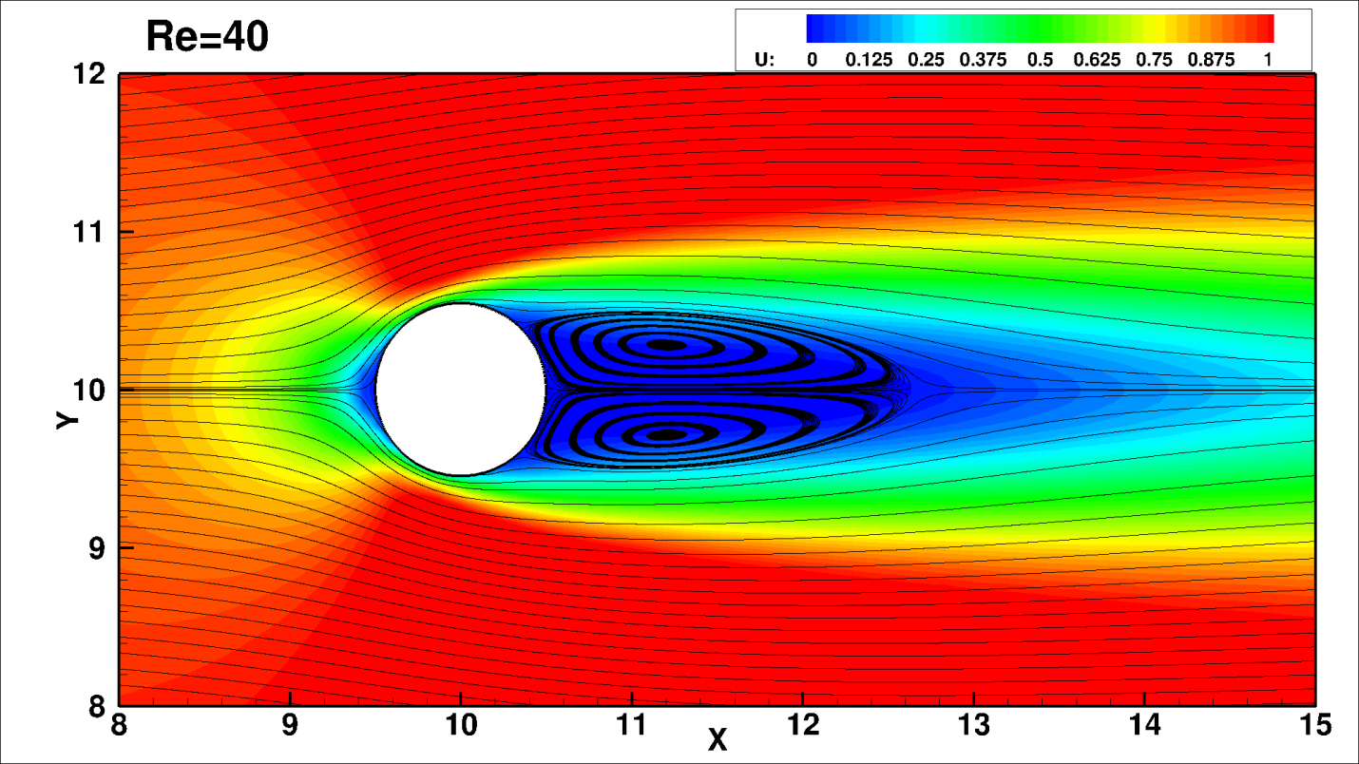
Steady flow past a circular cylinder
The streamlines of the steady state flow obtained by the present method at
Re = UD/ѵ = 20 and Re = 40.

Slide 4
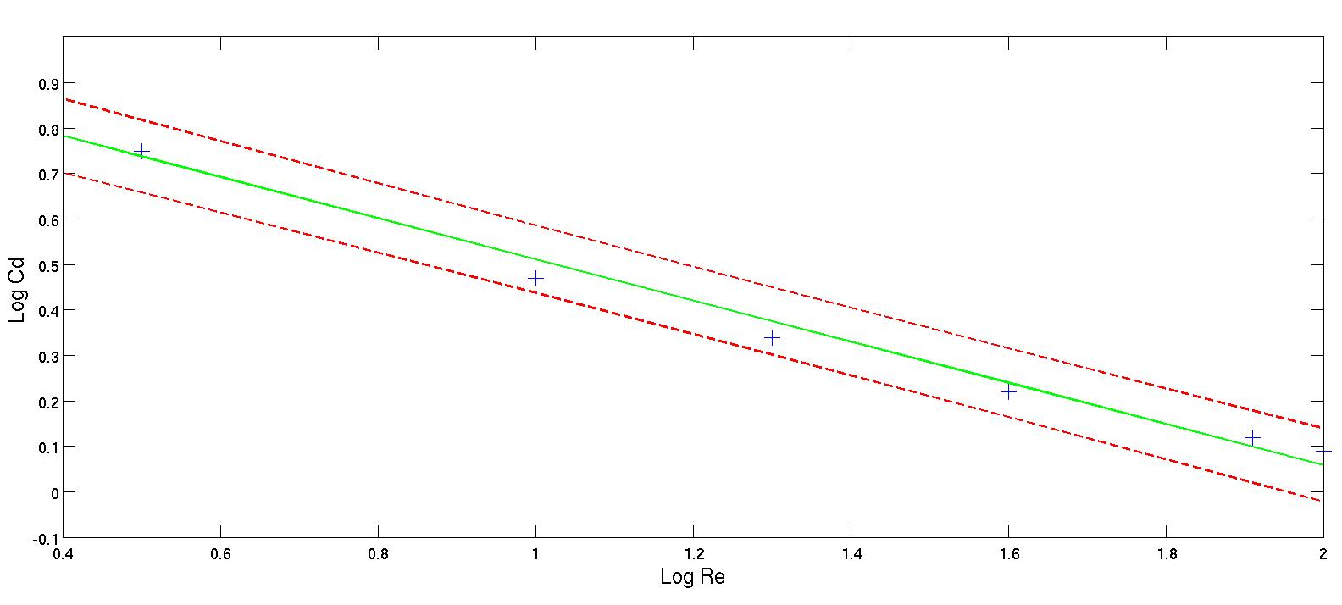
Steady flow past a circular cylinder
Regression analysis for drag coefficient (C_{d}) and Reynolds number (Re)

Slide 5
Unsteady flow past a circular cylinder
Contours of U velocity and swirl strength at Re = 150

Slide 6
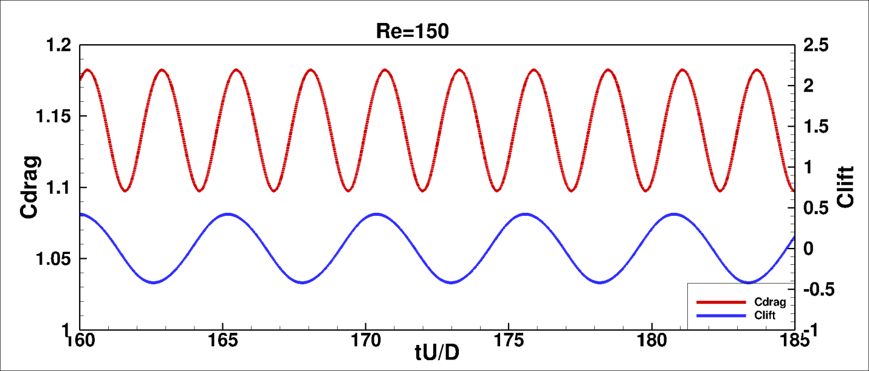
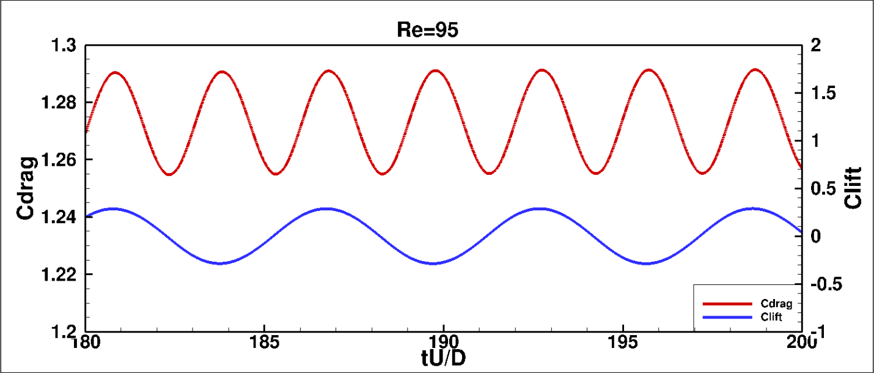
Unsteady flow past a circular cylinder
Lift and Drag coefficients at Re = 150 and Re = 95
f_{lift} ≈ 2.0*f_{drag}
f_{lift} ≈ 2.0*f_{drag}
y(t)=A sin(2πft)
C_{drag} = C_{drag} + 0.04 sin(2π*0.4*(tU/D))
C_{drag} = C_{drag} + 0.018 sin(2π*0.33*(tU/D))
C_{lift} = 0.025 sin(2π*0.2*(tU/D))
C_{lift} = 0.01 sin(2π*0.17*(tU/D))

Slide 7
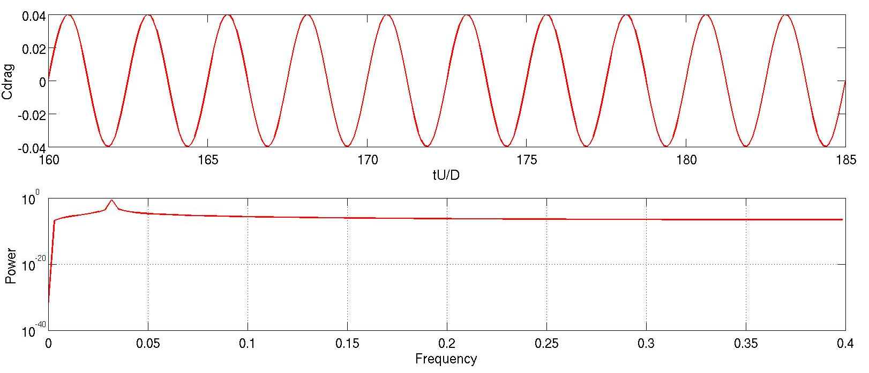
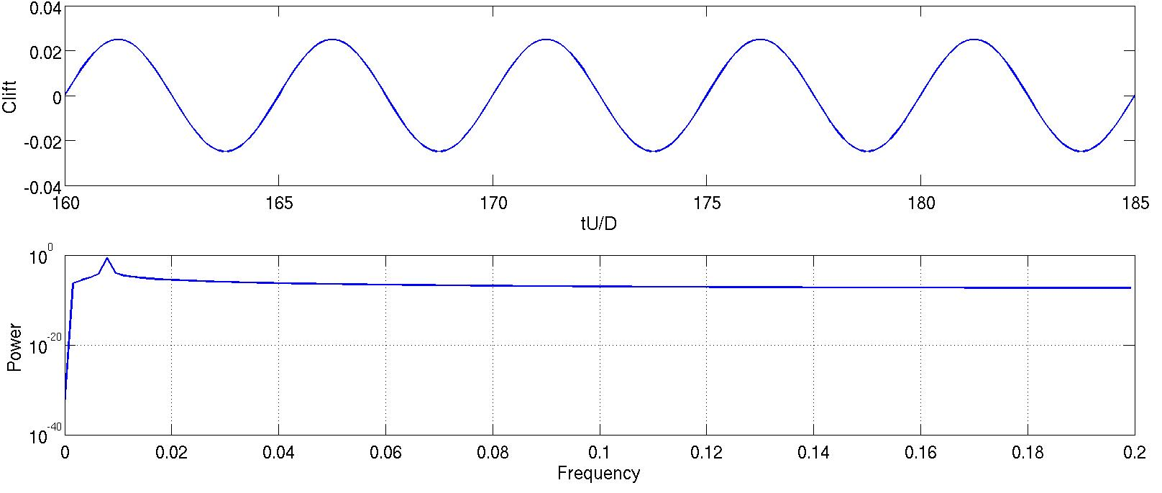
Power spectral density (re=150;c_{drag} &c_{lift})

Slide 8
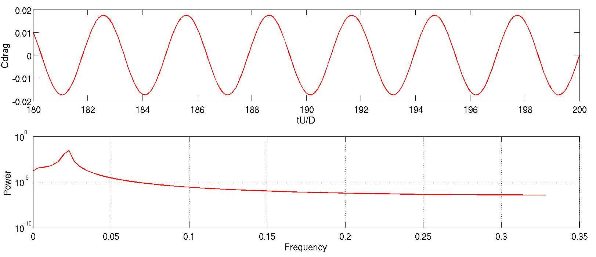
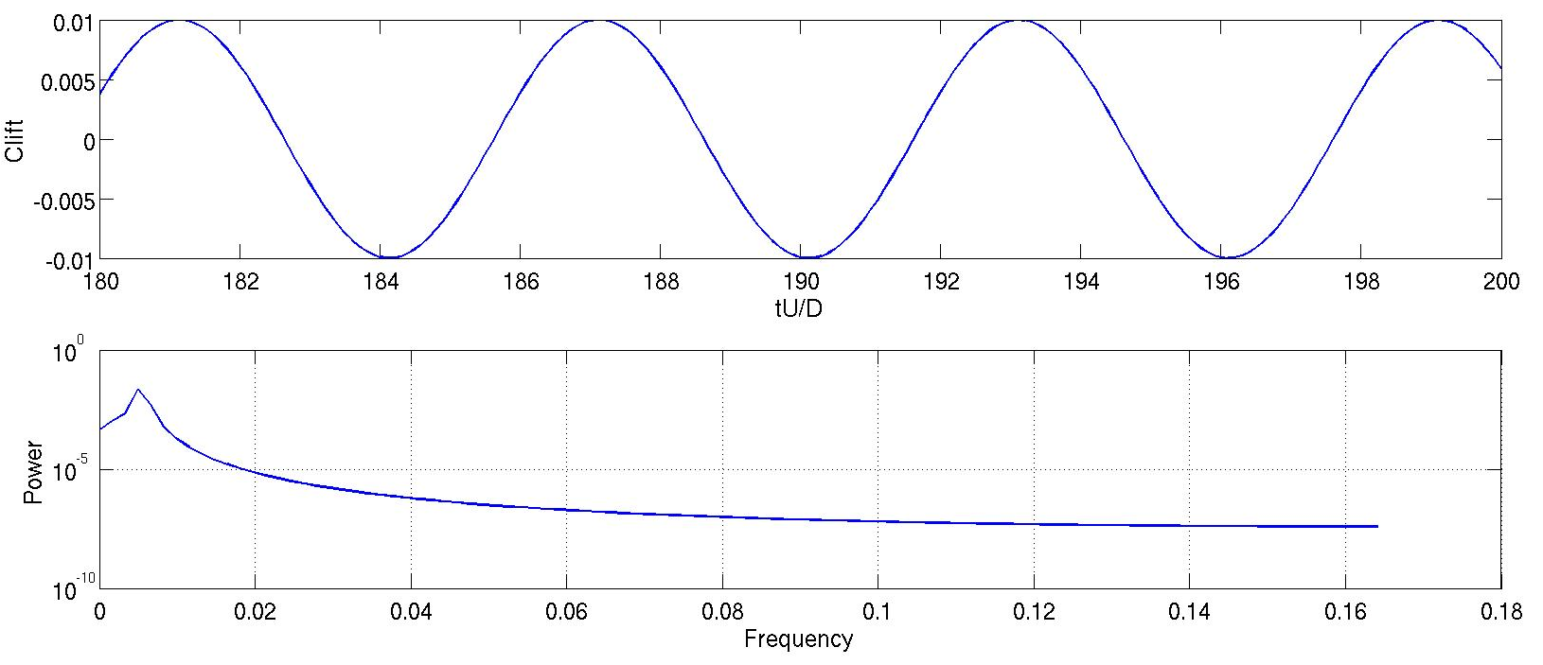
Power spectral density (re=95;c_{drag} &c_{lift})

Slide 9
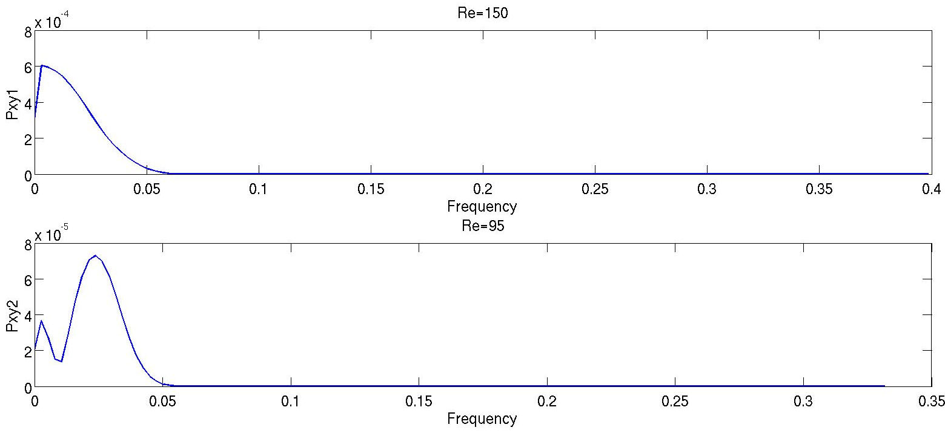
Crossspectral analysis (c_{drag} &c_{lift})

Slide 10
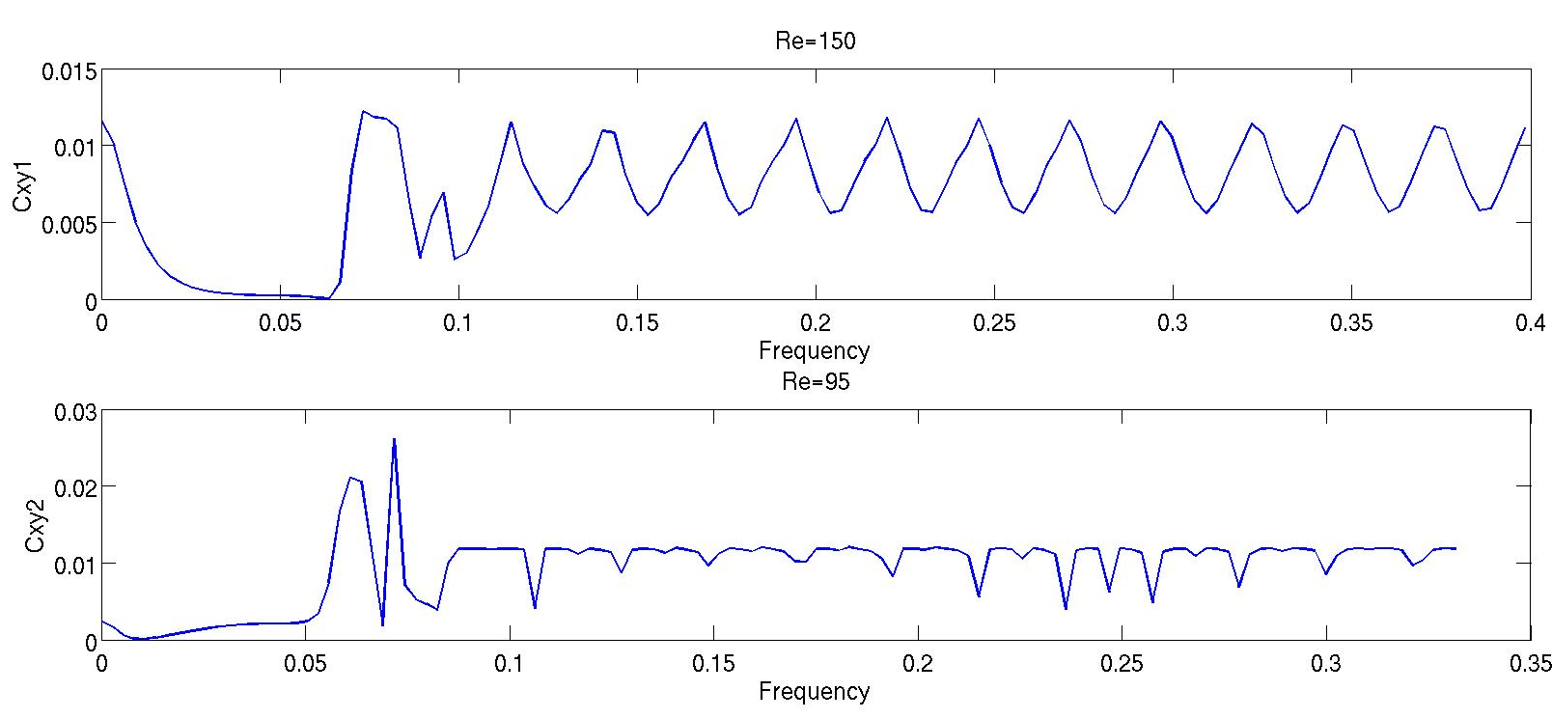
Coherence (c_{drag} &c_{lift})

Slide 11
Results
Instantaneous velocity analysis Vortex length depends on the Re for steady flow.
Vortex shedding becomes clear for unsteady flow.
Regression analysis for C_{d} and Re C_{d} decreases as Re increases.
Power spectral density Power for C_{d} and C_{l} waves are same for same Re.
analysis Power for C_{d} and C_{l} waves increases as Re increases.
Crossspectral analysis There is no correlation between C_{d} and C_{l} for the studied
cases.

Slide 12
Q & A
Thank you !
Structural Engineering

