Slide 1
Effectiveness of Addition of SCMs
in Concrete
against Ingress of Chloride
EAS 4480/CEE 4480 Environmental Data Analysis
Instructor: Professor Yuhang Wang
Presented by
Sichoon Park
April 25, 2013
Notes:
Hi everyone. My name is sichoon park.
As you are seeing in this slide, my presentation title is “Effectiveness of Addition of SCMs in Concrete against Ingress of Chloride”.

Slide 2
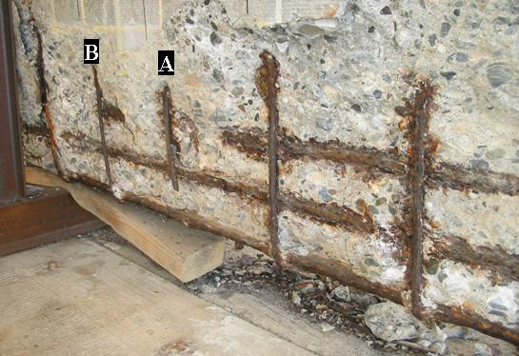
Background
Chloride-Induced Corrosion
➔ Chlorides from the marine environment are able to ingress into concrete, and it affects steel reinforced rebar corrosion.
Concrete mix design is one of the solution of this problem.
➔ Addition of SCMs
Notes:
First of all, I am going to explain background of this research.
According to the research paper, Chlorides from the marine environment are able to ingress into concrete structure, and it affects steel reinforced rebar corrosion. This corroded steel rebar strong influences on strength of concrete structure.
The one of the solution to alleviate this problem is concrete mix design. In other words, changing of concrete composition can help to prevent the ingress of Chloride into concrete. SCMs can be used for this.

Slide 3
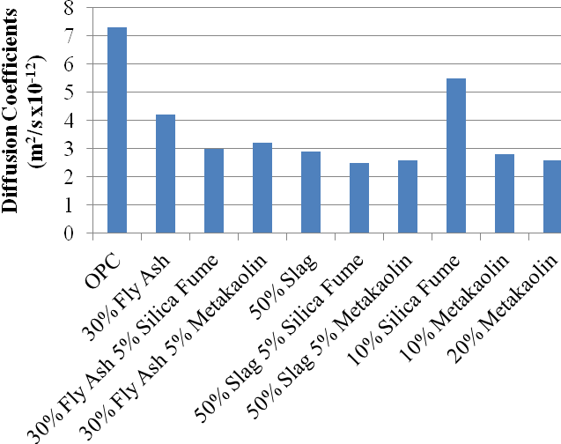
Background
SCMs: Supplementary Cementitious Materials
Slag, fly ash, silica fume, metakaolin, etc.
Diffusion Test
Bulk Diffusion Test
Chloride Permeability Test
Etc.
Profile grinding is performed on the sample to measure diffusivity after exposed to chloride.
Notes:
SCMs stands for Supplementary Cementitious Materials. It includes slag, fly ash, silica fume, metakaolin, etcetra. There is a number of tests to verify the effect of SCMs by measurement of diffusion rate of chloride. Bulk diffusion test, Chloride permeability test, etcetra.
This figure is result of these diffusion test. As you can see, the diffusion coefficient of concrete containing SCMs is less than OPC. OPC means ordinary Portland cement. That is pure cement.
However, these tests have disadvantage. Profile grinding is needed to measure diffusivity after exposed to chloride. It cannot be measured without damage.

Slide 4
Non-Destructive Testing
Non-Destructive Testing (NDT):
NDT is a wide group of analysis techniques used in science and industry to evaluate the properties of a material, component or system without causing damage. <http://en.wikipedia.org/wiki/Nondestructive_testing> (April 2013)
To preserve original state of concrete material, high-frequency ultrasound test is applied to characterize material properties of concrete as one of the NDT method.
Notes:
In this regards, NDT can be applied as an attractive method to measure concrete property.
NDT is a wide group of analysis techniques used in science and industry to evaluate the properties of a material, component or system without causing damage.
Ultrasonic test is applied to characterize material properties of concrete to preserve original state of material.

Slide 5
Objective
To analyze the effect of addition of SCMs into concrete, material parameters (diffusivity and dissipation) from three different mix designs in concrete is investigated by using ultrasound waves.
Statistical tests such as Chi-squared test, F-test, and t-test are applied to verify if material parameters from each sample are statistically different.
Notes:
This is objective of my project.
To analyze the effect of addition of SCMs into concrete, material parameters (diffusivity and dissipation) from three different mix designs in concrete is investigated by using ultrasound waves.
To verify the differences of material parameters measured from each concrete group, statistical tests are applied.

Slide 6
Sample Preparation
A specimen (5 x 5 x 18 in.) is prepared for each mix design and the composition of each mix design is shown below.
Mix ID | Cement fraction in binder (%) | ASTM C 150 Cement Type | Slag (%) | Metakaolin (%)
Type II | 100 | II | 0 | 0
S35-MK5 | 60 | II | 35 | 5
S50-MK5 | 45 | II | 50 | 5
The number of data for diffusivity and dissipation in each mix design is 30.
Notes:
This is sample preparation.
Three mix design concrete is prepared and the concrete composition is shown in this chart.
Type II is 100% cement. On the other hand, S35MK5 and S50MK5 containing Slag and Metakaolin with different percentage.
The number of data for diffusivity and dissipation in each mix design is 30.

Slide 7
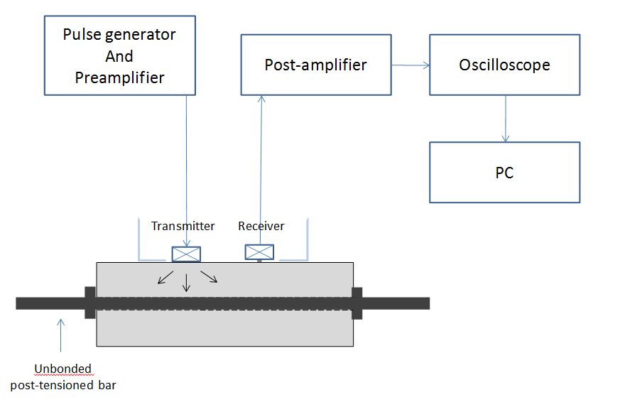
Experimental Procedure
The diffusion coefficient, D(f) [m²/s] : the diffusion rate of the ultrasonic field
The dissipation coefficient, σ(f) [1/s] : the rate of loss of energy
Notes:
This is experimental procedure.
This is concrete specimen, and these are signal in and out transmitters.
Ultrasonic wave from pulse generator will propagate though the concrete and will be recorded and saved in computer / to calculate the diffusivity and dissipation parameters.

Slide 8
Hypothesis 1
Verify if the material parameters of each mix design are normally distributed.
Before hypothesis testing, what the distribution looks like to be tested.
Notes:
For the analysis, first of all, what the distribution looks like to be tested.
Null Hypothesis is that verify if the material parameters of each mix design are normally distributed.

Slide 9
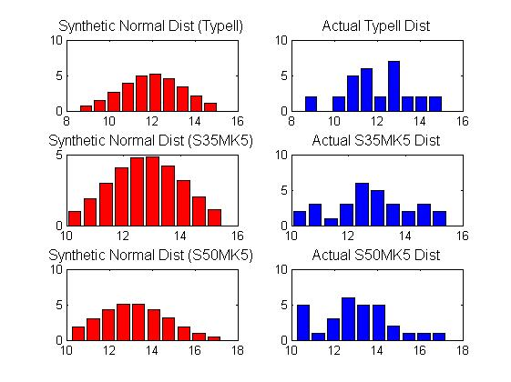
Normality test (for Diffusivity)
Null hypothesis: Verify if the material parameters of
a sample in each mix design are normally distributed.
Chi-squared test
Ideal_chi2= 16.919
Chi2_typeII= 9.3606
Chi2_S35MK5= 5.4264
Chi2_S50MK5= 9.0672
Notes:
The chi-squared test is carried out by determining an ideal or critical value at 95% confidence.
The calculated chi-squared values for all three data distributions were lower than the critical chi-squared values for the 95% confidence level with the same degrees of freedom. Thus, the null hypothesis cannot be rejected
(they can be considered normal distributions. This conclusion has a 5% probability of being incorrect due to the use of a 95% confidence level. )

Slide 10
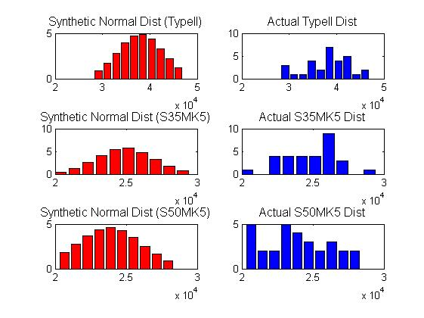
Normality test (for Dissipation)
Chi-squared test
Ideal_chi2= 16.919
Chi2_typeII= 10.9681
Chi2_S35MK5= 9.0719
Chi2_S50MK5= 9.4449
Null hypothesis that material parameters of each mix design are normally distributed cannot reject.
Notes:
Dissipation data sets also chi-squared test is carried out with the same confidence level and degrees of freedom. Null hypothesis that material parameters of each mix design are normally distributed cannot reject.

Slide 11
Normality test (2)
Jarque-Bera test
Null hypothesis: The data in each mix design comes from a normal distribution with unknown mean and variance.
Matlab syntax: [h,p] = jbtest (X,0.05)
Results: all distributions come from a normal distribution. (h = 0)
Jarque-Bera tests often use the chi-square distribution to estimate critical values for large samples, deferring to the Lilliefors test for small samples
Lilliefors test
Null hypothesis: The data in each mix design comes from a distribution in the normal family.
Matlab syntax: [h,p] = lillietest (X,0.05)
Results: all distributions come from a distribution in the normal family. (h = 0)
Notes:
To verify this finding, I applied another normality test.
Jarque-Bera test. Null hypothesis is …, Result presented same as chi2 test.
Jarque-Bera tests usually used for large samples. However, in my project case, sample size is samll. Thus, I will applied Killiefors test. Results are same as before.

Slide 12
Hypothesis 2
Verify if the material parameters of each mix design are not significantly different.
F-test:
Null Hypothesis: Material parameters of each mix design have equal variances
Student t-test
Null Hypothesis: Means of material parameters of each mix design are not significantly different
Notes:
Next, to determine whether or not distributions have equivalent variances and means, F-test is carried out. If distributions have statistically similar variances, Student t-test will be carried out.

Slide 13
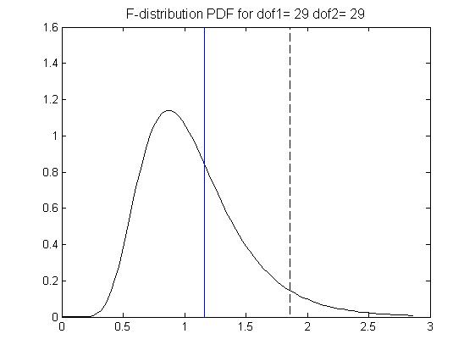
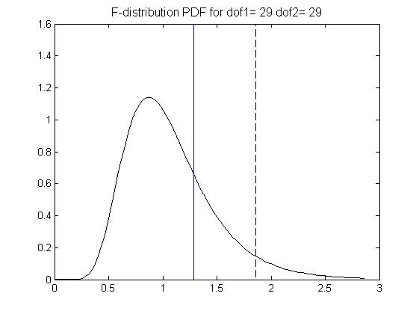
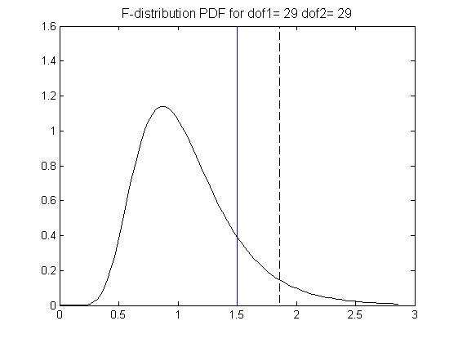
F test (for Diffusivity)
Type II vs S35MK5
Type II and S50MK5
S35MK5 and S50MK5
F_actual= 1.1649
F_table= 1.8608
(Ftable > Factual)
Not reject
F_actual= 1.2852
F_table= 1.8608
(Ftable > Factual)
Not reject
F_actual= 1.4971
F_table= 1.8608
(Ftable > Factual)
Not reject
Notes:
This is result of F-test for diffusivity in each case.
All three cases, the actual F-value is less than the critical F-value, thus the null hypothesis cannot be rejected. It allows to use Student t-test.

Slide 14
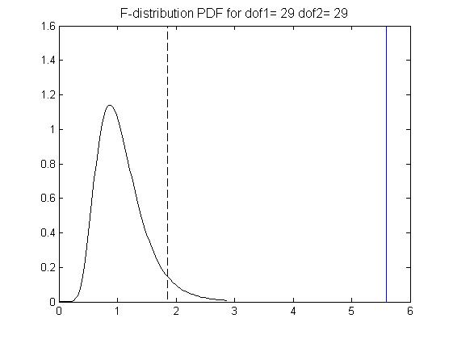
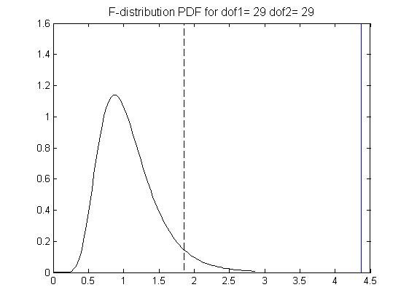
F test (for Dissipation)
Type II vs S35MK5
Type II and S50MK5
S35MK5 and S50MK5
F_actual= 5.5941
F_table= 1.8608
(Ftable < Factual)
reject
F_actual= 4.3726
F_table= 1.8608
(Ftable < Factual)
reject
F_actual= 1.2794
F_table= 1.8608
(Ftable > Factual)
Not reject
Notes:
This is result of F-test for dissipation in each case.
The only S35 versus S50 case, the actual F-value is less than the critical F-value, thus only this case, the null hypothesis cannot be rejected.

Slide 15
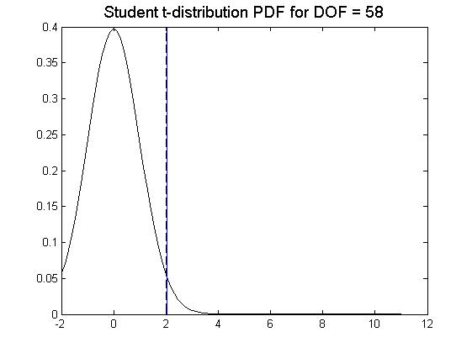
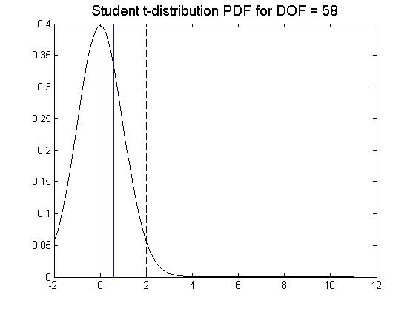
Student-T test (for Diffusivity)
Type II vs S35MK5
Type II and S50MK5
S35MK5 and S50MK5
T_cal= 2.0388
T_crit= 2.0017
h = 1
Sigt t=0.0460
(h==1, thus hypothesis is
rejected)
T_cal= 2.4157
T_crit= 2.0017
h = 1
Sigt t=0.0189
(h==1, thus hypothesis is
rejected)
T_cal= 0.5958
T_crit= 2.0017
h = 0
Sigt t=0.5536
(h==0, thus hypothesis is
not rejected)
Notes:
This is result of Student t-test for diffusivity in each case.
Type II and S35 case, and Type II and S50 case, these two cases shows that the calculated t-value is greater than the critical t-value, thus the null hypothesis for the T-test have to be rejected.
However, the result of S35 and S50 case is opposite. Only In this case, null hypothesis for the t-test cannot be rejected and the two distributions have statistically similar means with 95% confidence level.

Slide 16
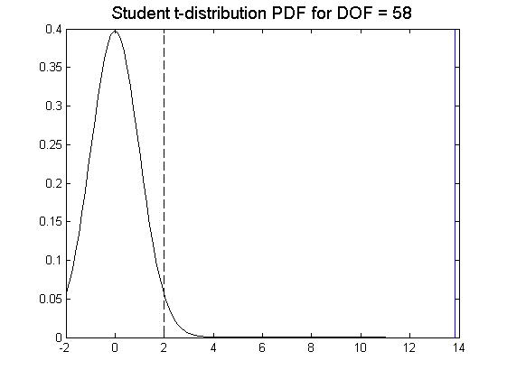
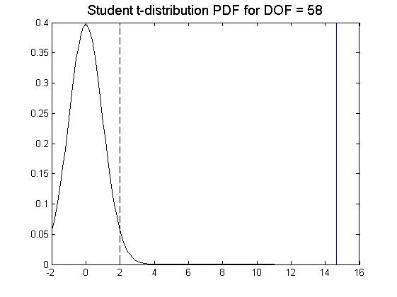
Student-T test (for Dissipation)
Type II vs S35MK5
Type II and S50MK5
S35MK5 and S50MK5
T_cal= 13.8426
T_crit= 2.0017
h = 1
Sigt t=4.9212e-020
(h==1, thus hypothesis is
rejected)
T_cal= 14.6664
T_crit= 2.0017
h = 1
Sigt t= 3.5820e-021
(h==1, thus hypothesis is
rejected)
T_cal= 1.9242
T_crit= 2.0017
h = 0
Sigt t= 0.0592
(h==0, thus hypothesis is
not rejected)
Notes:
Dissipation also shows same as diffusivity.
Only S35 and S50 case presents that calculated t-value is less than the critical t-value. Therefore, null hypothesis for the t-test cannot be rejected.

Slide 17
Results Summary
Null hypothesis that the material parameters of Type II and S35MK5 are not statistically different can reject.
Null hypothesis that the material parameters of Type II and S50MK5 are not statistically different can reject.
Null hypothesis that the material parameters of S35MK5 and S50MK5 are not statistically different cannot reject.
 | Type II vs. S35MK5 | Type II vs. S50MK5 | S35MK5 vs. S50MK5
Diffusivity
F | Not reject | Not reject | Not reject
t | reject | Reject | Not reject
Dissipation
F | reject | reject | Not reject
t | reject | Reject | Not reject
Notes:
These are results summary.
In Type II and S35 case and Type II and S50 case, null hypothesis that material parameters are not statistically different can reject. However, S35 and S50 case, null hypothesis cannot reject.

Slide 18
Conclusion
According to statistical test results, it is shown that there appears to be a statistical difference for mean and variance of material parameters in between S35MK5/S50MK5 and Type II samples.
The difference between S35MK5/S50MK5 and Type II may relate to addition of SCMs. The addition of SCMs into concrete influenced on the formation of microstructure in concrete.
Diffusivity of ultrasonic energy in S35MK5/S50MK5 is shown to be higher than the one in Type II, which means the microstructure of S35MK5/S50MK5 is much denser than that of Type II. In conclusion, the addition of SCMs can help to prevent the ingress of Chloride into concrete.
Notes:
In conclusion,
내용 읽고
3번 전에
Actually, --
마지막 읽고 따라 읽을 것. This results is consistent with the results by the techniques that I mentioned earlier

Slide 19
References
[1] Chi-Won In, “Defect Characterization in Heterogeneous Civil Materials Using Ultrasound”, A dissertation in Georgia Institute of Technology, May 2013.
[2] R. Brett Holland, “Durability of Precast Prestressed Concrete Piles In Marine Environments”, A dissertation in Georgia Institute of Technology, August 2012
[3] Deroo, F., Kim, J.-Y., Qu, J., Sabra, K. and Jacobs, L.J. (2010) Detection of damage in concrete using diffuse ultrasound. The Journal of the Acoustical Society of America 127, 3315.

Slide 20
THANK YOU
Q&A

