Slide 1
The North Atlantic Oscillation’s (NAO) Impact on the Atlantic Hurricane Season
Cynthia James
EAS 4480
Spring 2013

Slide 2
Overview
• North Atlantic Oscillation (NAO)
• Data
• Methods
◦Univariate Statistics
◦ Bivariate Statistics
◦ Time Series Analysis
• Conclusions
• Future Work

Slide 3
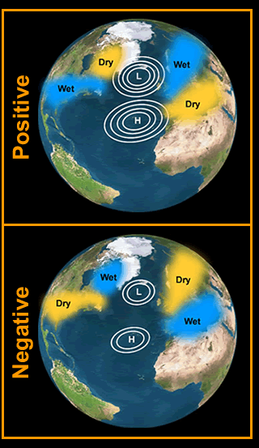
North Atlantic Oscillation
• The NAO is a reversal of atmospheric pressure between the Icelandic Low and the Bermuda-Azore High in the Atlantic Ocean.
◦ It has an effect on winter weather in Eastern North America and Europe.
◦ The NAO has two phases: a positive phase and a negative phase, and it can also be zero-a neutral phase.
• The NAO typically varies from year to year, but it is possible for this teleconnection pattern to stay in one phase for an extended period of time.

Slide 4
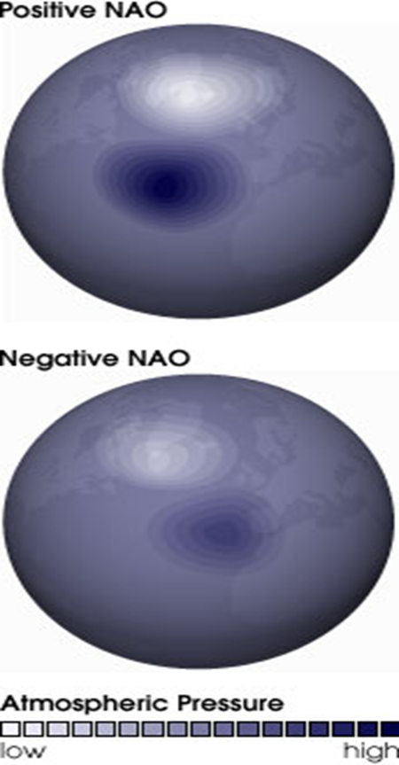
North Atlantic Oscillation
• Positive phase:
◦ Atmospheric pressure in the region around the Icelandic Low drops.
◦ Atmospheric pressure in the region around the Bermuda-Azores High rises.
◦ The atmospheric pressure difference between the two regions results in stronger westerlies.
◦ The Eastern United States tends to see wet and mild winters.
• Negative Phase:
◦ Atmospheric pressure in the region around the Icelandic Lows rises.
◦ Atmospheric pressure in the region around the Bermuda-Azores High drops.
◦ The atmospheric pressure difference between the two regions results in weaker westerlies.
◦ The Eastern United States tends to see cold and dry winters.
Notes:
Additionally:
Positive phase→ westerlies turn stronger storms on a more northerly track into Northern Europe, where winters tend to be wet and mild.
Northern Canada and Greenland are usually cold and dry.
Negative phase→ wet weather to Southern Europe and to the region around the Mediterranean Sea. Northern Europe sees cold and dry winters, while Greenland and northern Canada experience mild winters.

Slide 5
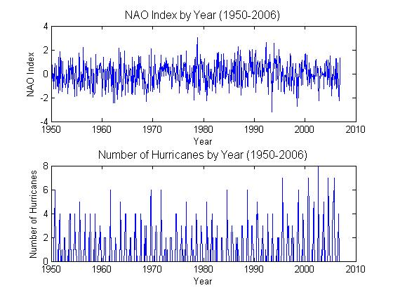
Data
• Data from 1950-2006
• Number of hurricanes and tropical storms that began in a month from NOAA’s Earth System Research laboratory page.
http://www.esrl.noaa.gov/psd/data/climateindices/list/
• Monthly mean NAO index from the Climate Prediction Center
http://www.cpc.ncep.noaa.gov/products/precip/CWlink/pna/nao.shtml

Slide 6
Methods
• Annual Data
• Hurricane Season (June through November) Data
• Filter out hurricane frequency data based on whether NAO Index is positive, negative, or zero.
Notes:
The data was the number of hurricanes and tropical storms that began in a month.
The daily NAO index is constructed by projecting the daily (00Z) 500mb height anomalies over the Northern Hemisphere onto the loading pattern of the NAO. Monthly mean height.

Slide 7
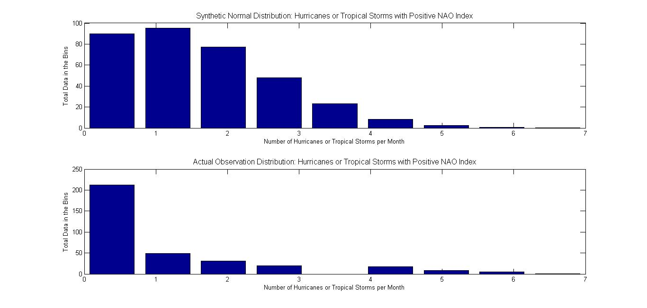
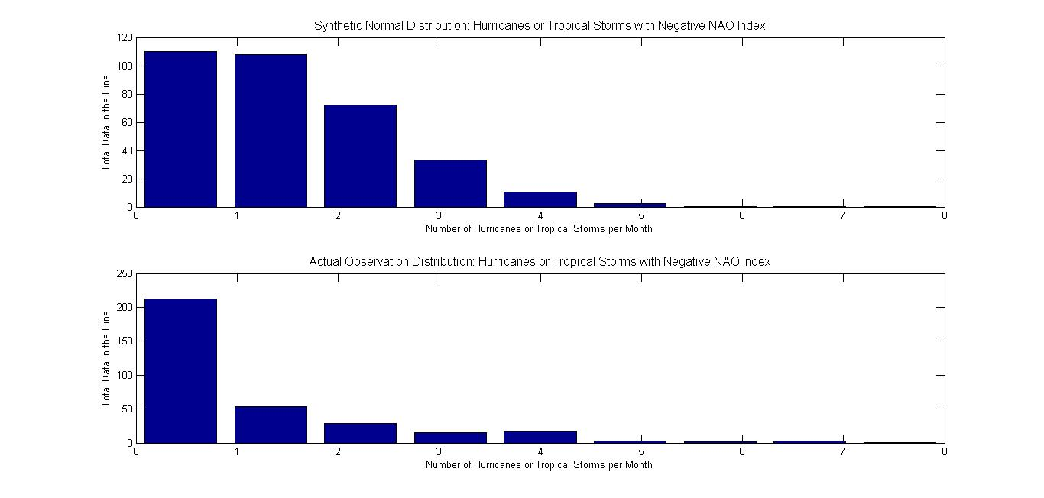
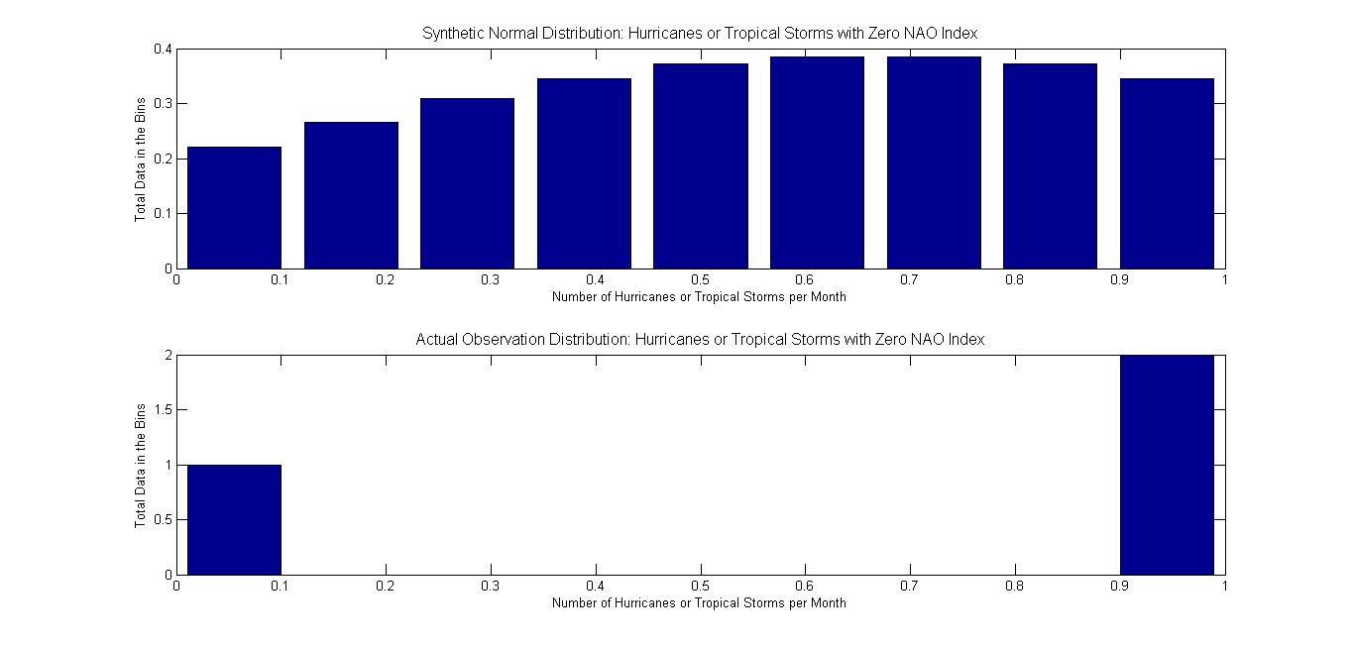
Univariate Statistics: Empirical Distributions
• Total hurricanes from 1950-2006 based on Positive (top left), Negative (top right), or Zero (bottom left) NAO Index.
• Hurricane Data with NAO Index:
◦ Positive NAO Index: 345 times,325 hurricanes
◦ Negative NAO Index: 336 times,281 hurricanes
◦ Zero NAO Index: 3 times, 2 hurricanes
Notes:
How many times 0 hurricanes were in a month, etc.
Synthetic dataset centered around mean and standard deviation of original dataset. Should look Gaussian.

Slide 8
Univariate Statistics: Statistical Measurements
• Positive NAO
Mean = 0.9420
Kurtosis = 5.0998 → wide distribution
Skewness = 1.6982 → distribution shifts to the right of the mean
• Negative NAO
Mean = 0.8363
Kurtosis = 7.8692 → wide distribution
Skewness = 2.1519 → distribution shifts to the right of the mean
• Zero NAO
Mean = 0.667
Kurtosis = 1.500 → narrow distribution
Skewness = -0.7071 → distribution shifts to the left of the mean

Slide 9
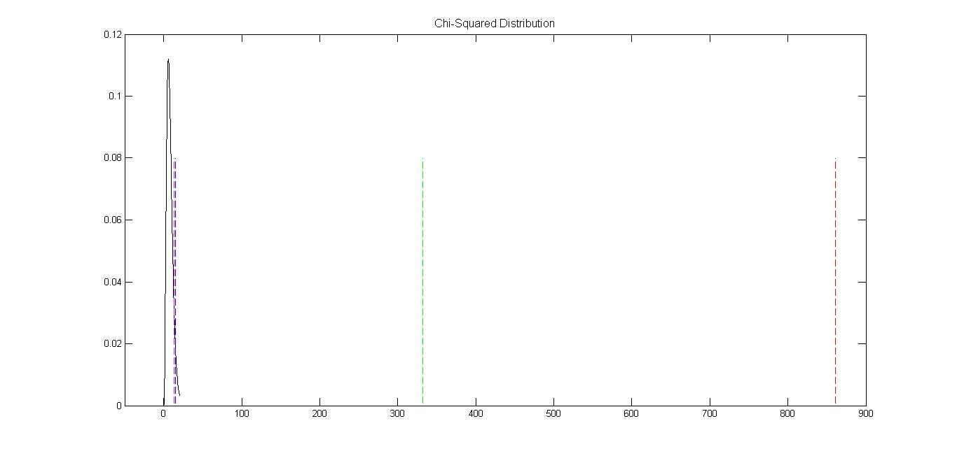
Univariate Statistics: Chi-Squared Test
Critical Chi2 = 15.5073
◦ Blue
Chi2Pos = 332.0328
◦ Green
Chi2Neg = 860.9289
◦ Red
Chi2Zero = 13.1163
◦ Magenta
• Chi-squared value for zero NAO is less than the critical chi-squared value.
◦ Cannot reject null hypothesis → Gaussian distribution
• Chi-squared values for positive NAO and negative NAO are much larger than critical chi-squared value.
° Reject null hypothesis → data cannot be described by a Gaussian distribution
Notes:
Chi-squared test was carried out by determining the critical chi2 value at a 95% confidence interval with degrees of freedom equal to 8 because I used 9 bins. 5% probability of being incorrect due to the use of a 95% confidence interval.

Slide 10
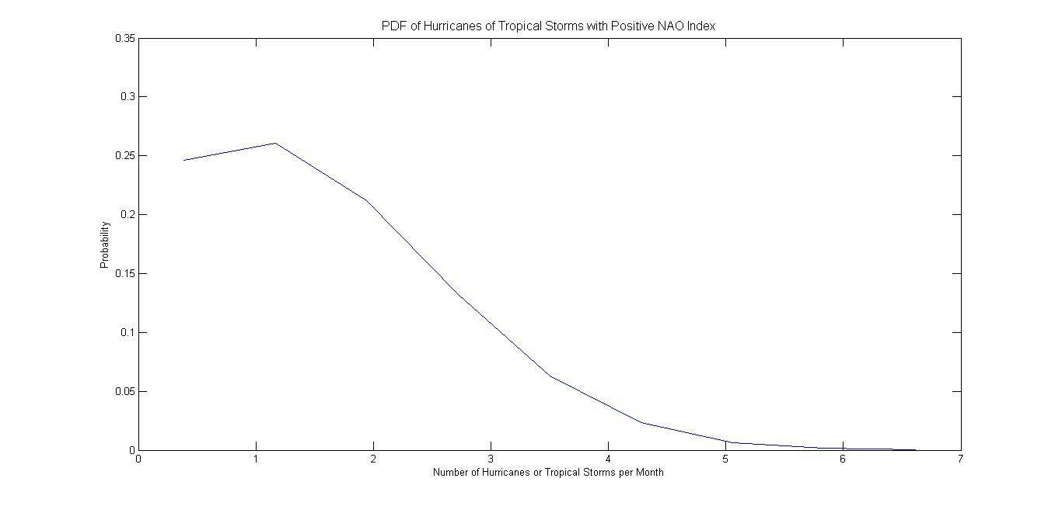
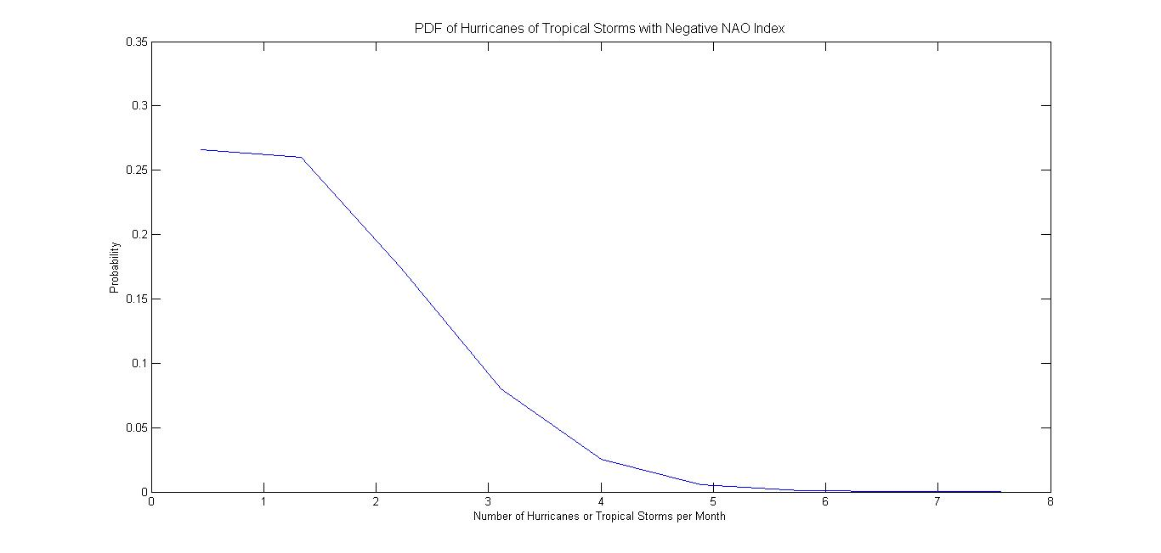
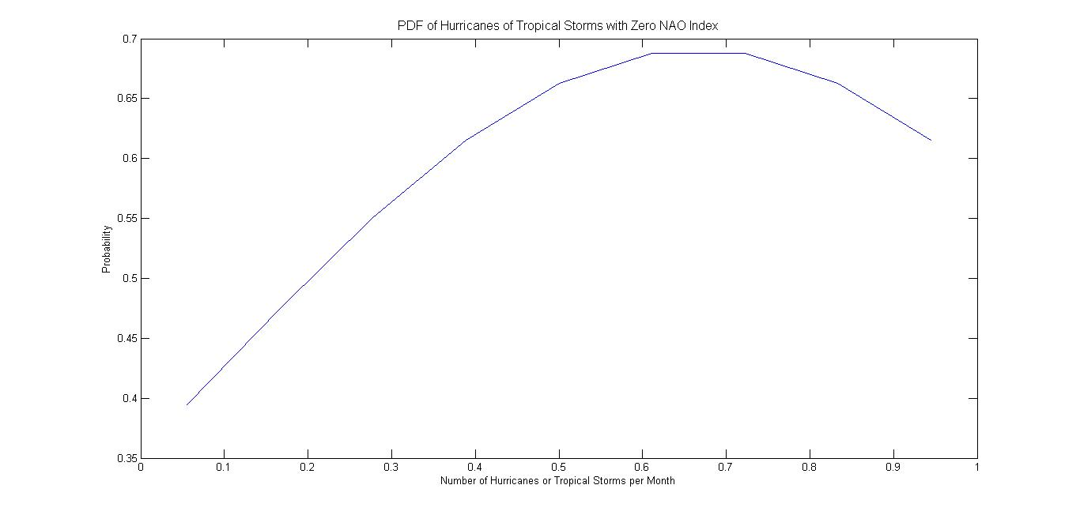
Univariate Statistics: PDF
Notes:
PDF = probability density function: defines the probability that the variable has a value equal to x (x is the x-axis value).
Gaussuan

Slide 11
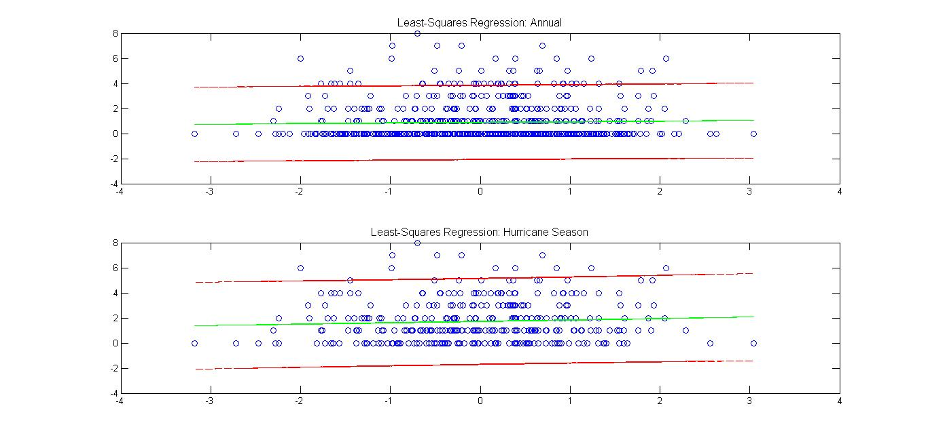
Bivariate Statistics: Least-Squares Regression
Slope for Annual Data = 0.0473
Slope for Hurricane Season Data = 0.1099
Notes:
Data outside of the 95% confidence interval (error bounds-red lines) is when there is a high number of hurricanes or tropical storms a month.
Green line is the LS regression between the two datasets. X axis is independent variable. Regression line passes through the data center determined by the means.
Not steep slopes.
Doesn’t fit the data well.
Maybe a higher order regression would give a better fit.

Slide 12
Bivariate Statistics: Correlation Coefficient
Variable | Annual Data | Hurricane Season Data
Correlation Coefficient | 0.0316 | 0.0636
Correlation Significance | 0.4089 | 0.2405
95% Confidence Interval | [-0.043445, 0.10634] | [-0.042703, 0.16855]
• The correlation between the North Atlantic Oscillation Index and the annual Atlantic Ocean hurricane frequency data is not significant.
• The correlation between the North Atlantic Oscillation Index and the hurricane season (June-November) Atlantic Ocean hurricane frequency data is not significant.
Notes:
The correlation coefficient is r. Abs(r)<0.3 for both→correlation is very small between NAO Index and hurricane frequency
The correlation significance is p.
P is not small (less than 0.05), so the correlation is not significant.
Correlation less significant for annual.
Because CI contains negative values, no real correlation.
Range of values that contains a 95% confidence of the “true” correlation coefficient.

Slide 13
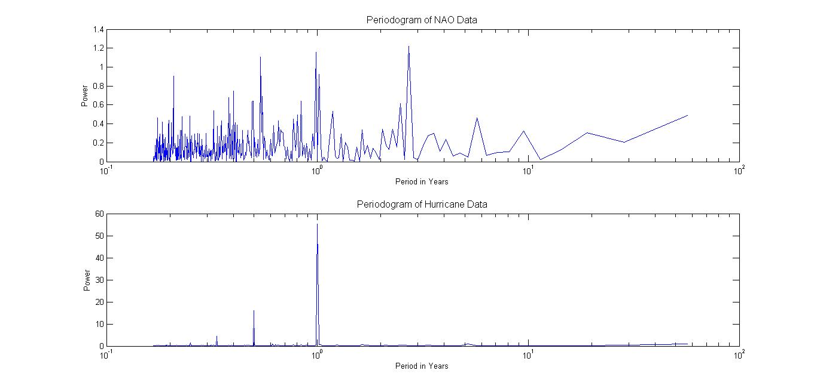
Time Series Analysis: Periodogram
NAO Data Periodogram
Hurricane and Tropical Storm Data
Periodogram
Notes:
Periodogram estimates the spectral density of a signal. Used to identify dominant periods of a time series.
Periodogram of hurricane data shows obvious annual cycles in hurricane activity and less obvious semi annual cycles→0.5 year, 0.33 year.
Periodogram of NAO data shows peaks yearly and during the year. Especially at 0.5, 1 year, and approximately 3 years. Cycles appear to mainly be yearly, with some possible changing of cycle magnitude on a slightly larger time scale.
NAO not necessarily an annual teleconnection. It can be an annual, monthly, or yearly (3 years). It is always changing , which is expected bc a large scale pattern. Unlike hurricane, which we know is seasonal/yearly.

Slide 14
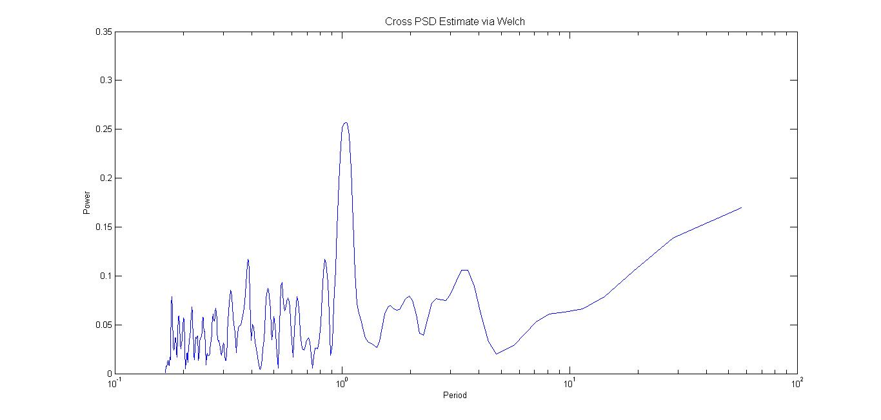
Time Series Analysis: Cross Spectral Analysis
Notes:
Cross spectral correlates two time frequencies in time domain.
Using Welch’s method, data are split into smaller subsets and periodogram is calculated.
High peak at approximately 1 year likely associated with the strong peaks previously seen in both datasets, so the periodogram and cpsd agree.

Slide 15
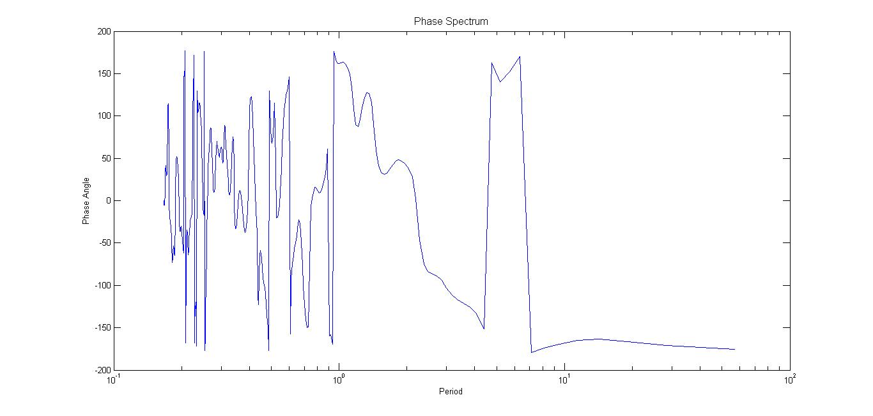
Time Series Analysis: Phase Spectrum
Notes:
Phase spectrum used to determine presence of a lag for a specific period, but it does not comment on the extent of the correlation between the NAO index and hurricane frequency.
Hurricanes lag behind NAO Index by about 0.4496 of a year (almost half a year).
One of the greatest peaks is at 1 year-phase lag.
Phase Lag = 161.8549
Year Lag = 0.4496 of hurricanes of NAO.

Slide 16
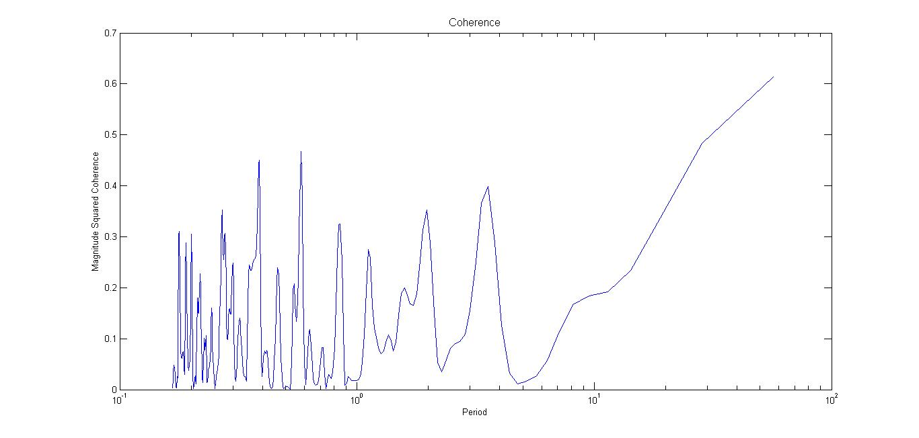
Time Series Analysis: Coherence
Notes:
Coherence comments on the significance of particular period relationships between the two datasets. Highest peaks during a yearly cycle. Not at year
Almost significant, just because other factors have to be looked at.

Slide 17
Conclusions and Future Work
•Conclusions
◦ No overall correlations between NAO and hurricane frequency
◦ However, the periods observed while performing time series analysis shows the period for the datasets are on an overall annual cycle.
• Future Work
◦ Hurricane Tracks
◦ Hurricane Intensity

Slide 18
References
• National Oceanic and Atmospheric Association
http://www.esrl.noaa.gov/psd/data/climateindices/list/
• Climate Prediction Center
http://www.cpc.ncep.noaa.gov/products/precip/CWlink/pna/nao.shtml
• Ahrens, C.D., 2009: Meteorology Today: An Introduction to Weather, Climate, and the Environment. Brooks/Cole, 549 pp.
• Trauth, M.H., 2010: Matlab Recipes for Earth Sciences. Springer, 336 pp.

