Slide 1
An Investigation of the Arctic Oscillation and Georgia Temperature/Rainfall
Melissa Le Fevre
EAS 4480 Data Analysis
Final Project Presentation
April 23, 2013

Slide 2
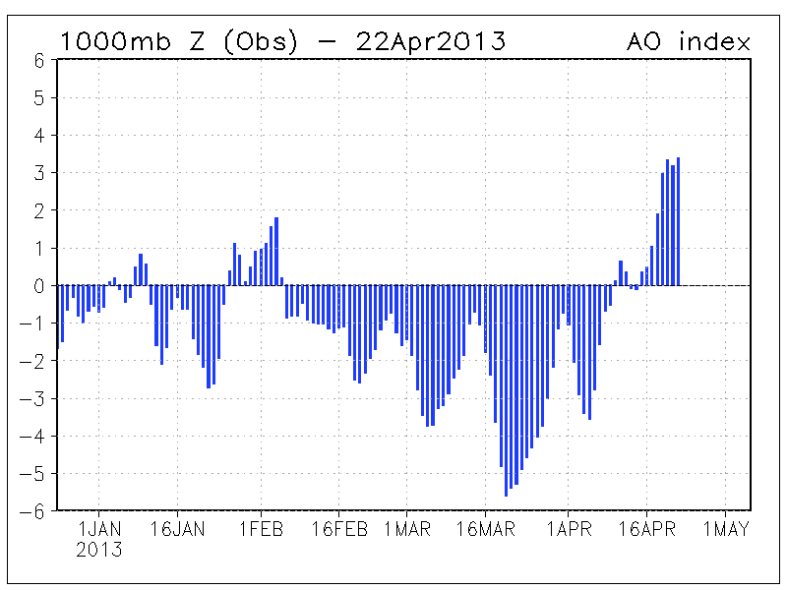
PRESENTATION OVERVIEW
Arctic Oscillation Introduction
Motivation
Source of data
Class Correlation
Statistical analysis
Univariate statistics
Bivariate statistics
Time series analysis
Facts and Figures
Conclusions
Future Work
CPC, 2013
Notes:
-

Slide 3
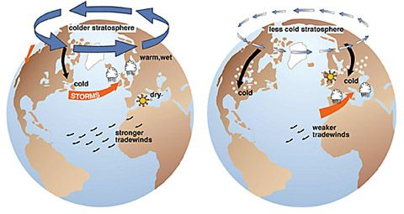
ARCTIC OSCILLATION BASICS
Distribution of pressure patterns over Arctic region and NH mid-latitudes
“AO flips” = fundamental changes in wind direction
Significant player in climate variability (Higgins et. al 2001)
Large variance in surface air temperatures
NSIDC, 2013

Slide 4
THE ARCTIC OSCILLATION
Positive phase – cool air constricted
Negative pressure anomalies over Arctic
Positive pressure anomalies over mid-latitudes
Negative phase – weakening of the winds
Positive pressure anomalies over Arctic
Negative pressure anomalies over mid-latitudes
Weathering AO Weather
Positive phase means warmer and drier conditions for U.S.
Negative phase – jet moves south, winter weather tags along
NSIDC, 2013

Slide 5
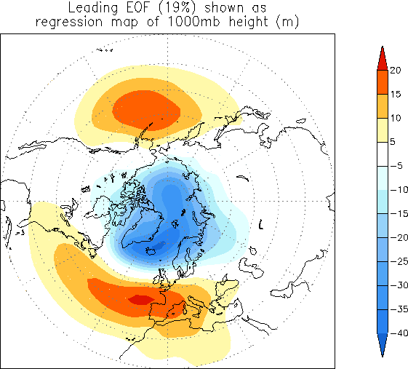
AO INDEX
EOF applied to monthly 1000hPa mean height anomalies
Poleward of 20° latitude
Max explained variance
For the period: 1979-2000
Loading pattern:
“First leading mode from EOF analysis”
Observations occur 1000hPa
Capture cold season patterns
CPC, 2013
Notes:
-

Slide 6
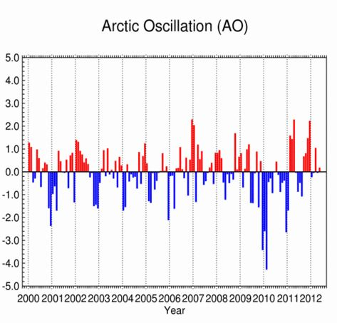
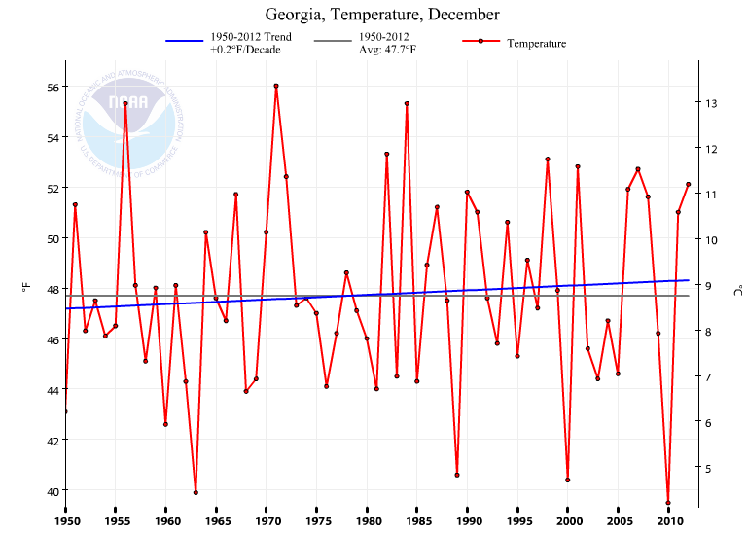
MOTIVATION
NCDC, 2013

Slide 7
HYPOTHESIS
AO and winter temperatures: significant correlation
Strongest in December
AO and winter rainfall: mediocre correlation
Georgia temperatures: lag behind AO
Georgia rainfall: lag behind AO
Datasets normally distributed
Pass $χ^{2}$ test

Slide 8
CLASS CORRELATION
Analysis from both parts of class
1950-2012 annual, DJF and individual winter month analysis
Statistical Analysis
Statistics
$χ^{2}$ Test
Correlation coefficients
Least-squares regression and error
Time Series Analysis
Periodogram
Cross-spectral density
Lag/phase values
Coherence

Slide 9
STATISTICAL ANALYSIS
Monthly analysis of DJF AO, temperature and rainfall data
Monthly skewness, kurtosis
Chi-squared $\left(χ^{2}\right)$ test on individual month’s variables
Monthly correlation coefficients and significance, 95% confidence interval
Total DJF least-squares regression and correlation coefficients

Slide 10
MONTHLY AND SEASONAL FACTS AND FIGURES

Slide 11
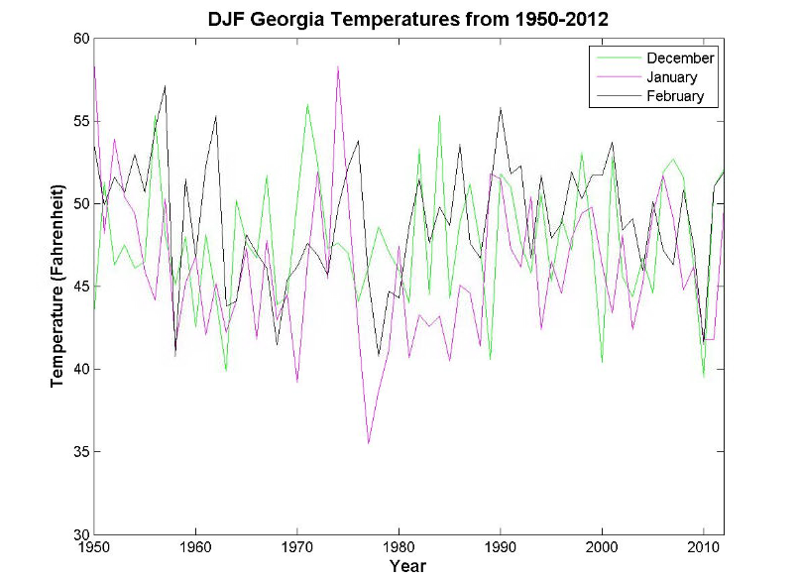
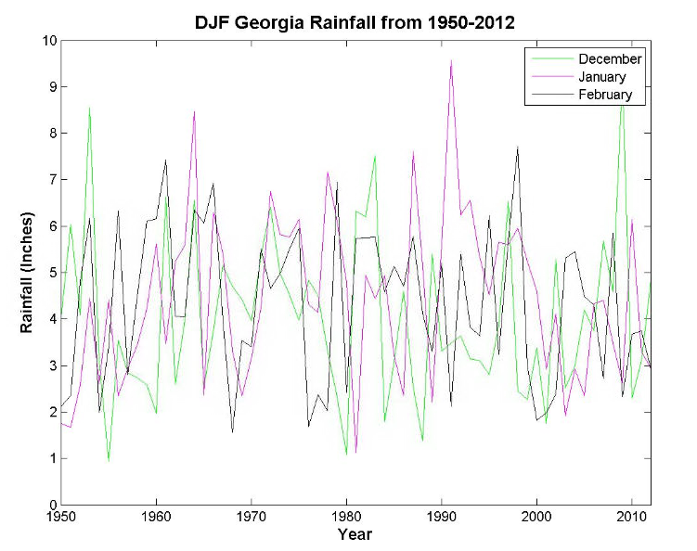
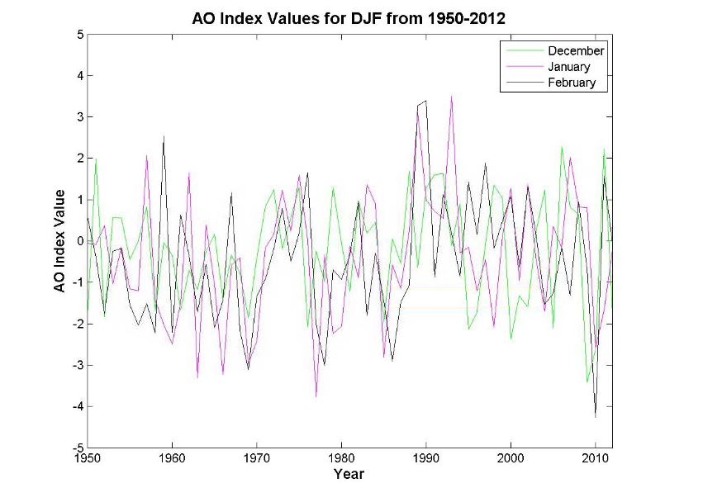
1950-2012 DJF GA Temperature
1950-2012 DJF GA Rainfall
1950-2012 DJF AO Index Values

Slide 12
STATISTICAL VARIABLES
GA Temperature | December | January | February
Mean | 47.7413 | 46.0111 | 49.0524
Skewness | 0.0497 | 0.5295 | -0.2415
Kurtosis | 2.6049 | 3.6938 | 2.6570
AO Index | December | January | February
Mean | -0.2222 | -0.4008 | -0.4553
Skewness | -0.1615 | 0.0381 | 0.2513
Kurtosis | 2.1953 | 2.8771 | 3.1664
GA Rainfall | December | January | February
Mean | 4.0171 | 4.4325 | 4.3506
Skewness | 0.7490 | 0.4075 | -0.0014
Kurtosis | 3.4796 | 2.9827 | 1.9305

Slide 13
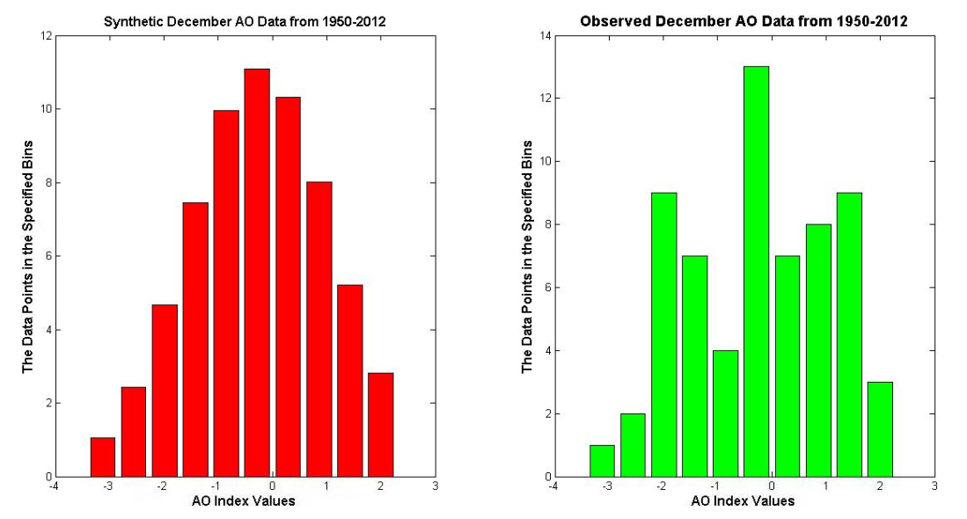

Slide 14
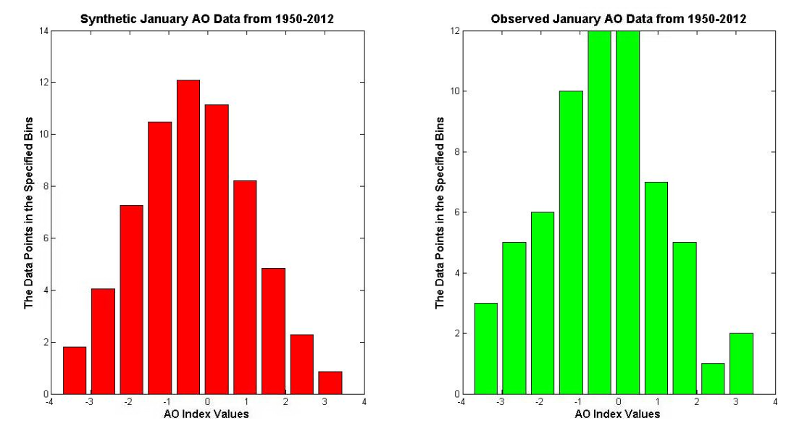

Slide 15
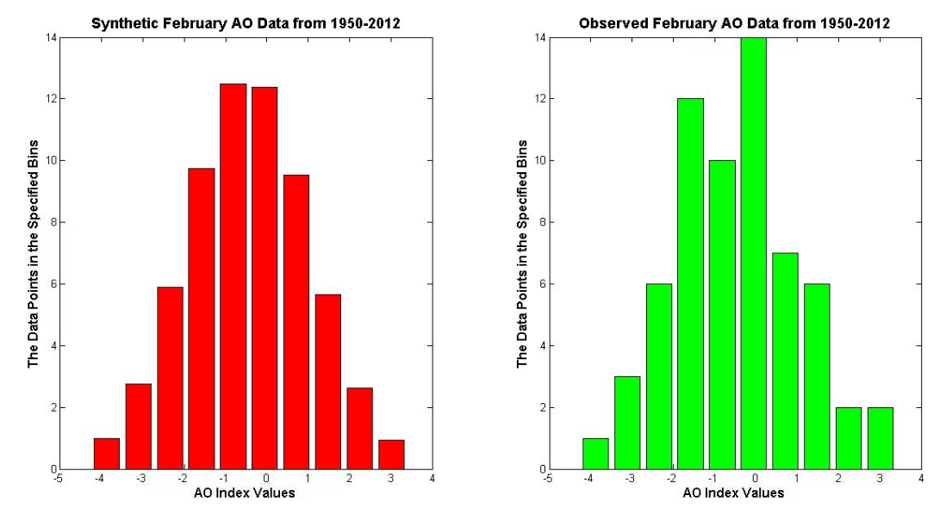

Slide 16
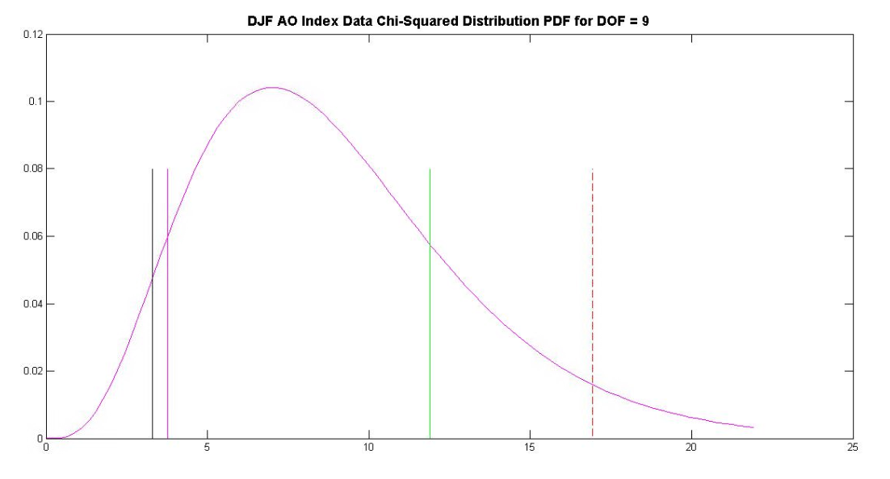
DJF AO INDEX CHI-SQUARED PROBABILITY DENSITY FUNCTION
February $χ^{2}$ value
Critical $χ^{2}$ value
January $χ^{2}$ value
December $χ^{2}$ value

Slide 17
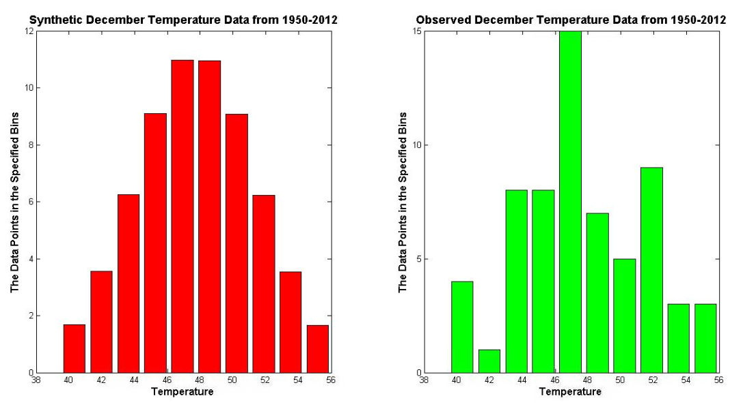

Slide 18
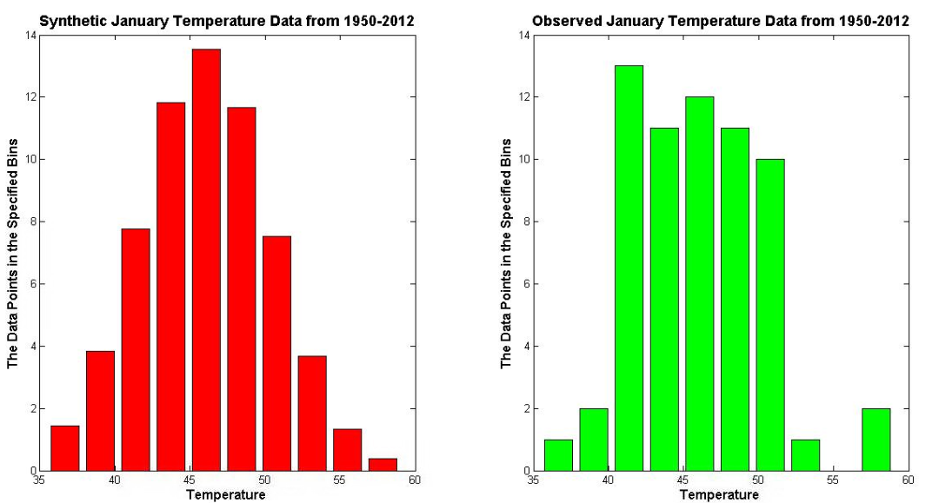

Slide 19
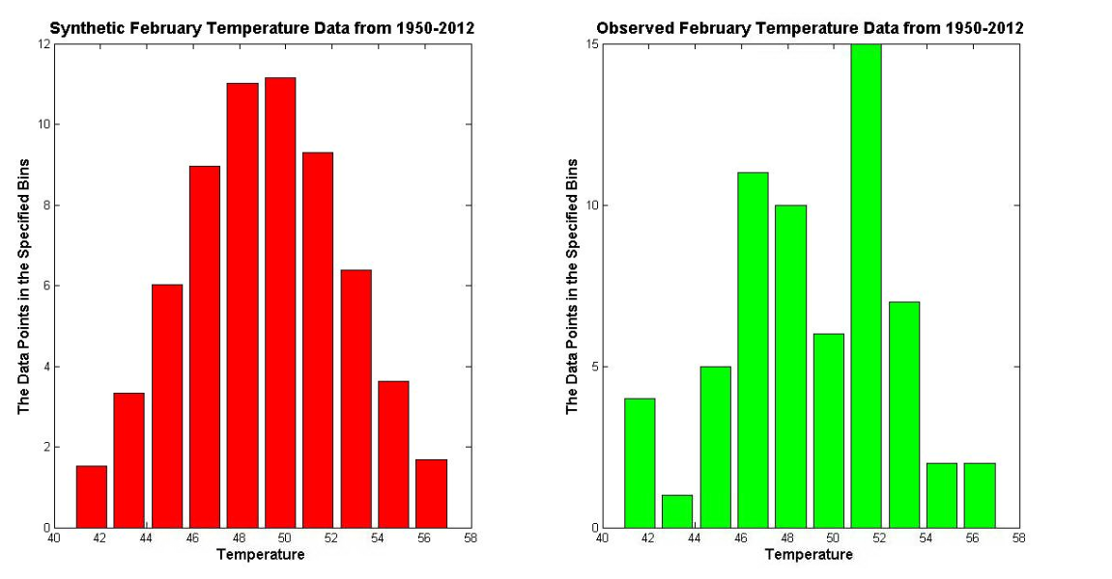

Slide 20
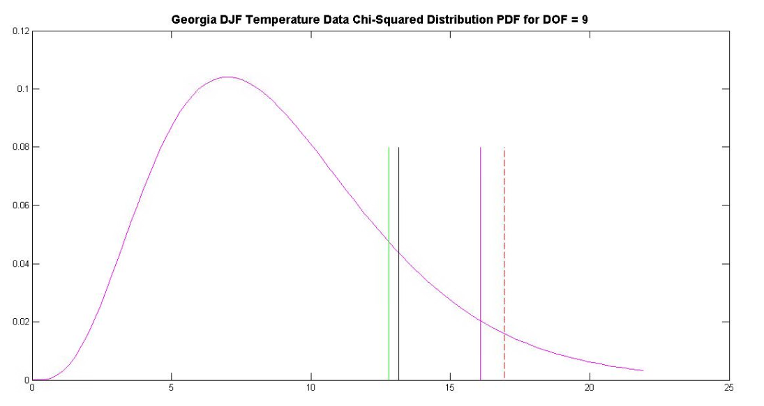
DJF GEORGIA TEMPERATURE CHI-SQUARED PROBABILITY DENSITY FUNCTION
January $χ^{2}$ value
February $χ^{2}$ value
Critical $χ^{2}$ value
December $χ^{2}$ value

Slide 21
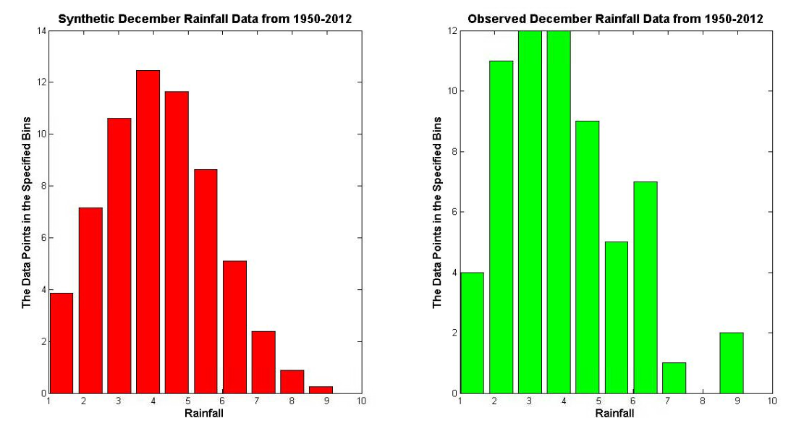

Slide 22
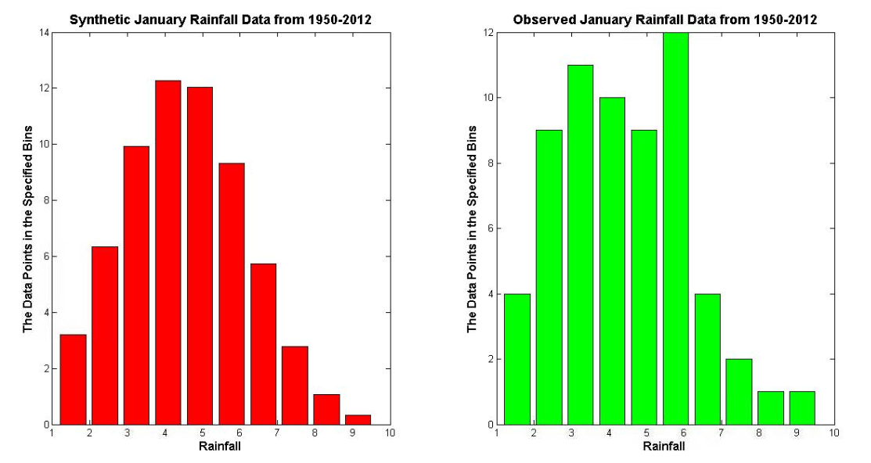

Slide 23
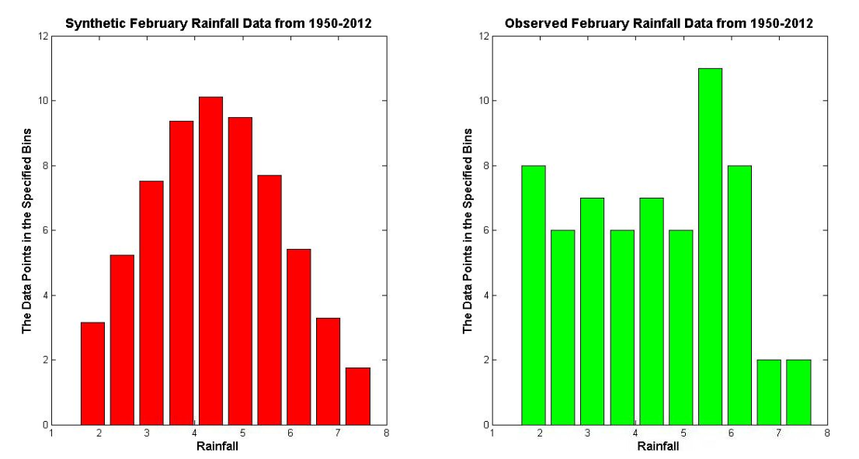

Slide 24
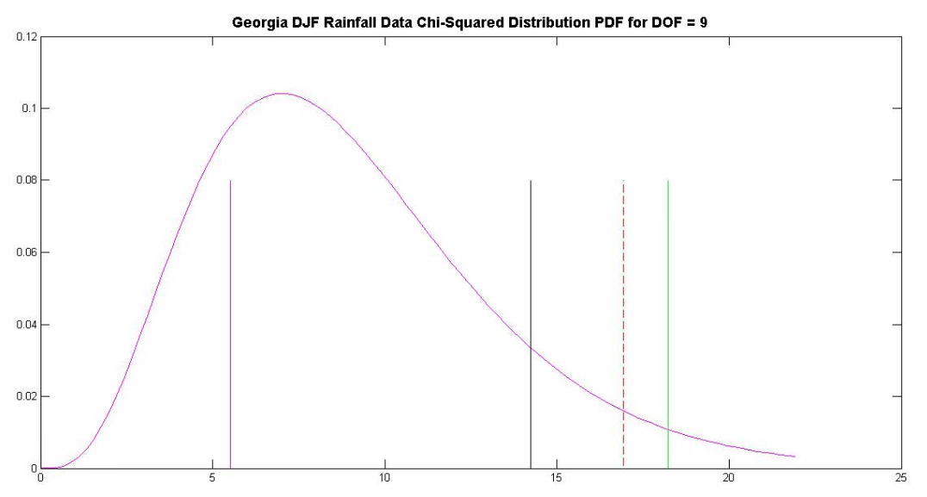
DJF GEORGIA RAINFALL CHI-SQUARED PROBABILITY DENSITY FUNCTION
February $χ^{2}$ value
January $χ^{2}$ value
Critical $χ^{2}$ value
December $χ^{2}$ value

Slide 25
CORRELATION COEFFICIENTS
AO-Temperature | December | January | February
Correlation Coefficient | 0.5299 | 0.4848 | 0.4754
Correlation Significance | 7.9763e-6 | 5.6523e-5 | 8.2223e-5
95% Confidence Interval | [0.6874; 0.3247] | [0.6540; 0.2694] | [0.6470; 0.2581]
AO-Rainfall | December | January | February
Correlation Coefficient | -0.1284 | 0.0447 | 0.0671
Correlation Significance | 0.3158 | 0.7282 | 0.6013
95% Confidence Interval | [0.1233; -0.3646] | [0.2892; -0.2054] | [0.3097; -0.1837]

Slide 26
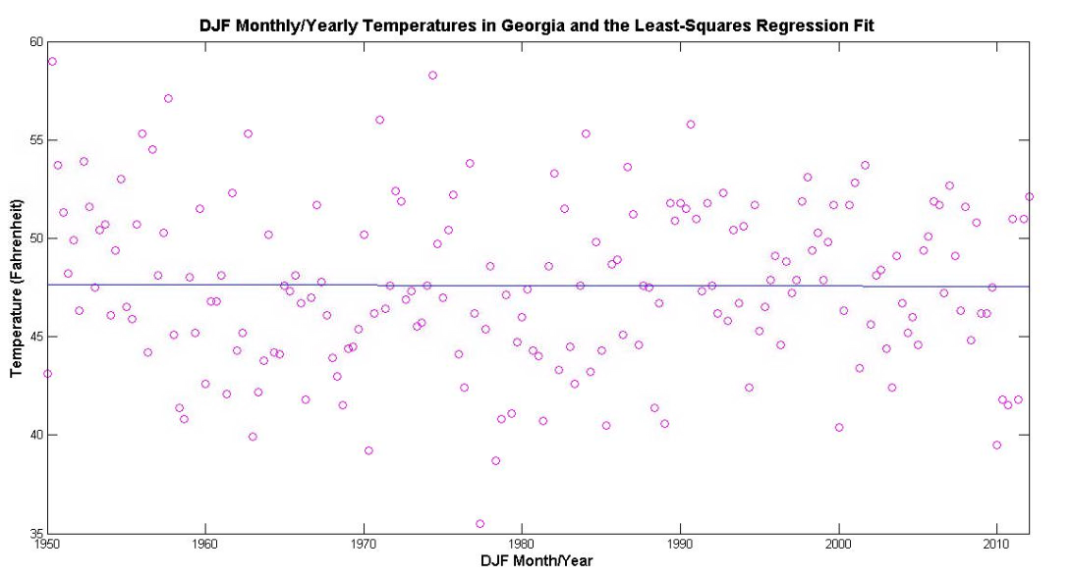
DJF MONTHLY TEMPERATURES, LEAST-SQUARES REGRESSION

Slide 27
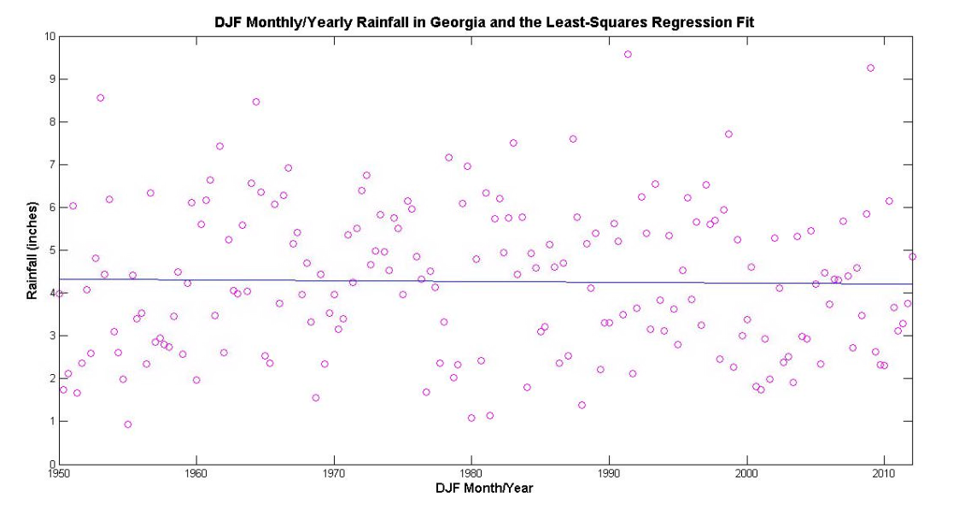
DJF MONTHLY RAINFALL, LEAST-SQUARES REGRESSION

Slide 28
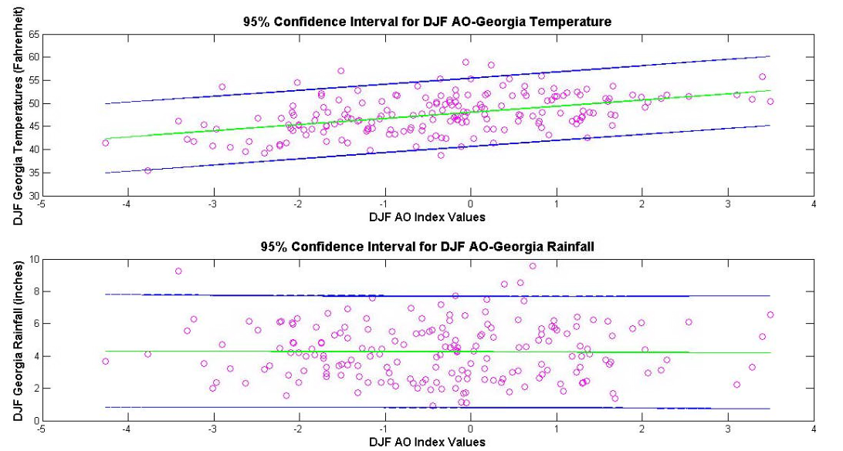
95% CONFIDENCE INTERVAL FOR TEMPERATURE AND RAINFALL

Slide 29
SEASONAL (DJF) CORRELATION COEFFICIENTS
AO-Temperature | DJF
Correlation Coefficient | 0.4667
Correlation Significance | 1.2933e-11
95% Confidence Interval | [0.5714; 0.3471]
AO-Rainfall | DJF
Correlation Coefficient | -0.0083
Correlation Significance | 0.9093
95% Confidence Interval | [0.1346; -0.1509]

Slide 30
ANNUAL FACTS AND FIGURES

Slide 31
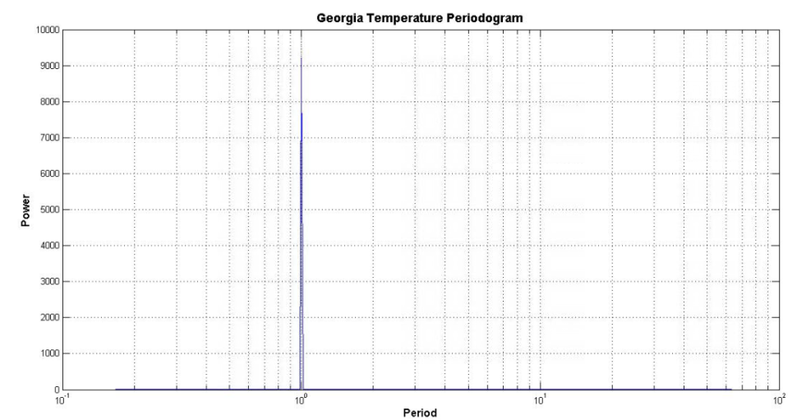
TIME SERIES ANALYSIS
Least-squares regression:
Georgia monthly temperature data (1950-2012)
Georgia monthly rainfall data (1950-2012)
Least-squares regression error:
AO Indices-Georgia Temperature
AO Indices-Georgia Rainfall
Periodogram
Cross-spectral density
Lags
Phase values
Coherence
Correlation coefficients

Slide 32
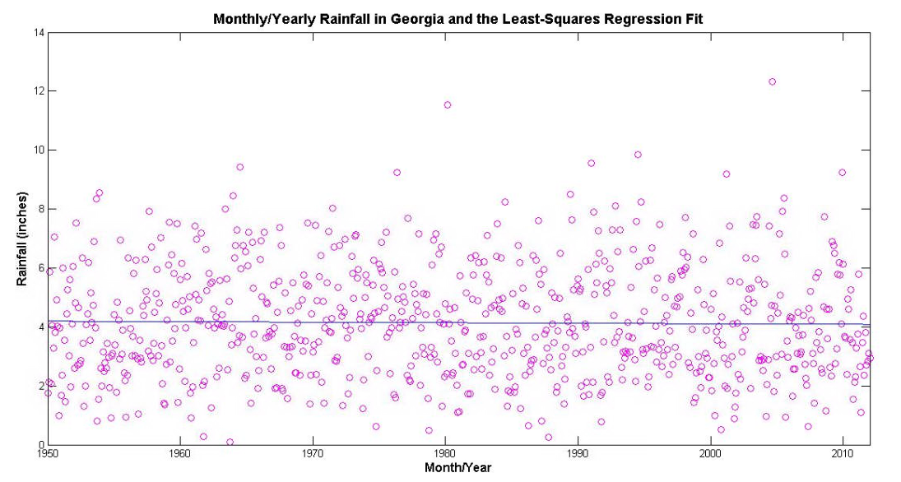
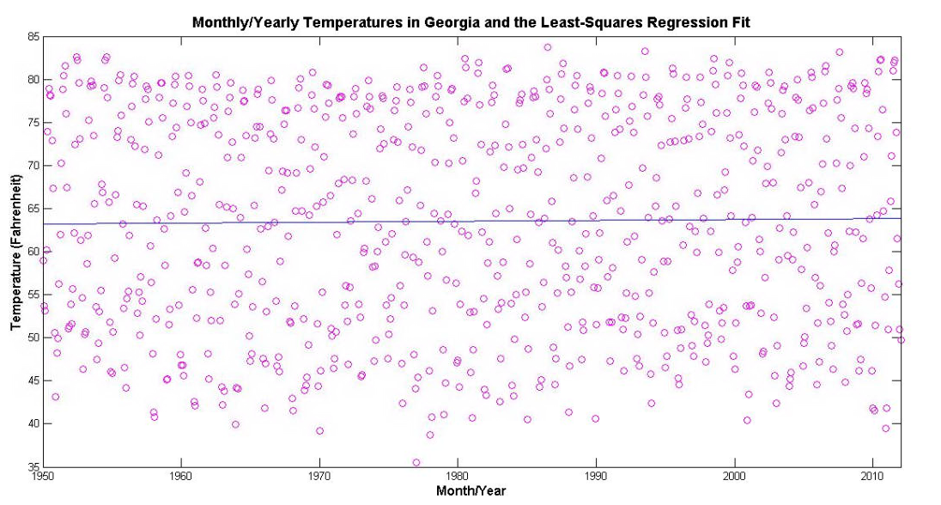
LEAST-SQUARES REGRESSION

Slide 33
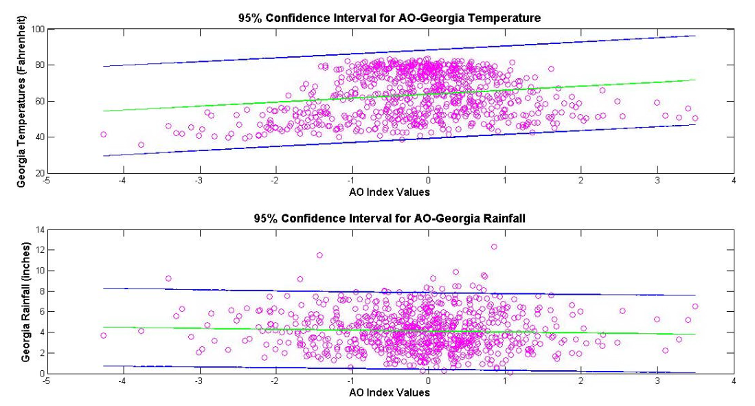
95% CONFIDENCE INTERVAL

Slide 34
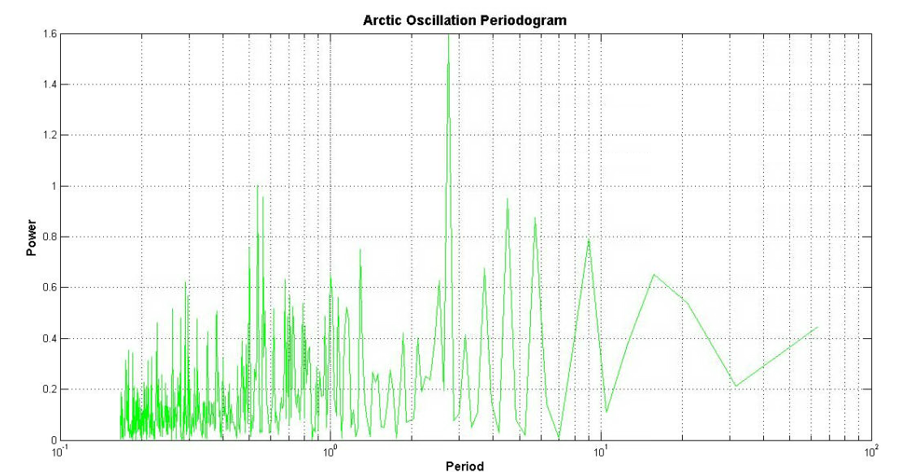
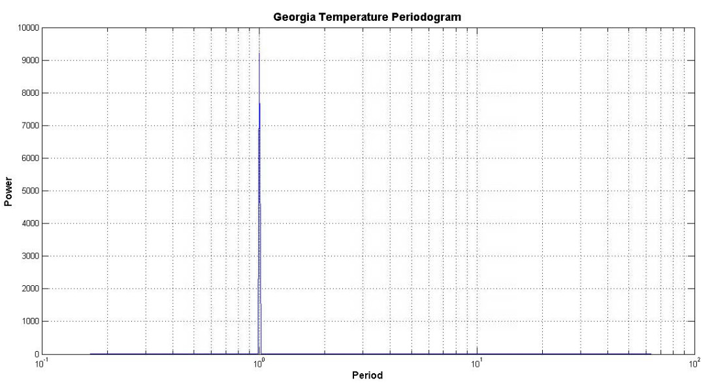
AO PERIODOGRAM
TEMPERATURE PERIODOGRAM

Slide 35
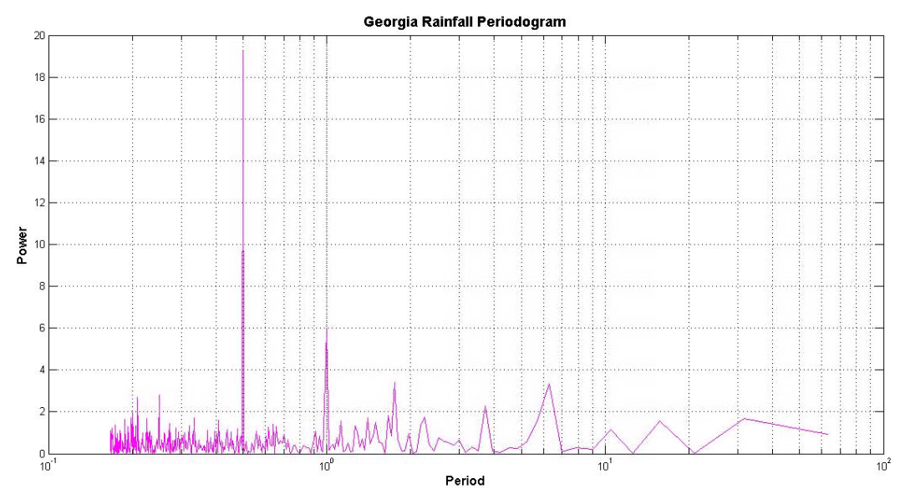
AO PERIODOGRAM
RAINFALL PERIODOGRAM

Slide 36
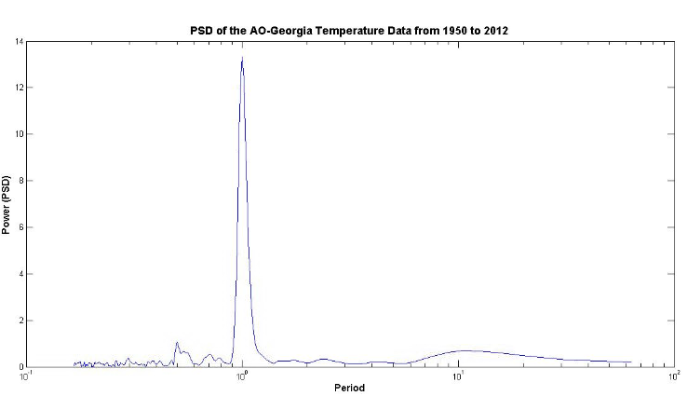
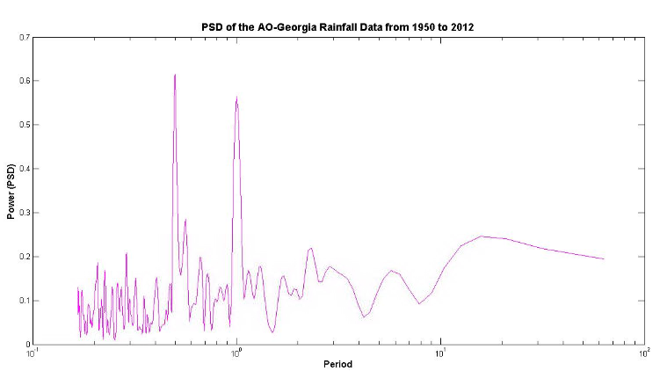
CROSS PSD ESTIMATE VIA WELCH

Slide 37
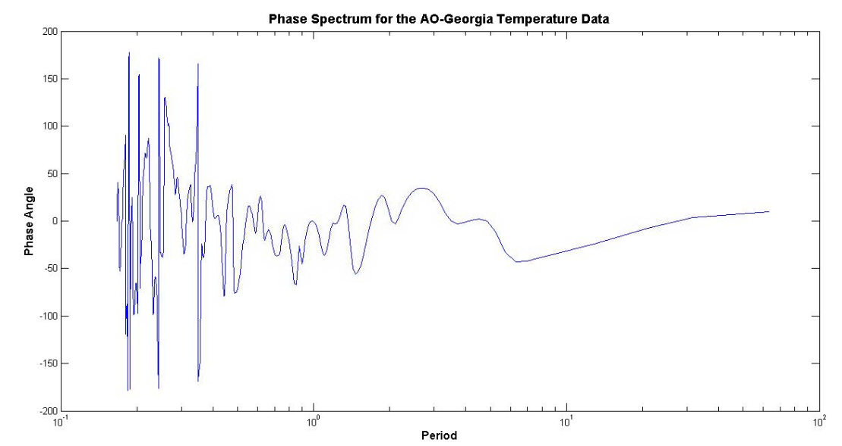
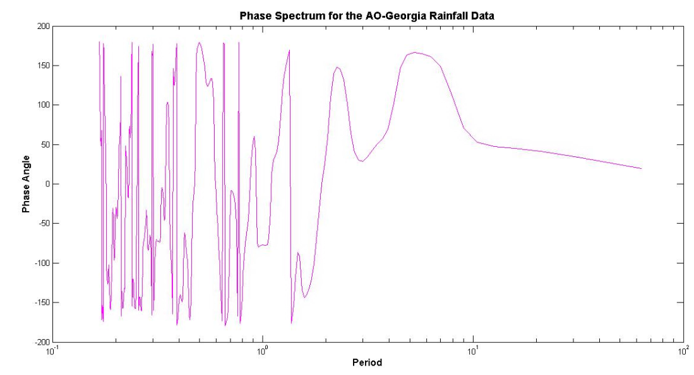
PHASE SPECTRUM

Slide 38
PHASE LAGS
 | AO-Temperature
Phase Lag | -0.8541
Yearly Lag | -0.0024
Daily Lag | -0.8660
 | AO-Rainfall
Phase Lag | -77.2009
Yearly Lag | -0.2144
Daily Lag | -78.2731

Slide 39
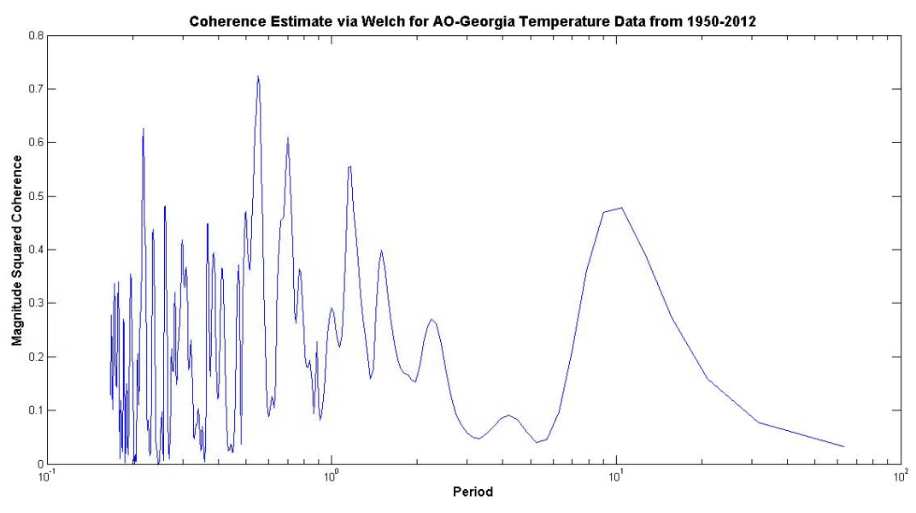
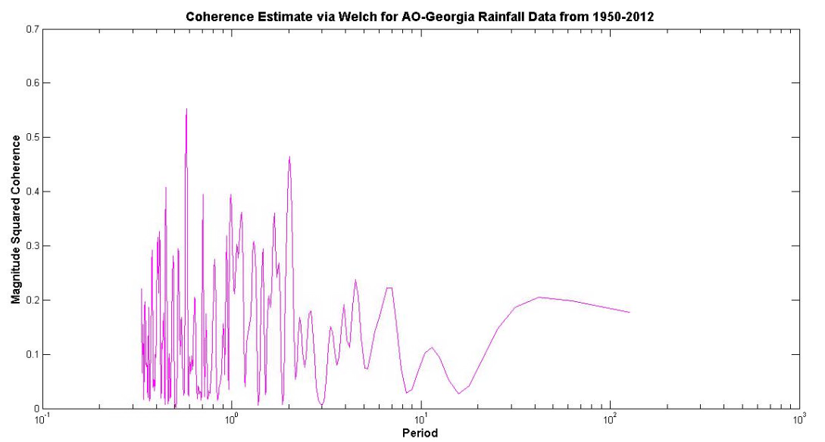
COHERENCE ESTIAMTE VIA WELCH

Slide 40
CORRELATION COEFFICIENTS
 | AO-Temperature
Correlation Coefficient | 0.1780
Correlation Significance | 8.4655e-7
95% Confidence Interval | [0.2461; 0.1080]
 | AO-Rainfall
Correlation Coefficient | -0.0451
Correlation Significance | 0.2152
95% Confidence Interval | [0.0263; -0.1161]

Slide 41
CONCLUSIONS
There is a significant correlation between the AO index and Georgia temperatures
Observed to be strongest in December (through correlation coefficient)
Little to no correlation between rainfall and AO
Georgia temperatures lag only slightly behind the AO index
Rainfall lags about 2.5 months
Overall, little correlation between annual temperatures and annual AO indices
Correlation does not mean causation

Slide 42
FUTURE WORK
Apply methods to data from the entire U.S.
See regional biases/consistencies
Study years with severe winter storms in the Southeast
Years with strongest negative AO values?
Investigate other teleconnections

Slide 43
REFERENCES
CPC, cited 2013: Arctic Oscillation (AO). [Available online at http://www.cpc.ncep.noaa.gov/products/precip/CWlink/daily_ao_index/ao.shtml.].
Higgins, R.W., Leetmaa, A. and Kousky, V.E., 2001: Relationships between Climate Variability and Winter Temperature Extremes in the United States. Journal of Climate.,15, 1555-1572.
NCDC, cited 2013: Monthly Mean AO index since January 1950. [Available online at http://www.cpc.ncep.noaa.gov/products/precip/CWlink/daily_ao_index/monthly.ao.index.b50.current.ascii.table.].
SERC, cited 2013: Georgia State Averaged Precipitation Data. [Available online at http://www.sercc.com/climateinfo_files/monthly/Georgia_prcp.html.].
SERC, cited 2013: Georgia State Averaged Temperature Data. [Available online at http://www.sercc.com/climateinfo_files/monthly/Georgia_temp.html.].
Websites Used for Images
http://nsidc.org/icelights/2012/02/02/the-arctic-oscillation-winter-storms-and-sea-ice/
http://www.cpc.ncep.noaa.gov/products/precip/CWlink/daily_ao_index/ao.loading.shtml
http://www.cpc.ncep.noaa.gov/products/precip/CWlink/daily_ao_index/ao_index.html
http://www.ncdc.noaa.gov/
http://www.cpc.ncep.noaa.gov/products/precip/CWlink/daily_ao_index/history/method.shtml
http://www.ncdc.noaa.gov/cag/
http://www1.ncdc.noaa.gov/pub/data/cmb/teleconnections/ao-5-pg.gif

