Slide 1
The Reliability of Tree Rings as a Temperature Proxy
Liz Wiggins

Slide 2
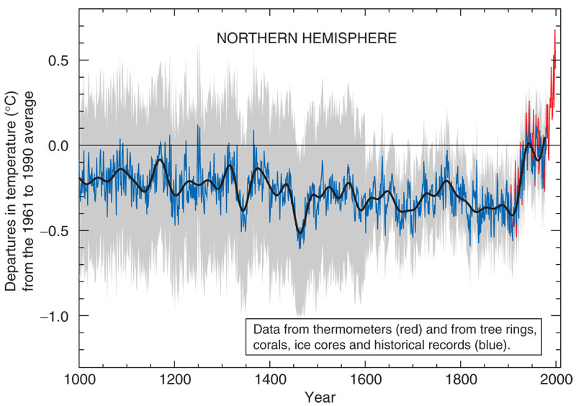
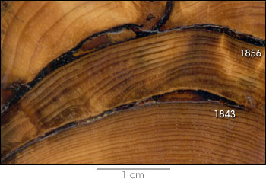
The Problem
Warming trend since the industrial revolution
Is it anomalous and/or anthropogenic?
Climate “Hockey Stick” (Mann et al 1998)
Large percentage of data from tree rings

Slide 3
Data
15 Northern Hemisphere tree ring records
Previously analyzed to extract temperature anomaly from tree ring width and density

Slide 4
Testing the Reliability
Determine the correlation between all 15 data sets
Average all 15 data sets by year and analyze warming trend
Compare historical (measured) warming trend to tree ring warming trend

Slide 5
Analysis
Determine the correlation between all 15 data sets
Calculate correlation coefficients
Resample using Bootstrap and recalculate correlation coefficients

Slide 6
Results
 | Mean | Standard Deviation
Before Bootstrap | 0.1224 | 0.1092
After Bootstrap | 0.1221 | 0.1250

Slide 7
Analysis
Average all 15 data sets by year and analyze warming trend
Perform least squares regression
Calculate slope and intercept
Resample using bootstrap
Perform least squares regression and calculate new slope and intercept

Slide 8
Results
 | Slope | Intercept
Before Bootstrap | 0.0024 | -4.4415
After Bootstrap | 0.0024 | -4.4643

Slide 9
Analysis
Compare historical (measured) warming trend to tree ring warming trend
Calculate correlation coefficient
Least squares regression (1880-present)
Calculate slope and intercept

Slide 10
Results
Correlation Coefficient = 0.5651
R² > 0.5 The two data sets are highly correlated

Slide 11
Results Cont.
Historical temperature least squares regression (1880 – present)
Slope: 0.0057
Intercept: -11.1633
Tree ring temperature least squares regression (1880 – present)
Slope: 0.0056
Intercept: -10.7432
Same slope = Same trend

Slide 12
Conclusions
Tree ring records are not highly correlated with each other (R² = 0.1224 < 0.3)
Average of all tree ring temperature anomalies is highly correlated (R² = 0.5651 > 0.5) to historical temperature anomalies
As long as multiple tree ring records are used, they can be considered a reliable proxy
Tree ring data used in “Hockey Stick” confirmed

Slide 13
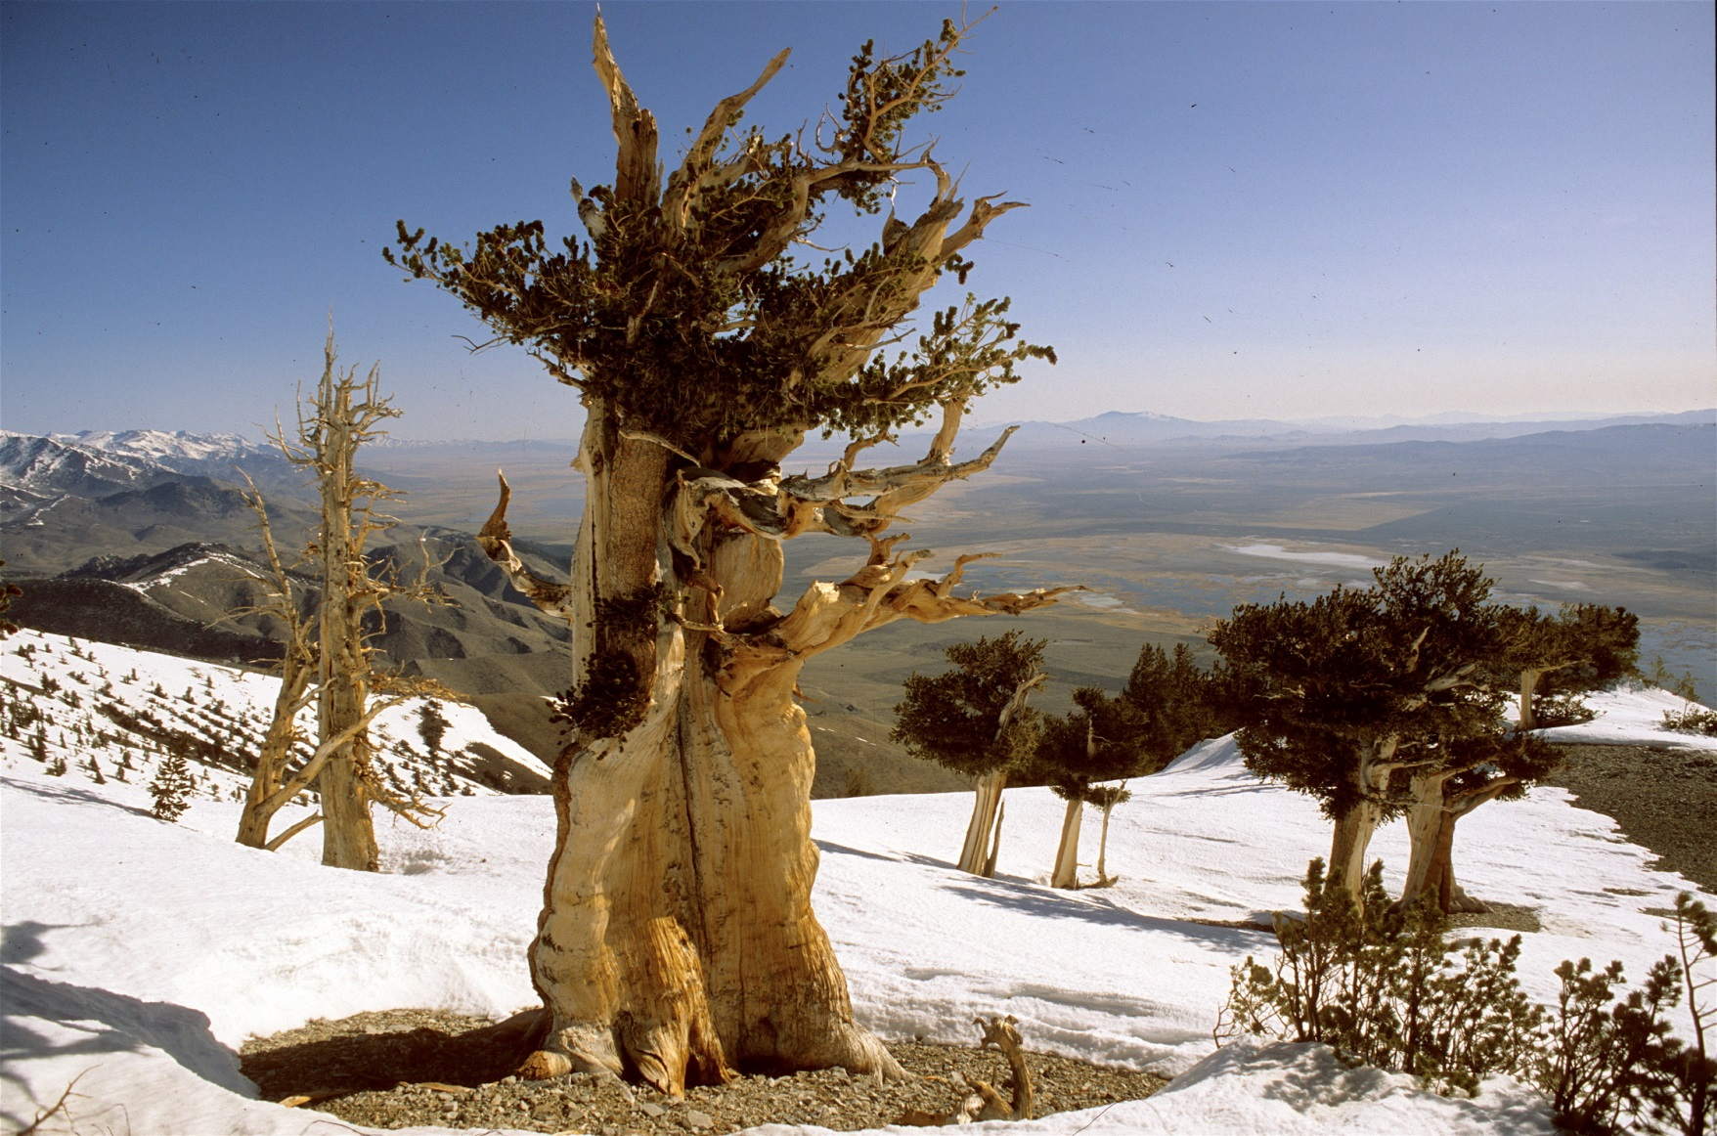
Questions??

Slide 14
References
Mann, Michael E., Raymond S. Bradley, and Malcom K. Hughes. Northern Hemisphere Temperatures during the past Millennium: Inferences, Uncertainties, and Limitations. Geophysical Research Letters 26.6 (1999): 759-62.
Wilson, Rob M., et al, A Matter of Divergence: Tracking Recent Warming at Hemispheric Scales Using Tree Ring Data. Journal of Geophysical Research - Atmospheres 112.D17103 (2007).
http://a-sceptical-mind.com/wp-content/uploads/2009/12/Hockey_stick_chart_ipcc_large.jpg
http://www.google.com/url?sa=i&rct=j&q=&esrc=s&source=images&cd=&docid=tYz42wFDW34WaM&tbnid=2DWa-hfxkmPGXM:&ved=0CAIQjBw&url=http%3A%2F%2F193.105.21.101%2Fimage%2F7358%2Fthe_texture_of_the_tree_rings_1920x1200.jpg&ei=wKZ2UZWTNIP-8ASAi4CoBw&bvm=bv.45512109,d.eWU&psig=AFQjCNEFs46ebQTZYe4ZCS-q7NzV54S-mg&ust=1366816818675207
http://www.mensadventuretravel.com/wp-content/uploads/2009/02/bristlecone-pine-12.jpg

