Slide 1
Correlation Between Health Risk Factors and Potential Years of Life Lost
Jacob C Heinrichs
Apr 25 2013

Slide 2
Hypothesis
1. Started out as a theory that West Coast Prevailing on shore winds decreases effects of PM2.5, PM10, CO, OZONE, and Sox
2. Finalized as a theory that all categories of health risk factors collected from the Census should show a correlation with Potential Years of Life Lost per 100,000 people.
Poor or Fair Health
Low Birth Weight
Smoking
Obesity
Physical Inactivity
Unemployment
Fine Particle Concentrations
Drinking Water Quality

Slide 3
Objective
Show Correlation between Risk Factors and YPLL
Least Squares Regression
Correlation Coefficient
Bootstrap Samples and Corr. Coef

Slide 4
Data
Data Collected from County Health Rankings & Roadmaps program is a collaboration between the Robert Wood Johnson Foundation and the University of Wisconsin Population Health Institute
2013

Slide 5
Original Data

Slide 6
Bootstrap Histogram
Correlation Coefficient: 0.742
Ideal chi2 = 11.0705
Calculated chi2 = 8.5069

Slide 7
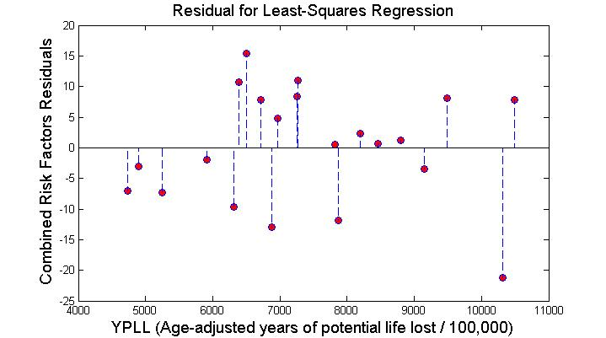
Regression Fitting

Slide 8
Conclusions
As expected the combined environmental and socio-economic risk factors showed a strong correlation to the Potential Years of Life Lost per 100,000 people.

