Slide 1
The Madden-Julian Oscillation and North Atlantic Hurricanes
Melissa Nord
EAS 4480

Slide 2
What You Will See & Hear (or so I hope…)
Introduction
Hypothesis
Method
Data and Results
Conclusions
Further Work

Slide 3
What is the Madden-Julian Oscillation?
Intra-seasonal variability (30-90 days)
Large scale coupling between atmospheric circulation and deep tropical convection
Propagates eastward 4-8 m/s above warm parts of the Indian and Pacific Oceans

Slide 4
Characteristics of the MJO
Eastward progression of large regions of enhanced/suppressed tropical rainfall
Indian & Pacific
Atlantic -> Lower Amplitude
Wet Phase
Dry Phase
Active Phase tracked using degree of outgoing long-wave IR
Lower IR, stronger convection

Slide 5
Characteristics of the MJO
Enhanced Surface Westerly Winds occur near the east side of the active convection
Easterly winds to the west of the enhanced rainfall area
Due to divergence aloft over t-storms

Slide 6
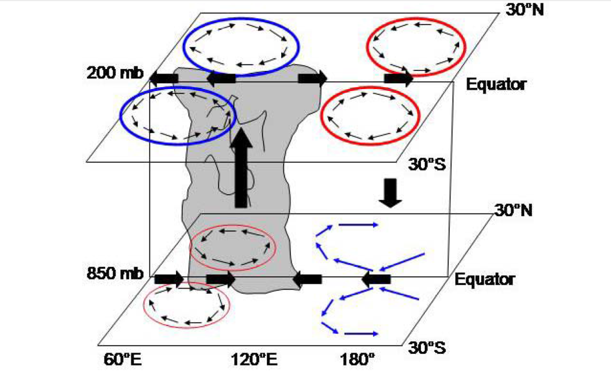
Influence on Tropical Cyclogensis
Modulates enhanced/suppressed activity by providing a large scale environment that is favorable/unfavorable for development
Ascending Motion
Descending Motion
MJO and favorable region for TC development both progress eastward together
Inverse relationship NW Pac and N Atl Basin
Opposite MJO Modes

Slide 7
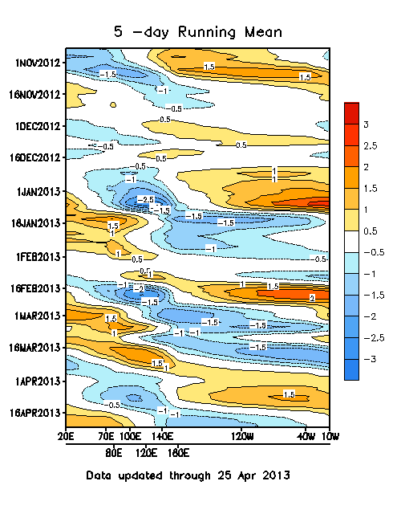
Daily MJO Indicies
Extended Empirical Orthogonal Function (EEOF) applied to 200 hPa for ENSO Neutral & Weak Winters
1st EEOF = 10 time-lagged patterns
Construct ten (10) MJO Indicies by regressing the data onto the ten patterns of the first EEOF.
Blue = Enhanced Convection
Red = Suppressed Convection

Slide 8
A Closer Look at MJO Index

Slide 9
Data
MJO Index 1-10
Atlantic Hurricanes By Month
Problem:
MJO = Weekly
Atlantic Hurricanes = Monthly

Slide 10
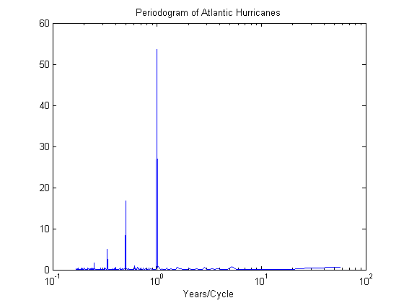
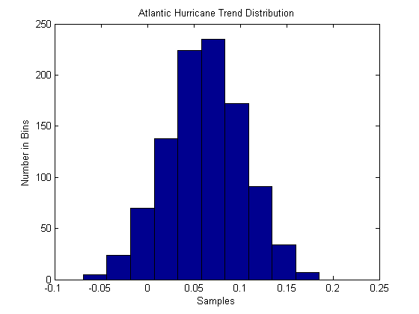
Looking at Hurricanes in Atlantic

Slide 11
A Look at the MJO Index

Slide 12
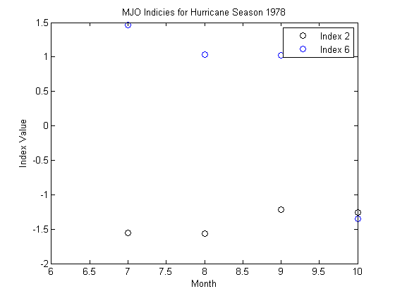
Just Looking at 1978

Slide 13
1978 Hurricane Histogram

Slide 14
Trying to Find Correlation Between MJO Index and Hurricane Frequency
%Correlations... T test
[h, significance, ci] = ttest2(Hurr_test, Index_1978_2)
[h, significance, ci] = ttest2(Hurr_test, Index_1978_6)
%Correlation Coefficient
corrcoef(Index_1978_2, Hurr_test)
corroef(Index_1978_6, Hurr_test)
corrcoef(Index_1978_2, Index_1978_6)
%Polyyy
p = polyfit(Index_1978_2, Index_1978_6, 1)
p2 = polyfit(Index_1978_2, Hurr_test, 1)
p3 = polyfit(Index_1978_6, Hurr_test, 1)
DID NOT WORK WELL SINCE SO FEW DATA POINTS!

Slide 15
What I’m Doing This Weekend
CODING!
Better Sorting Through Data
Figuring Out Problem of Months Vs. Weeks
T-test, F-Test, Correlation Coefficient, Pearson Correlation Coefficient, Autocorrelation, Periodogram, Least Squares Regression, and Time Series Analysis
Phase Lag!

Slide 16
Sources
http://www.cgd.ucar.edu/~maloney/hurricanes/hurr.web.pdf
http://www.atmos.washington.edu/~dennis/Maloney%26HartmannScience.pdf
CPC MJO Information
Wikipedia

Slide 17
WHAT IS AWESOME

