Slide 1
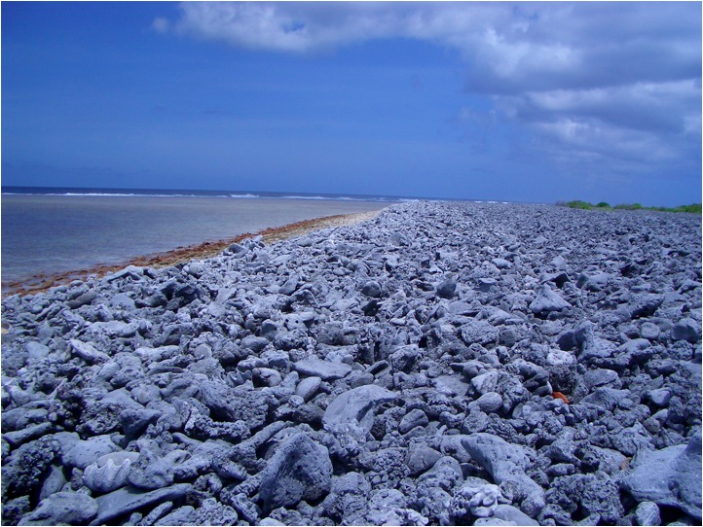
Christmas Island Coral Demonstrates Tropical Pacific ENSO Variability
Pamela Grothe
EAS 4480 Class Project
April 25th, 2012

Slide 2
MOTIVATION FOR PALEO-ENSO RECONSTRUCTION
Collins et al., 2010
Motivational Questions:
How will ENSO variability be affected by global warming?
What climate models do best at predicting ENSO variability
Problems:
Modern record of SST in the Tropical Pacific is not long enough to test validity of future ENSO predictions
Need longer proxy records for model calibration
Collins et al., 2010

Slide 3
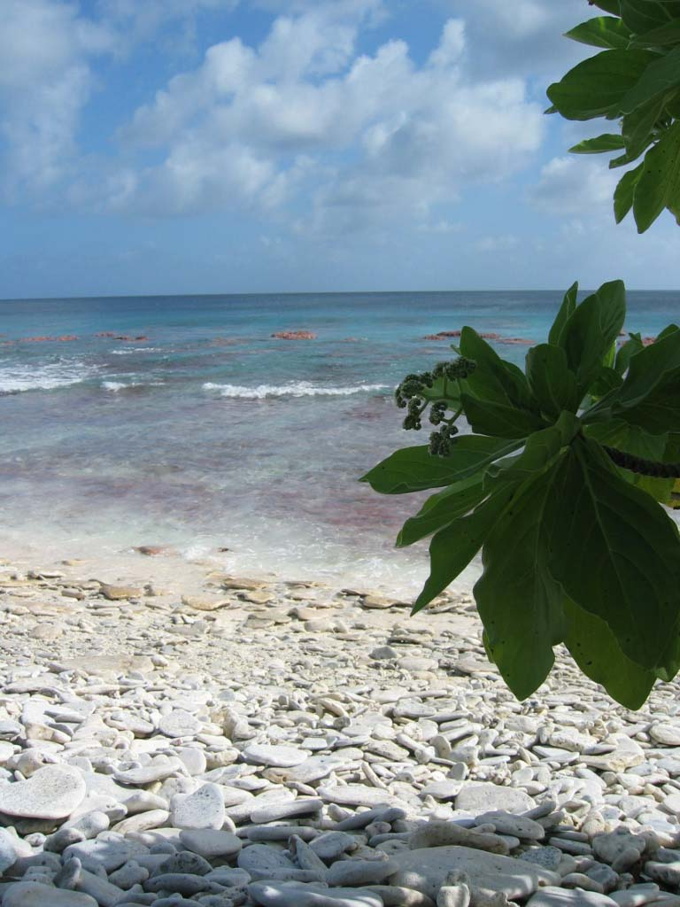
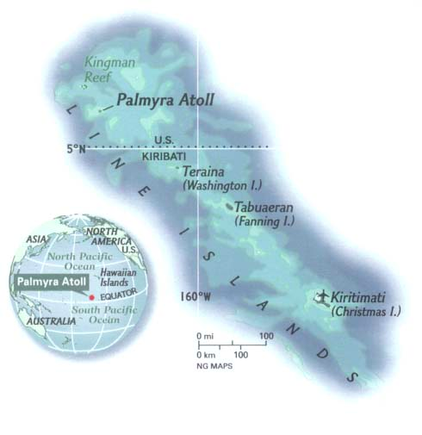
Research Question:
Can we extend SST records, and thus ENSO records, using coral from the Central Tropical Pacific?

Slide 4
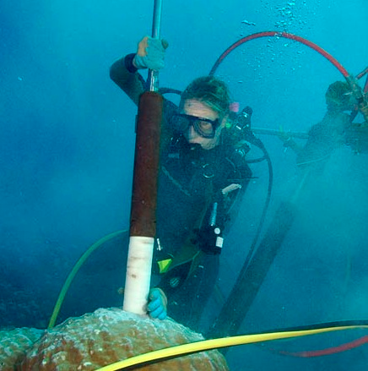
Before you can use fossil coral for paleo ENSO-reconstruction, you must calibrate the modern coral to the instrumental record
Can I use the δ¹⁸O of modern coral on Christmas Island as a proxy for SST?
If so, how well does the δ¹⁸O, and thus SST, at Christmas Island record ENSO variability?
These are fundamental questions that must be answered before I can apply my δ¹⁸O work on fossil coral at Christmas Island as a climate/ENSO proxy
Nurhati et al., 2009

Slide 5
2012
Geochemistry and Coral Background
Coral’s build aragonite skeleton
During growth of their skeleton, they take up oxygen from the water
CaCO₃
We can measure the ratio of oxygen 18 to oxygen 16 atoms in their skeleton
δ¹⁸O
δ¹⁸O of the sea water is a function of SST and Salinity
Lighter (more negative) = warmer and wetter
Heavier (more positive) = cooler and dried
Christmas Island Porites corals grow on average 15 mm a year - Band count to get accurate age model
We sample every 1 mm – obtaining a sub-monthly resolution
1998
40 cm

Slide 6
Methods
Data
  Coral δ¹⁸O from my own work and from Cobb et al. (2013)
  SST from IGOSS dataset from Reynolds et al. (2002)
  NINO3.4 Index
Data Processing
  Splice coral δ¹⁸O records
  Interpolation methods for δ¹⁸O
Correlation between δ¹⁸O and SST at Christmas Island
  Pearson’s correlation coefficient and its significance at the 95% confidence interval
Correlation between δ¹⁸O and Nino3.4 Index
  Individual periodograms
  Cross spectral analysis and coherence
  Band-pass filter to the most coherent frequencies
  Pearson’s correlation coefficient and its significance at the 95% confidence interval

Slide 7
Data Processing
Correct for offsets – 0.1 per mil offset between overlapping values
Splice my record to Cobb et al. 2013 record

Slide 8
Data Processing
Interp1 to interpolate the δ¹⁸O to the monthly SST and Nino3.4 Index

Slide 9
-

Slide 10
Confidence Interval = [-0.7786 to -0.8229]

Slide 11
RMA Slope = -5.13
RMA Intercept = 2.77
PC Slope = -6.32
PC Intercept = -2.92
Notes:
Slope and intercept for the 2
Mean-squared error – which method has a smaller one
Residual analysis – if not normally distributed…..

Slide 12
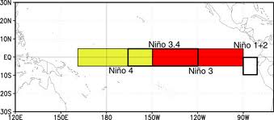
Coral δ¹⁸O and Nino3.4 Index

Slide 16
Confidence Interval = [-0.9185 to -0.9291]

Slide 17
Future Work – Advanced Environmental Data Analysis!
Add a third component – Precipitation?
Reconstruct ENSO using fossil coral δ¹⁸O – look at a change in the standard deviation compared to the modern?
It’s only my first year – I have four more years to do all this!

