Slide 1
Arctic Oscillation Index vs. FFC Temperatures DJF 1997-2012
Will Lanxton

Slide 2
Scientific Question
We want to analyze the possible correlation between the Arctic Oscillation Index and winter high temperatures in Peachtree City, Georgia. The null hypothesis is that there is no correlation between the AOI and temperatures in Peachtree City. The alternative hypothesis is that there is a correlation, and that in general the cold air outbreaks are directly correlated with a largely negative AOI trend.

Slide 3
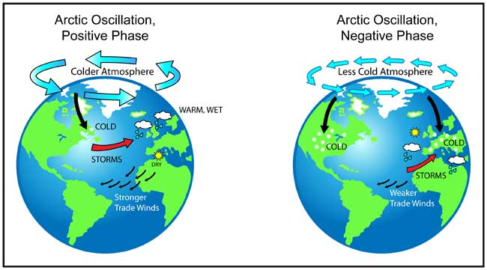
Arctic Oscillation

Slide 4
Analysis Methods
Pearson's Correlation Coefficient
Periodogram
Cross-spectral analysis

Slide 5
Data Time Series

Slide 6
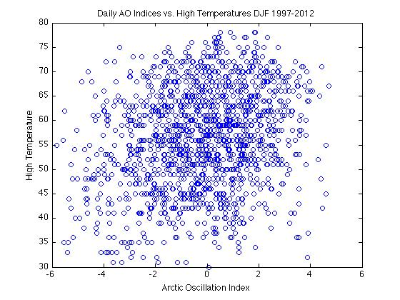
Correlation Coefficient
R = 0.23
P = 4.43x10⁻¹⁹

Slide 7
Periodogram

Slide 8
Cross-Spectral Analysis

Slide 9
Conclusion
Winter-time surface high temperatures in Peachtree City are slightly correlated to the AO index for that day, but the correlation is significant.

Slide 10
Further Steps To Take
Gather and use continuous data from 1997-2012 – not just winter months.
Histograms of each AO phase
Re-do CC – expect it to be more correlated
Periodogram – expect it to be less noisy
Expect to actually get something from the cross-spectral analysis

