Slide 1
1870-2013 Nino3.4 Indices and Monthly Precipitation Totals for Select U.S. Cities
Bryson McNulty
EAS-4480
Georgia Inst. Of Technology
April 22nd, 2014

Slide 2
Outline
Intro: ENSO and the Effects on U.S. Precipitation
Project Goals and Tests to Perform
Processing the Data for Comparison
Nino3.4 Indices Before and After 1950
Total Monthly Precipitation Data From Multiple Stations Within a “City”
City by City Comparison to the Nino3.4 Indices
Discussion and Future Work

Slide 3
Brief Intro: Nino3.4 Index
El Nino Southern Oscillation Anomalies in the SST and Circulations at the Equatorial Pacific
Warm SST Anomalies = El Nino
Cold SST Anomalies = La Nina
Mean SST in the Nino3.4 Box Defines Index
Good for Mature El Nino and La Nina Events
Image Source: http://www.cpc.ncep.noaa.gov/products/analysis_monitoring/ensostuff/nino_regions.shtml

Slide 4
El Nino Effects on U.S. Precipitation
Seasonal Variations
Wet Coasts in Winter
Dry Northwest in Fall
Dry Midwest in Spring and Winter
Focus on Locations That see Strong Anomalies
Positive or Negative
Image Source: http://www.cpc.ncep.noaa.gov/products/precip/CWlink/ENSO/composites/

Slide 5
La Nina Effects on U.S. Precipitation
Image Source: http://www.cpc.ncep.noaa.gov/products/precip/CWlink/ENSO/composites/

Slide 6
Project Goals and Tests to Perform
Build a El Nino and La Nina Event History Without Global SST Trend Influence or Monthly Variation Noise
Linearly Detrend and use a 3-Month Smoothing From Literature
Combine Station Data for Overlapping Times and Calculate the 95% Confidence Interval at Each Time
Test the Correlation Between the Nino3.4 Index and the Total Monthly Precipitation at Each City
P must be < 0.05 for Significance

Slide 7
Nino3.4 Indices Before and After 1950
Most Robust Data from 1950-Present
SST Observations More Frequent After 1950
Models of SST Allow for Pre-1950 Data From Scarce Observations
HadISST (Hadley Centre Sea Ice and Sea Surface Temperature) data set
1870 to 2013 Monthly Nino3.4 Data

Slide 9
City Data Collection
National Climatic Data Center (NCDC) Data
Included all Stations Within a City’s Radius
Cover the Time Frame
Data to Compare Each Month
Higher Confidence
Selected 3 U.S. Cities
Chicago, IL
Jacksonville, FL
Seattle, WA
Image Source: http://www.ncdc.noaa.gov/

Slide 10
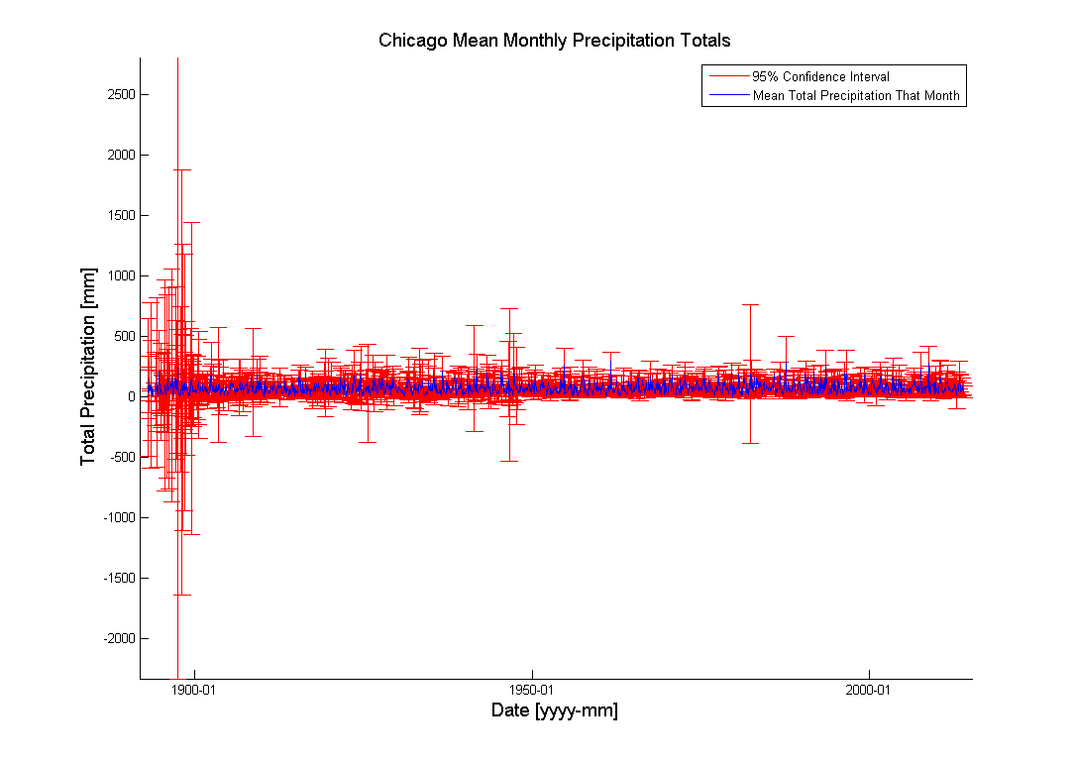

Slide 11
Correlation for Chicago vs. Nino3.4
R = .2149
P = ~1.2E-16

Slide 12
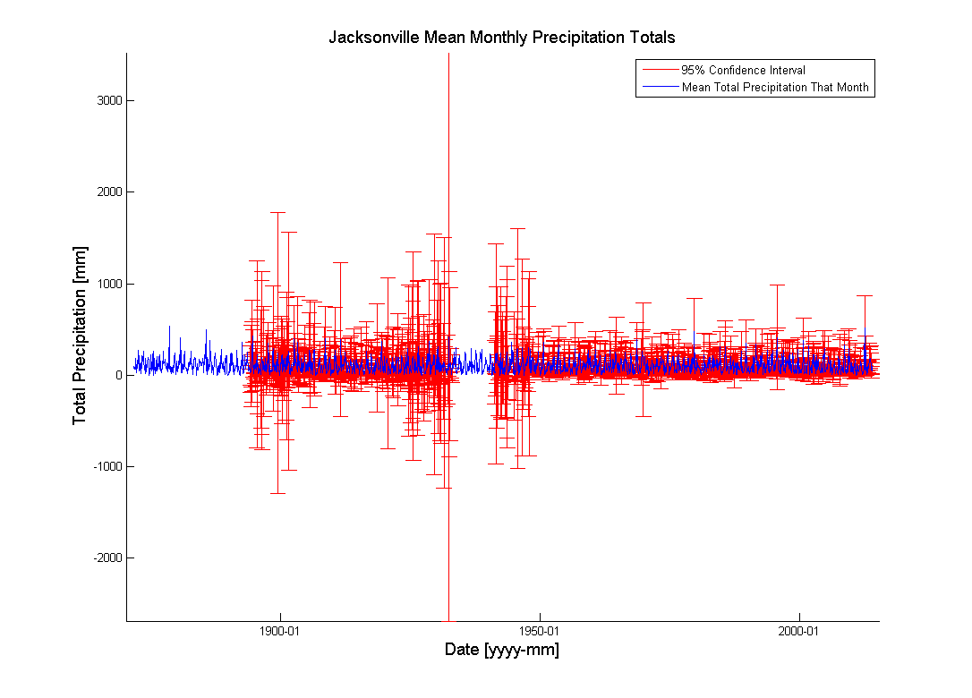

Slide 13
Correlation for Jacksonville vs. Nino3.4
R = 0.1908
P = ~1.9E-15

Slide 14
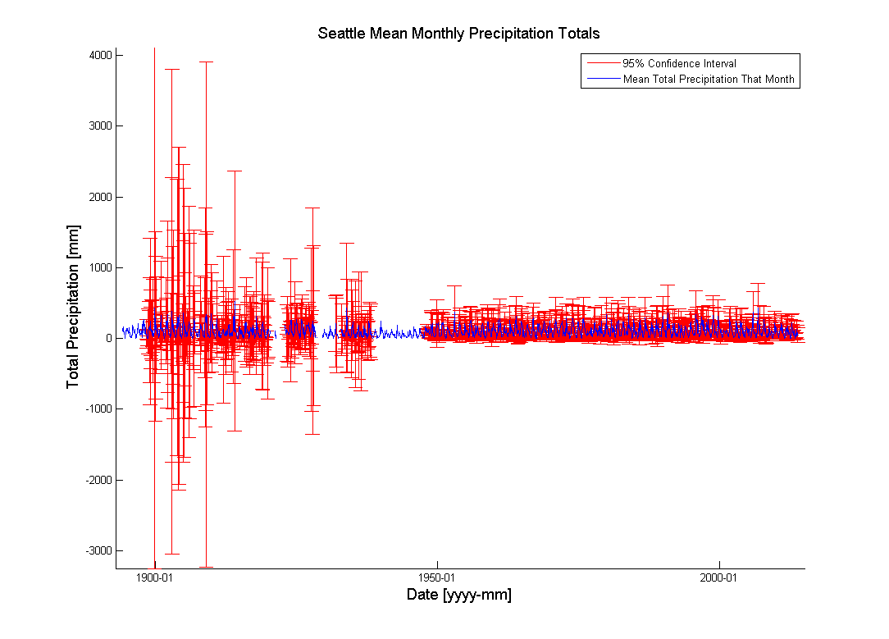

Slide 15
Discussion
A Little Positive Correlation (0<r<0.3) between 3-Month Smoothed Data With Entire Year
This was Significant for Both Jacksonville and Chicago
Seasonal Cancelling (wet winter, dry summer, positive Nino3.4, etc.) Needs to be Considered
Time Gaps in Station Data Increase 95% Confidence Interval Range/Size
Chicago has the Best Coverage in This Respect
Missing Data for Seattle Make Calculations Difficult
Comparison of La Nina and El Nino Events Defined by my Calculations to Literature Require More Research

Slide 16
Future Work
Use Nino3.4 El Nino and La Nina Distinctions to Compare only Stronger Events
Use Only JFM Months for Strong Events
Compare Different Station/City Data Sets
New Locations (Los Angeles, Atlanta, etc.)
New Data Types (Temperatures, Max Temperatures, etc.)
New Data Time Frames (Daily and Yearly)
Periodicity and Lag Autocorrelation Tests

Slide 17
Resources
http://www.cpc.ncep.noaa.gov/products/analysis_monitoring/ensostuff/nino_regions.shtml
http://www.cpc.ncep.noaa.gov/products/precip/CWlink/MJO/enso.shtml
http://www.esrl.noaa.gov/psd/gcos_wgsp/Timeseries/Data/nino34.long.data
http://www.metoffice.gov.uk/hadobs/hadisst/
http://www.ncdc.noaa.gov/

