Slide 1
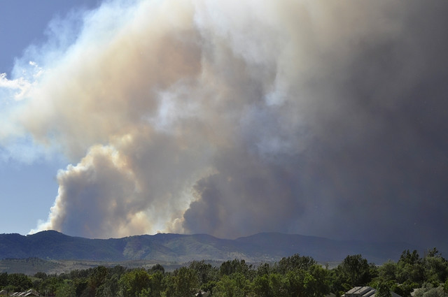
Data analysis project
Simone phillips
24 april 2014
Eas 4480
Notes:
http://www.droughtoutlook.com/

Slide 2
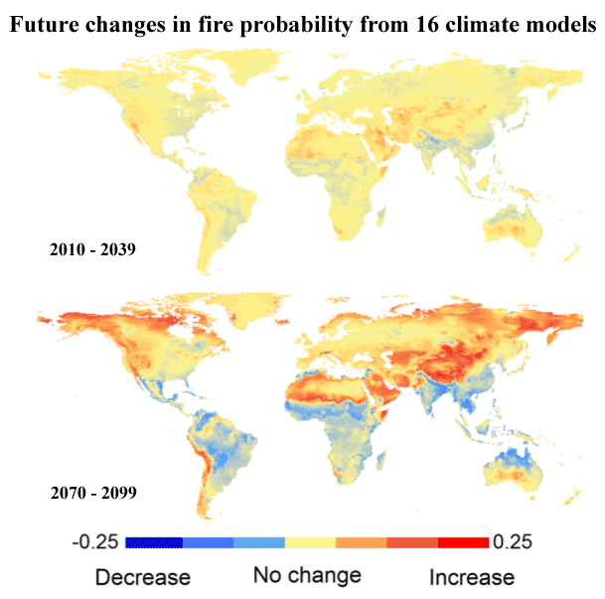
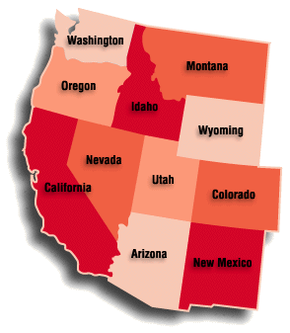
Overview – drought and wildfires in western u.s.
History of intense wildfires and periods of prolonged drought
Speculated that both will intensify throughout the 21st century
Frequency of wildfires and extent of their burn areas have already shown increases in recent years (Patterson 2013).
Goal: to determine if there is a correlation between the intensity of drought and frequency of wildfires in this region
Notes:
Picture (change): Climate change and disruptions to global fire activity, Moritz et al., 2012, from the journal Ecosphere.

Slide 3
Palmer drought severity index (PDSI)
Displays long-term meteorological droughts and wet conditions
Derived from a combination of current weather patterns as well as those from the previous few months
Indices base their outputs on temperature and the balance of precipitation, evapotranspiration, and runoff
Positive values represent wet conditions and negative values represent drought conditions
Notes:
http://www.cpc.ncep.noaa.gov/products/analysis_monitoring/regional_monitoring/palmer/2004/

Slide 4
NOAA’s Earth system research laboratory (esrl)
Used ESRL’s NCAR reanalysis datasets to collected monthly gridded PDSI values
Multiplied by -1 to make drought times positive
Data range: January 2001 to December 2010
Special coverage:
2.5 degrees latitude and longitude grid
Latitude range: 31.25 N to 49.00 N
Longitude range: 129.25 W to 102.00 W

Slide 5
Global Fire data, version 4 (Gfed4) - burned area
Data describes the area of each grid point burned by wildfires
Obtained with The University of Maryland’s GFED4 dataset
Special coverage:
2.5 degrees latitude and longitude grid
Latitude range: 31.25 N to 49.00 N
Longitude range: 129.25 W to 102.00 W
Notes:
http://www.globalfiredata.org/

Slide 6
Data manipulation and analysis techniques
The University of Maryland’s GFED4 monthly data
ESRL’s database to gather daily PDSI measurements
Both monthly variables were averaged over the desired land area
Monthly PDSI and Burned Area plots
Periodogram
CPSD
Phase shift
Coherence

Slide 7
PDSI and Burned Area per Month jan 2001 to dec 2010
Notes:
PDSI:
Min: -2.5594 on June 2002 (18)
Max: 1.9048 on October 2004 (46)
BA:
Min: 0 on January 2002 and January 2010 (13 and 109)
Max: 123.8034 on July 2007 (79)

Slide 8
Periodograms
Strong peak at ~5 years
Strong peak at 1 year

Slide 9
Cross Power Spectral Density (CPSD)
Peak near 1 year associated with the annual cycle between the two indices
Second wide peak between ~1 and ~5 year

Slide 10
Phase Spectrum
Image shows the phase spectrum calculated using angle function
Phase angle = displacement between two waves
Peaks at ~3 months, and between and 6 months 1 yr/1 month
Phase Lag = 41.2178
Year Lag = 0.1145 (~1 month)
Positive: burned area followed drought

Slide 11
Coherence
Strongest peak at ~1 year
Describes the consistency of the period relationship between PDSI and burned area indices
coherence peak = 0.3651
Low coherence describes that the correlation between PDSI and burned area are insignificant

Slide 12
Conclusions
On the western half of the United States, the monthly Palmer Drought Severity Index (PDSI) and the average monthly area burned by wildfires are correlated at a 1 year period.
There may be a relationship between these two datasets, but their correlation is not significant
Peaks in most intense wildfire seasons are likely influenced by phenomena other than drought indices
Notes:
http://www.nocaptionneeded.com/2008/10/california-wildfire-american-apocalypse/

Slide 13
References
http://www.droughtoutlook.com/
http://8sistersofzion.com/
Climate change and disruptions to global fire activity, Moritz et al., 2012, from the journal Ecosphere.
http://www.cpc.ncep.noaa.gov/products/analysis_monitoring/regional_monitoring/palmer/2004/
http://www.globalfiredata.org/
http://www.nocaptionneeded.com/2008/10/california-wildfire-american-apocalypse/

