Slide 1

Interaction of PM 2.5 in the
San Joqauin Valley

Slide 2
Introduction
Determine the relationship of PM 2.5 concentrations between three cities located in the San Joqauin Valley.
The cities analyzed included: Fresno, Hanford and Bakersfield
Daily PM 2.5 concentrations [µg/m³] from the California Environmental Protection Agency database was analyzed.
Statistical Analysis Performed: Chi Squared Test, Pearson Correlation, Bootstrap Correlation, Least Squares Regression, Reduced Major Axis Regression, Principle Component Regression

Slide 3
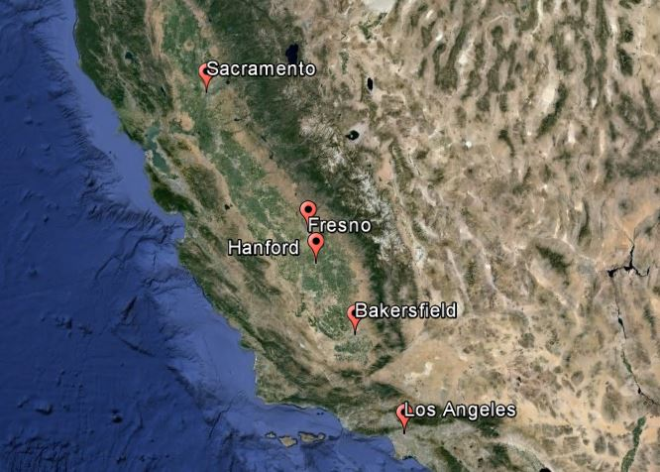
PM 2.5 Sources
Vehicular emissions
Diesel soot and chemical fumes from oil production
Burning of coal for electricity
Wood burning stoves / furnaces
Chemical reactions of gases
Pollution carried by prevailing winds

Slide 4
Chi Squared Test -95% Confidence
Null Hypothesis: The data sets are normally distributed
Location | Chi_2 | Chi_Calculated | Null Hypothesis
Bakersfield | 27.58 | 195.18 | reject
Hanford | 27.58 | 142.21 | reject
Fresno | 27.58 | 199 | reject

Slide 5
Correlation and Regression Analysis
Pearson Correlation: 0.2738
P-Value = .0100
Pearson Correlation: 0.3161
P-Value = .0153
Pearson Correlation: 0.6873
P-Value = .0123

Slide 6
Bootstrap Test of Correlation Coefficient
Average Correlation Coefficient r computed using the mean function yields:
Location | r- value
Bakersfield | 0.2731
Hanford | 0.3193
Fresno | 0.6877
Which is in agreement with the Pearson Correlation results:
Location | r- value
Bakersfield | 0.2738
Hanford | 0.3161
Fresno | 0.6873

Slide 7
Conclusion
All three cities are not normally distributed however they all were positively skewed
Hanford- Fresno showed the greatest correlation of PM 2.5 followed by Hanford-Bakersfield
Bootstrap Method results were in agreement with the Pearson Correlation results
P-Values for all three cities were less than 0.05. The correlation is therefore considered statistically significant

Slide 8
Questions???

