Slide 1
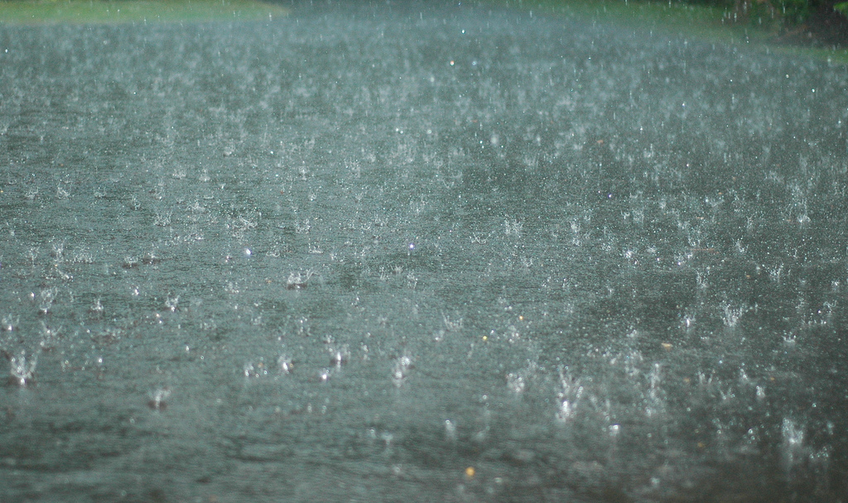
Precipitation Trends Over Recent Decades in Selected US Cities
Justin Hancock
EAS 4480
Picture from Flickr Creative Commons.
User: tomgrundyphoto

Slide 2
Motivation/Goals
Water is like, important and stuff.
Source of almost all fresh water is precipitation
Population of Earth is increasing exponentially
Atmospheric warming will increase the atmosphere’s capacity to hold moisture.
How will this effect precipitation?
-More droughts?
-More floods?

Slide 3
Data and Methods
All precipitation data were obtained from the NCDC Climate Data Online website.
Daily Precipitation Summaries
Monthly Precipitation Summaries
Plotted annual precipitation vs. year
Plotted number of days with >1” rain vs. year
Plotted number of days with rain vs. year
Linear LS fits

Slide 4
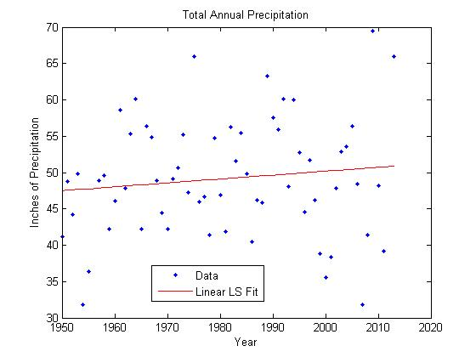
Atlanta
LS Slope: 0.0536 in/year
Bootstrap average slope: 0.0563”
Bootstrap slope confidence interval: 0.0523-0.0603 in/year
LS slope | 0.0536 in/year
Bootstrap average slope | 0.0563 in/year
Bootstrap slope confidence interval | 0.0523-0.0603 in/year

Slide 5
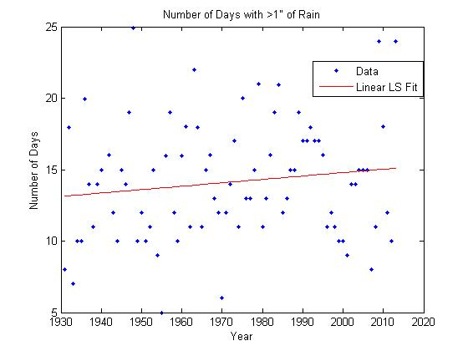
Atlanta
LS slope | 0.0238 year⁻¹
Bootstrap average slope | 0.0241 year⁻¹
Bootstrap slope confidence interval | 0.0228-0.0254 year⁻¹

Slide 6
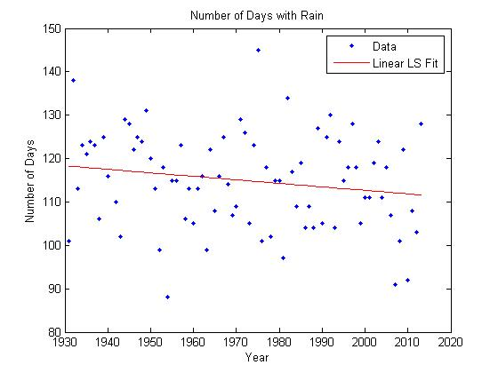
Atlanta
LS slope | -0.0807 year⁻¹
Bootstrap average slope | -0.0782 year⁻¹
Bootstrap slope confidence interval | -0.0814 -0.0749 year⁻¹

Slide 7
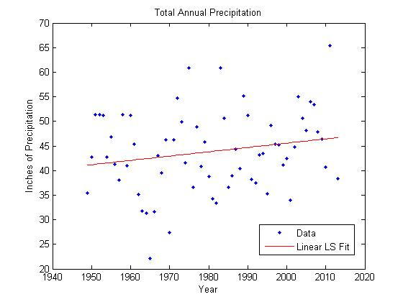
New York, NY

Slide 8
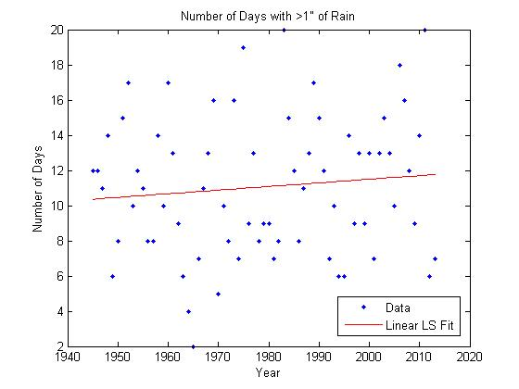
New York, NY

Slide 9
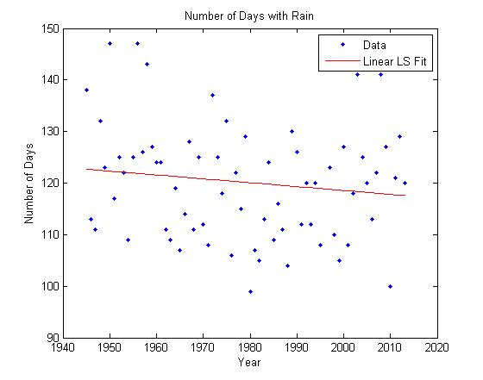
New York, NY

Slide 10
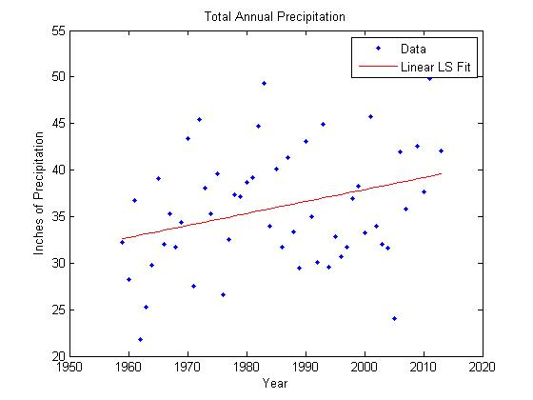
Chicago

Slide 11
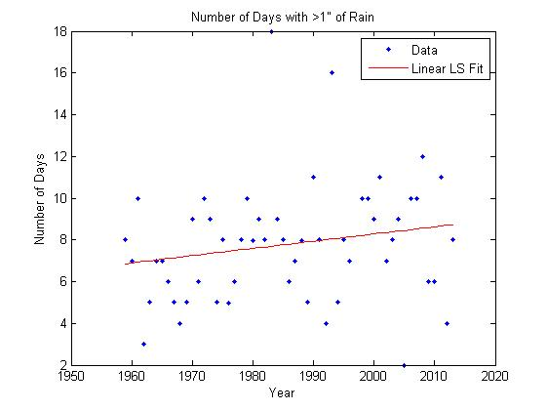
Chicago

Slide 12
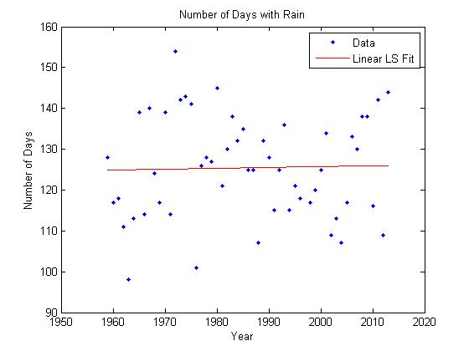
Chicago

Slide 13
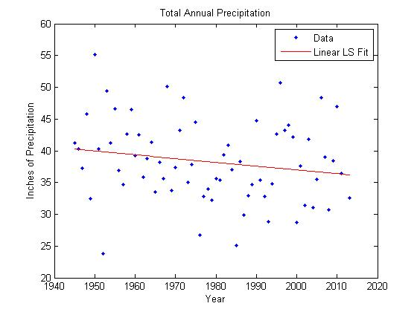
Seattle

Slide 14
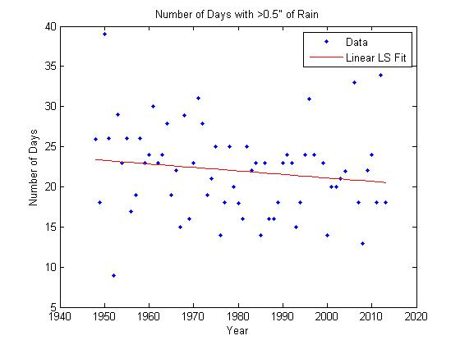
Seattle

Slide 15
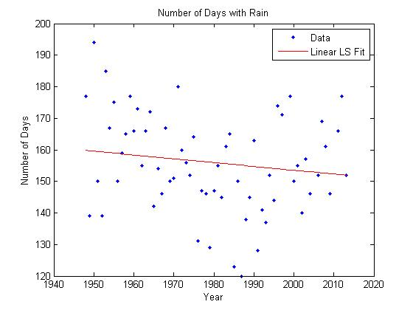
Seattle

Slide 16
Summary of Precipitation Trends
City | Change in Annual Precipitation Per Century | Change in Frequency of Precipitation Per Century
Atlanta, GA | +5.36” | -8 days
New York, NY | +8.80” | -8 days
Chicago, IL | +12.88” | +2 days
Seattle, WA | -5.89” | -12 days

