Slide 1
Analyzing Atmospheric Variables and Baseball Statistics at Turner Field
Steve Gregg
EAS 4480 Data Analysis
April 24th, 2014

Slide 2
Overview
Motivation
Data and Sources
Methods
Results
Summary

Slide 3
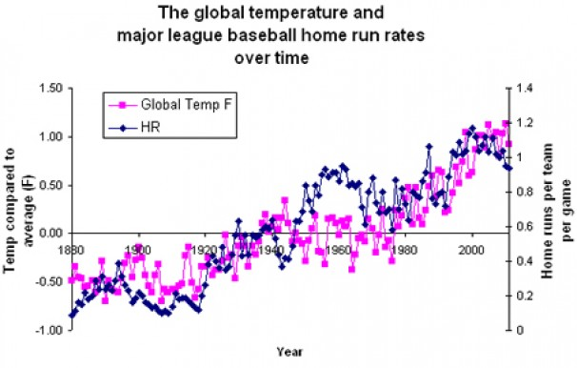
Motivation
Figure 1. From Jason Samenow, Capital Weather Gang, Washington Post. Temperatures compared to a 1951-1980 baseline since 1880 and the average home runs per team per game since 1880.

Slide 4
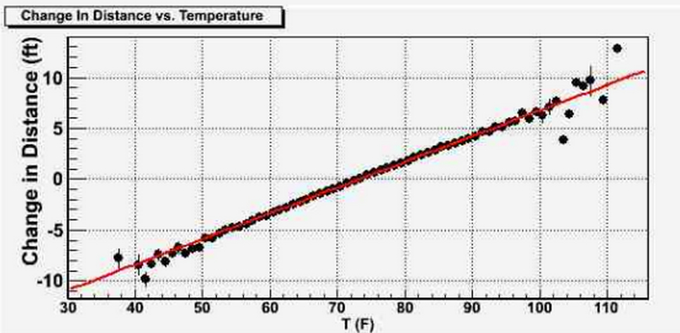
Motivation
Figure 2. From Alan M. Nathan, Baseball Prospectus. For a given home run hit at temp T, R-R1 is the extra distance the ball travels at that temperature relative to how far it would have traveled had the temperature been 72.7°F. Plot shows the average value of R-R1 for each temperature bucket, slope of line is 0.25 ft/°F.

Slide 5
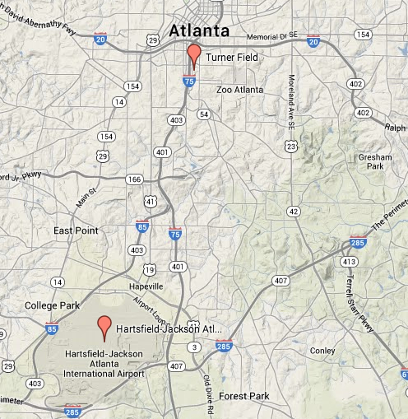
Data and sources
Focus on Turner Field regular season games from 1997 – 2013 (≈ 1300 games)
Baseball data from retrosheet.org
Offensive stats: total home runs and runs per game
Pitching stats: total strikeouts and walks per game
Weather data from Iowa State University’s archive of Automated Surface Observing Network (ASOS)
Weather data: Temperature, dew point, relative humidity, MSLP, cloud cover
Figure 3. Locations of Turner Field and ASOS station at Hartsfield-Jackson International Airport. Distance between them approximately 7 miles.

Slide 6
Methods
Correlation coefficients calculated to determine a statistically significant relationship
Regression analysis used to identify whether least squares, RMA, or PC best for data.
Bootstrap done for LSR slope and correlation coefficient.

Slide 7
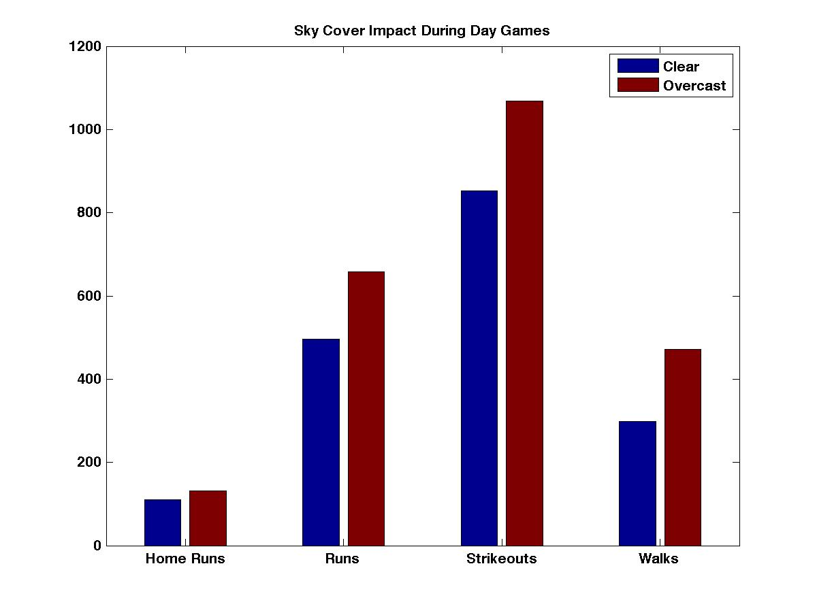
Results: Sky condition Impact
Sky condition only impacts day games
CLR vs. OVC only
Day games significantly smaller sample (387 games, 29%)
Unexpected results for strikeouts, compared to Kent and Sheridan, 2011
Figure 4. Sky conditional impact for day games at Turner Field, 1997-2014.

Slide 8
Results: Correlations
 | Temp | Dew Point | RH | MSLP
Home runs | 0.0602 | 0.0169 | -0.0404 | -0.0361
Runs | -0.0025 | 0.0154 | 0.0225 | -0.0073
Strikeouts | -0.053 | -0.025 | 0.0311 | 0.3481
Walks | -0.0916 | -0.0519 | 0.031 | -0.0171
Overall low correlations somewhat surprising
Only two statistically significant (p < 0.05) correlations
Two also within the CC 95% confidence interval
HR and temperature
p = 0.032
(CI: 0.0051 to 0.1149)
Walks and temperature
p = 0.001
(CI: -0.146 to -0.037)
Table 1. Correlation Coefficients. Red indicates statistically significant.
Notes:
HR and BB show a statistically significant correlation to temperature

Slide 9
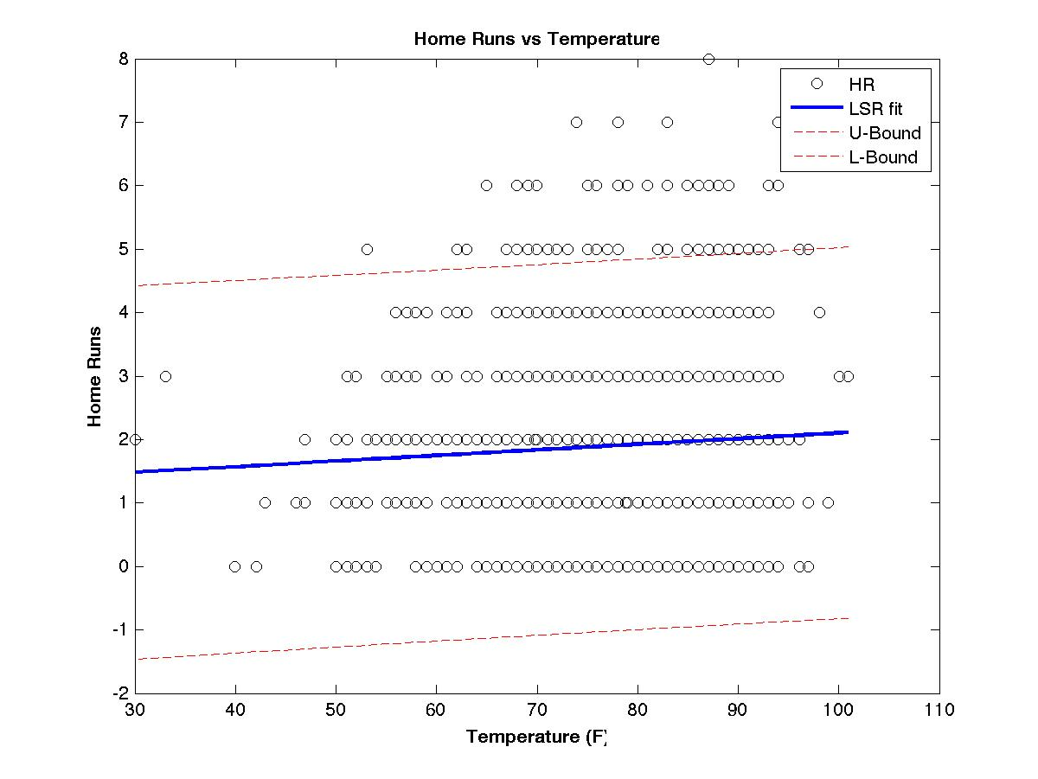
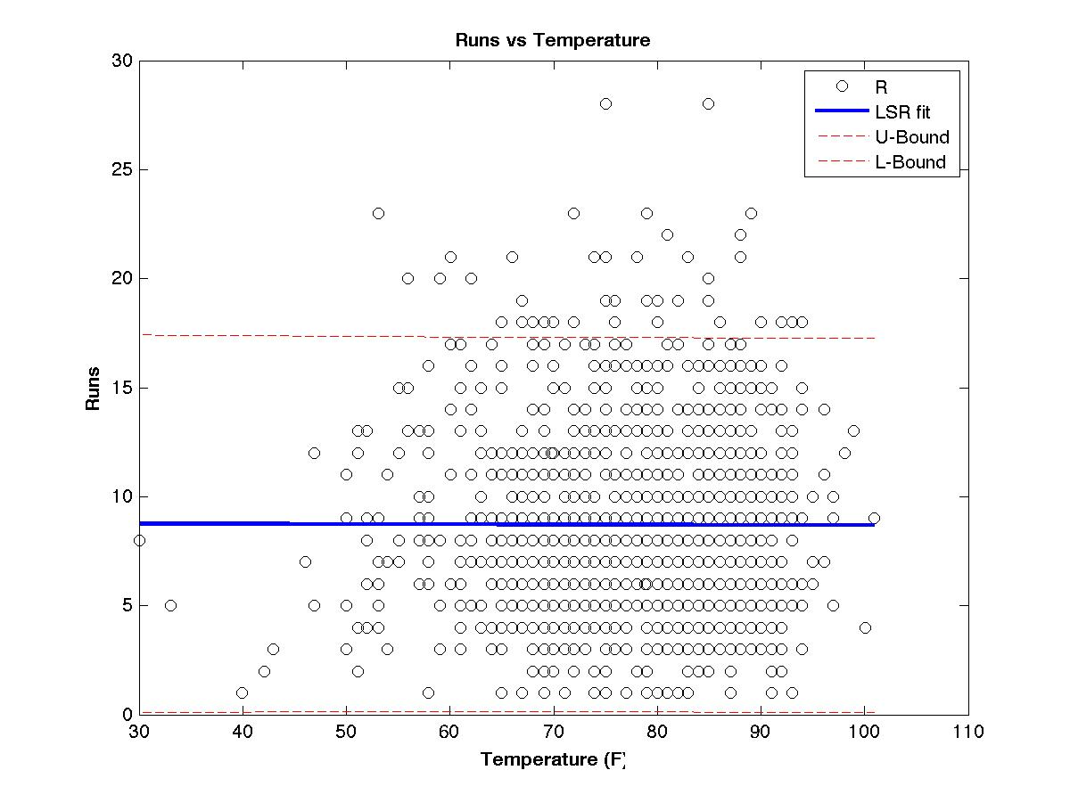
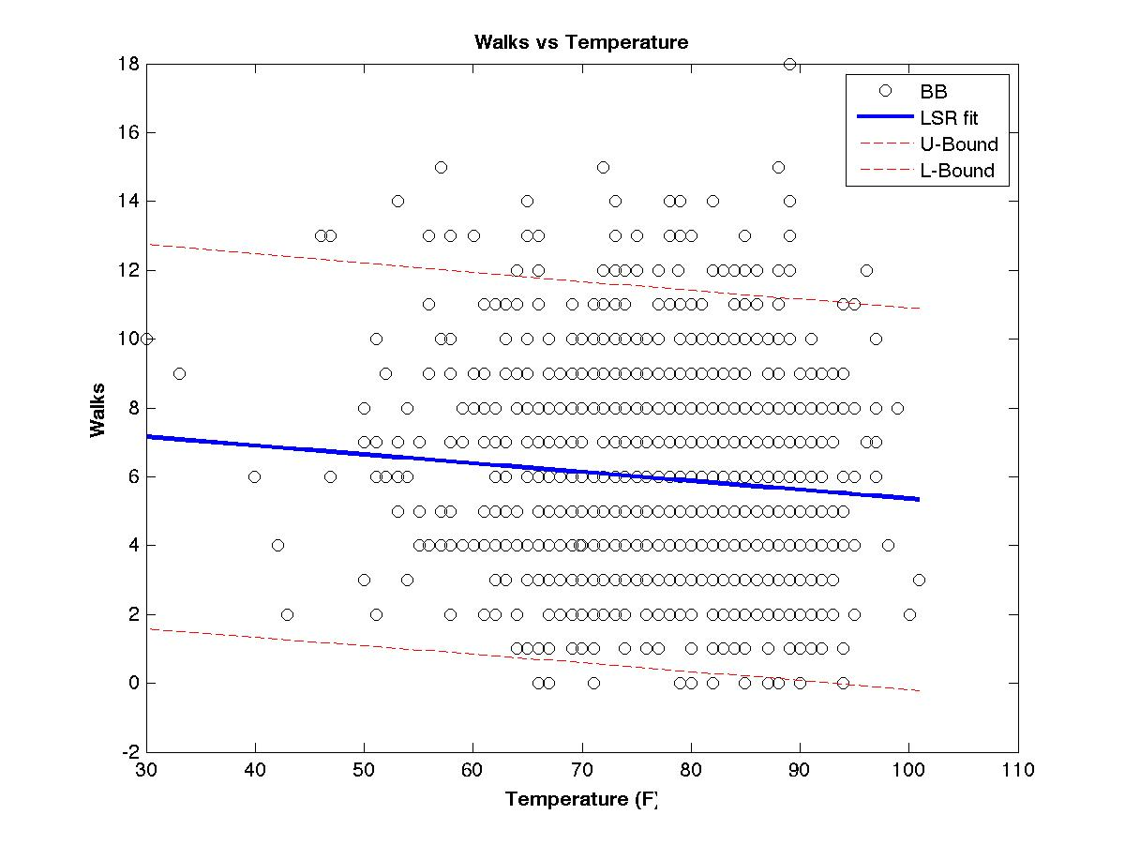
Results: LSR regressions
Figure 5. LSR home run vs. temperature
Figure 6. LSR run vs. temperature
Figure 7. LSR walks vs. temperature

Slide 10
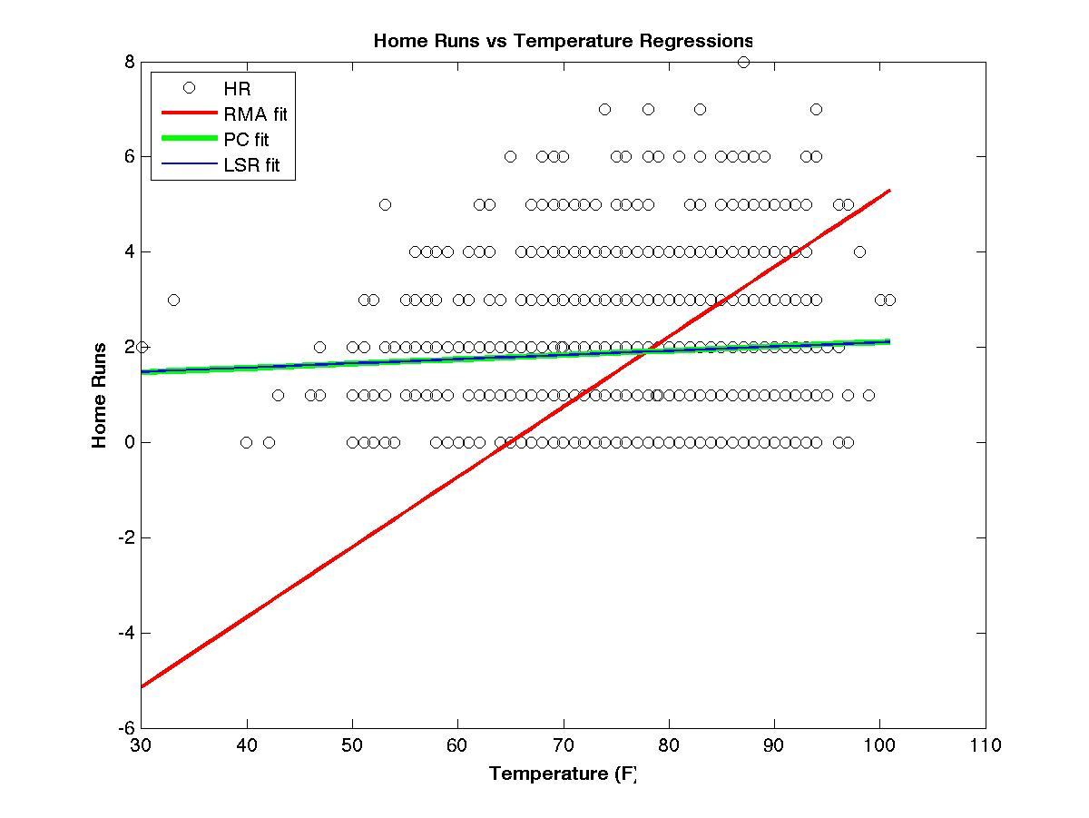
Results: Home run regressions
Slopes
LSR | PC
0.089 | 0.009
LSR slope 95% CI
Lower | Upper
-0.2793 | 0.297
R² (variance)
LSR | PC
0.0036 | 0.872
Figure 8. LSR, RMA, and PC regression fit comparison for home run vs. temperature.
Notes:
-LSR and PC provide very similar fit
-LSR 95% CI bound indicates that nature (positive/negative) of correlation could be questioned but existence of correlation is not
-Variance MUCH better explained from PC…difference could be because PC takes into account variance in x and y

Slide 11
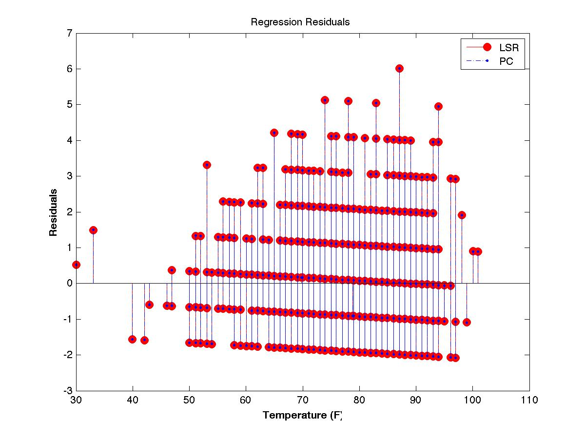
Results: Home run residuals
Residual Chi-squared
Chi critical value | LSR chi-squared value | PC chi-squared value
46.2 | 2.11e3 | 2.11e3
Figure 9. Stem plot of LSR and PC residuals.
Residuals taken and tested.
Chi-squared test for LSR and PC residuals indicates that neither are normally distributed.
Notes:
-Chi-squared value > chi critical means null hypothesis can be rejected

Slide 12
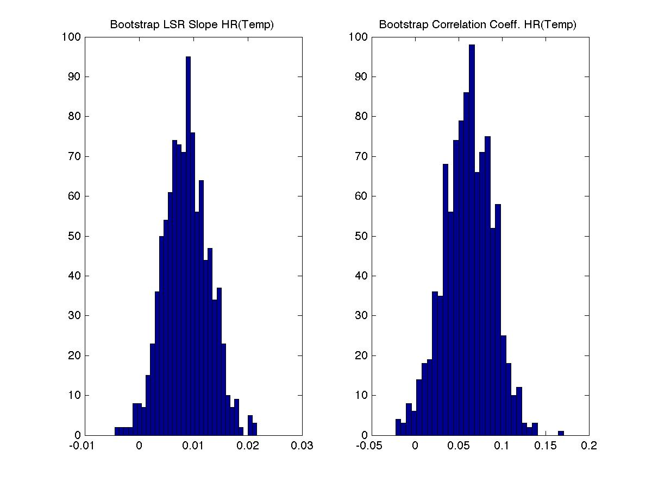
Results: Bootstrap LSR slope, correlation coefficient
Bootstrap
Mean LSR slope (original) | Mean correlation coefficient (original)
0.0087 CI: 0.0085 to .0090 (0.0089 CI: -0.279 to 0.297) | 0.061 CI:0.059 to 0.063 (0.060 CI: 0.0051 to 0.1149)
Figure 10. Histogram of bootstrapped slope and correlation coefficient.
Bootstrap mean slope and mean CC similar to original.
Bootstrap chi-squared test confirms what we already knew: data not normally distributed.

Slide 13
Summary
Physics of baseball tell us that temperature, dew point, and other variables should have impact on ball flight (batters) and ball movement (pitchers).
Correlation of temperature and home runs and walks at Turner Field not high but it is statistically significant.
Too many other non atmospheric factors: baseball is a “game of inches”.
Non-normality of data does call into question confidence intervals for regression analysis.

