Slide 1
Is Integrated Kinetic Energy a Comprehensive Index to Describe Tropical Cyclone Destructiveness?
Emily Madison

Slide 2
Overview
Introduction
Methods and Data
Results
Discussion
Conclusions

Slide 3
Introduction
2004 and 2005 Atl hurricane season spurred thoughts of retiring Saffir-Simpson Hurricane Scale
Hurricane Katrina and Sandy costliest, but were Categories 3 and 1 at landfall
Size of storm a major factor of destruction
Use Index/Scale that includes both max velocity and storm size

Slide 4
Data
Extended Best Track Dataset
Climatology of Atlantic tropical cyclones (TC)
Data used (at/near landfall):
1-miunte maximum sustained surfaces winds
Radius of maximum wind
Radius of hurricane wind
Time steps 6-hourly
Translational speed calculated from time and lat/lon
Costliness data from NHC review of the deadliest, costliest, and most intense U.S. TC from 1851 to 2012
Cost in billions $US

Slide 5
Methods
Linearly interpolated time and other data to hourly time steps
Calculated Hurricane Intensity Index, Hurricane Hazard Index, and Weight Integrated Kinetic Energy

Slide 6
Saffir Simpson Scale
Type | V_{max} m/s
Category 1 | 33-42
Category 2 | 43-49
Category 3 | 50-58
Category 4 | 59-69
Category 5 | >70
Where:
V_{max} = 1-miunte maximum
sustained surfaces winds
R = maximum radius
S = translational velocity
V_{max0} = 74 mph
R₀ = 60 miles
S₀ = 15 mph
HII = (V_{max}/V_{max0})²
HHI = (R/R₀)²(V_{max}/V_{max0})³(S/S₀)

Slide 7
Weighted IKE = IKE₂₅₋₄₀ + 6IKE₄₁₋₅₄ + 30IKE₅₅

Slide 8
Methods
Correlation coefficient calculated between Cost and each scale/index
Regression analyses
Least squares
Reduced Major Axis (RMA)
Principal Component
Determined variance explained by each fit
Residuals analyzed
Bootstrapped least squares slope and correlation coefficient

Slide 9
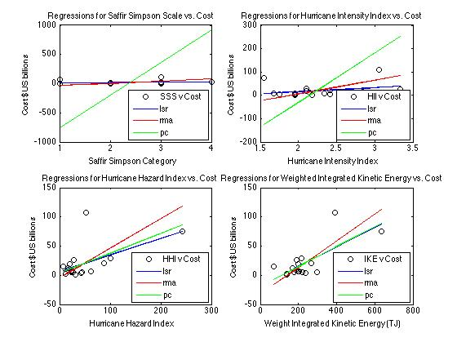
Regression Analysis

Slide 10
Results of Regressions
 | SSS | HII | HHI | IKE
r(corrcoef) | 0.0634 | 0.2779 | 0.5622 | 0.7345
R² (variance explained)
 | SSS | HII | HHI | IKE
LS | 0.004 | 0.0772 | 0.316 | 0.5395
RMA | 1 | 1 | 1 | 1
PC | 0.97 | 0.98 | 0.72 | 0.87
IKE with highest correlation coefficient
RMA fit R² =1

Slide 11
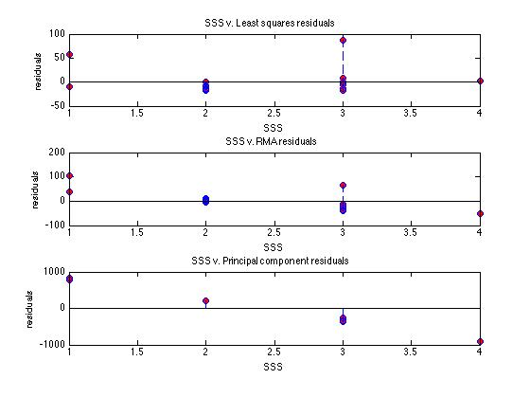
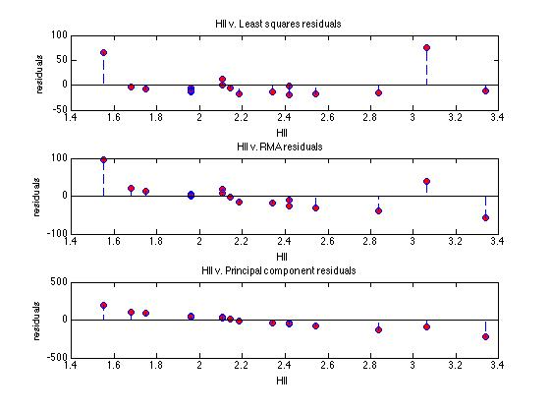
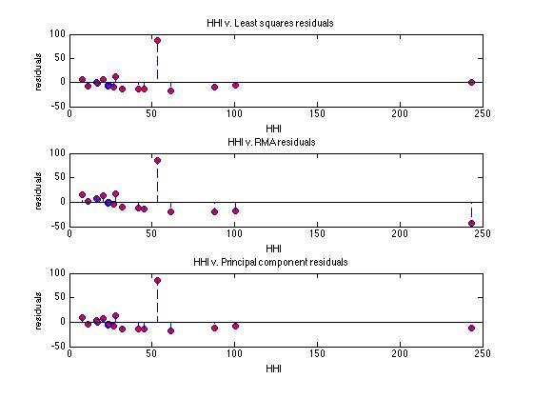
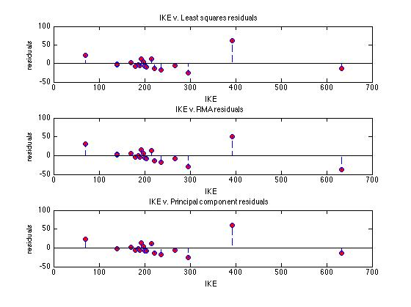

Slide 12
Residuals
Tested for normal distribution of residuals using chi-squared test
RMA only regression that failed to reject the null hypothesis (distribution is normal)
Notes:
Residuals should be normally distributed if the statistical fit leaves out only a random variable
that is normally distributed via the central limit theorem (some argument similar to this).

Slide 13
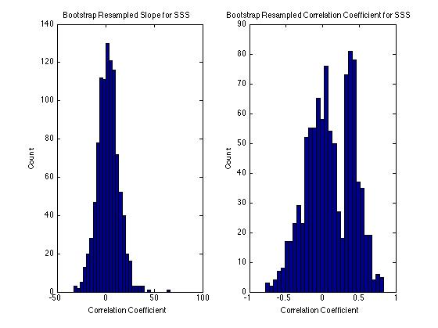
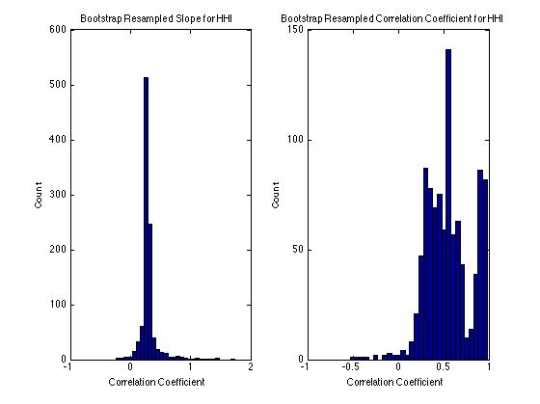
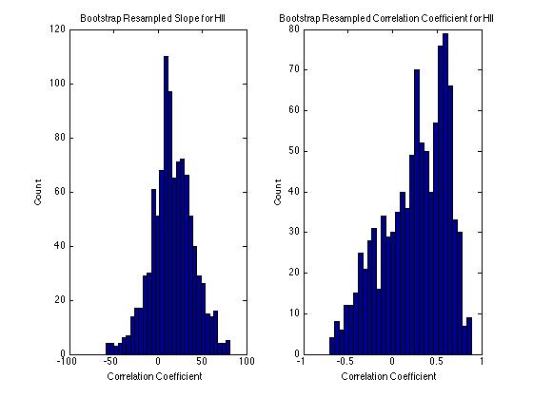
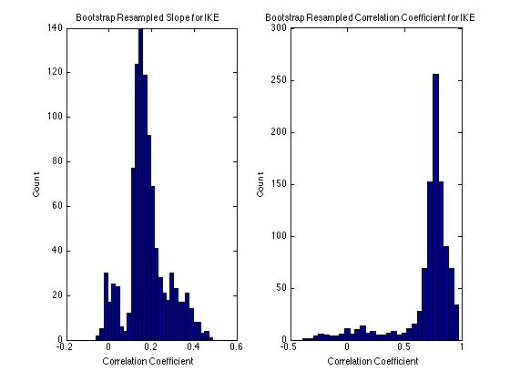

Slide 14
Bootstrap Results
 | SSS | HII | HHI | IKE
Ls slope | 2.2692 | 16.3461 | 0.2845 | 0.1683
r | 0.0634 | 0.2779 | 0.5622 | 0.7345
Mean r boot | 0.1030 | 0.2497 | 0.5544 | 0.6984
Mean slope boot | 2.6071 | 16 | 0.3 | 1.771
R CI | 0.0836- 0.1225 | 0.2274- 0.27194 | 0.5391- 0.5695 | 0.6832- 0.7134
Slope CI | 1.9244- 3.2897 | 14.5746- 17.4889 | 0.2921- 0.3115 | 0.1711- 0.1830
Chi-squared boot | reject | reject | reject | reject

Slide 15
Discussion
Continuous scales provide better correlation coefficients
IKE has the largest correlation coefficient
RMA “best” fit
R² = 1
Residuals follow normal distribution
(However, PC fit takes into account variance in x-values; also, had decent variances )
Can put some stock in correlation coefficients as bootstrap resampled average corrcoeffs very close
Not so much for confidence intervals as distributions not necessarily normal

Slide 16
Conclusion
Results show the addition of size in hurricane intensity indices better explains costliness of storm
IKE explains more variance than HHI
Important to note that coastal vulnerability, infrastructure and affected population should also be taken into account
IKE useful for forecasting destruction potential for response planning purposes

