Slide 1
PM 2.5 and Asthma-Related Emergency Room Visits in California
Maisie Hugdahl
4.24.2014
EAS 4480 Term Project

Slide 2
Introduction
Many studies have found a link between PM 2.5 and asthma
WHO cited more hospital admissions
This study’s focus:
% of days over the US standard (35 micrograms/m³ per 24 hours)
# of emergency room visits due to asthma (age-adjusted, per 10,000)

Slide 3
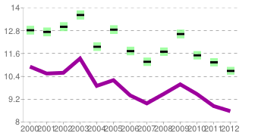
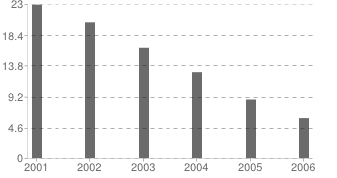
Data Source
California Environmental Health Tracking Program
Data for Los Angeles
# ER Visits
% Days Above Standard
Time
Time
**Purple line is California average

Slide 4
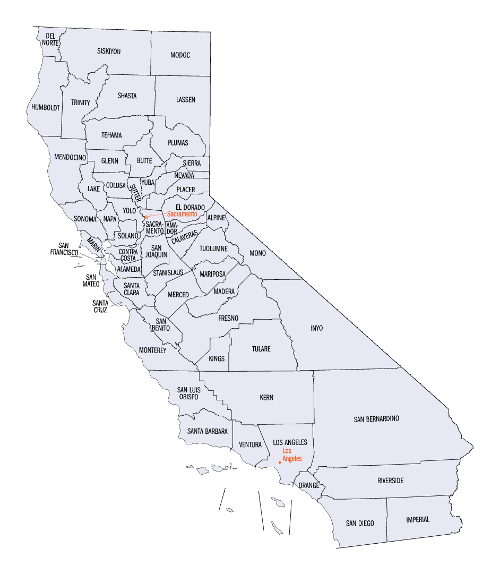
Data Distribution
16 counties
6 years (2001-2006)

Slide 5
Methods
Apply three different regression methods
Compare the slopes and R² values
Find the correlation coefficient
Apply the bootstrap and jackknife methods
Plot the histograms
Compare results to other studies

Slide 6
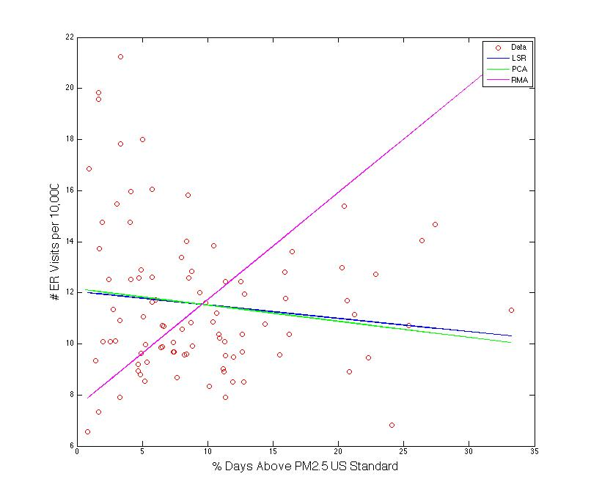
Regressions
Type | Slope | R²
LSR | -0.0524 | 0.0156
PCA | -0.0633 | 0.0228
RMA | 0.4194 | 0.0156
Correlation Coefficient | -0.1250
Upper Limit | 0.0808
Lower Limit | -0.3205

Slide 7
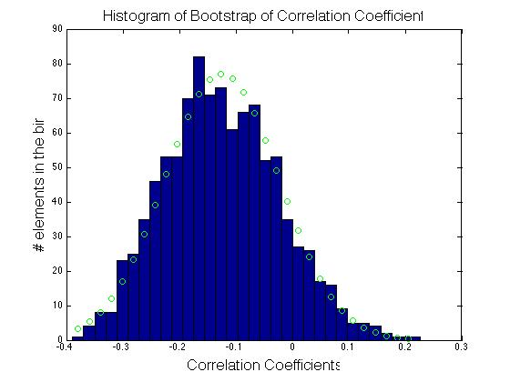
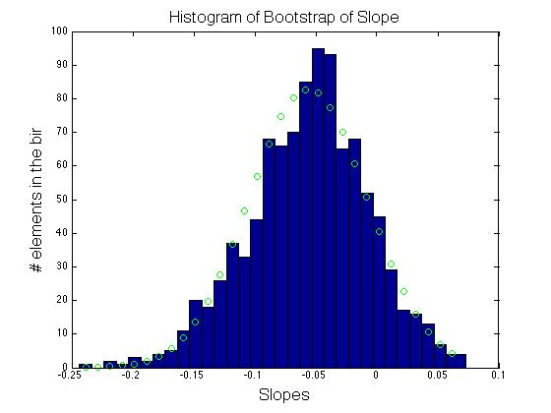
Bootstrap
Normally
Distributed
Normally
Distributed

Slide 8
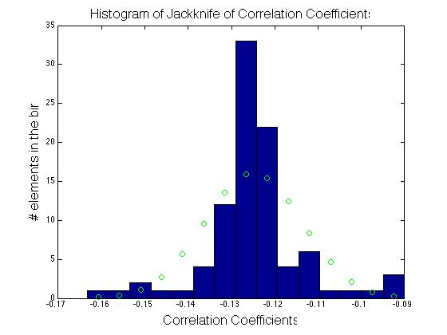
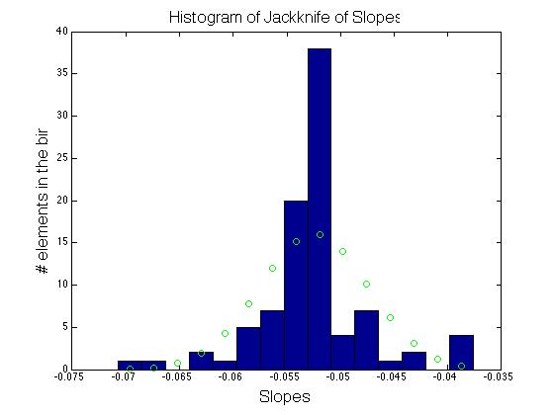
Jackknife
Normally
Distributed
Normally
Distributed

Slide 9
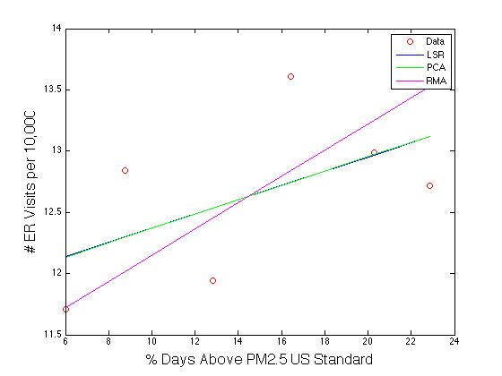
Individual County: LA
Type | Slope | R²
LSR | 0.0581 | 0.2940
PCA | 0.0586 | 0.2988
RMA | 0.1072 | 0.2940
Correlation Coefficient | 0.5422
Upper Limit | 0.9401
Lower Limit | -0.4810
Not enough data!

Slide 10
Conclusions
Contradictory to other studies
Seems to be a slight negative correlation
Air quality isn’t one of the main causes for asthma-related ER visits?
Threshold is too low?
More sensitive to different age groups?
Need more data
Longer time span, more counties

