Slide 1
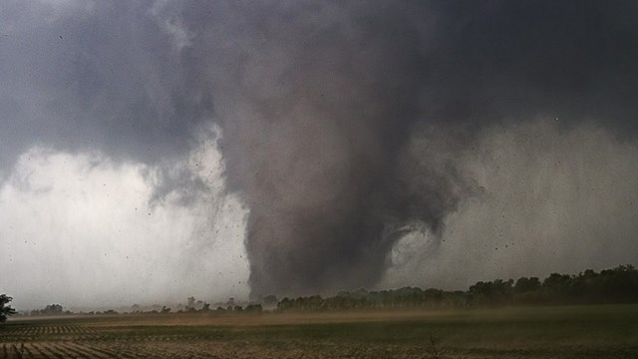
Tornadoes and the Arctic Oscillation
Daniel Nielsen

Slide 2
Motivation/Goals
Existence of year-to-year variability in tornado count
Bias toward recent years due to increased storm spotting capabilities
Improvements in radar network and deployment of NEXRAD
Increasing population and improved communications
Goals:
Determine whether there is a relationship between the Arctic Oscillation (AO) and tornado count
Explore tornado trends from 1950-2007

Slide 3
Data
Tornado data obtained from the Storm Prediction Center (SPC) severe weather archive
Includes each confirmed tornado, as well as its location, magnitude on Fujita/Enhanced Fujita Scale, date of occurrence, etc.
Monthly AO index data obtained from Climate Prediction Center’s archive
Includes AO index for each month from 1950-present

Slide 4
Methodology
Cross-spectral analysis was performed on AO and tornado data
Only the months of March and April were used (for simplicity)
Periodogram, cross power spectral density (CPSD), coherence
Linear regression analysis was performed on tornado data
All confirmed tornadoes from 1950-2007 were considered
Correlation coefficient

Slide 5
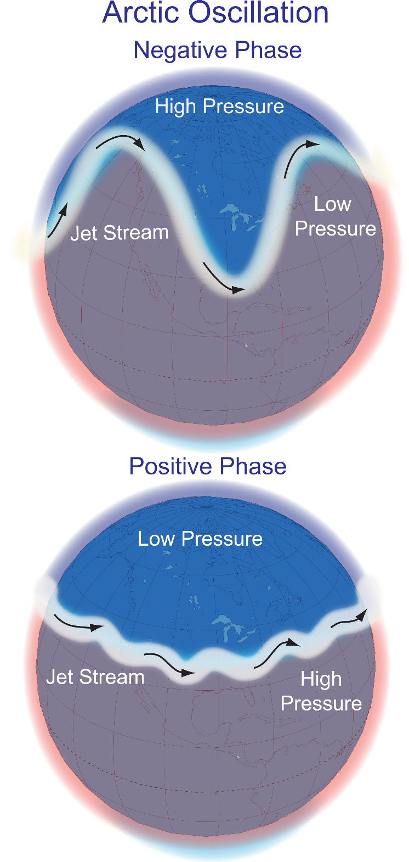
What is the Arctic Oscillation?
Photos from http://en.wikipedia.org/wiki/File:Arctic_Oscillation.png

Slide 6
Tornadoes and Arctic Oscillation
March
April
R²
=0.3556
R²
=-0.1926

Slide 7
Periodograms for Strong Tornadoes and AO Data
March
March
April
April

Slide 8
Cross-Spectrum Power Density (Welch’s Method)
March
April

Slide 9
Coherence
March
April

Slide 10
Tornado Trends
As mentioned before, increased spotting capabilities have led to more confirmed tornadoes in recent years

Slide 11
Trends in F/EF3+ Tornadoes
Might this decrease be specific to a certain region? Is “Tornado Alley” shifting?

Slide 12
A Changing Tornado Alley
R²
=-0.2429
R²
=-0.4535
Old Alley: OK, TX, KS, NE, SD
New Alley: AL, MS, LA, AR, MO, IL
Average slope from bootstrap method = -0.2793
Confidence Interval: [-0.2843 -0.2743]

Slide 13
Conclusions
Relationship between tornadoes and Arctic Oscillation is not clear
Increasing trend in tornadoes over time
Likely due to bias associated with increased spotting capability
Overall decreasing trend in strong (EF3 or greater) tornadoes
Most pronounced in “Tornado Alley” states (OK, KS, TX, NE, SD)
Weaker decreasing trend in “New Alley” (AL, MS, LA, AR, MO, IL)
Future work might focus on potential correlation between global warming and tornadoes

