Slide 1
Is global warming deoxygenating the ocean?
Anh Pham
04/21/2015

Slide 2
Drake Passage
Is there any correlation between temperature and oxygen concentration at Drake Passage? If so, is this correlation high?
Is there any factor other than temperature that controls oxygen?

Slide 3
Data descriptions and methods (SOCCOM project)
Around 55S, 60W in the Southern Ocean
Original data comprise of some hydrological and biological factors (e.g. temperature, salinity, oxygen…)
1/2009 - 8/2012. Sampling period is about 5 days.
Averaged into monthly data for further analysis
Using correlation, time series and spectral analysis to explore the relationships between variables

Slide 4
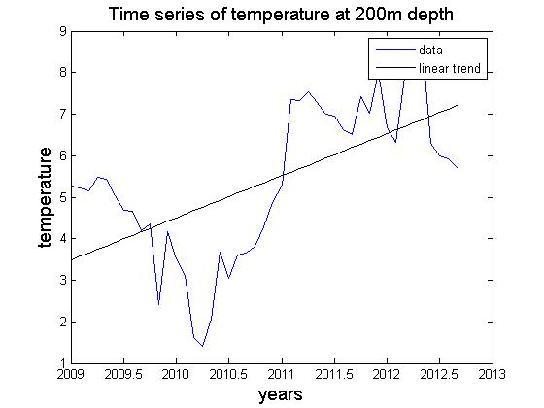
Time series of temperature and oxygen
Correlation coefficient : -0.6943, range: from -0.59073 to -0.80684, p = 10E-7 <<< 0.05 (using bootstrap method)

Slide 5
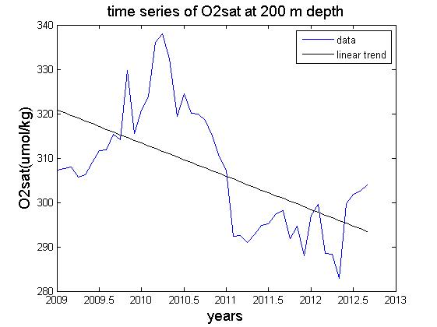
Time series of temperature and oxygen
O2observation = O2saturation (S,T) – apparent oxygen utilization (AOU)
Correlation coefficient : 0.6841, range: from 0.56463 to 0.79835, p = 10E-7 <<< 0.05 (using bootstrap method)

Slide 6
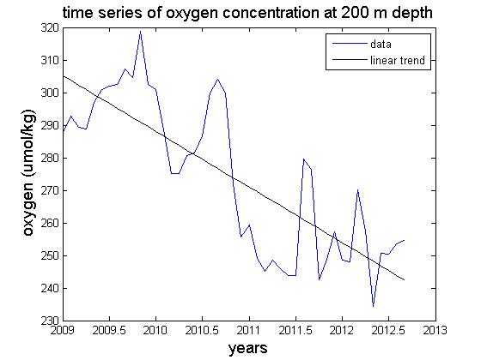
Effect of oxygen utilization by biological activity
O2observation = O2saturation (S,T) – apparent oxygen utilization (AOU)
Correlation coefficient : -0.8162, range: from -0.72085 to -0.99959, p = 10E-12 <<< 0.05 (using bootstrap method)

Slide 7
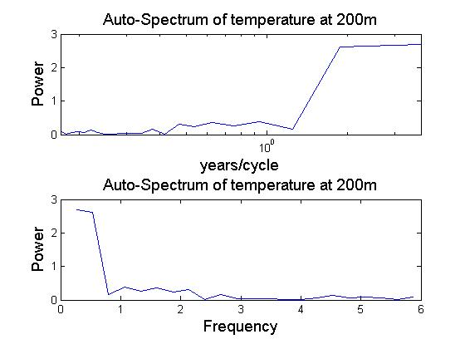
Spectral analysis

Slide 8
Spectral analysis
Correlation coefficient : -0.9994, range: from-0.99923 to -0.99961, p = 10E-64 <<< 0.05 (using bootstrap method)

Slide 9
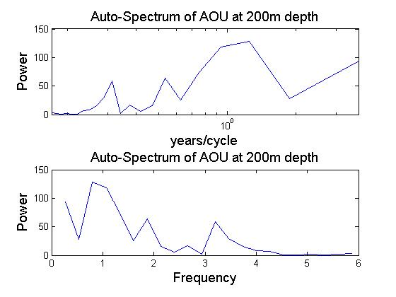
Spectral analysis
Correlation coefficient : -0.8162, range: from -0.72085 to -0.99959, p = 10E-12 <<< 0.05 (using bootstrap method)

Slide 10
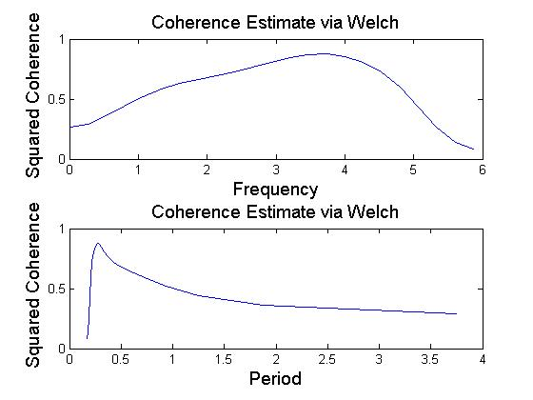
Cross spectral analysis
Cross – correlation analysis shows that AOU and oxygen are mainly related by around 1 year period. The coherence value calculated at this period is 0.5172

Slide 11
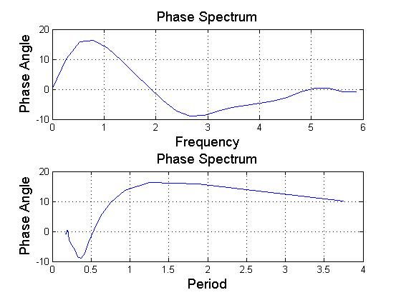
Cross spectral analysis
At the 1-year period peak, there is an observed phase lag. The lag is positive, meaning AOU leads oxygen by ~1/2 month (0.0400yr*365d/yr = ~15days ~1/2 month)

Slide 12
Conclusion
There is a strong relationship/correlation between temperature and oxygen, but temperature is not the only factor that controls oxygen concentration.
Biological activity could be a more important factor.
Higher temperature does not always necessary lead to lower oxygen concentration (Ito and Deutsch., 2013)

