Slide 1
Birth Dates: Are they affected by Temperature, Barometric Pressure, and Lunar Phase?
EAS 4480
4/23/15
Olivia Bailey

Slide 2
Introduction
Objective: Discover whether or not outside force can influence the birth time of babies, especially pre-term births.
Also Investigate for time trends/ in the birth of babies.
Data: Total number of babies and preterm babies collected from Newton Medical Center (Covington GA) and Clearview Medical Center (Monroe GA)
Time: Sampled from April 20th, 2013 to December 31st 2014.

Slide 3
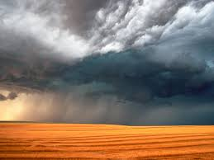
Background
Parameters:
Meteorology:
Temperature and barometric pressure.
Moon Phase.
Methods:
Periodogram, Cross Spectral Density (CSPD),
Phase lag, and Coherence analyses.

Slide 4
Hypothesis:
Expecting Lunar phases to not have a correlation/effect with increases in full-term birth rates nor pre-term birth dates.
Expecting temperature and barometric pressure to have an impact on both full-term and pre-term births.

Slide 5
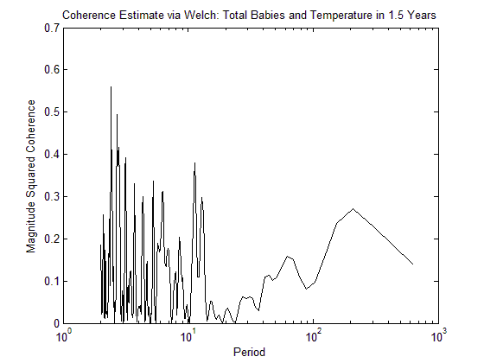
Total Baby births and Temperature.
CPSD
No period found
Coherence
Correlation Coefficient: None found

Slide 6
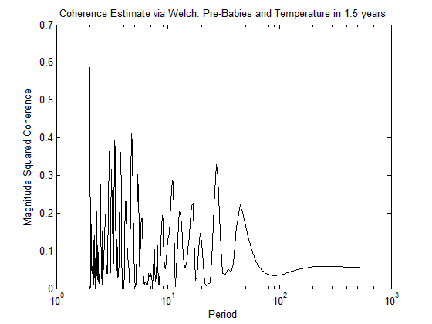
Pre-term Baby births and Temperature.
CPSD
Period ~ 1 month (27 days.
Lag -2.3 days
Coherence
Correlation Coefficient: 0.33

Slide 7
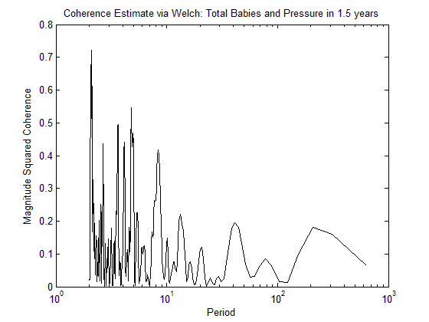
Total Baby births and Barometric Pressure.
CPSD
Period ~ 2 days
Lag -0.5 days
Coherence
Correlation Coefficient: 0.72

Slide 8
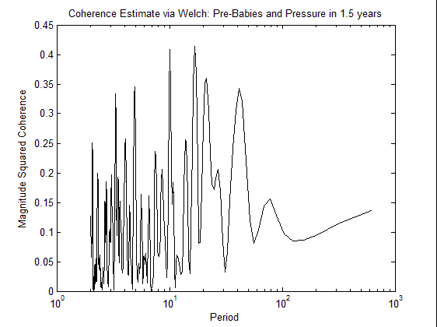
Pre-term Baby births and Barometric Pressure.
CPSD
Period ~3 weeks (25 days)
Lag - 10 day lag
Coherence
Correlation value: 0.40

Slide 9
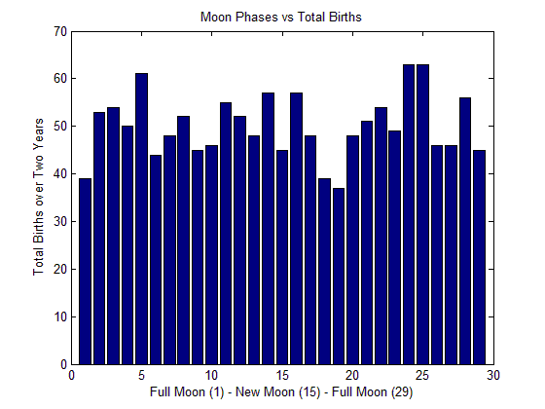
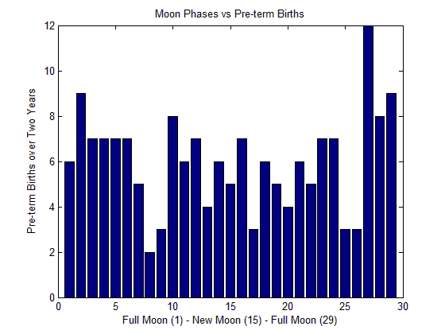
Lunar Phases
Total births and moon phases (Top left)
Pre-births and moon phases(bottom right)
Around average number of births on full moon days/nights compared to the rest of the month

Slide 10
Is There a Trend in the General Baby Birth Data?

Slide 11
Trends in the baby data?
Plot the total and pre-term births in time (~1.5 years).
Periodogram of the births: ~ 14 day cycle and ~ 27 day cycle
For total number of births there appears to be both a bi weekly trend and a bi monthly trend.
The pre-term data, does not show this.

Slide 12
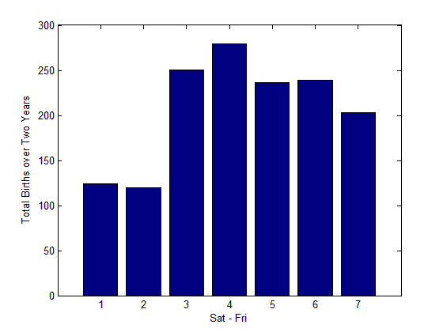
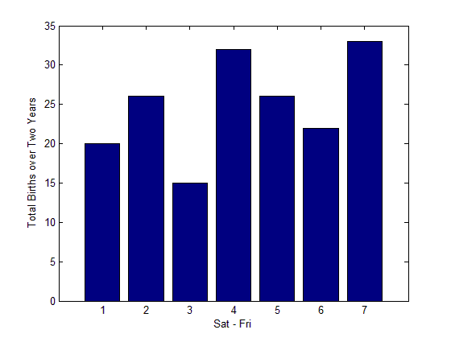
Weekday vs. Weekend
Pre-term babies (Left) do not show significant signal, but total babies do (Right)
Take signal from the Weekend days.
Less babies are born on the weekend than any other day of the week

Slide 13
Conclusions & Discussion
It appears that temperature and pressure do not play a significant role in the timing of full-term births or pre-term births.
Results also show that the phases of the moon have no impact on either full or pre-term births.
The analyses seem to show a bi-weekly and bi-monthly cycle as per the full-term births, however not for the pre-term births.
Only have the number of babies are borne on the weekend

Slide 14
Conclusions & Discussion
Perhaps a larger sampling pool of both full-term and pre-term births and over a larger sampling time would give more promising results.
Other important factors in timing of births:
Age of parent
Health of parent
Multiple births (twins, etc.)
Prenatal care
(Sadovnick, 2007)

Slide 15
Questions, anyone?

