Slide 1
Analysis of chlorophyll data in Labrador Sea: what affect the phytoplankton bloom
Daoxun Sun
2015.04.21

Slide 2
Outline
Background
Data
Technical details
Result
  EOF of chlorophyll data
  Correlation with possible factors
Summary

Slide 3
Outline
Background
Data
Technical details
Result
  EOF of chlorophyll data
  Correlation with possible factors
Summary

Slide 4
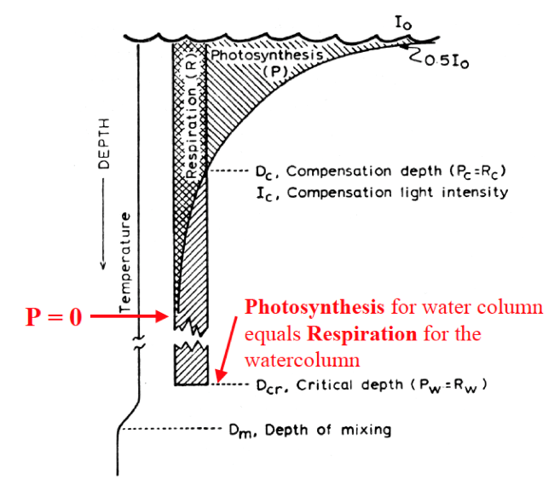
Primary production and the depth of mixed layer
Two possible factors:
Stratification
–>surface density
Light
->shortwave radiation
Plankton is vertically transported through the depth of the mixed layer
If MLD < critical depth, the vertically integrated photosynthesis exceeds respiration in the mixed layer.
(Notes from phys and chem of oceans)

Slide 5
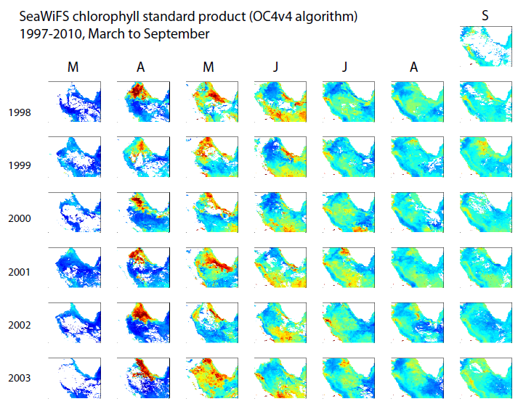
Northern bloom
Central bloom

Slide 6
Outline
Background
Data
Technical details
Result
  EOF of chlorophyll data
  Correlation with possible factors
Summary

Slide 7
Data source
Chlorophyll: Sea-Viewing Wide Field-of-View Sensor (SeaWiFS)
Temperature, salinity, density: Simple Ocean Data Assimilation (SODA)
Shortwave radiation: National Centers for Environmental Prediction (NCEP) Reanalysis
Period: 1998 to 2010

Slide 8
Outline
Background
Data
Technical details
Result
  EOF of chlorophyll data
  Correlation with possible factors
Summary

Slide 9
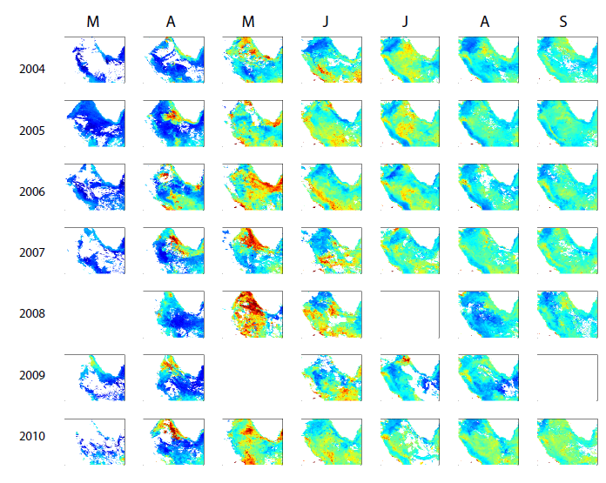
Discontinuity of data
The months with data covers less than 40% (~70% maximum coverage) of grid points were neglected
Cubic spline interpolation was applied for other months
Be care about the lag correlation

Slide 10

Effective sample size
The data is more likely to be Red noise
(Bretherton et al, 1999)

Slide 11
Outline
Background
Data
Technical details
Result
  EOF of chlorophyll data
  Correlation with possible factors
Summary

Slide 12
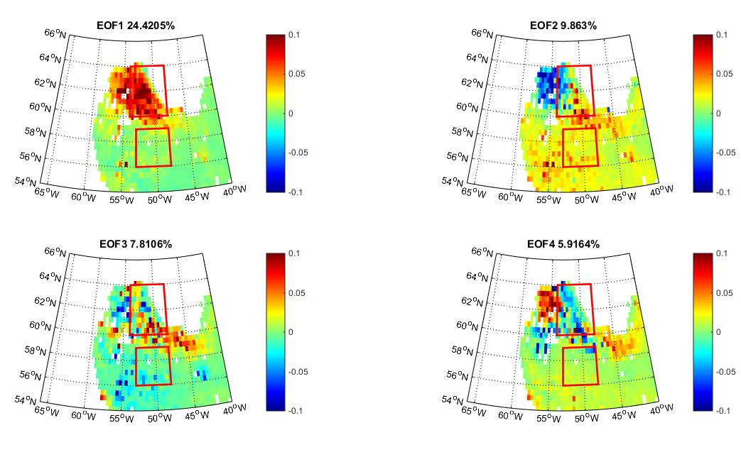
EOF analysis

Slide 13
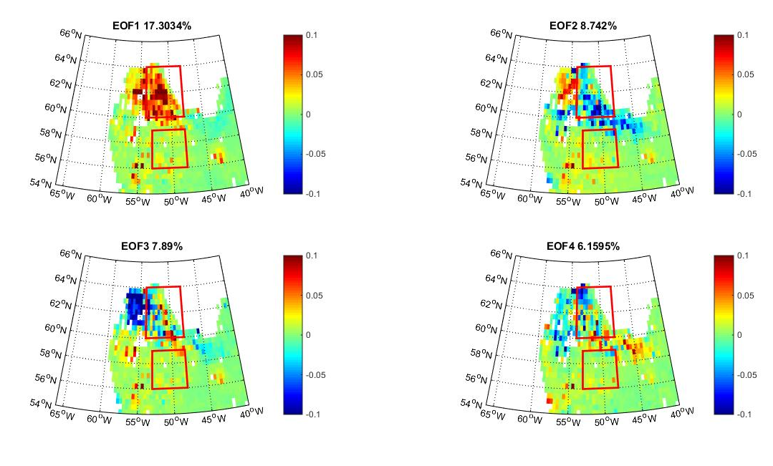
EOF of anomaly

Slide 14
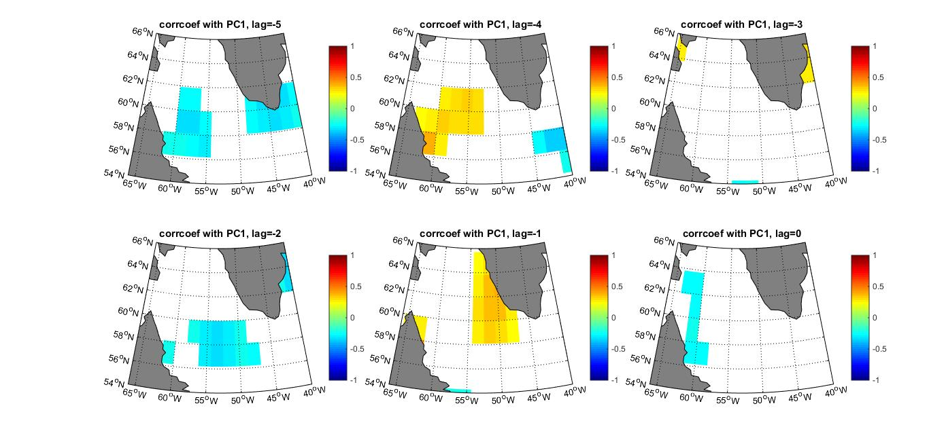
Lag correlation with shortwave radiation

Slide 15
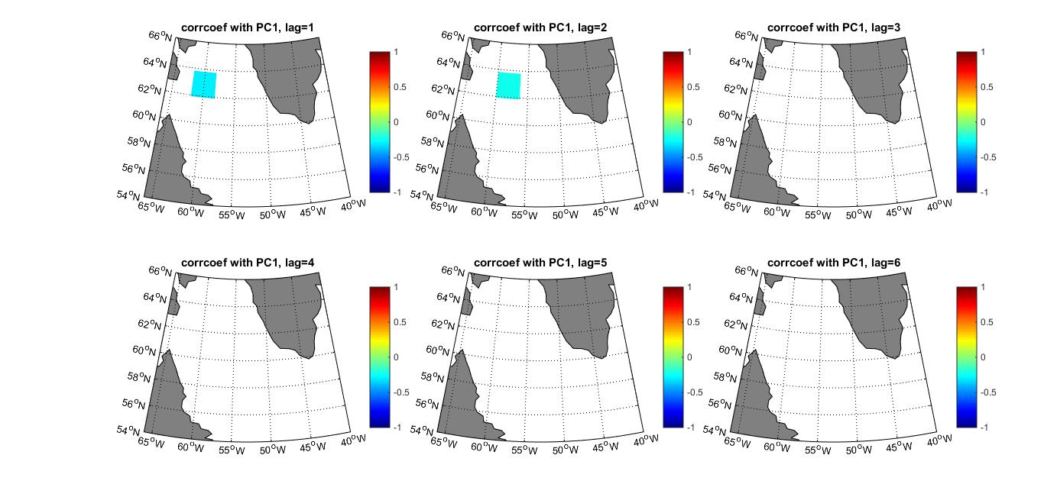
Lag correlation with shortwave radiation

Slide 16
Lag correlation with surface density

Slide 17
Lag correlation with surface density

Slide 18
Lag correlation with surface salinity

Slide 19
Lag correlation with surface salinity

Slide 20
Lag correlation with surface temperature

Slide 21
Lag correlation with surface temperature

Slide 22
Outline
Background
Data
Technical details
Result
  EOF of chlorophyll data
  Correlation with possible factors
Summary

Slide 23
Summary
The inter annual variability of the phytoplankton bloom at northern Labrador Sea can be captured by the 1st EOF of the chlorophyll data
The inter annual variability of chlorophyll data is likely connected with the surface density anomaly
The negative density anomalies possibly come from the fresh and cold signal along the West Greenland Current. It is likely connected with the ice melting from Greenland.

