Slide 1
How Weather, Income, and Education affects Internet Use in the United States
Jackie Valett
EAS 4480 Final Project

Slide 2
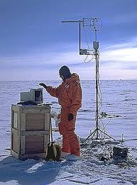
Motivation and Questions
People in Hotlanta use internet in coffee shops, schools, libraries, etc. instead of buying their own internet access.
I’m a wimp about cold weather so I assume colder, rainier locations keep people indoors and purchasing their own internet.
NO
Being comfortable outside may decrease need
for indoor entertainment such as the internet.
Does “better” weather decrease the amount of
(home) internet users?

Slide 3
Further Analysis: Income and Education
In addition to weather, I look at income level and education as factors that affect internet use.
A higher income seems likely to correlate to internet use since internet is an extra expense.
Academic education almost requires internet use. I assume that people with a bachelors degree are more likely to continue purchasing and using the internet.

Slide 4
Data Set-up
Weather data for U.S. state annual precipitation (inches) and temperature (ºF) taken from NOAA.
Percentage of households with Internet access, percentage of persons with a bachelors degree or above (age 25+), and household median income data were taken from the U.S. census for each state.

Slide 5
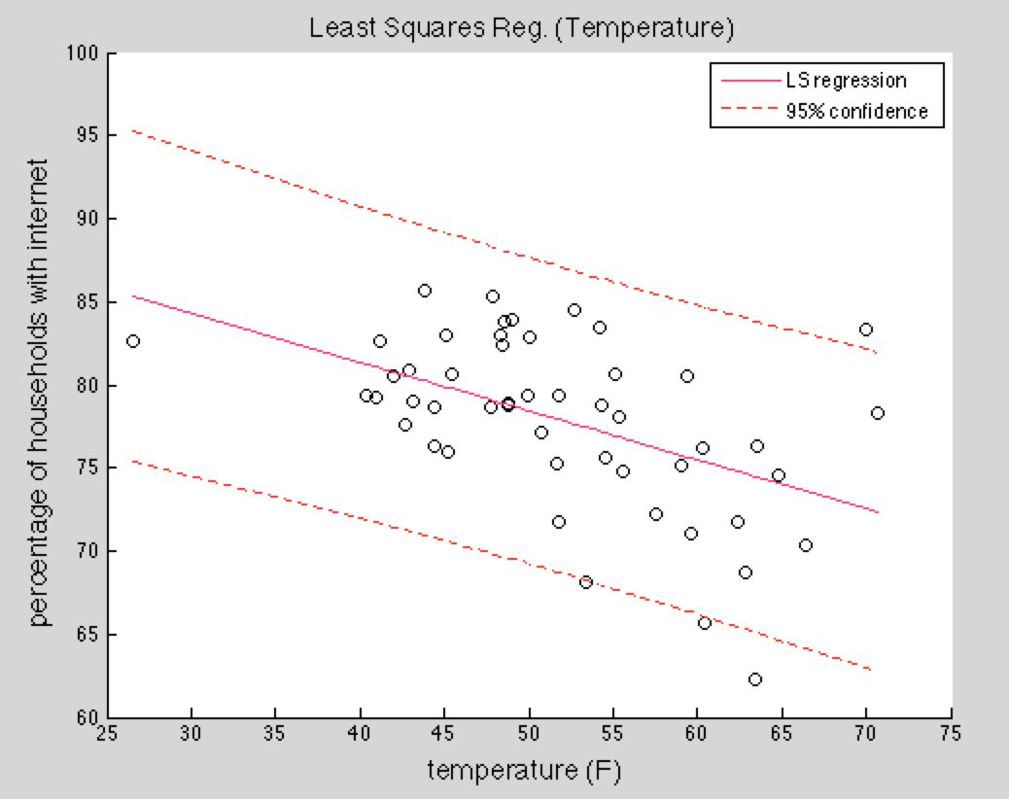
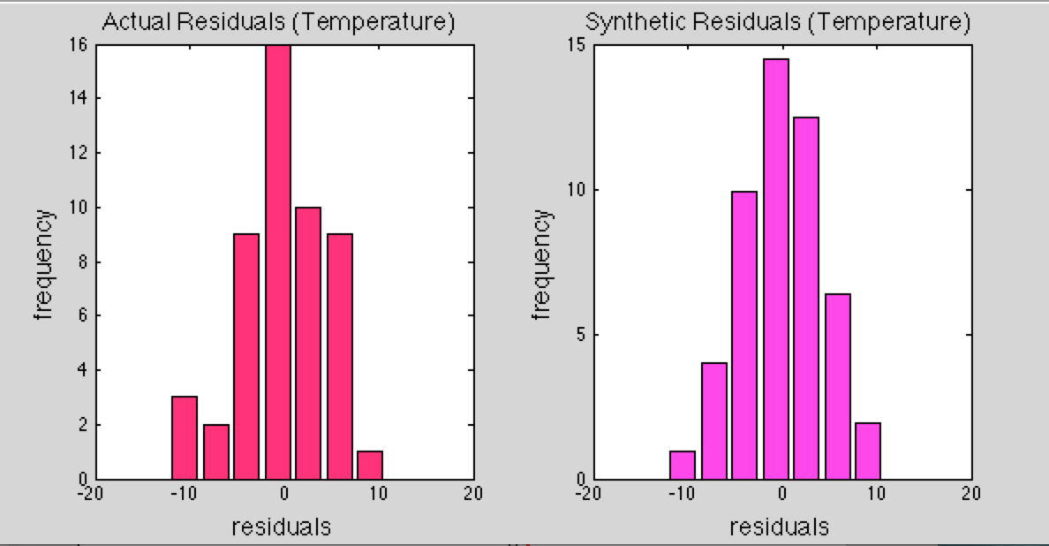
Temperature
LS slope: -0.29
Generally as temperature increases, internet percentage decreases.
Chi squared: 7.69
Critical value: 9.49
Passes chi squared test. Residuals are not significantly different from a normal distribution.
Notes:
Residuals ideally are purely random, i.e., gaussian distributed with zero mean. Test the hypothesis that our residuals are gaussian distributed

Slide 6
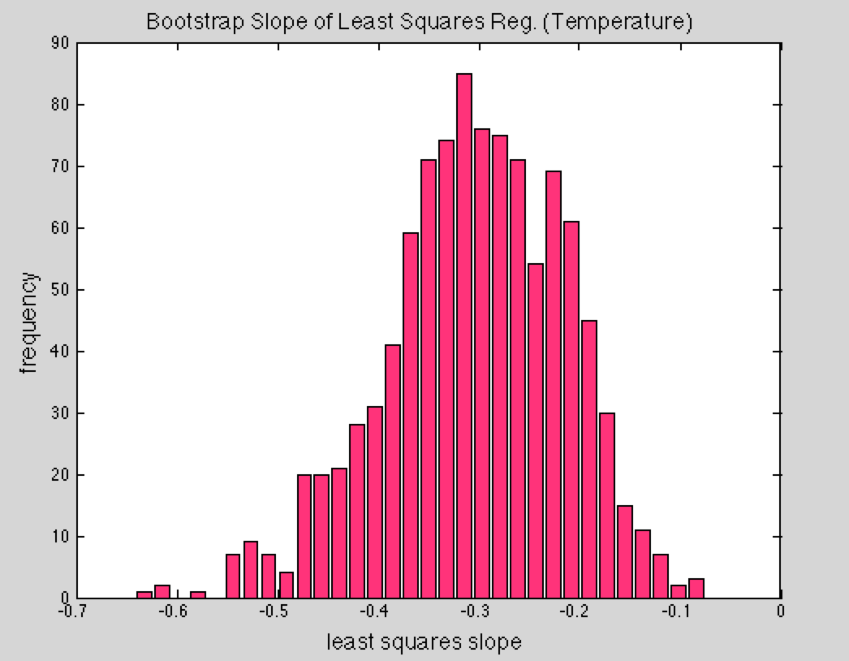
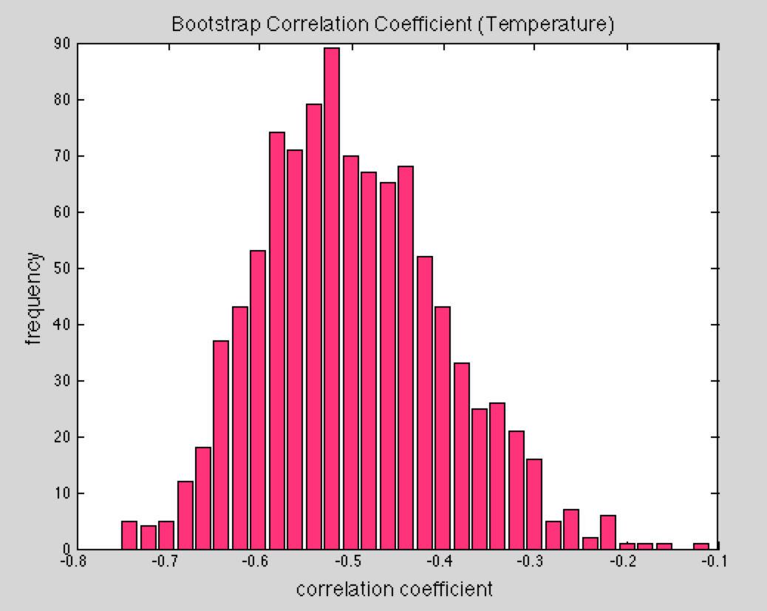
Temperature
LS slope: -0.29
Bootstrap LS: -0.30
95% CI: [-0.48 -0.15]
Corr. Coef.: -0.49
95% CI: [-0.68 -0.25]
Bootstrap C.C.: -0.50
95% CI: [-0.67 -0.29]
Moderate anticorrelation.

Slide 7
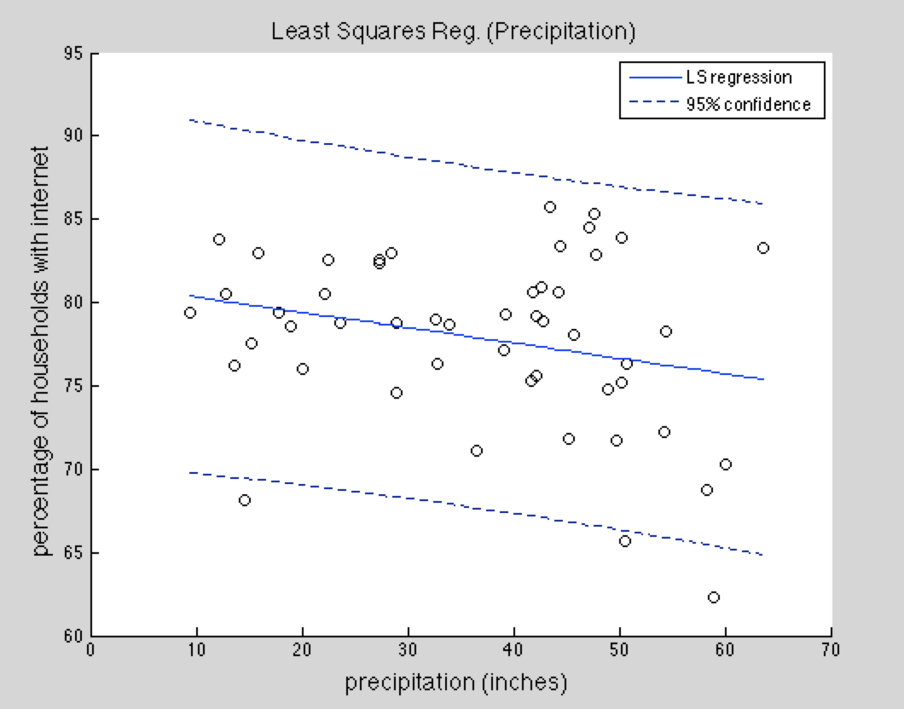
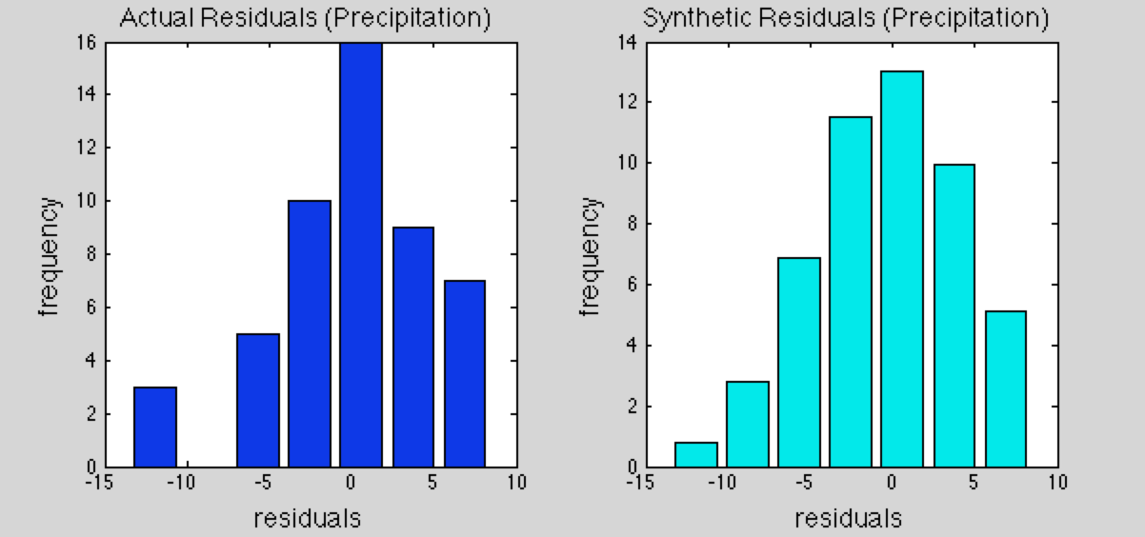
Precipitation
LS slope: -0.09
Generally as precipitation increases, internet percentage decreases.
Chi squared: 11.60
Critical value: 9.49
Does not pass chi squared test. Residuals are significantly different from a normal distribution.
Notes:
significant trend in the residuals suggests that the model not fully describes the data

Slide 8
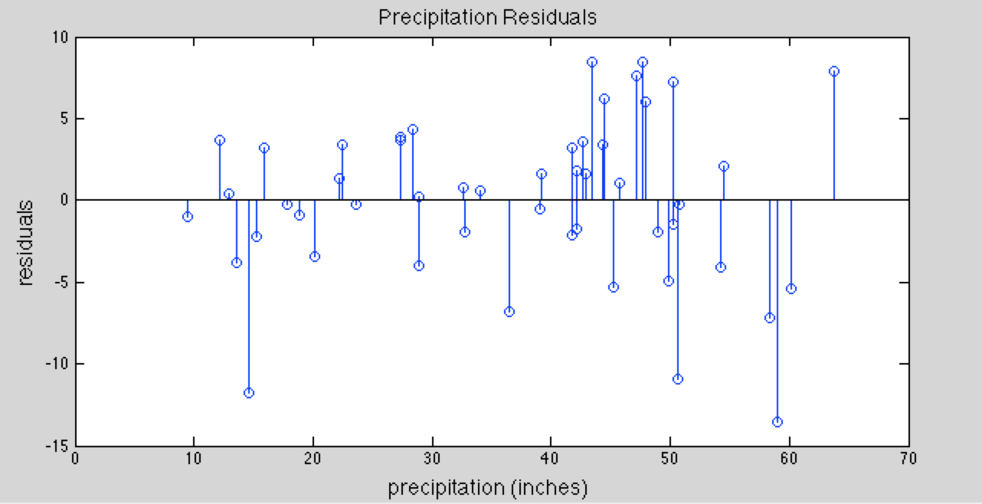
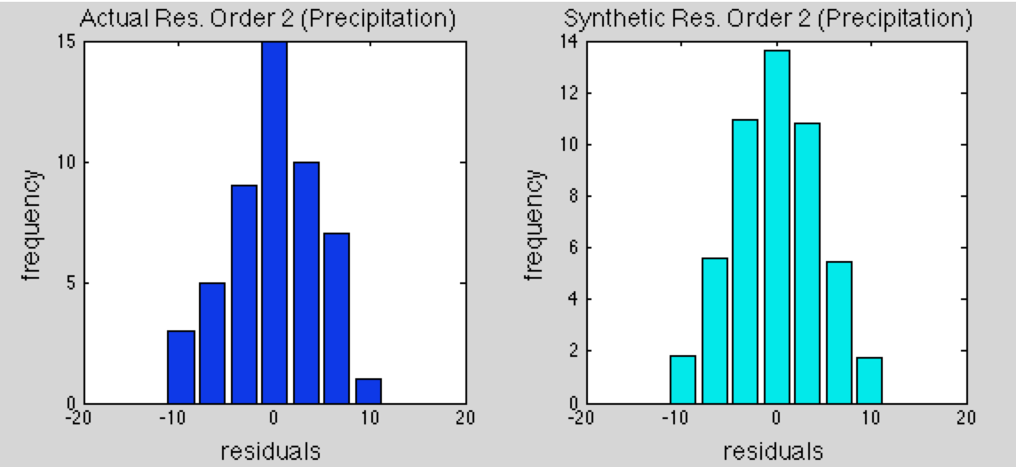
Precipitation
I try order 2 polynomial since residuals are not normally distributed.
Chi squared: 2.14
Critical value: 9.49
Passes chi squared test. Residuals are not significantly different from a normal distribution.

Slide 9
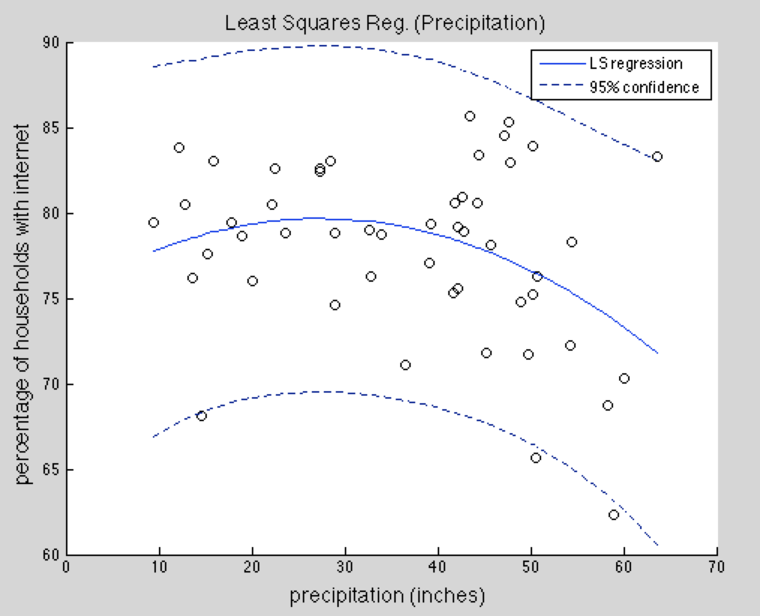
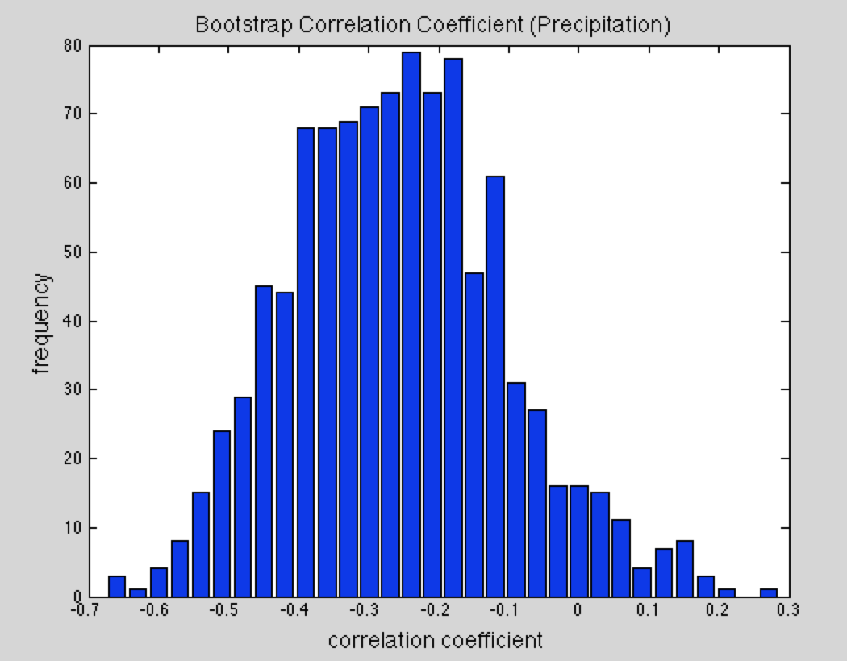
Precipitation
Corr. Coef.: -0.26
95% CI: [-0.50 -0.02]
Bootstrap C.C.: -0.25
95% CI: [-0.53 0.05]
Weak anticorrelation

Slide 10
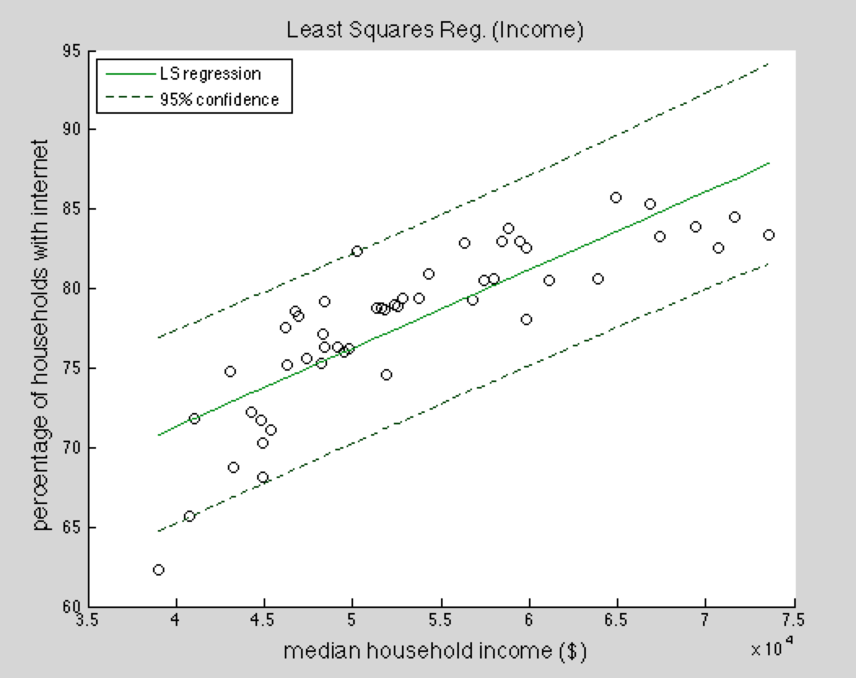
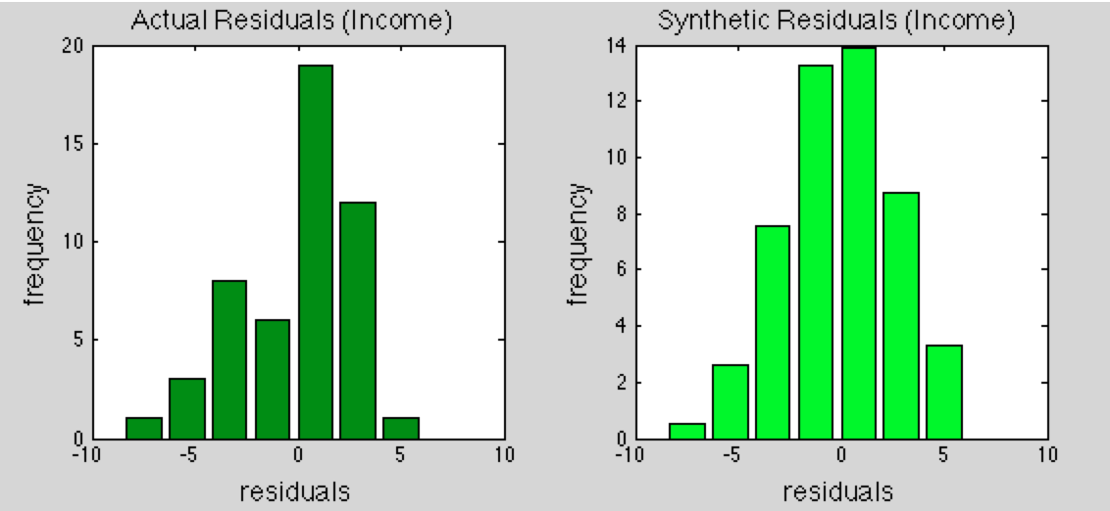
Income
LS slope: 4.9 x 10⁻⁴
Generally as income increases, internet percentage increases.
Chi squared: 9.12
Critical value: 9.49
Passes chi squared test. Residuals are not significantly different from a normal distribution.

Slide 11
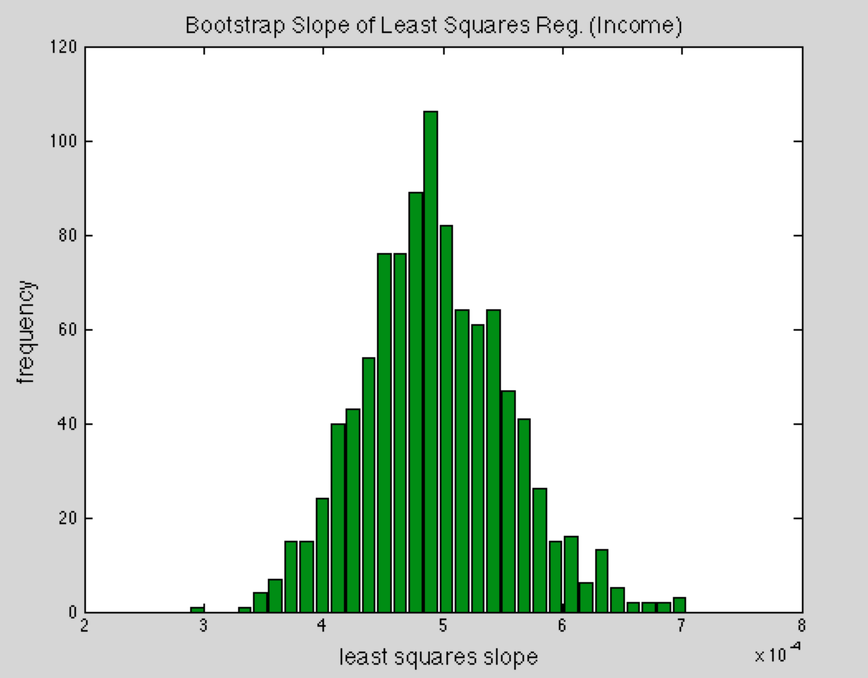
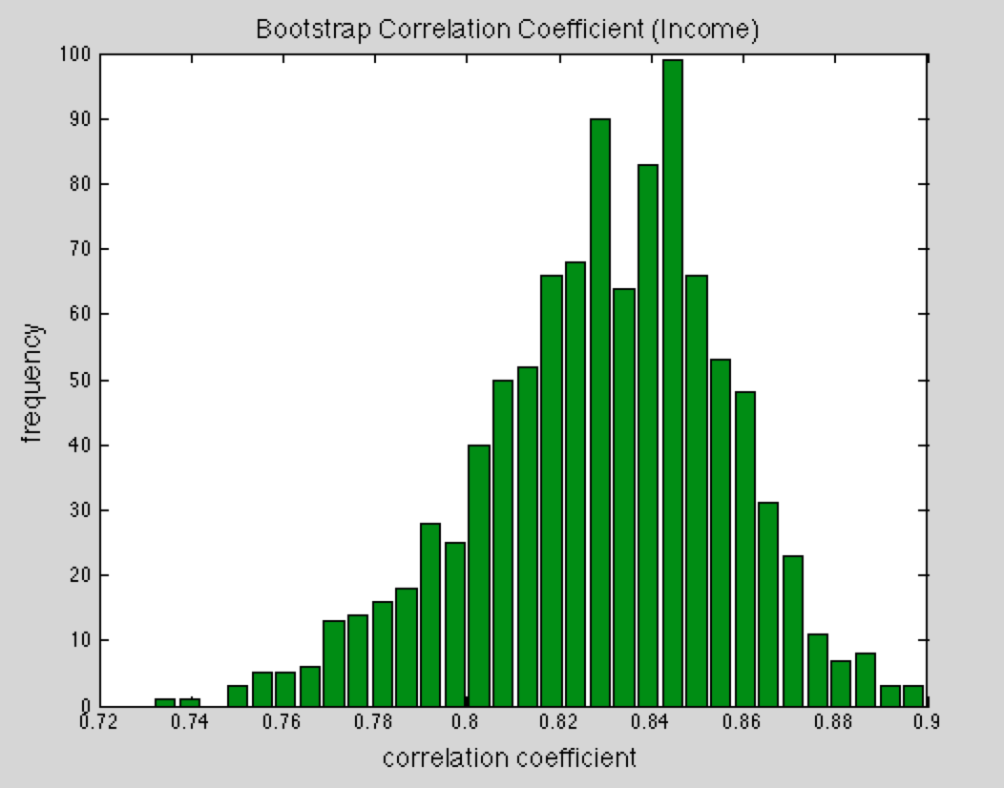
Income
LS slope: 4.9 x 10⁻⁴
Bootstrap LS: 5 x 10⁻⁴
95% CI: [3.8 6.3] x 10⁻⁴
Corr. Coef.: 0.83
95% CI: [0.71 0.90]
Bootstrap C.C.: 0.83
95% CI: [0.77 0.88]
Strong correlation

Slide 12
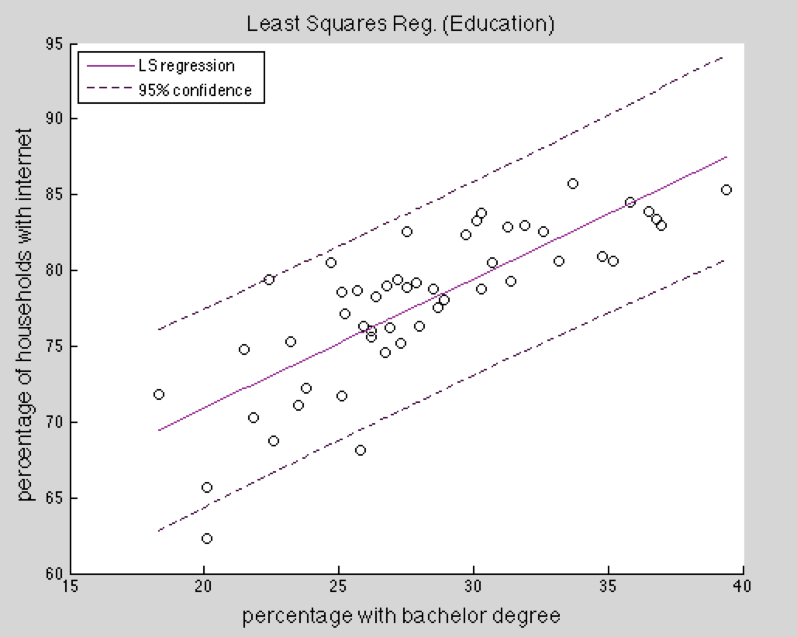
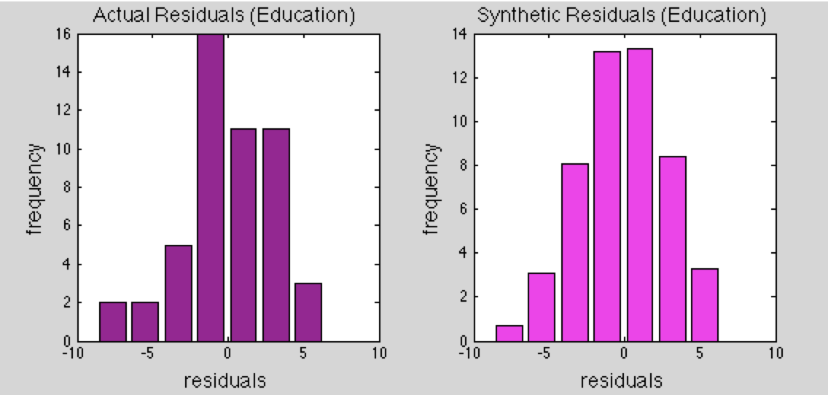
Education
LS slope: 0.85
Generally as degree percentage increases, internet percentage increases.
Chi squared: 5.63
Critical value: 9.49
Passes chi squared test. Residuals are not significantly different from a normal distribution.

Slide 13
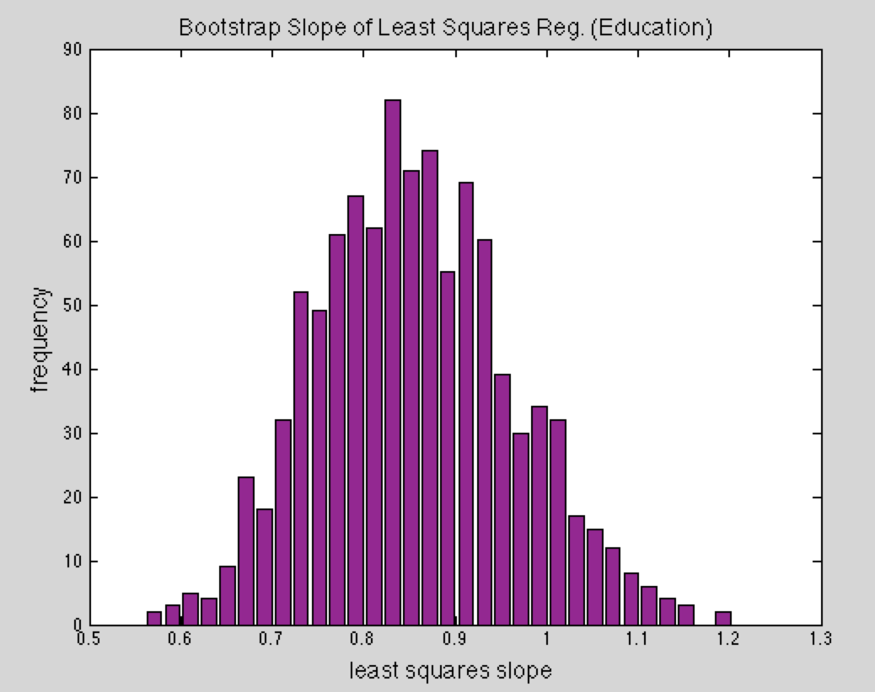
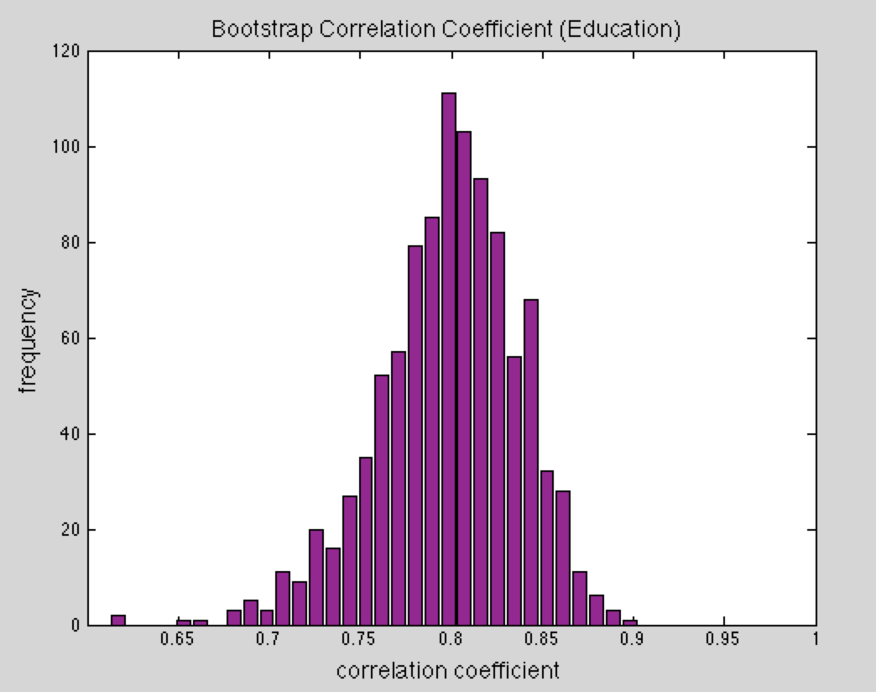
Education
LS slope: 0.85
Bootstrap LS: 0.86
95% CI: [0.67 1.06]
Corr. Coef.: 0.80
95% CI: [0.67 0.88]
Bootstrap C.C.: 0.80
95% CI: [0.71 0.86]
Strong correlation

Slide 14
Problems and Additional Thoughts
Statewide averages do not capture differences within states for all factors (internet use, weather, income, education).
Many other factors may influence internet use (cultural differences, etc.)
Easier access to internet in public spaces may decrease home internet use.
Certain states may allow more jobs that require internet usage.
Some people aren’t as affected by cold weather.
Notes:
Regional variations within states. Culturally north and south differences may manifest in temperature changes.

Slide 15
Conclusion
Higher income and education level are correlated with (home) internet use.
Precipitation effects are difficult to determine.
Higher temperatures seem moderately anticorrelated with internet use but may be associated with other differences.
Notes:
Correct hypothesis for temperature, income, and education! Precipitation rates are highly variable within states.

Slide 16
Questions?
References:
National Oceanic and Atmospheric Administration
United States Census Bureau

