Slide 1
The Relationship of Weather and Movie Ticket Sales
An analysis to show if temperature and precipitation influence ticket sales of Atlantic Station Regal Cinema
By: Elizabeth Johnson

Slide 2
The Fundamental Question
Does weather influence sales?
Null Hypothesis: High/low temperatures and precipitation influence gross ticket sales of Regal Atlantic Station.
Notes:
Reasoning: The reason I chose this was to better understand what can drive sales in general. And find different ways to bring in sales if there is a correlation between nature and attendence.

Slide 3
Data
Regal Corporate – Matt Carr- Business Analyst
Daily Gross Sales through May 1 – August 31 of 2012-2014
Precipitation (in), High Temp (F), Low Temp (F) through May 1 – August 31 of 2012-2014

Slide 4
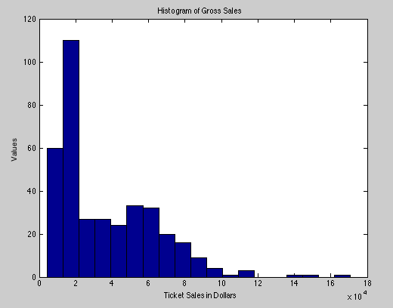
Gross Sales Statistics
Histogram
Mean - $36,767
Max - $170,660
Min - $4306
Standard Deviation - 27,106
Median - $24,517

Slide 5
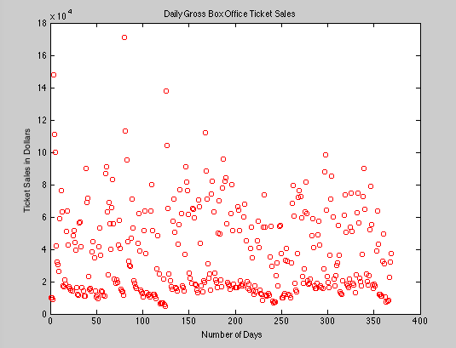
Gross Sales Stats Continued
Quartiles
25% = $15,426
50% = $24,517
75% = $55,506
Variance- 7.3473e08
Skewness - 1.2238
Kurtosis - 4.7882
Notes:
Anyday > $100,000 is a large franchise movie release date and the day following

Slide 6
Gross Sales vs. High Temp, Low Temp, and Precipitation
Notes:
Plot relationship of data sets

Slide 7
Correlation Coefficient
Gross Vs. High Temperature:
Corrcoef Number (r) = -0.1037
Corrcoef Significance (p) = 0.0466
Corrcoef 95% confidence interval = -0.0015807 to -0.20359
Gross Sales vs. Low Temperature:
Corrcoef Number (r) = -0.0372
Corrcoef Significance (p) = 0.4768
Corrcoef 95% confidence interval = 0.065186 to -0.13872
Gross Sales vs. Precipitation:
Corrcoef Number (r) = 0.0622
Corrcoef Significance (p) = 0.2331
Corrcoef 95% confidence interval = 0.16328 to -0.040117
Notes:
All r is small,
Slight Positive correlation with precipitation
Overall = no correlation

Slide 8
Least Squares Regression Gross vs. High Temperature
Least Squares Regression Slope of Gross vs. High Temperature
-2.6432e-05
LS Slope 95% Confidence Interval of Gross vs. High Temperature
low = -5.2585e-04
high = 4.7299e-04
Notes:
Small Negative Slope

Slide 9
Least Squares Regression Gross vs. Low Temperature
Least Squares Regression Slope of Gross vs. Low Temperature
-8.4233e-06
LS Slope 95% Confidence Interval of Gross vs. Low Temperature
low = -0.0016
high = 0.0016
Notes:
Even smaller negative slope

Slide 10
Least Squares Regression Gross vs. Precipitation
Least Squares Regression Slope of Gross vs. Precipitation
8.8183e-07
LS Slope 95% Confidence Interval of Gross vs. Precipitation
low = -0.0063
high = 0.0063
Notes:
Small positive slope

Slide 11
Bootstrap- Corrcoeff
Gross vs. High Temperature
Corrcoeff =
1.0000 -0.1037
-0.1037 1.0000
Bootstrap mean = -0.0994
Bootstrap std =0.0647
Gross vs. Low Temperature
Corrcoeff =
1.0000 -0.0372
-0.0372 1.0000
Bootstrap mean = -0.0386
Bootstrap std = 0.0547
Gross vs. Precipitation
Corrcoeff =
1.0000 0.0622
0.0622 1.0000
Bootstrap mean = 0.0632
Bootstrap std = 0.0563
Notes:
There is Validity in the result since the mean is close to the calculated ‘r’
Gaussian distribution, we can use their mean as a good estimate for true correlation coeff.
Small standard deviation

Slide 12
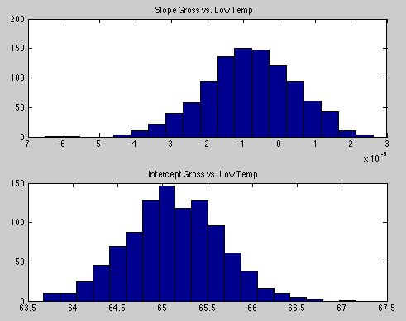
Bootstrap-LS Regression
Mean slope :
High Temperature = -2.5911e-05
Std slope:
High Temperature = 1.6599e-05
Mean Intercept:
High Temperature = 87.1614
Std Intercept:
High Temperature = 0.5991
Mean slope : Low Temperature = -8.4087e-06
Std slope:
Low Temperature = 1.2636e-05
Mean Intercept:
Low Temperature = 65.1196
Std Intercept:
Low Temperature
= 0.5276
Notes:
Using bootstrap method to obtain a better estimate of the regression coefficient
Mean of slope = ls slope
Small std = accurate estimate

Slide 13
Bootstrap-LS Regression
Mean slope :
Precipitation =
8.7440e-07
Std slope:
Precipitation=
8.2375e-07
Mean Intercept:
Precipitation =
0.1246
Std Intercept:
Precipitation =
0.0335

Slide 14
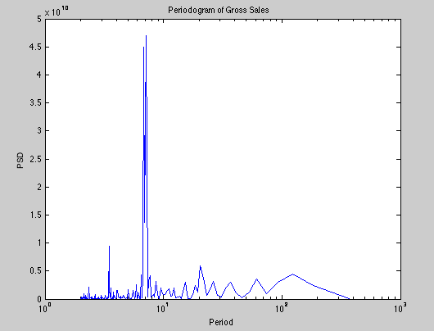
Time Series Analysis
Periodogram shows a small ½ weekly and a large weekly cycle.
Why?
Notes:
Major Period = 7
When I found the magnitude of periodogram, I saw that the slight and major peaks fall at: days 2-3 (Monday) , days 6-7, (Friday and Sat) and day 20. (5/5/12-7/20/12; 5/3/13-6/14/13)
EDU>> 1./f(Pxx >5e9) Magnitude of periodogram
ans =
20.5000
7.2353
7.0962
6.9623
6.8333
3.4811
½ Weekly = Monday
Weekly= Weekends
3Weeks = Big movie Rotation?

Slide 15
Histogram for Each Day
Notes:
If you notice the histograms. Friday and Saturday shows more days with higher gross sales because everyone goes to the movies for date night on the weekend. What is interesting is that Monday also shows more days of higher sales as well. This is happening because in 2013 large franchise movies were released on Mondays in the summer.

Slide 16
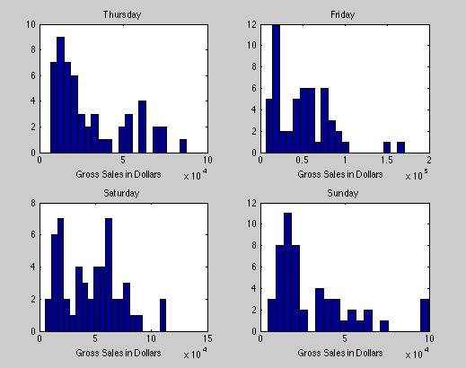
Histogram for Each Day
Notes:
Friday_Max =
1.7066e+05
Monday_Max =
1.3764e+05
Saturday_Max =
1.1295e+05
Sunday_Max =
9.9688e+04
Thursday_Max =
8.7686e+04
Tuesday_Max =
104044
Wednesday_Max =
7.5972e+04

Slide 17
Conclusions
Small correlations relating temperature and precipitation to gross sales.
Weak negative slope of temperatures
Weak positive slope of precipitation
½ week and weekly cycle of gross sales due to normal popular weekends and release dates of franchise movies.
Gross Sales are not influenced by temperature or precipitation

Slide 18
Data Sources
“Horticulture Research Farm The University of Georgia.” Georgia Weather. 1 Jan. 2011. Web. 10 Apr. 2015. < http:// www.griffin.uga.edu/aemn/cgi-bin/AEMN.pl? site=GAWH&report=hi.
Matt Carr,
Vice President Business Analytics
Regal Entertainment Group
Notes:
http://www.griffin.uga.edu/aemn/cgi-bin/AEMN.pl?site=GAWH&report=hi

