Slide 1
Mexico City: Predicting the Next, Big Earthquake
Kelly Flanagan
April 20, 2014

Slide 2
Motivation
Why study earthquakes in Mexico City?
Map of Mexico
Mexico City is uniquely susceptible to highly damaging earthquakes.
Factors exacerbate earthquakes:
Active Tectonic Environment
Greater Population Density
Extensive, Poorly Built Infrastructure
Unstable Bedrock Composition

Slide 3
1) Active Tectonic Environment
Active Tectonics
Tectonic Map
Plate Interactions
North American Plate
Cocos Plate
Pacific Plate
Caribbean Plate
Middle American Trench
Zones
Spreading Zone
Rapid subduction Zone
Take Away: Tectonic movement generates earthquakes.

Slide 4
2) Great Population density
Population
Population Timeseries
Quantify
~9 million people
~20 million ‘area’
Titles
Most Populated City in the Western Hemisphere
9th Most Populated City in the World
Take Away: Larger population leads to an increase in risk.

Slide 5
3) Extensive Infrastructure
How Buildings are Built
Hillside Residencies
Rapid Population Growth led to Rapid Building Construction
Infrastructure Built on Pre-existing Infrastructures
Take Away: Sturdy infrastructures are more safe in shaking events.

Slide 6
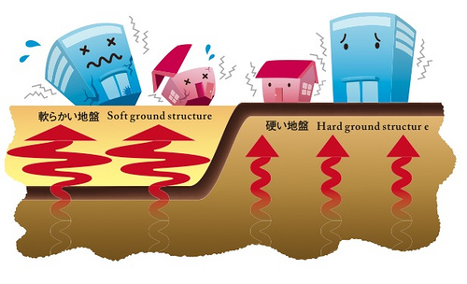
4) Unstable Bedrock Composition
History of Mexico City
Flag of Mexico
Toltec Empire Falls
Aztecs Relocate
Sign: Eagle Eating a Snake on a Cactus
Site: Island on Lake Texcoco
Spanish Arrived
drain Lake Texcoco
Result: Mexico City is Built on Unstable Grounds
Take Away: Unstable ground exacerbates shaking events.

Slide 7
Dataset
Earthquake information comes from USGS ANSS catalog
Limitations
Time: 1787 – 2015
Magnitude: Only M 4-9 recorded
Chosen above Mexico earthquake database
Mw Scale

Slide 8
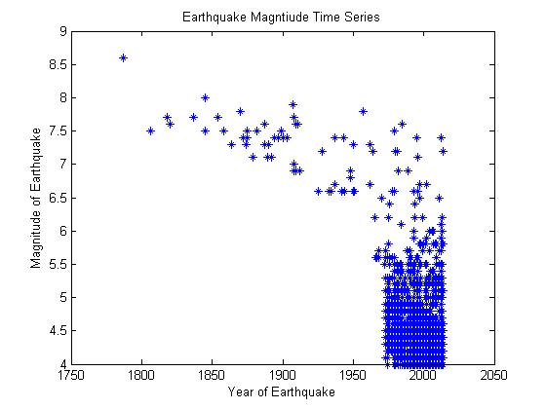
Histogram and Log-scale
Earthquake
Magnitude Histogram
Earthquake
Magnitude vs. Year
Problem: Data is not useable in its current state due to technology bias. Need to make data usable

Slide 9
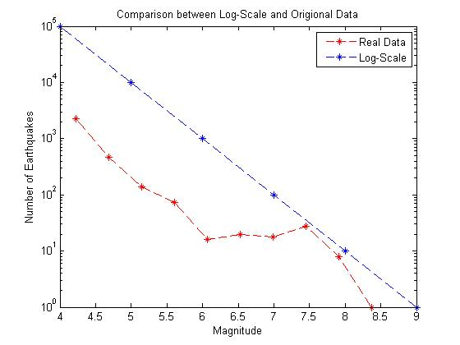
Make useable Data: Upper Rectangle
Gutenberg-Richter Law:
a global scale, earthquake frequency follows a log-normal distribution with respect to magnitude.
There should be 1 M 8.0-8.9; 10-20 M7.0 -7.9, 100-150 M6.0-6.9 earthquakes, and so on.
Distribution: Log-scale
Test: Failed Chi-squared test

Slide 10
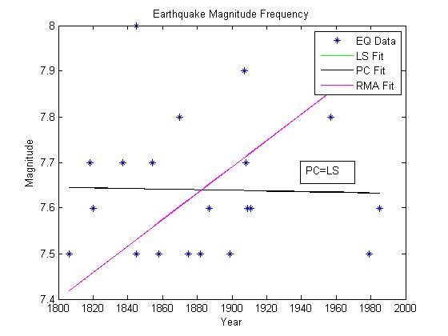
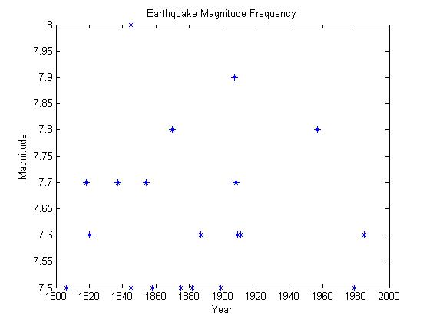
Truncated DATA & LS, RMA, and PC Regression Fit
Regression Fits
Least Squares (LS)
Principle Component (PC)
Same Fit
Reduced Major Axis (RMA)
Not a good trend
20 Data Points
Between M 7.5 -8
Between 1800 and 2000

Slide 11
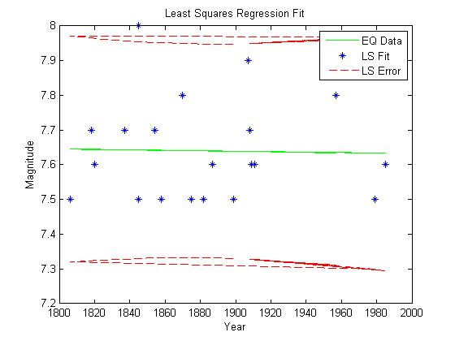
Least Squares Plot with Equation
Equation for Earthquake Return
Return Interval: 0.0044 years from major event
Equation from Least-Squares regression
Y: magnitude
X: year
High Magnitude Prediction: M 7.63 earthquake in 2015
Limitation: based on linear fit and distances, and gives average, low magnitudes

Slide 12
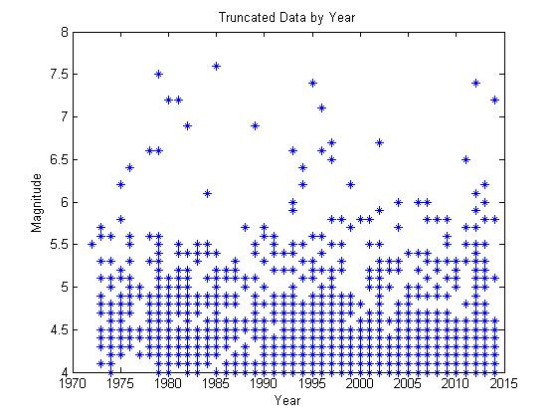
Make useable Data: Lower Rectangle
Truncated Data by Year
New Dataset
2980 Data Points
Between 1973 and 2015

Slide 13
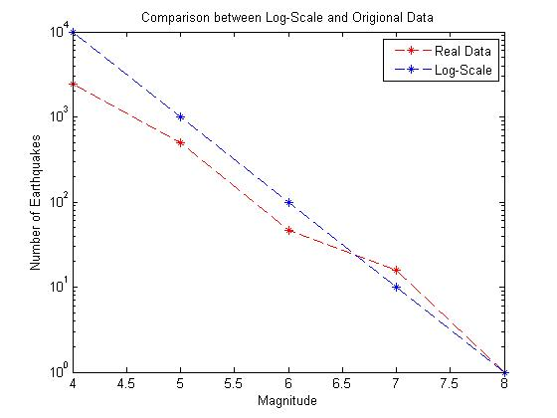
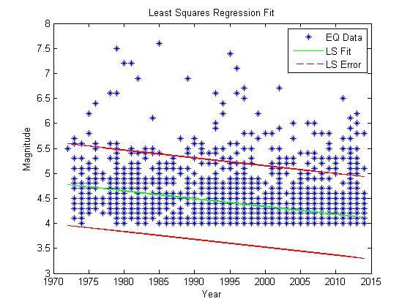
Make useable Data: Lower Rectangle
Log-Scale Distribution
Least Squares Fit
Log Scale fit is appropriate. General Magnitude of EQ are ↓

Slide 14
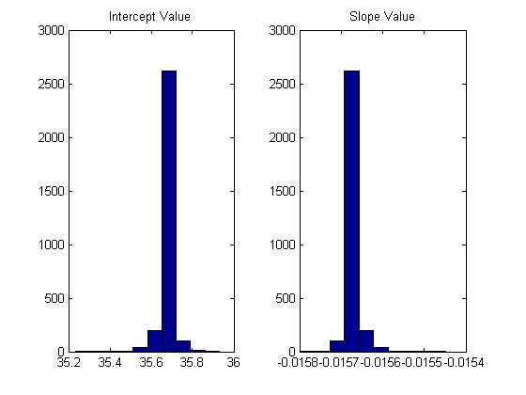
Resample the data
Equation
Low Magnitude Prediction for 2014: M4.03
Limited by Weights, distances above
Jackknife (LOOCV) method
Corresponding results

Slide 15
General Observable trends
Two Method Comparison
Trends
Statistic | Upper Rectangle | Lower Rectangle
Alternate Name | Great Earthquake | Recent Earthquake
Magnitude Trend | Decreasing | Decreasing
Slope | -6.714E-05 | -0.0157
Intercept | 7.7661 | 35.6641
Prediction for 2015 | Extreme Value of M 7.63 | Avg of M 4.03
Number of Earthquakes | Increasing | Increasing
Magnitude Trend
Decreasing in Magnitude
Frequency Trend
Increasing
Due to Enhanced detection methods

Slide 16
General Observable Trends
Chart of Divided Data
Trends
Statistic | Pre-1994 | Post-1994
Number of Data Points | 577 | 2403
Mean Magnitude | 4.7246 | 4.2594
Standard Deviation of Magnitude | 0.6508 | 0.4237
Spread | More | Less
More ability to detect and record earthquakes reliably

Slide 17
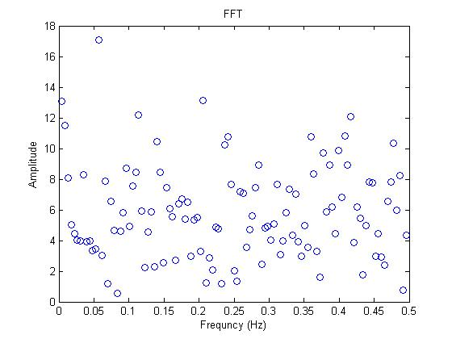
Domain and fast Fourier Transform
Current Method
Domain
Previous methods insufficient
Apply FFT and IFFT analysis
Domain visible to the right
FFT Tranformation

Slide 18
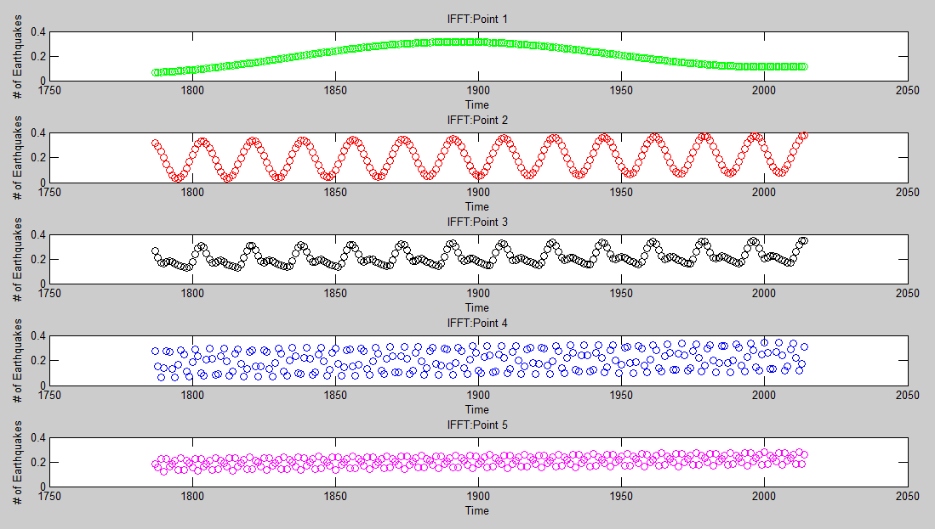
IFFT Plots
These ‘f’ values to the left represent the predicted trend.
It is the likelihood of a large value per year.
Increase in frequency (down the chart/points)
Averaged/Summed, conservative estimate is 0.25, so one M 7.0 or greater in the next 4 years.
f = 0.12
f = 0.40
f = 0.32
f = 0.20
f = 0.20

Slide 19
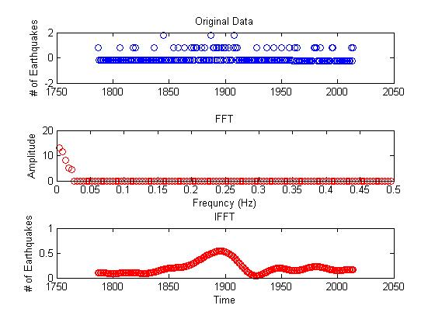
Fast Fourier Transform anD Inverse Fast Fourier Transform
FFT and IFFT of >M7
Original Data
# of Earthquakes vs. Time
FFT Plot
Amplitude vs. Frequency
Take most prominent frequencies
IFFT Plot
# of Earthquakes vs. Time
Trend for Prediction: M7 or larger impending

Slide 20
CONCLUSION: IS A big Earthquake impending?
Evidence
Plots
Based on Gutenberg-Richter Law, we are ‘missing’ a large M 8.5 and above
Least Squares Fit for Large Magnitudes indicates an average of M 7.63
Least Squares Fit for Recent Data indicates an average of M 4.03
FFT and IFFT indicate a trend for an uptick in Earthquakes, with greater than a M7.0 in the next four years

Slide 21
Conclusions
Results
Methods
A likelihood of a large earthquake is promising.
Data follows the Gutenberg-Richter Magnitude Law
Approximately Log Scale
Fault movement
Fault is becoming increasingly locked
→ Lower magnitudes now
→ High magnitude event later on
Used numerous statistical methods
Histogram
Time series (Magnitude vs. Time)
Least Squares
Principle Component
Reduced Major Axis
95% Confidence Interval
Jackknife (LOOCV)
FFT and IFFT
Predicted an earthquake
Avg. of M 4.03
High Mag 7.63

Slide 22
References
"ANSS Comprehensive Catalog." USGS. USGS, 15 Mar. 2015. Web. 14 Mar 2015.
Earthquake Hazards Program. 2013. U.S. Geological Survey. Earthquake Facts & Earthquake Fantasy. U.S. Department of the Interior. Web. p 1-8.
Earthquakes. 2000. Forces of Nature. Web. p 1.
Mexico City Population. World Population Statistics. Web. p 1-4.
Moreno Murilla, Juan Manuel. The 1985 Mexico Earthquake. Geofísica Colombiana, 3:5-19, Oct. 1995.
“Richter Magnitude Scale.” Wikipedia. 16 Mar. 2015. Web. 5 Apr. 2015
United States Geological Survey, USGS. Poster of the Oaxaca, Mexico Earthquake of 20 March 2012 - Magnitude 7.4. 20 March 2013.
Wilcox, K. 2012. Earthquake Tests Mexico Building Codes. Civil Engineering. p 1-2.
Wisner, B., Blaikie, P., Cannon, T., and Davis, I. 1994. At Risk: Natural Hazards, People's Vulnerability and Disasters. Routledge. p 282-285.

Slide 23
Questions?

