Slide 1
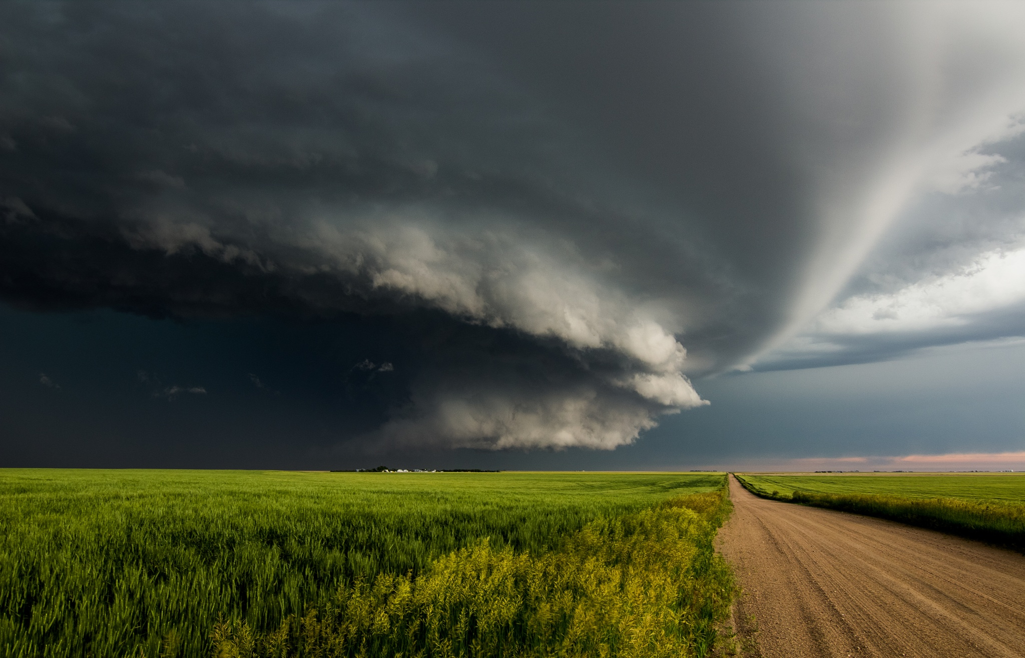
Tornado Frequency and Intensity in Oklahoma
Lauren Merritt
EAS 4480 - Data Analysis
April 21, 2015

Slide 2
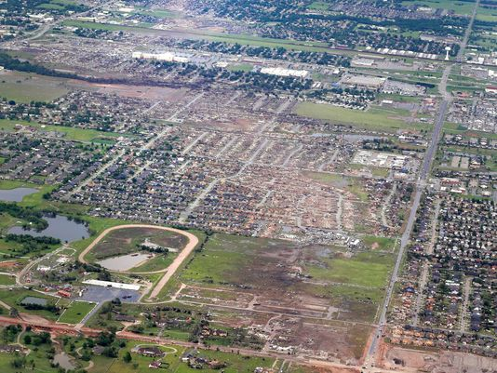
Motivation
Interest in severe weather
Climate change/global warming
Possibly more intense and more frequent tornadoes
Oklahoma is known for Tornadoes
Notes:
Moore, OK – May 20th EF5

Slide 3
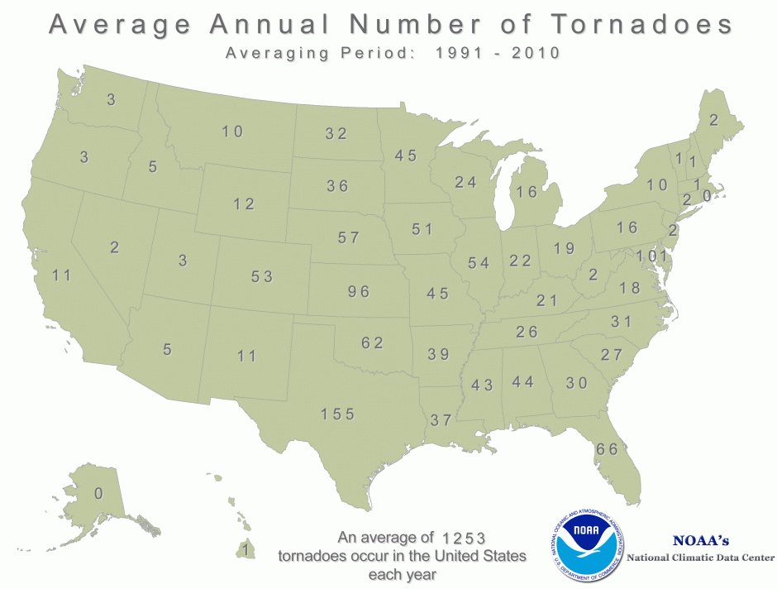
Question
Over time, is there an increase in either tornado intensity or frequency, potentially due to global warming?

Slide 4
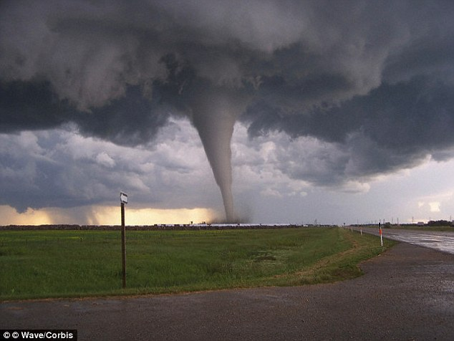
Data
Data from NWS WFO in Oklahoma (NOAA data)
Dates: 2004 to 2014
Number and Rating

Slide 5
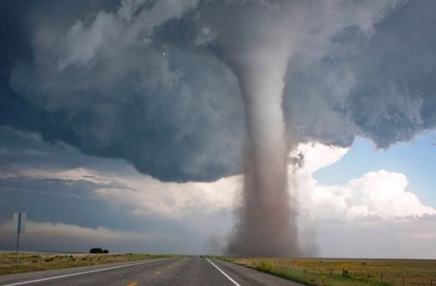
Methods
Visualization of data
Chi squared test
LS Regression/Bootstrap analysis of slopes
Periodogram

Slide 6
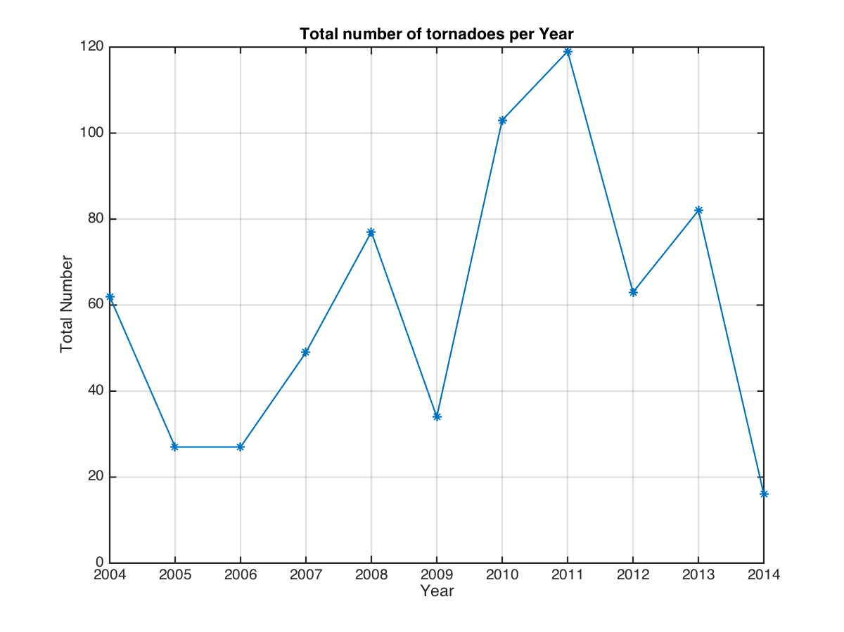
Visualization

Slide 7
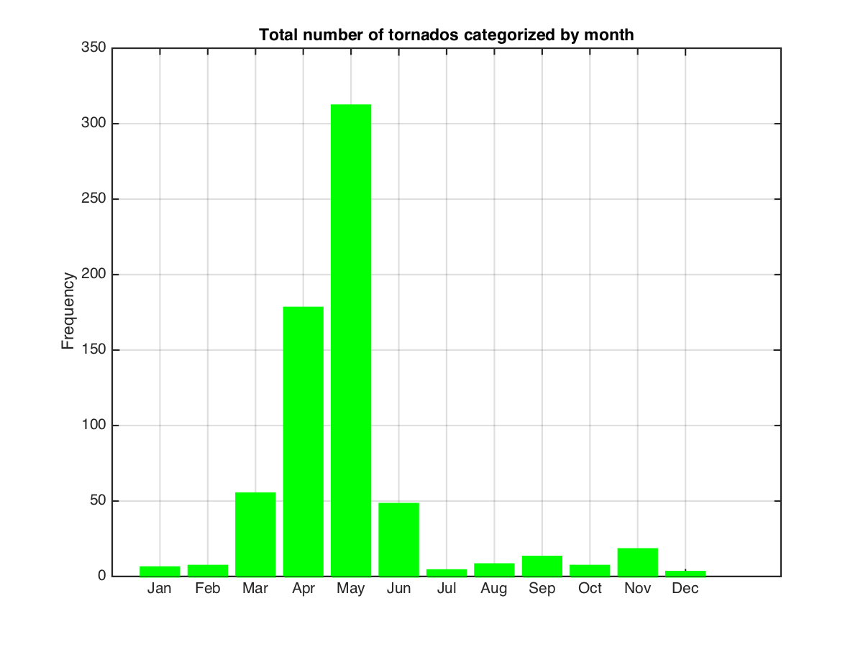
Visualization

Slide 8
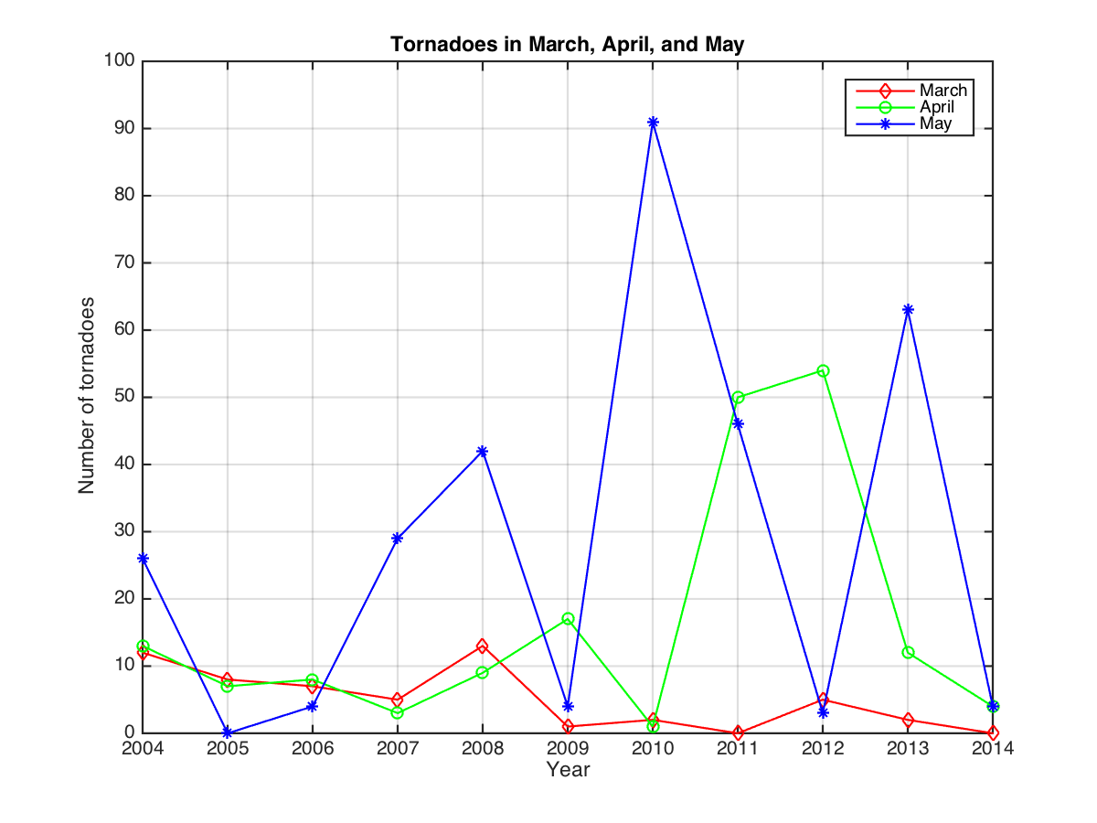
Visualization

Slide 9
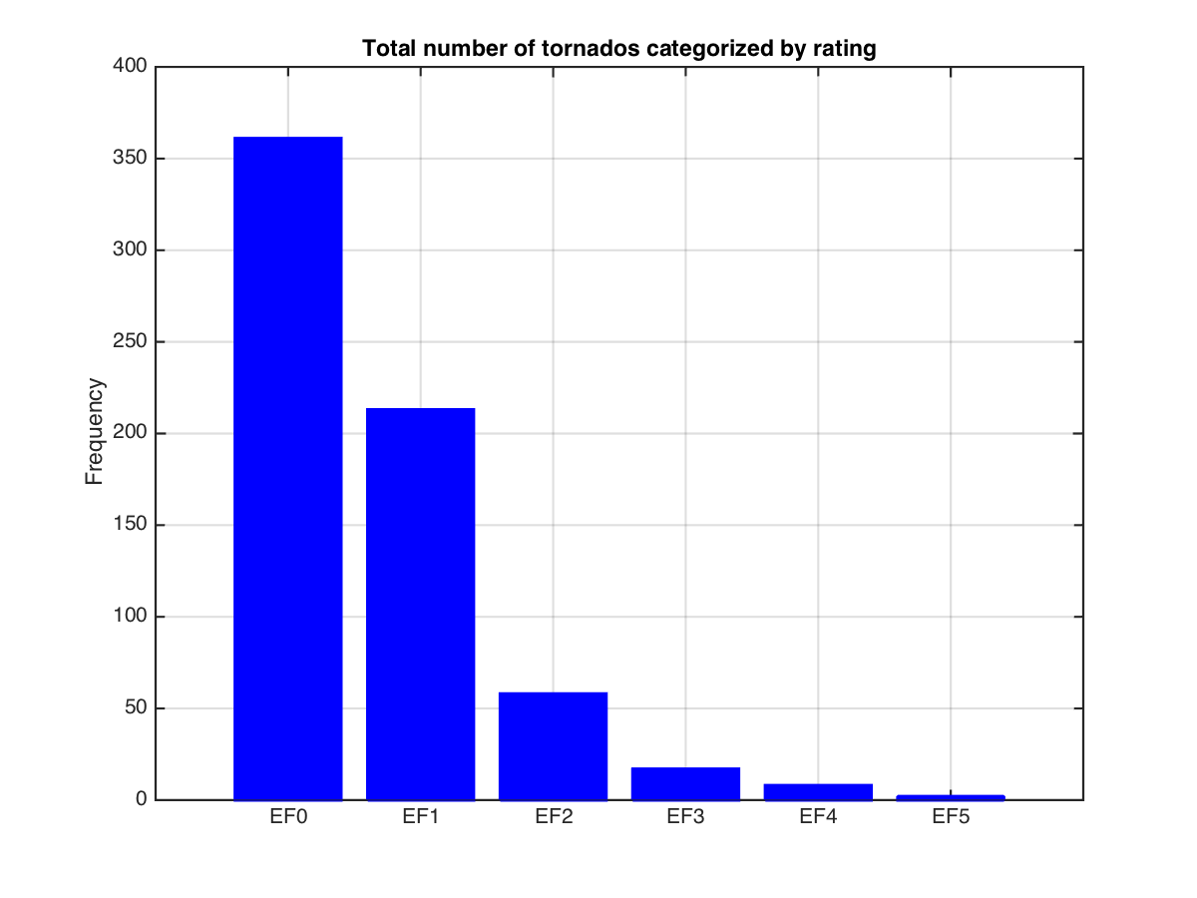
Visualization

Slide 10
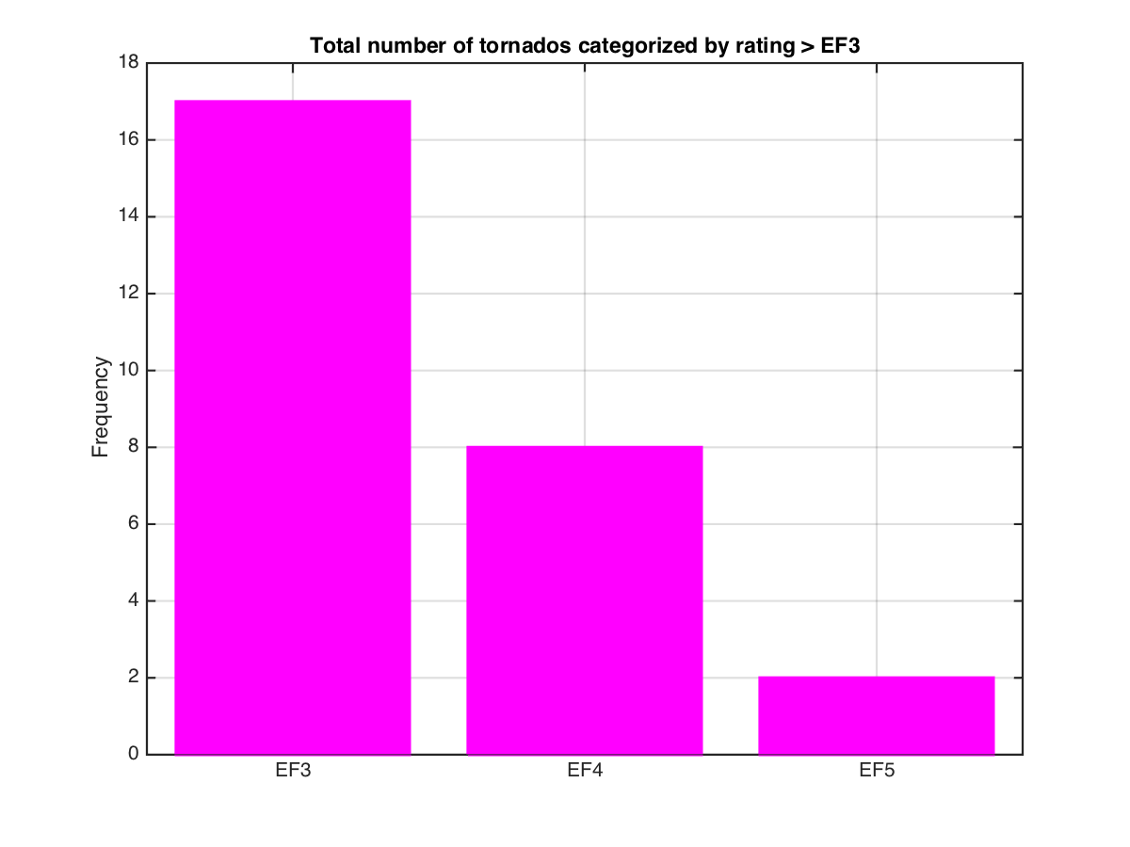
Visualization

Slide 11
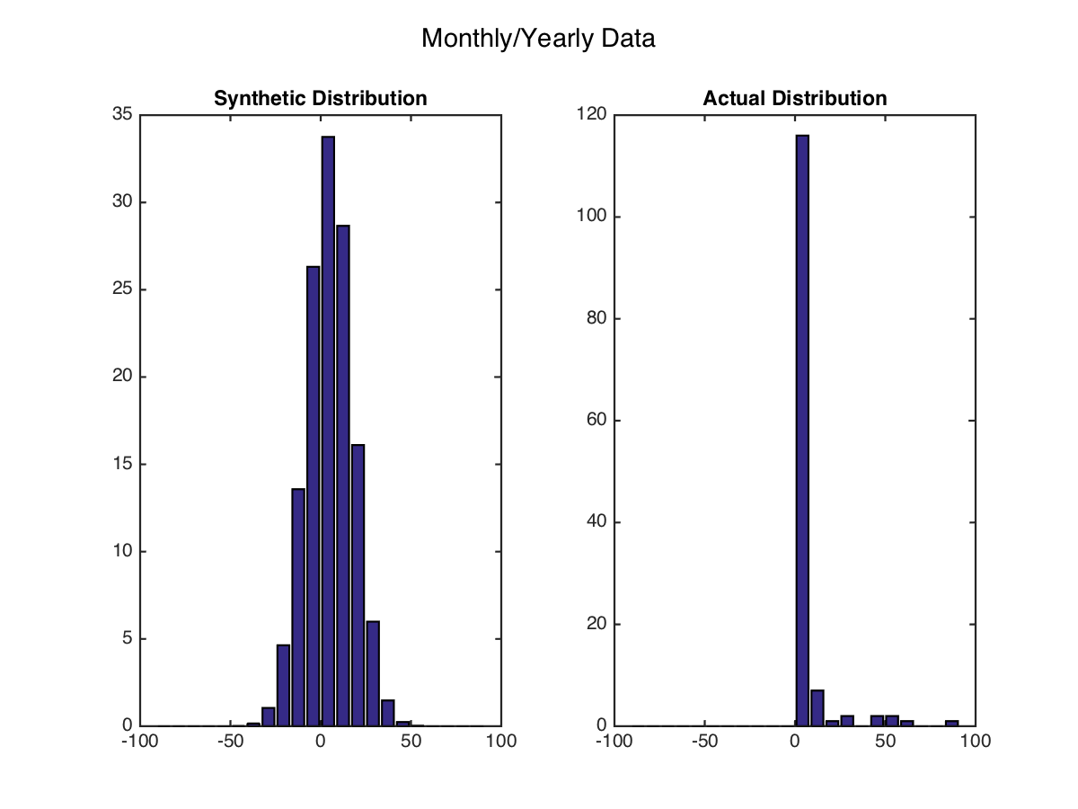
Chi Square Test: Frequency
Monthly
Null Hypothesis | The data is normally distributed.
Chi Value | 1.7440e+07
Chi Critical Value | 156.5075
Reject/Accept? | Reject

Slide 12
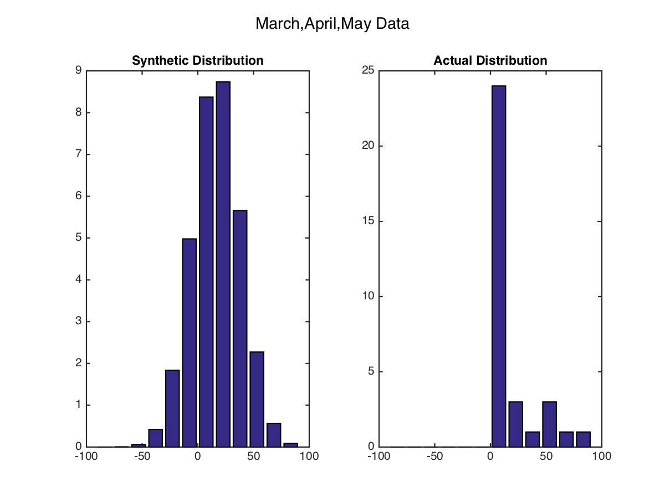
Chi Square Test: Frequency
March, April, May
Null Hypothesis | The data is normally distributed.
Chi Value | 54.1240
Chi Critical Value | 43.7730
Reject/Accept? | Reject

Slide 13
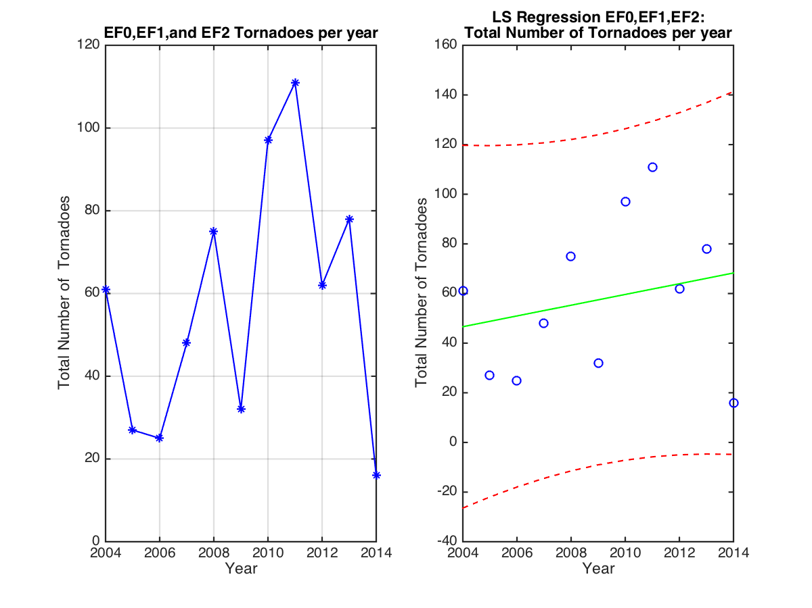
LS Regression: Intensity
EF0, EF1, EF2
Method | Slope Value | CI
LS Reg. | 2.1636 | [-19.5435 23.8708]
Bootstrap | 2.7876 | [-5.6089 7.7296]
Upwards Trend

Slide 14
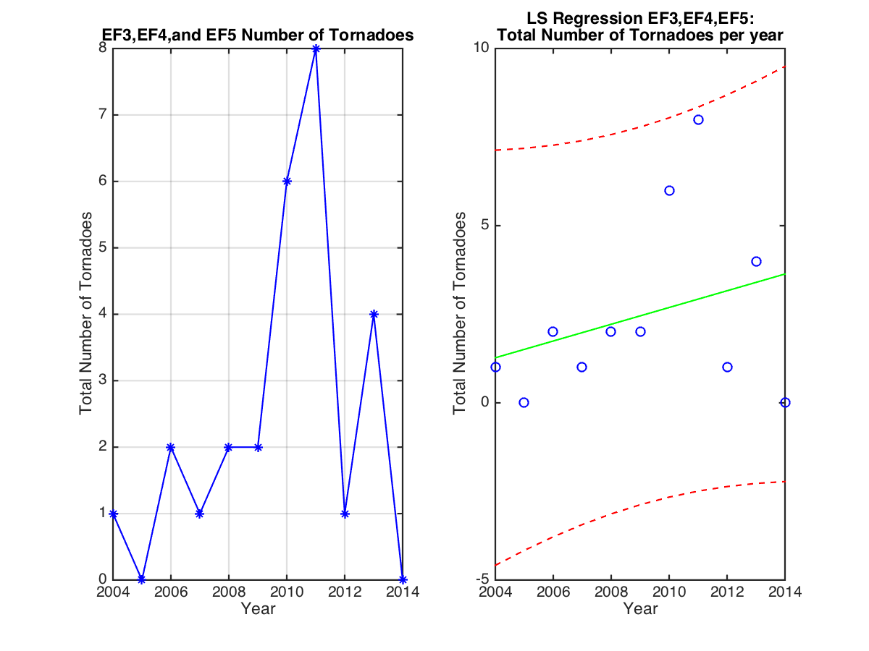
LS Regression: Intensity
EF3, EF4, EF5
Method | Slope Value | CI
LS Reg. | 0.2364 | [-1.5128e3 1.5132e3]
Bootstrap | 0.2628 | [-0.2530 0.7596]
Upwards trend!

Slide 15
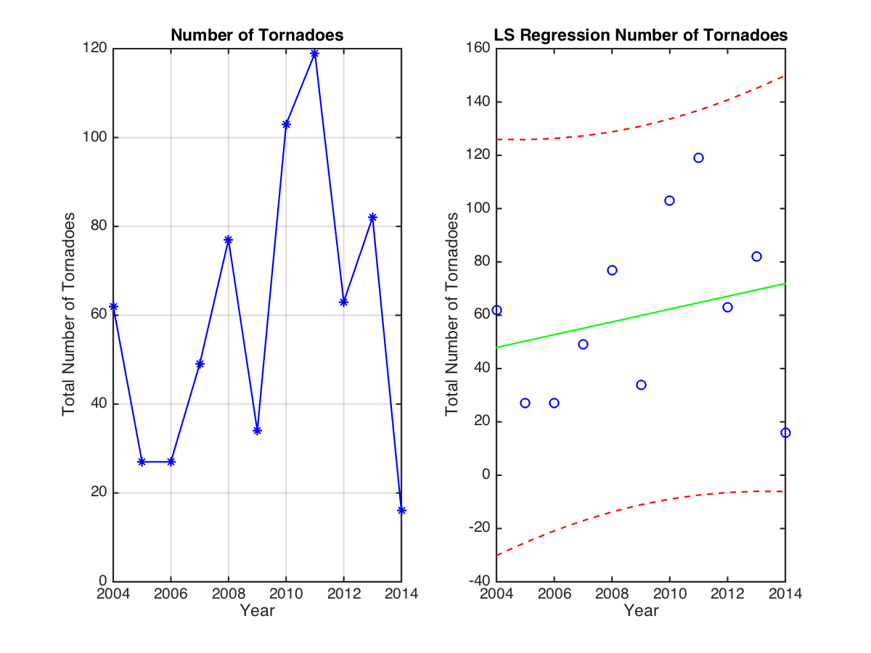
LS Regression: Frequency
Method | Slope Value | CI
LS Reg. | 2.4000 | [-1.4673e3 1.4721e3]
Bootstrap | 2.8543 | [-4.4450 9.0378]
Upwards Trend

Slide 16
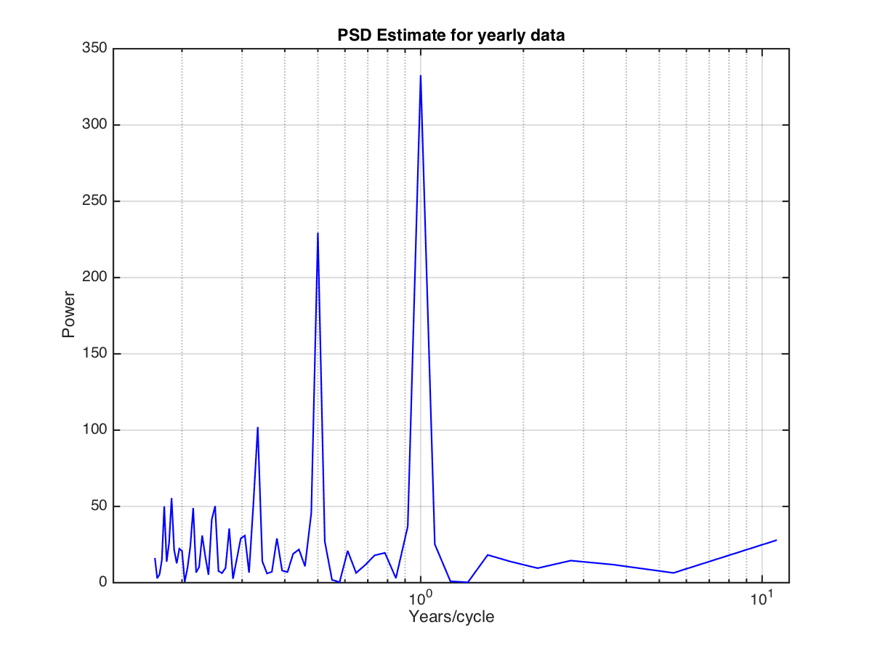
Periodogram: Frequency
Time | Cycles
Monthly | Yearly Seasonal Monthly
EF0 and EF1 | Monthly
EF2 | Monthly
EF3, EF4, and EF5 | None

Slide 17
Conclusion
Fails chi square test
Amount of months with no tornadoes skews the data
Too few data points (too short time period) to see a real trend.
Can’t apply one state to the entire US
Despite positive trend and visually seeing increasing data
Inconclusive as to whether global warming is increased frequency or intensity of tornadoes.

Slide 18
Sources
http://www.srh.noaa.gov/oun/?n=tornadodata-ok-julytornadoes
http://www.usatoday.com/story/news/nation/2013/06/08/oklahoma-tornadoes-ef5-moore/2401885/
http://news.nationalgeographic.com/news/2013/05/130522-tornado-climate-change-oklahoma-science-global-warming/
http://cdn.ientry.com/sites/webpronews/article_pics/tornado_tracks_huge.jpg
http://i.dailymail.co.uk/i/pix/2014/09/03/1409751076553_wps_5_F5_tornado_touches_down_i.jpg
http://k11.kn3.net/taringa/1/4/5/6/1/3/79/gaspiribun2/E05.jpg?8897
http://www.southernspiritonline.org/wp-content/uploads/2011/06/hd-Tornado-Warning-Protect-Your-Family-and-Your-Home-in-the-Event-of-a-Tornado-The-Home-Depot-Blog.jpg

Slide 19
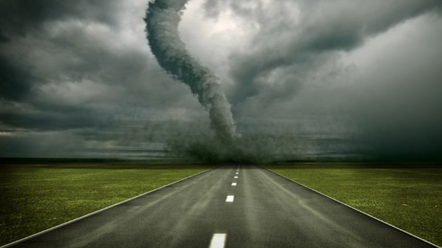
Questions?

