Slide 1
Analysis of water quality trend of a stream in Atlanta
EAS 4480
Qian Zhang
04/23/2015

Slide 2
Background
Clean Water Atlanta (CWA,1993)
  Clean Water Atlanta is a comprehensive, multi-program initiative to improve water quality in Atlanta through capital construction programs and enhanced operation of the City's drinking and wastewater systems.
Goal
  Assess the effect of CWA by studying on the trend of water quality parameters.

Slide 3
Background
Data:
  (SOU-1) 02203655
  South River @ Forrest Park SE, Atlanta
  (Ocmulgee River)
  5 water quality indexes (pH, temperature, conductivity, Dissolved Oxygen, turbidity)
  Sample rate: daily, converted to monthly average
  Time: year 2004 to 2014
Method:
  LS regression
  Bootstrap resampling
  Chi2 test
  Correlation Coefficient

Slide 4
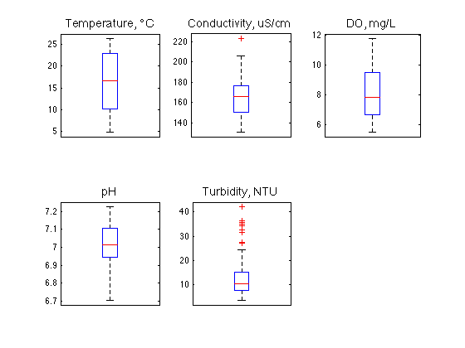
Result: Water Quality
 | Standard | Data
Temperature | < 32 ℃ | 100%
Conductivity | 150 ~ 500 µS/cm | 100%
DO | Daily avg. 6.0 mg/L | 93.94%
pH | 6.0 ~ 8.5 | 100%
Turbidity | < 20 NTU | 89.39%

Slide 5
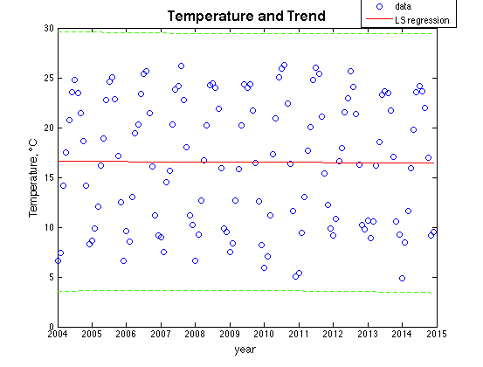
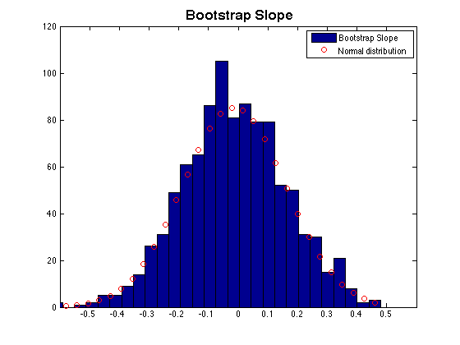
Result: Trend (Temperature)
 | LS | Bootstrap
slope | -0.0153 | -0.0101
CI | (-4.0004, 3.9699) | (-0.2937, 0.2750)

Slide 6
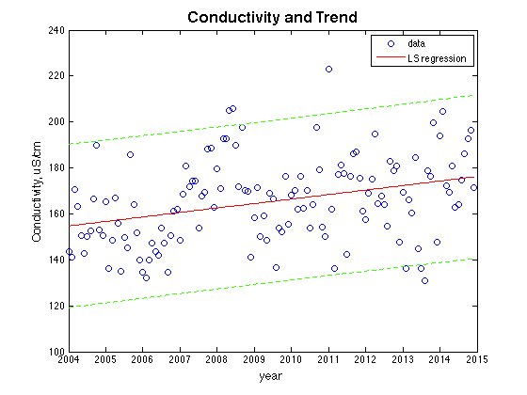
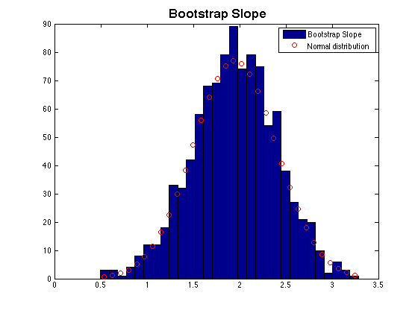
Result: Trend (Conductivity)
 | LS | Bootstrap
slope | 1.9528 | 1.9471
CI | (-8.9287, 12.8344) | (1.1939, 2.6970)

Slide 7
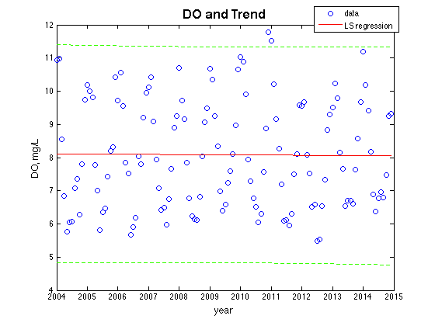
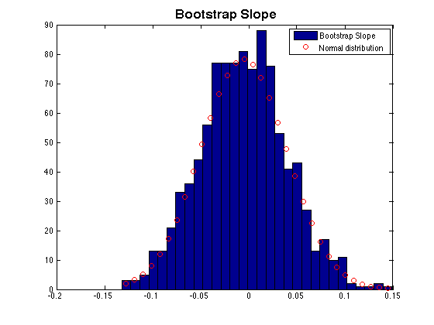
Result: Trend (DO)
 | LS | Bootstrap
slope | -0.0054 | -0.0055
CI | (-1.0108, 0.9999) | (-0.0794, 0.0687)

Slide 8
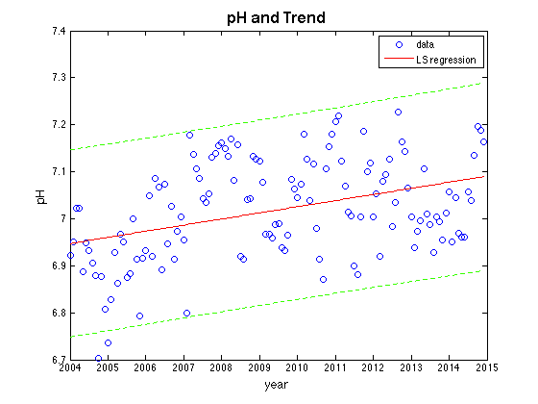
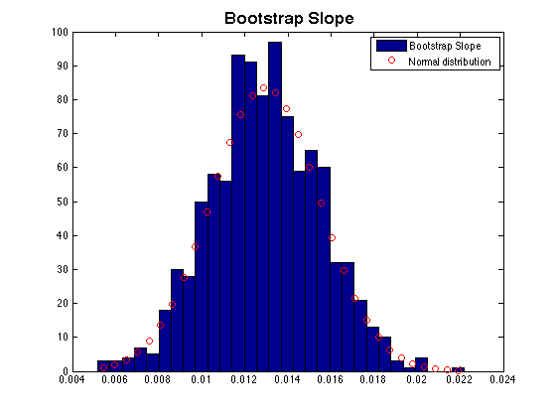
Result: Trend (pH)
 | LS | Bootstrap
slope | 0.0130 | 0.0129
CI | (-0.0479, 0.0740) | (0.0088, 0.0171)

Slide 9
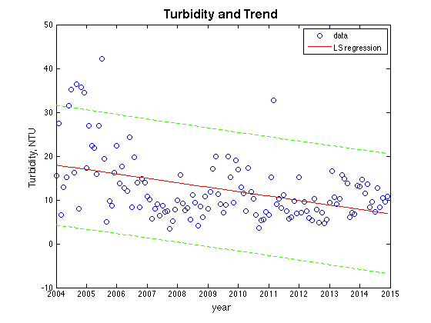
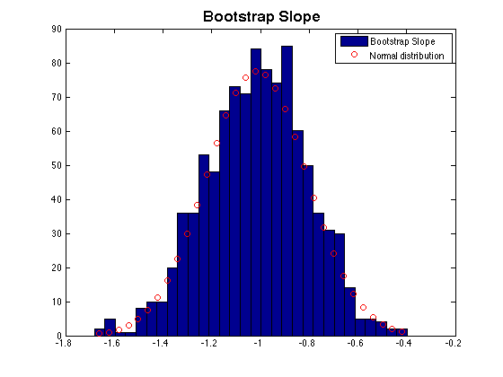
Result: Trend (Turbidity)
 | LS | Bootstrap
slope | -1.0117 | -1.0152
CI | (-5.1969, 3.1735) | (-1.3561, -0.6811)

Slide 10
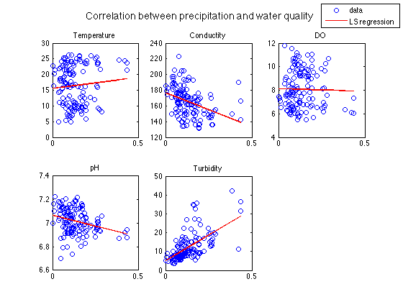
Result: Other Effect
 | r | p
Temperature | 0.0911 | 0.2991
Conductivity | -0.3876 | 4.39e-6
DO | -0.0205 | 0.8154
pH | -0.2871 | 8.45e-4
Turbidity | 0.6043 | 1.69e-14

Slide 11
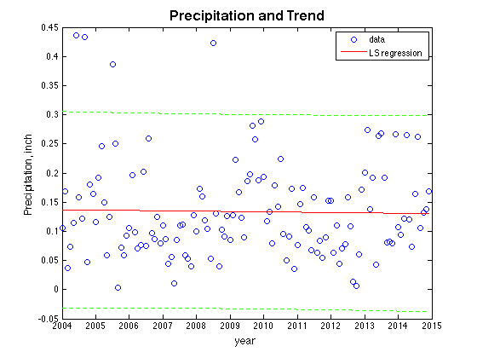
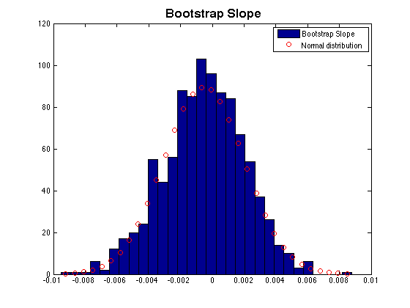
Result: Other Effect
 | LS | Bootstrap
slope | -6.04e-4 | -5.26e-4
CI | (-0.0521, 0.0509) | (-0.0050, 0.0034)

Slide 12
Conclusion
Water quality
  DO & turbidity
  Note: monthly average
Trend over 2004 to 2014:
  Trends are slight
  Turbidity going down → good
  Note:Also subjected to the change of meteorological conditions
Temperature | Conductivity | DO | pH | Turbidity
- | ⬆️️ | - | ⬆️ | ⬇️

Slide 13
Reference
Clean Water Atlanta
  http://www.cleanwateratlanta.org
USGS
  http://water.usgs.gov/edu/characteristics.html
  http://waterdata.usgs.gov/ga/nwis/current?type=precip&group_key=county_cd
EPA
  http://watersgeo.epa.gov/mwm/?layer=LEGACY_WBD&feature=03130001&extraLayers=null
Georgia EPD
  http://epd.georgia.gov/existing-rules-and-corresponding-laws
  https://epd.georgia.gov/sites/epd.georgia.gov/files/related_files/site_page/303d_Draft_Streams_Y2014.pdf

Slide 14
Thank you!

