Slide 1
PM2.5 in China: Cycles, Trend, and Regional Correlation
Shitian Liu

Slide 2
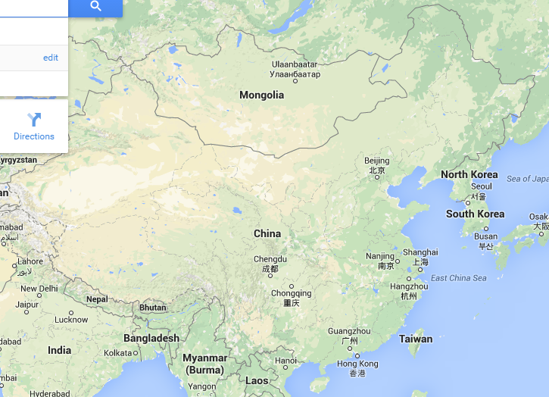
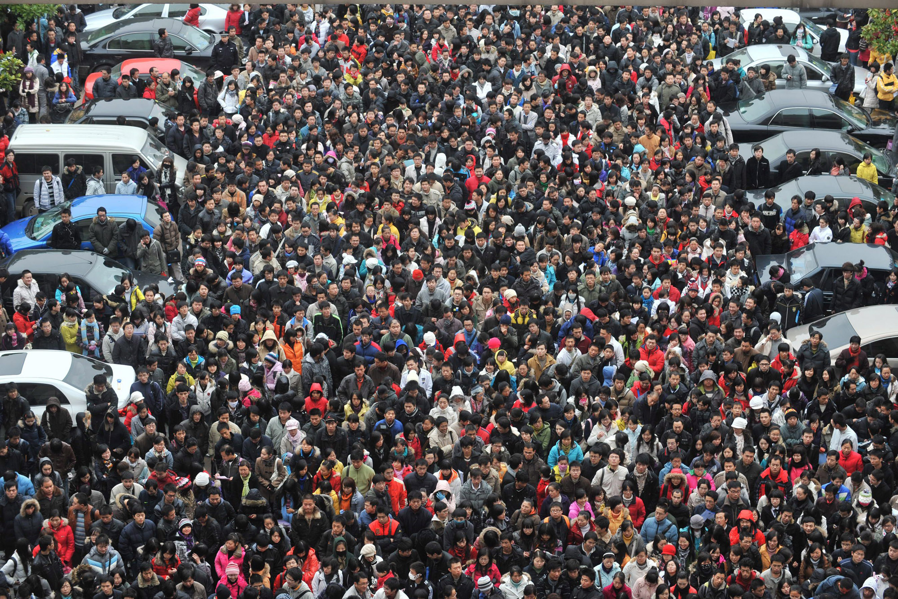
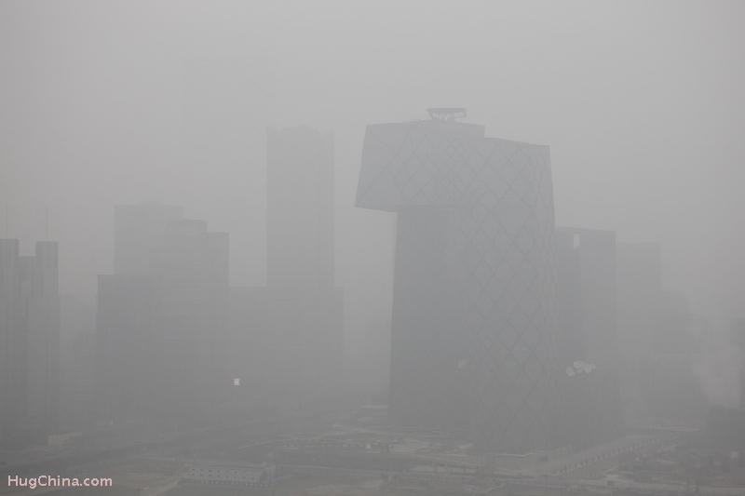
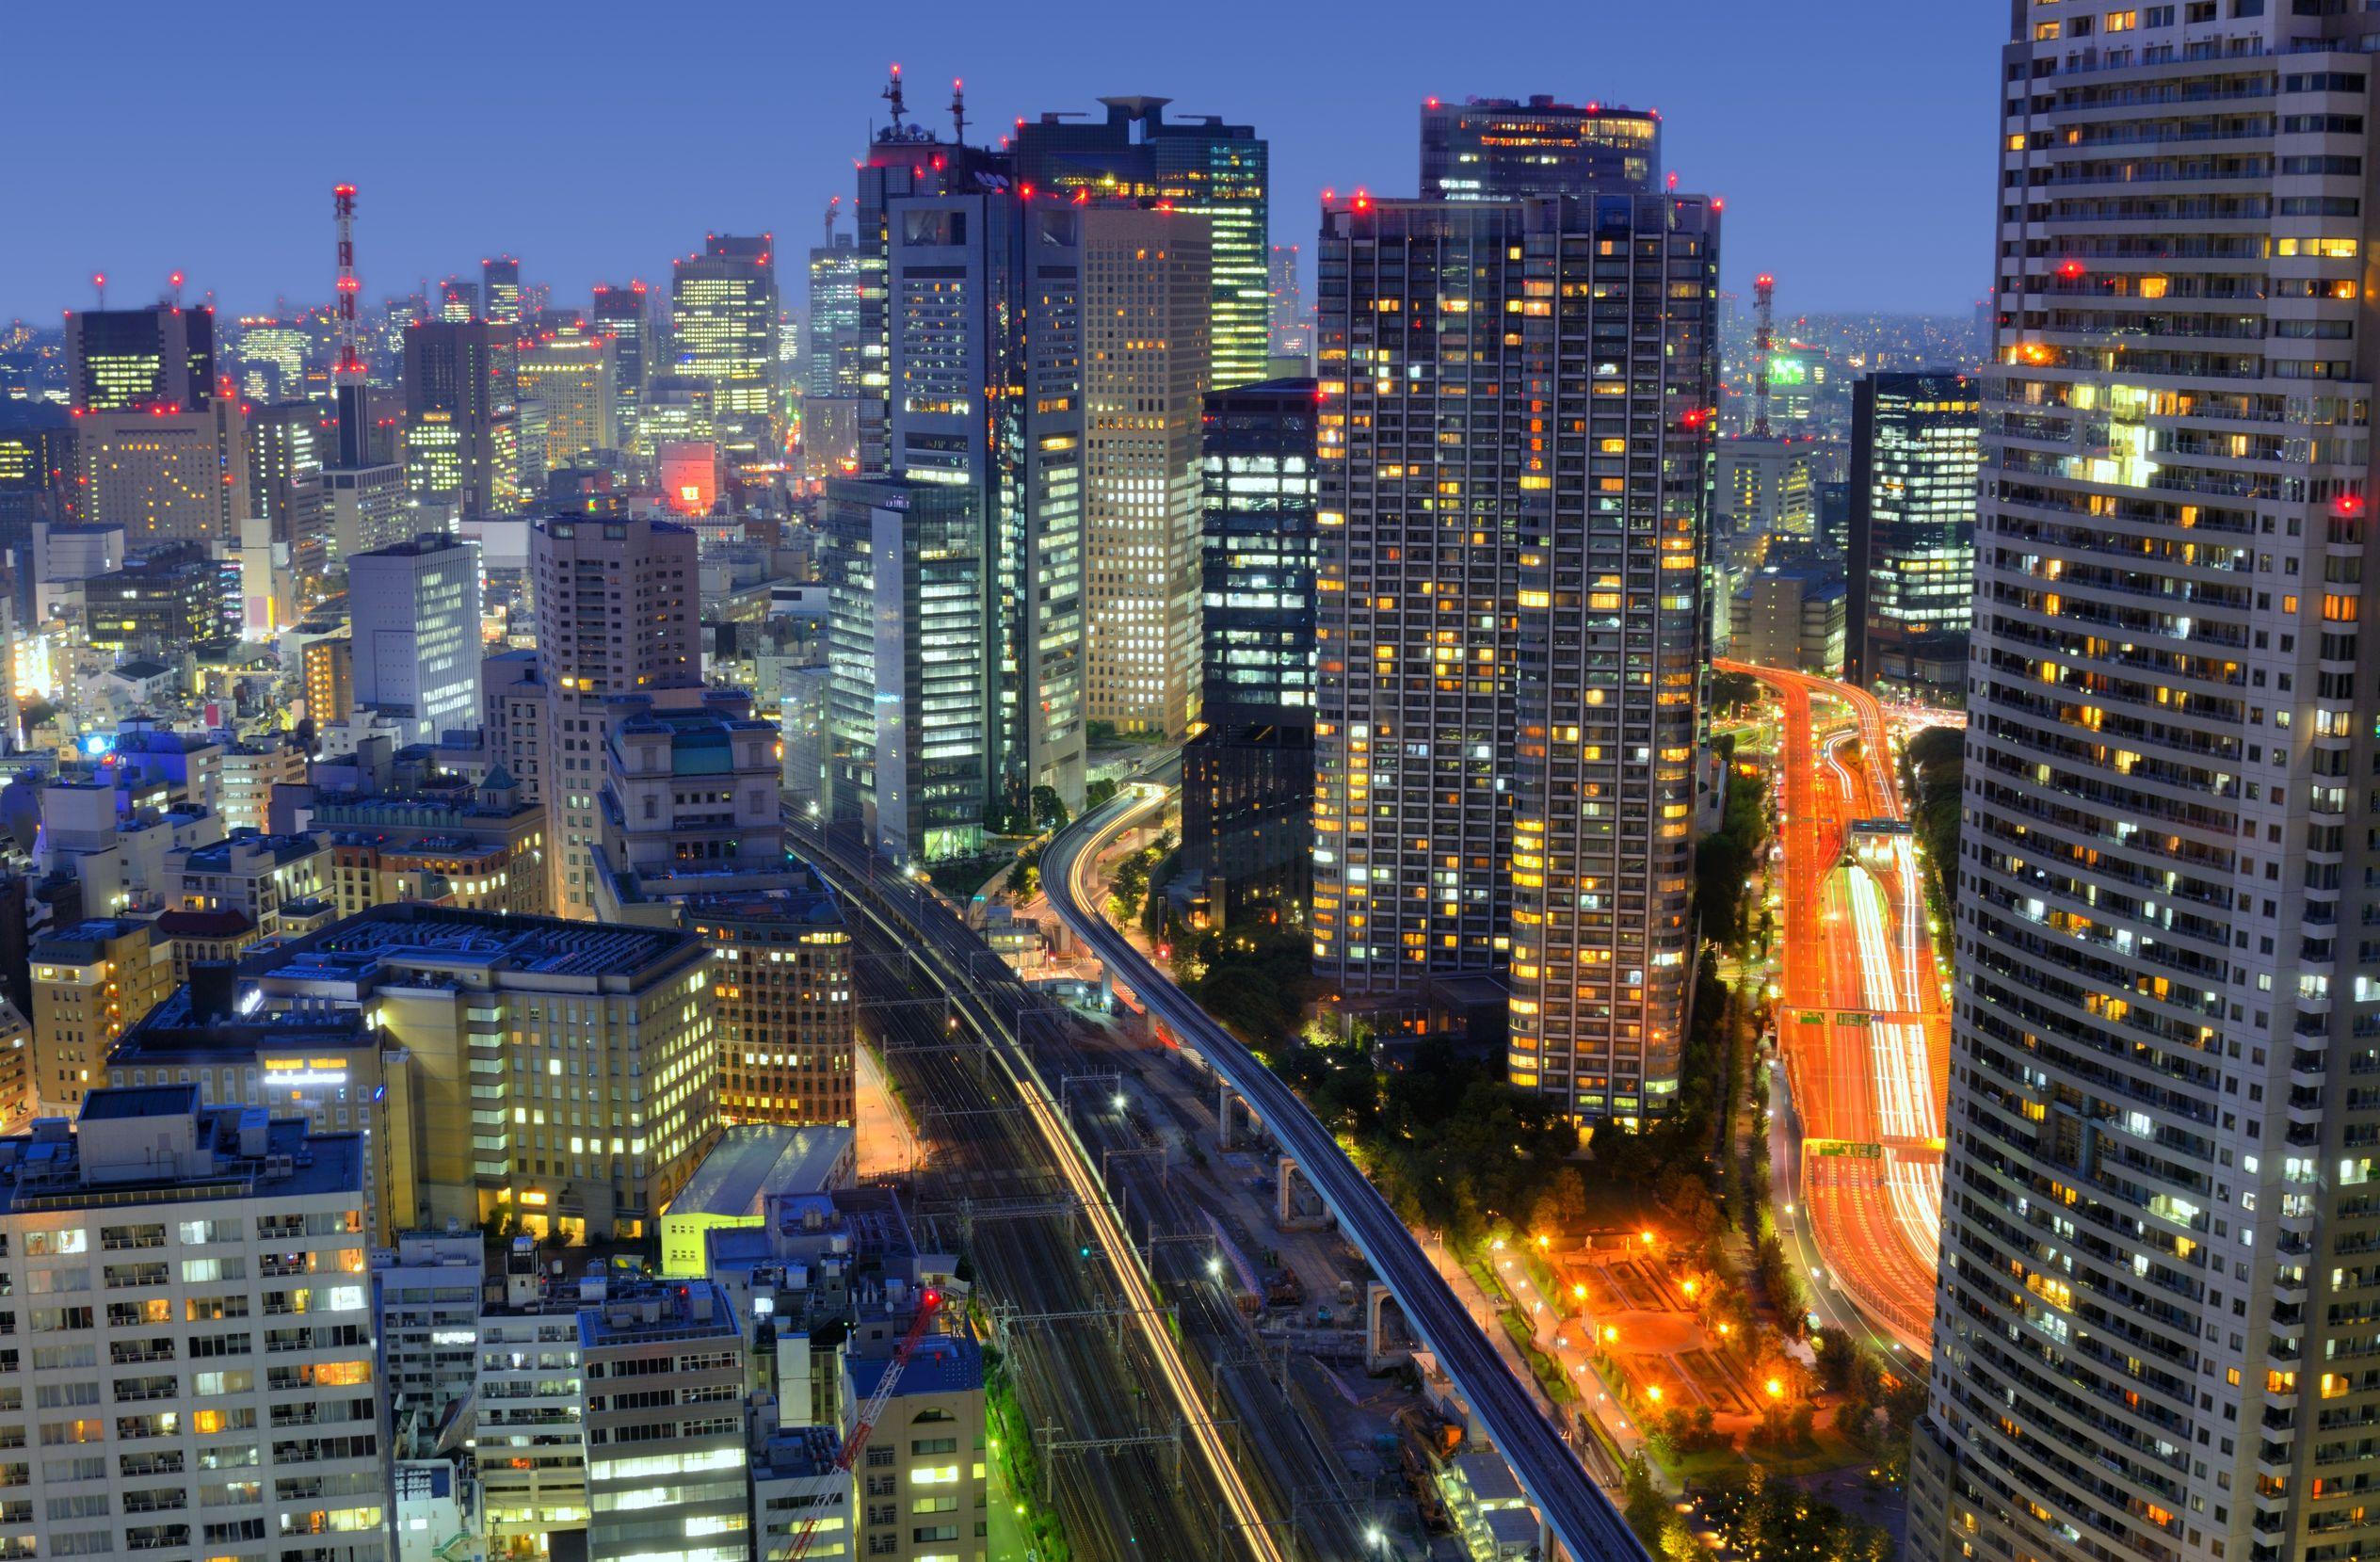
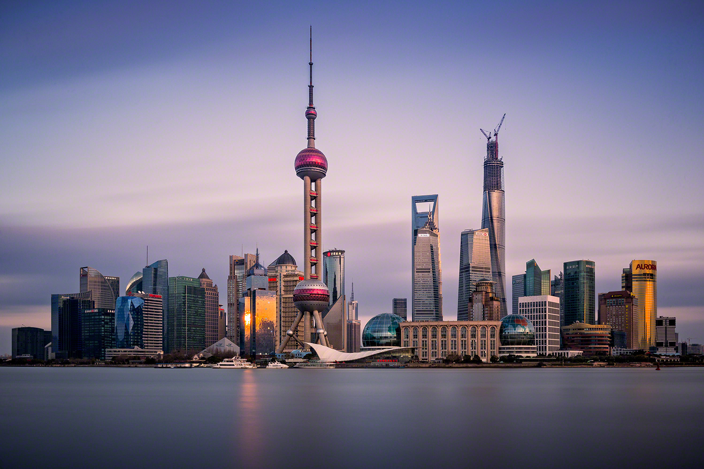
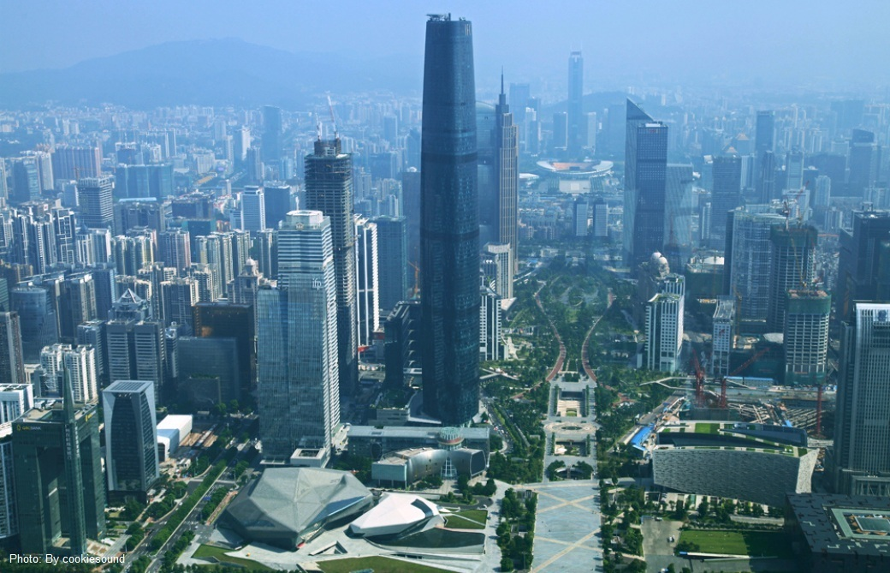
Background on Geography
Five major cities where the US Embassies are located.

Slide 3
How to find the threshold for “extreme value” ?
% = 0.8029
% = 0.5327
Does not include NAN days.

Slide 4
Beijing Monthly Average
Peaks in Winter
Possibly due to low precipitation
Not due to heating because Guangzhou and Shanghai do not have indoor heating but still show the peaks
Valleys in Summer
Possibly due to higher precipitation
Jan 2011 is suspicious!

Slide 5
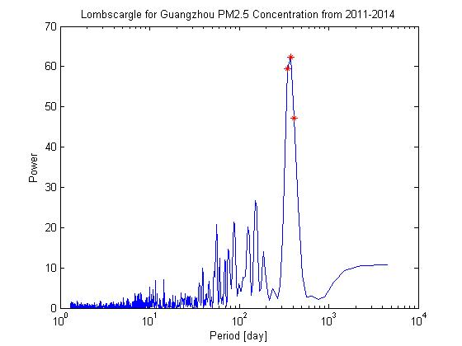
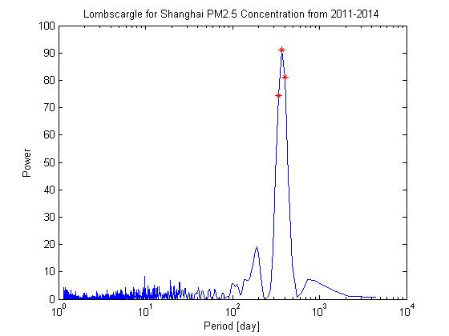
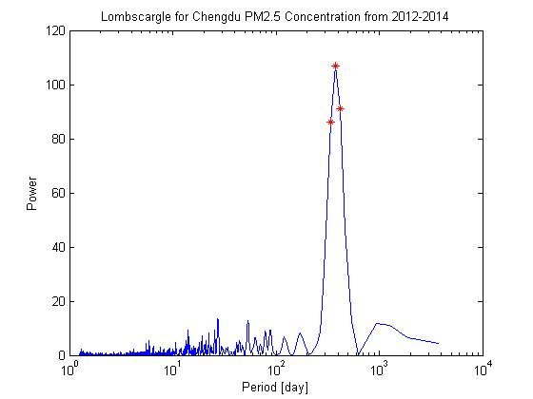
Cycles
Can definitely see yearly cycles.
But no weekly cycle!

Slide 6
Trend Daily Average
 | Slope | Confidence | Interval
Least-Square | -0.0033 | -0.2466 | 0.2381
Bootstrap |  | -0.0087 | 0.0023
NO TREND!

Slide 7
Trend Monthly Average
 | Slope | Confidence | Interval
Least-Square | -9.581106044019294e-04 | -9.581106044019294e-04 | -9.581106044019294e-04
Bootstrap |  | -0.0107 | 0.0088
NO TREND!

Slide 8
Extreme Days
Slope | Confidence Interval
0.0019 | [-0.0183,0.0220]
NO TREND!

Slide 9
Extreme Values
Slope | Confidence | Interval
29.0106 | -157.998 | 216.02
45.9015 | -87.9016 | 179.705
12.1704 | -34.3599 | 58.7008
-5.4577 | -24.198 | 13.2825
-1.8896 | -35.8073 | 32.028
-24.478 | -71.038 | 22.082
-5.3185 | -48.9975 | 38.3605
-15.298 | -69.0843 | 38.488
-16.062 | -81.9726 | 49.8483
15.2712 | -67.7323 | 98.2747
-31.975 | -142.189 | 78.2397
-9.6701 | -67.134 | 47.7939
NO TREND!

Slide 10
Extreme Values
Slope | Confidence | Interval
0.48625 | -4.84964 | 5.82214
-1.0706 | -9.67179 | 7.5306
0.38125 | -3.98281 | 4.74531
0.70357 | -5.97041 | 7.37755
0.66292 | -12.3288 | 13.6546
-1.2249 | -18.1598 | 15.71
-1.4785 | -5.61997 | 2.66307
-1.7927 | -9.72794 | 6.14258
-4.3392 | -12.1367 | 3.45836
1.03815 | -4.61933 | 6.69564
-2.3334 | -7.17189 | 2.50511
-0.6543 | -4.59471 | 3.28602
NO TREND!

Slide 11
Correlation Coefficient
Correlation Coefficients
P values
 | Beijing | Shanghai | Guangzhou
Beijing | 1 | -0.013452 | 0.2112303
Shanghai | -0.013452 | 1 | 0.195848
Guangzhou | 0.2112303 | 0.195848 | 1
 | Beijing | Shanghai | Guangzhou
Beijing | 1 | 0.7345203 | 7.21E-08
Shanghai | 0.7345203 | 1 | 6.18E-07
Guangzhou | 7.21E-08 | 6.18E-07 | 1
Although p-values for the correlation coefficients between Guangzhou & Beijing and Guangzhou & Shanghai is less than 0.05, the correlations are weak.
WEAK CORRELATION!

Slide 12
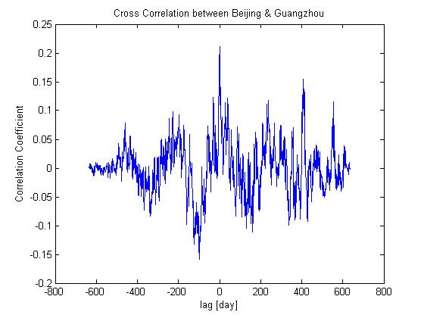
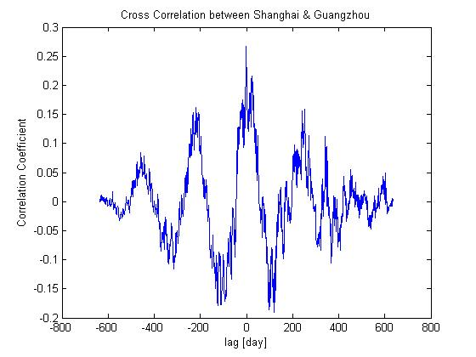
Cross Correlation
The Correlations between the three cities are weak, which implies that PM2.5 is possibly a local pollutant instead of a regional pollutant.
Again….

Slide 13
Conclusions
PM2.5 concentration in all four cities show yearly cycle, but not weekly cycle.
PM2.5 concentration shows no significant trend in China’s major cities.
No significant decrease in number of extreme days, neither.
PM2.5 concentration shows no regional correlation which implies that the pollutant is local.

Slide 14
References
StateAir: U.S. Department of State Air Quality Monitoring Program
http://www.stateair.net/web/historical/1/1.html
Questions?

