Slide 1
Hot Temper(ature)s:
Relationship between Heat and Crime
Presented by: Sarah Schulte
Date: April 21st, 2015
Class: EAS 4480 - Environmental Data Analysis

Slide 2
Background:
“The minds of men do in the weather share,
Dark or serene as the day’s foul or fair.“
Cicero (106-43 B.C.)
Heat-related imagery has been used for thousands of years.
Hot-headed
Hot temper
Doing a slow burn
Analysts of human behavior began to test the theory of a correlation between weather and human actions in the middle 1700s.
Anderson et al. (2000)

Slide 3
Hypothesis:
Elevated temperatures result in increases in violent crime
Greater discomfort puts strain on tempers
More people outside in the warmer weather leads to more chances for confrontation

Slide 4
Data:
Crime Data: Georgia Bureau of Investigation website
Monthly totals separated by specific crimes
Murder, rape, robbery, assault, burglary, larceny and vehicle theft
Temperature Data: Georgia Automated Environmental Monitoring Network website
Archived daily temperatures

Slide 5
Analysis:
Performed least-squares linear regression to find significance (p) values
Time period: 2000-2013 (excluding Dec 2010 - Dec 2011)
Crime Categories:
Violent: murder, rape, robbery, assault
Total: includes all violent crimes, burglary, larceny and vehicle theft
Temperatures: averaged monthly maximum temperatures
Location: Fulton County, Atlanta, Georgia

Slide 6
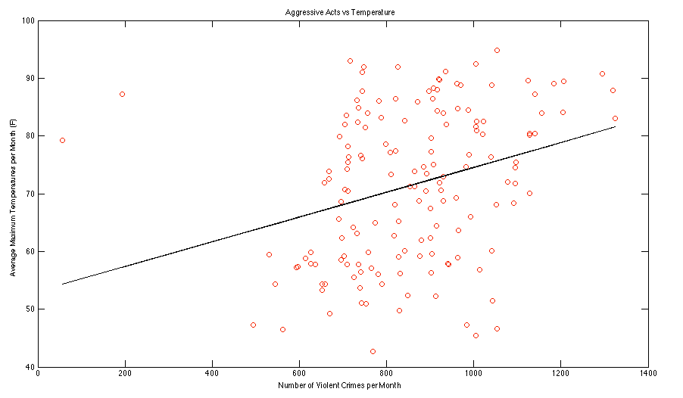
Violent Criminal Acts per Month

Slide 7
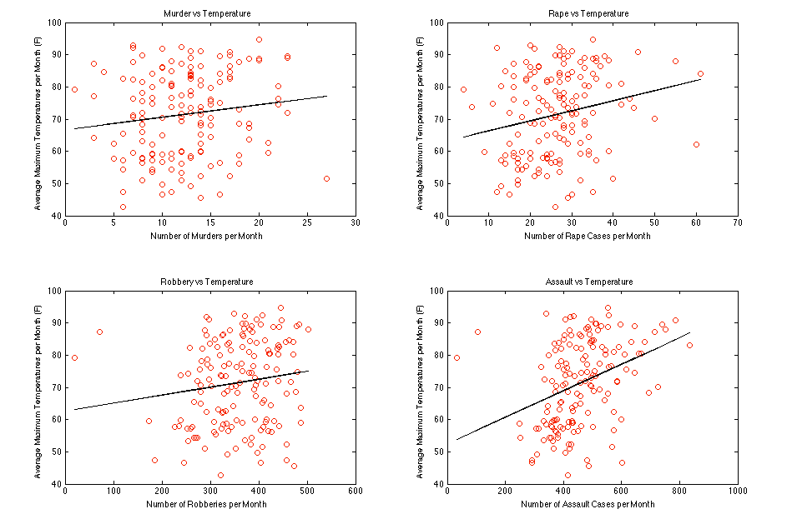
Individual Violent Crime Totals

Slide 8
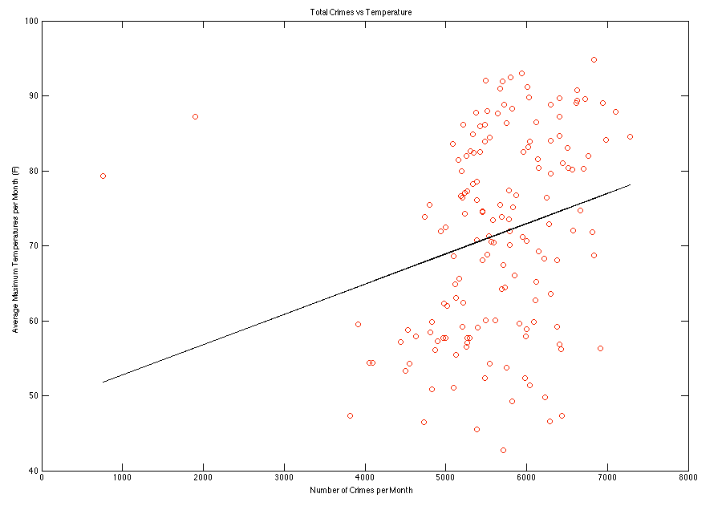
Total Criminal Acts per Month

Slide 9
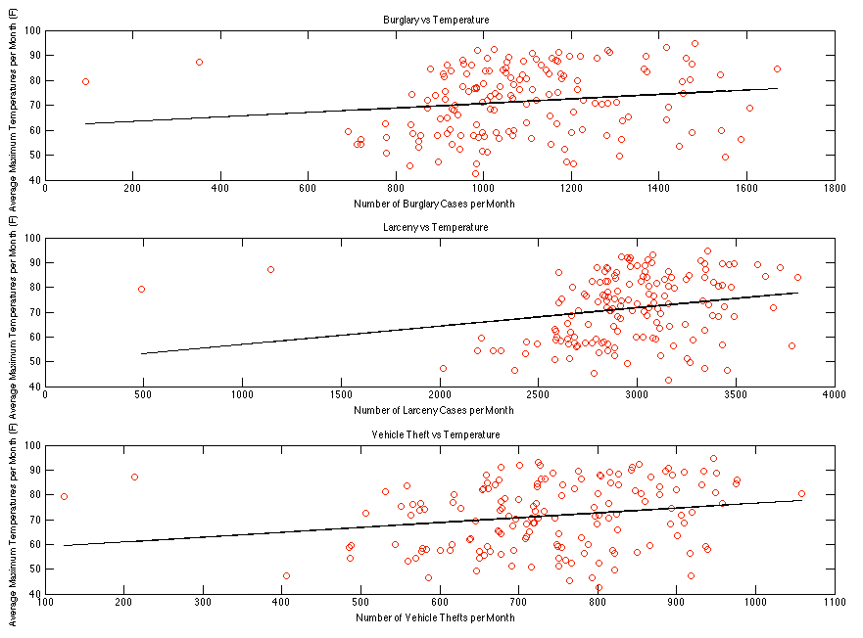
Additional Crime Categories

Slide 10
Significance Values: p < 0.005
Total Crime: 0.0015
Individual Crimes:
Burglary: 0.0549
Larceny: 0.0045
Vehicle theft: 0.0114
Combined Violent Crime: 0.0001
Individual Crimes:
Murder: 0.0899
Rape: 0.0057
Robbery: 0.0719
Assault: 0.0000

Slide 11
Results:
Violent crimes showed the most significant correlation
Assault showed greatest significance of all of the crimes
Total crime still showed significant correlation, though not as much as the violent crimes
Larceny showed the most significance of the less-violent crimes
Murder and robbery were the least significant

Slide 12
Conclusions
Assault and rape arise as a result of heightened emotions (ie: anger, lust), which may be amplified by temperature
Larceny is made easier when there are more people out and about, and when they might leave more possessions unattended
Burglary, robbery and vehicle theft are less correlated:
require more preparation (ie: procuring firearms, scoping out targets)
Murder shows the least correlation:
murderers are more likely to be predisposed towards this behavior regardless of environment

Slide 13
References/Sources
Data Sources:
http://www.griffin.uga.edu/aemn/cgi-bin/AEMN.pl?site=GAAA
http://services.georgia.gov/gbi/crimestats/displayCrimeStatForm.do
References:
Anderson, C.A., Anderson, K.B., Dorr, N., DeNeve, K.M., Flanagan, M.. Temperature and Aggression. Advances in Experimental Social Psychology. 2000. Volume 32. pp.63-133.

